Slide 1







Evolving Antennas for Ultra-High Energy Neutrino Detection
Alex Machtay
Genetically Evolving NEuTrino teleScopes (GENETIS) Collaboration
APS Meeting April 19, 2020
Generously supported by:
CCAPP
The National Science Foundation
The Ohio Supercomputer Center

Slide 2
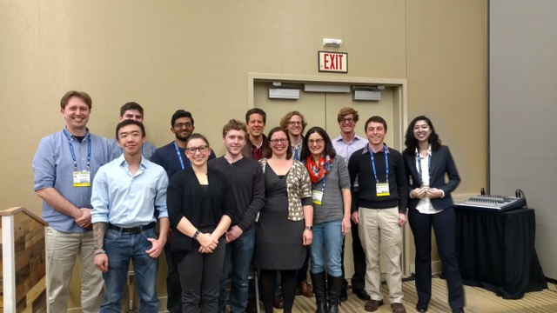
GENETIS
Using genetic algorithms to evolve detector designs
Members
3 Professors
Amy Connolly, The Ohio State University
Carl Pfendner, Denison University
Stephanie Wissel, Pennsylvania State University
1 Research Scientist
Kai Staats, North Western University
1 Grad Student
7 Undergrads
Numerous former undergrad members

Slide 3
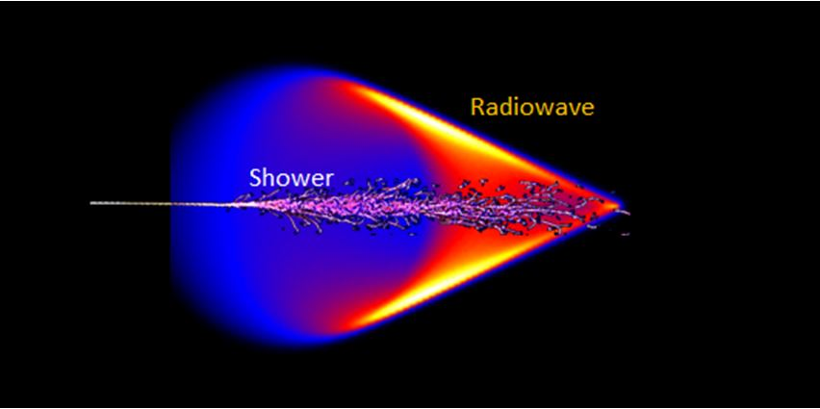
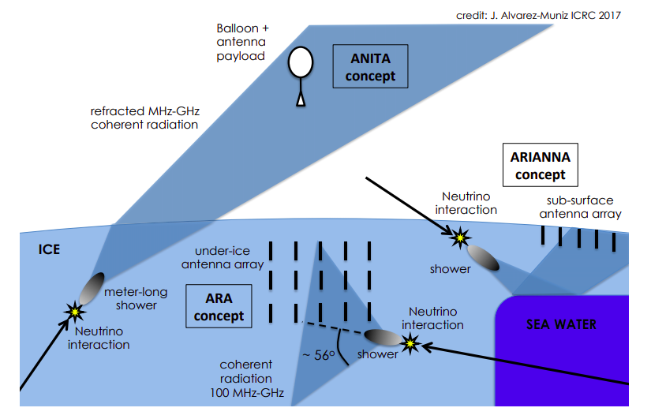
Neutrino Radio Detection
Ultra-High Energy (UHE) neutrinos interacting with ice create particle cascades
These cascades emit Askaryan radiation
Experiments need to cover large areas to be able to detect events
Antennas are placed in holes drilled in the ice
[1]
[2]

Slide 4
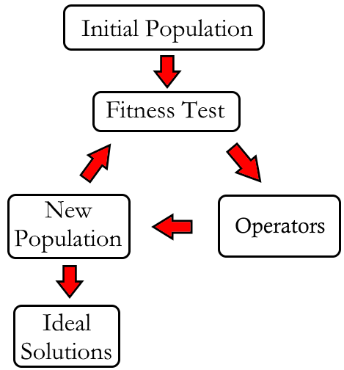
Genetic Algorithms
Can we use GAs to design better antennas?
Designed to mimic evolution
Generate an initial population of possible solutions, or individuals
Determine the fitness of individuals
Select some individuals to be used to make the next generation
Repeat until an ideal solution is approached!

Slide 5
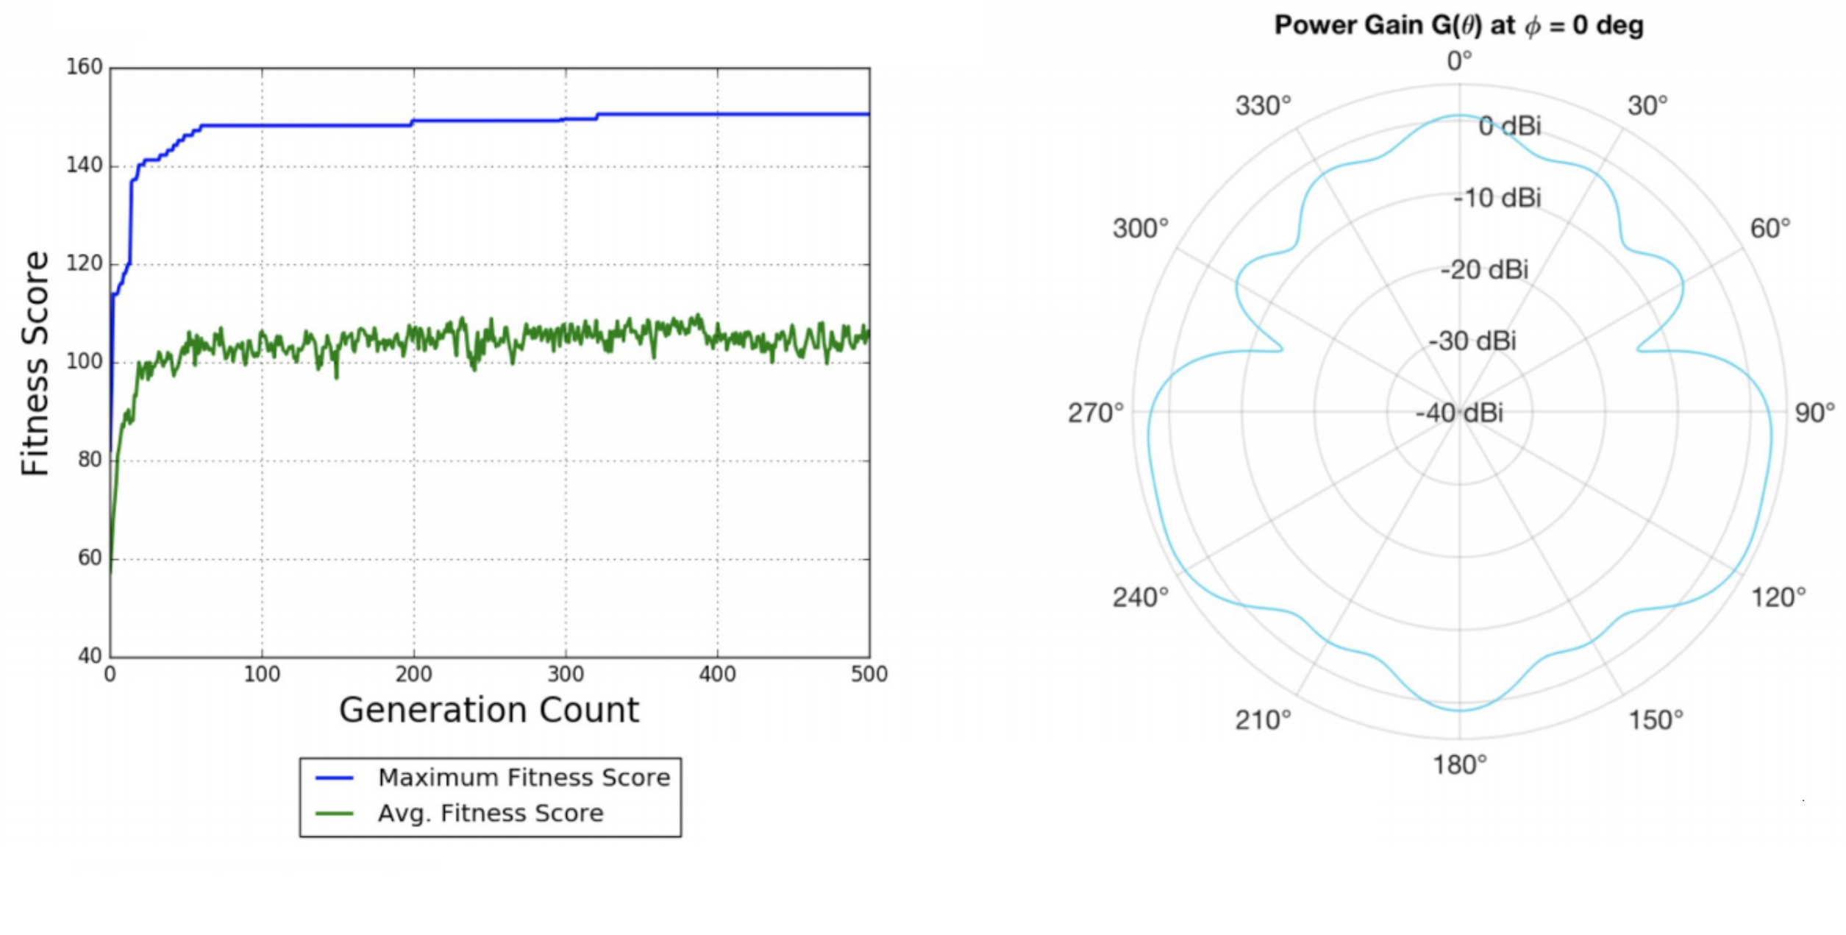
Past Work
Antenna Response Targeted Evolution (AREA)
Evolved ideal beam patterns for in ice neutrino detection
Fitness function was the number of neutrino events that trigger the detector
[3]
Cal Poly undegrads Corey Harris, Luke Letwin, and Jacob Trevithick

Slide 6
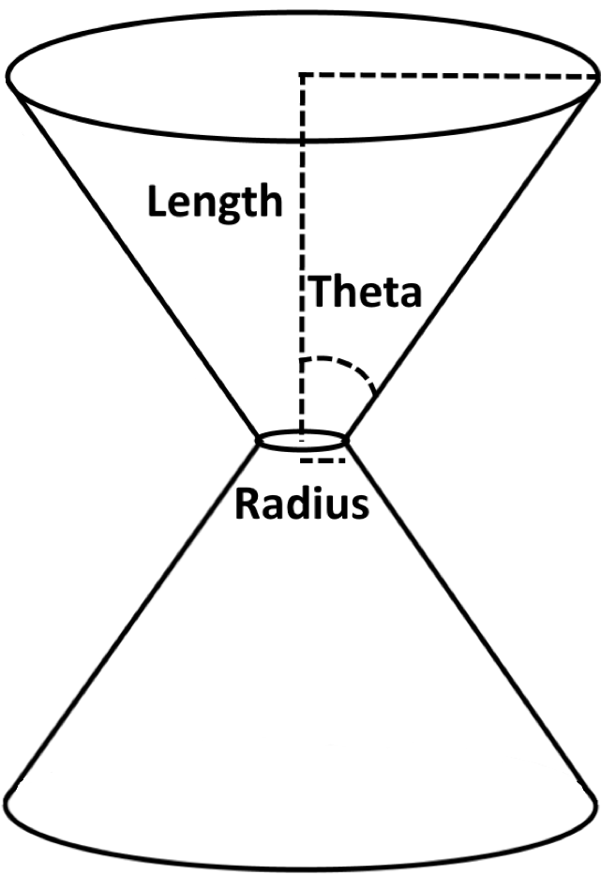
Evolving Antennas
Currently evolve bicone antennas with 3 genes
Length, inner radius, and opening angle
Genes for initial generation are generated from gaussian distributions
Antenna beam patterns determined using an industry standard modeling software (XFdtd)
Pass these beam patterns to neutrino detection simulation software (AraSim)

Slide 7
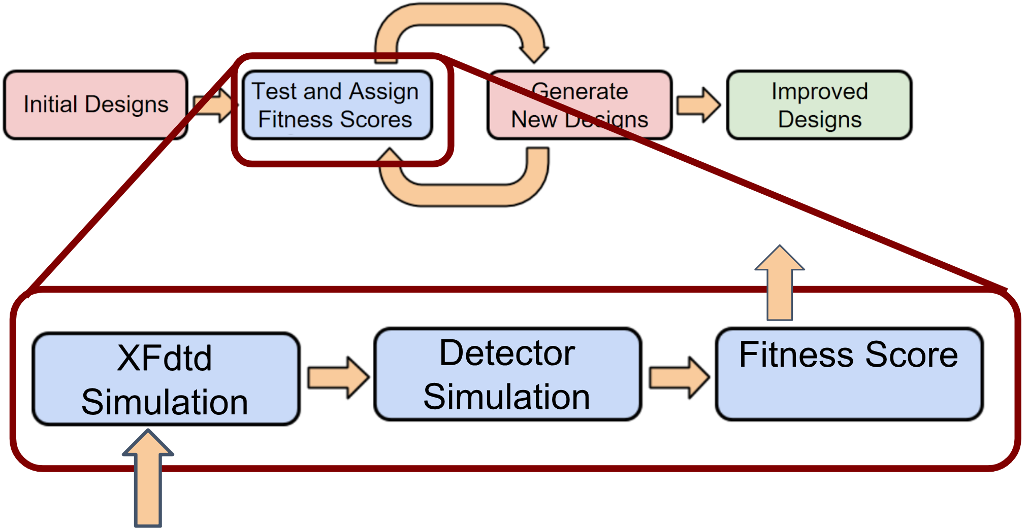
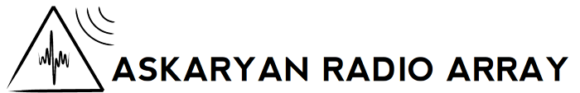
“The Loop”
Generate new population
Model individuals in XF to create beam patterns
Send beam patterns through AraSim
Calculate Fitness Score
Select individuals to create next generation
Total run time is ~3 hours per generation (for 10 individuals and 10⁵ neutrinos)
[4]
XF | AraSim | Rest of Code | Total
2-3 hours | 1 hour | Negligible | 3 hours

Slide 8
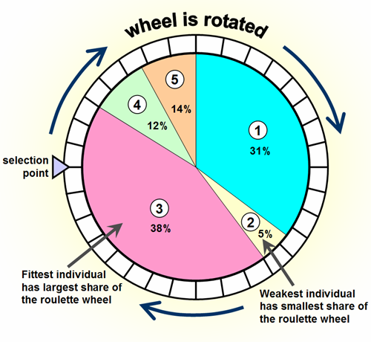
Fitness Function
Uses sensitivity of antenna to neutrino events as described by (VΩ)_{eff}
Neutrino energies are set to 10¹⁸ eV
Antennas are penalized for being too big
Holes in ice are drilled with a 15 cm diameter
Antennas bigger than are penalized to encourage the algorithm to make smaller antennas
Roulette Selection
Higher fitness scores are more likely to be selected
[5]
$P_{i}=\frac{F_{i}}{\sum{F}}$

Slide 9
Efforts to Automate and improve speed
Only human interaction with the loop is at the start
Detector simulation
Sped up by a factor of 2 since last year
Parallelized in the loop (by a factor of 100)
(OSU undergrad Alex Patton)
Developing a database of simulated antennas
Eliminates the need to simulate the same antennas repeatedly

Slide 10
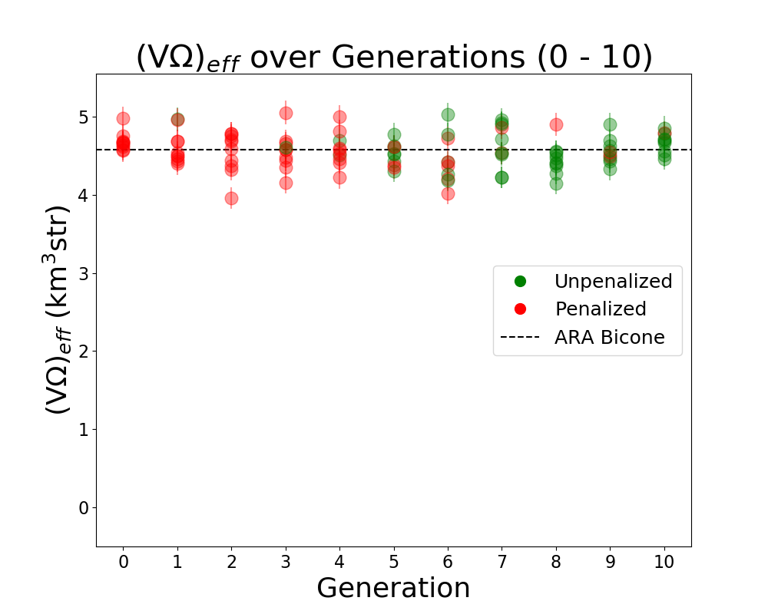
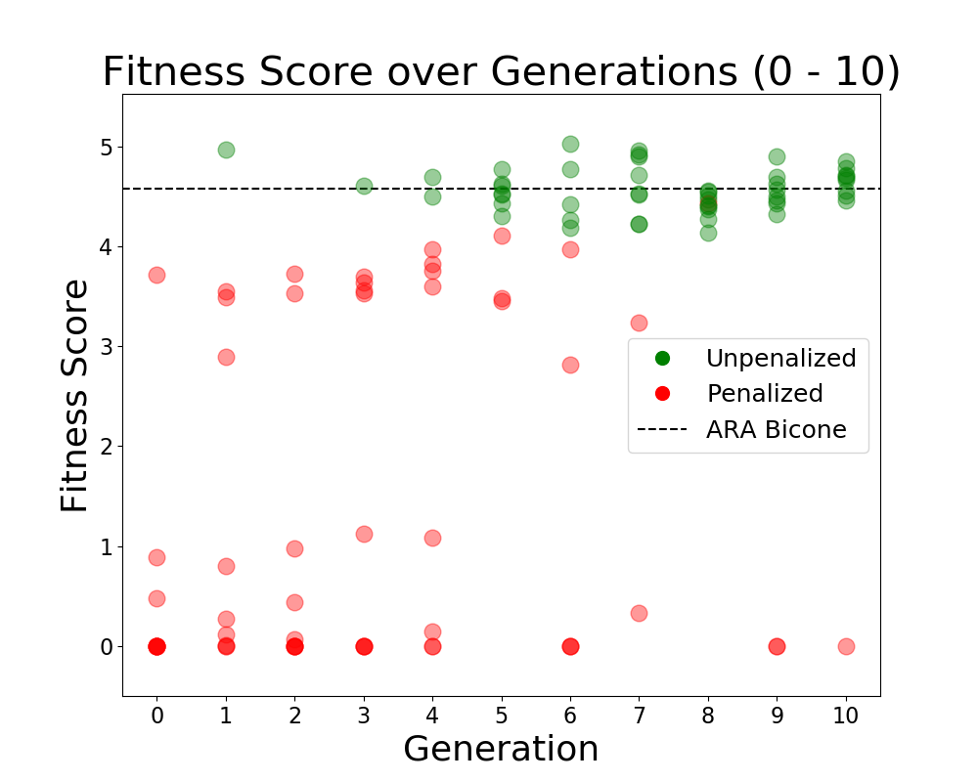
Results
Evolved 10 individuals for 10 generations using 10⁵ neutrinos at E_{ν} = 10¹⁸ eV
Algorithm learns to create “fitter” antennas

Slide 11
Next Steps
Keep evolving!
Goal is hundreds of individuals and hundreds of generations
Explore other types of algorithms
Increase number of parameters
Design asymmetric antennas
Build and test designs
Center for Design and Manufacturing Excellence at OSU can help machine candidate antennas
Deploy a prototype with Radio Neutrino Observatory in Greenland
Expand into other areas
Use GAs to improve other aspects of experiments

Slide 12
Bibliography
[1] LeCosPA Group, National Taiwan University
https://lecospa.ntu.edu.tw/zh/experiment-zh/experiment-i-ultra-high-energy-neutrinos
[2] J. Alvarez-Muniz, ICRC 2017
https://pos.sissa.it/301/1111/pdf
[3] “Optimization of Antennas in the Askaryan Radio Array Using Genetic Algorithms,” Corey Harris, Luke Letwin, Jacob Trevithick, 2018
[4] Askaryan Radio Array Info Page
https://ara.wipac.wisc.edu/home
[5] Engineering Design Center, Newcastle University
http://www.edc.ncl.ac.uk/highlight/rhjanuary2007g02.php/

