Slide 1
Genetically Evolving NEuTrIno teleScopes (GENETIS)
Alex Machtay
Machtay.1@osu.edu

Slide 2
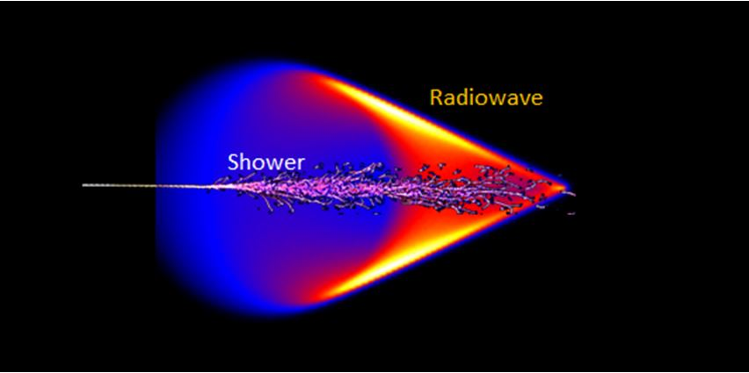
Radio Neutrino Detection
Neutrino strikes atom in the Antarctic ice
Showers of particles are produced
Showers moving relativistically and in a dense dielectric medium
Propagate faster than phase velocity of light in medium
Optical (Cherenkov) and radio (Askaryan) radiation
[1]

Slide 3
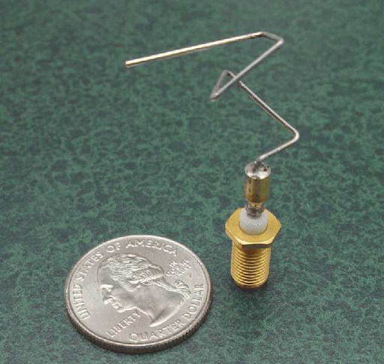
GENETIS
GENETIS seeks to optimize detector designs in astrophysics experiments
Exploring genetic algorithms (GAs) for optimized antenna design
Can we design an antenna that outperforms current detectors?
ST5: A narrow-band antenna designed using genetic algorithms by NASA for satellite communications [2].

Slide 4
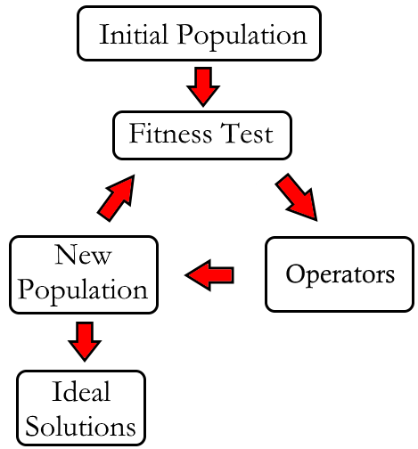
Genetic Algorithms
Optimization technique that creates “populations” of solutions
Then uses principles of biological evolution to evolve the population over multiple generations
Ideal for complex optimization problems with large parameter spaces [3]

Slide 5
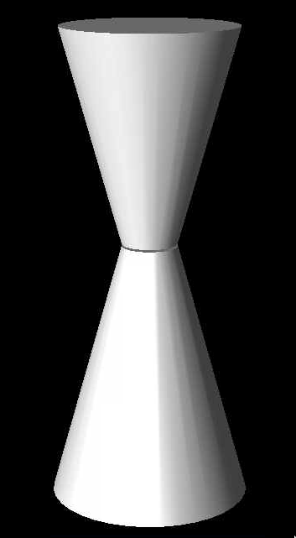
Bicone Antennas
Beginning by generating asymmetric bicone antennas
Simple starting design
ARA V-pol antennas!
Evolve six “genes” (parameters)
Cone length, minor radius, opening angle
Constrain using ARA borehole dimensions
Evolved 50 individuals over 31 generations
ϴ
r
L

Slide 6
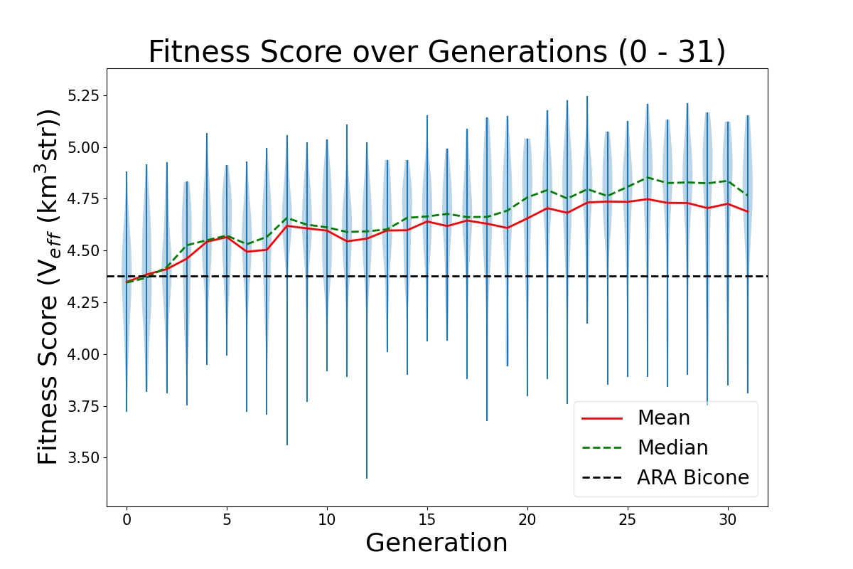

Asymmetric Evolution

Slide 7
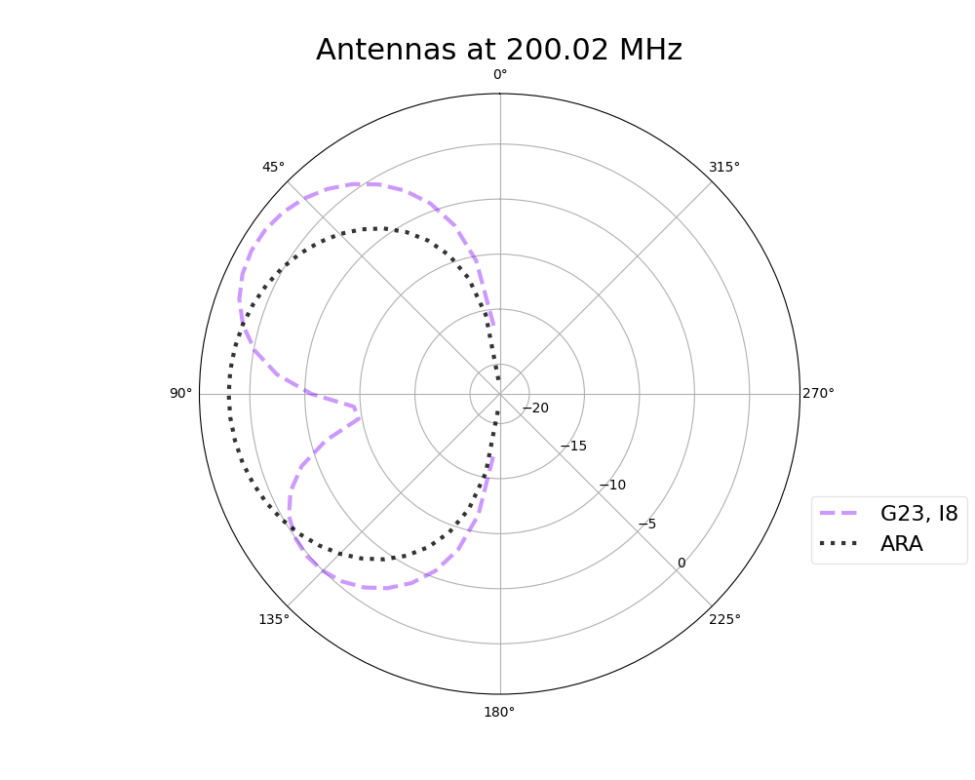
Next Steps
Justify with physics!
Why do these antennas perform well?
Use NN surrogate model
Decrease computation time from simulation (See Dr. Glaser’s presentation from AstroHEP section!)
Search for relationships b/n features (genes) and fitness score
Add more genes
Bigger parameter space to explore

Slide 8
Surrogate Model Challenges
Small data set
Even after 30 generations, only ~1000 individuals
Easy to over fit!
As designs update, model becomes obsolete
From linear→ nonlinear cones means NN learned on narrow data set
Current goal is to test training during evolution
May help with later generations

Slide 9
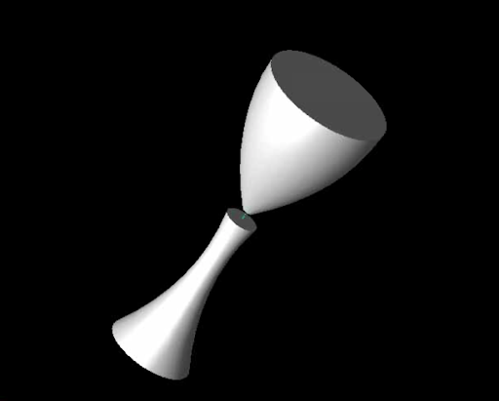
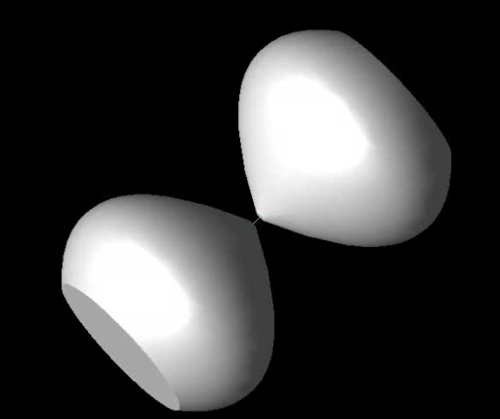
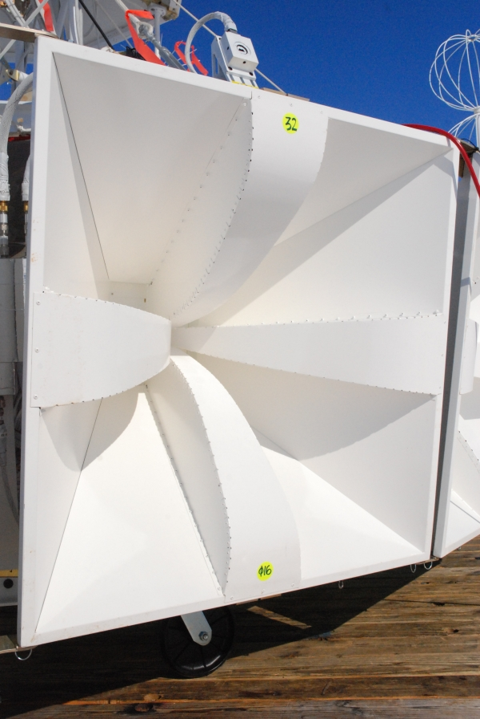
Adding Complexity
Nonlinear sides
Replace angle with higher order terms of polynomial
Allows more sophisticated bicone design
Use different antenna designs
ANITA experiment quad-ridge horn antennas
[4]

Slide 10
Bibliography
[1] https://lecospa.ntu.edu.tw/zh/experiment-zh/experiment-i-ultra-high-energy-neutrinos
[2] G. Hornby et al.,Automated Antenna Design with Evolutionary Algorithms,American Institute of Aeronautics and Astronautics (2006).
[3] Davis, L. Handbook of Genetic Algorithms. Van Nostrand Reinhold. (2016).
[4] https://www.phys.hawaii.edu/~anita/new/images/fullSize/DSC_0083.JPG

Slide 11
Backup Slides

Slide 12
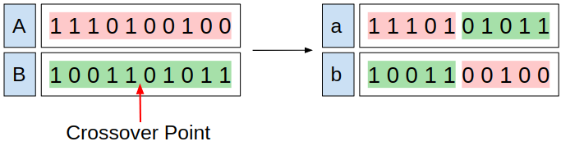
Terminology
Fitness Score: Value representing how ideal an individual is
Analogous to a cost function in gradient descent
Selection Methods: Techniques used to select parent(s) that will build the next generation (e.g. roulette, tournament, rank)
Genetic Operators: Techniques used to create the next generation by modifying the selected parent(s) (e.g. mutation, reproduction, crossover)

Slide 13
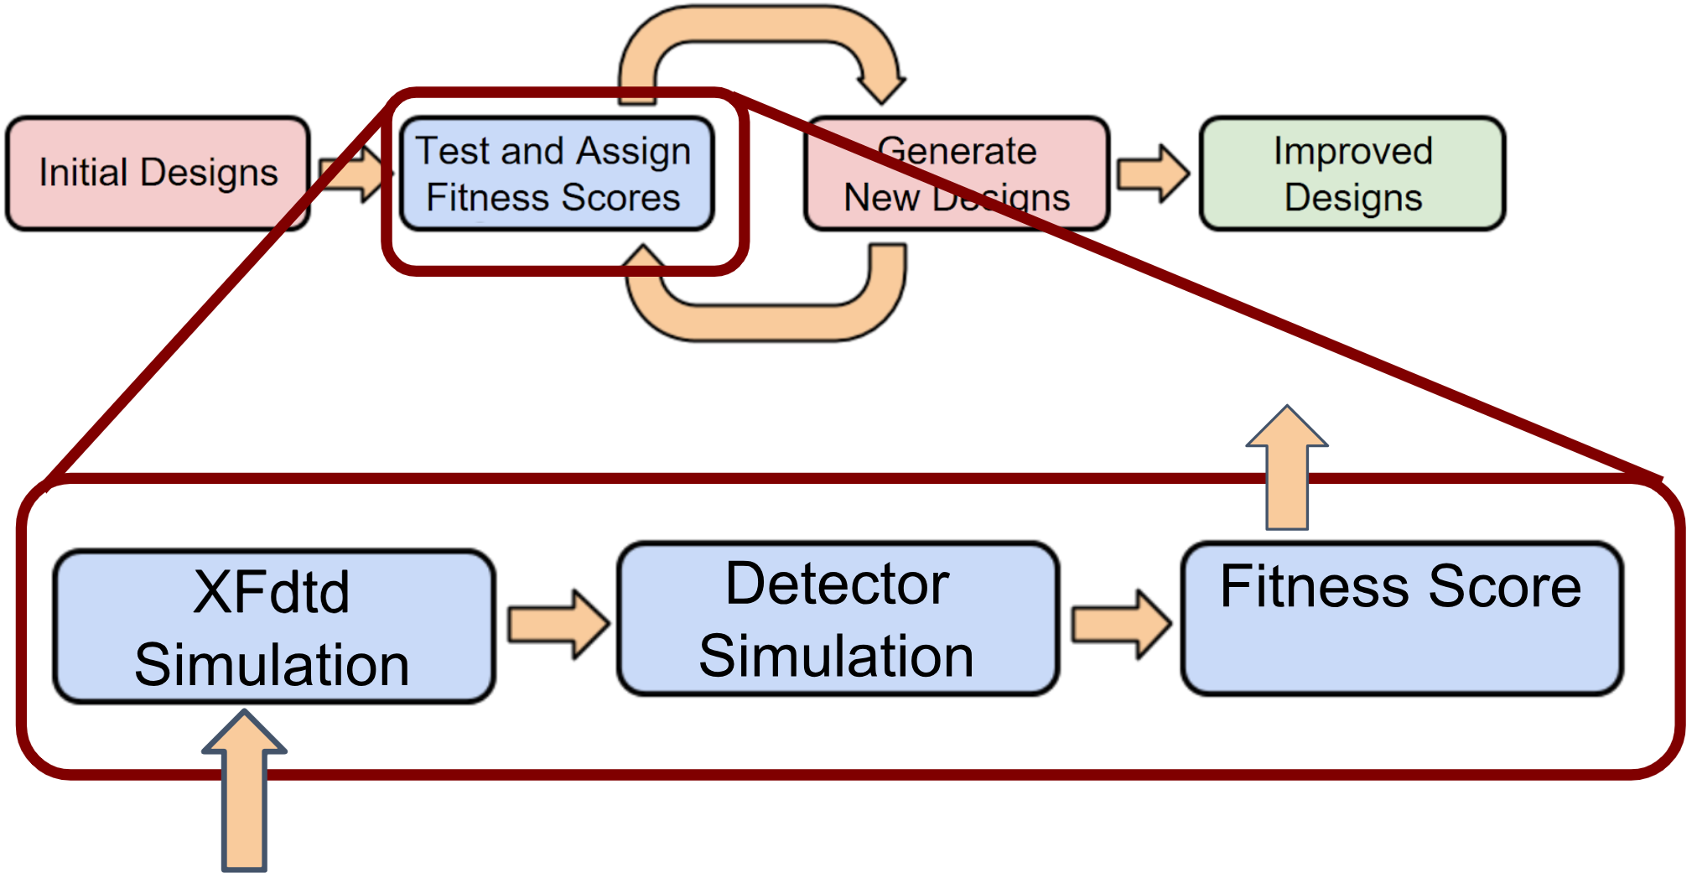
GENETIS Workflow
XFdtd: 3D finite-difference time domain EM simulator
Generates response of each evolved antenna
Detector Simulation (ex: AraSim)
Uses antenna response from XFdtd to evaluate antenna’s performance w.r.t. detecting neutrinos

Slide 14
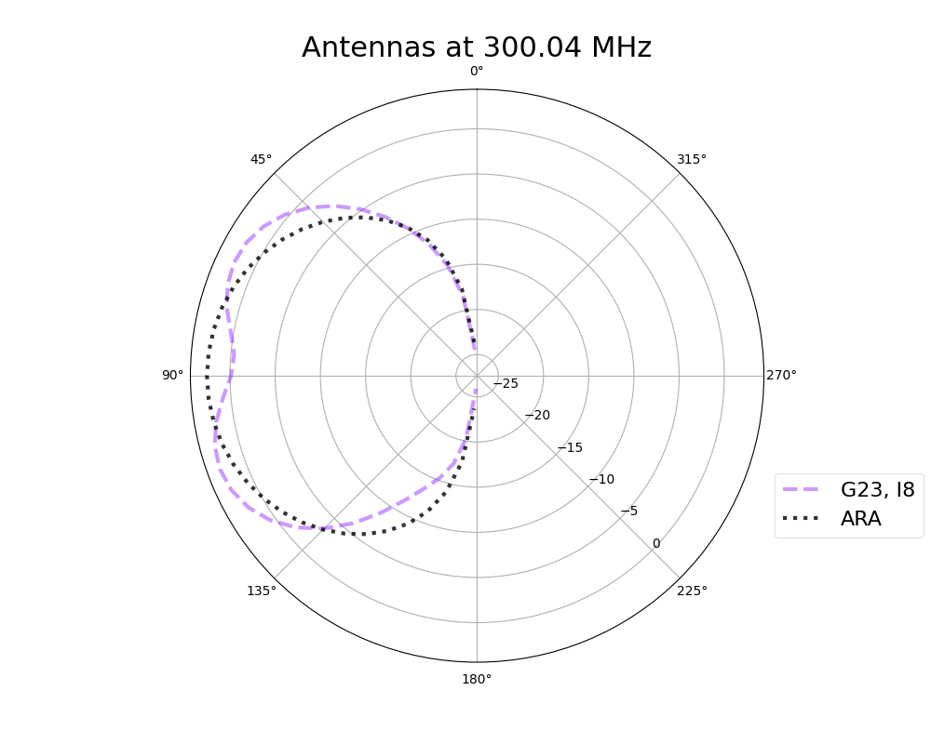
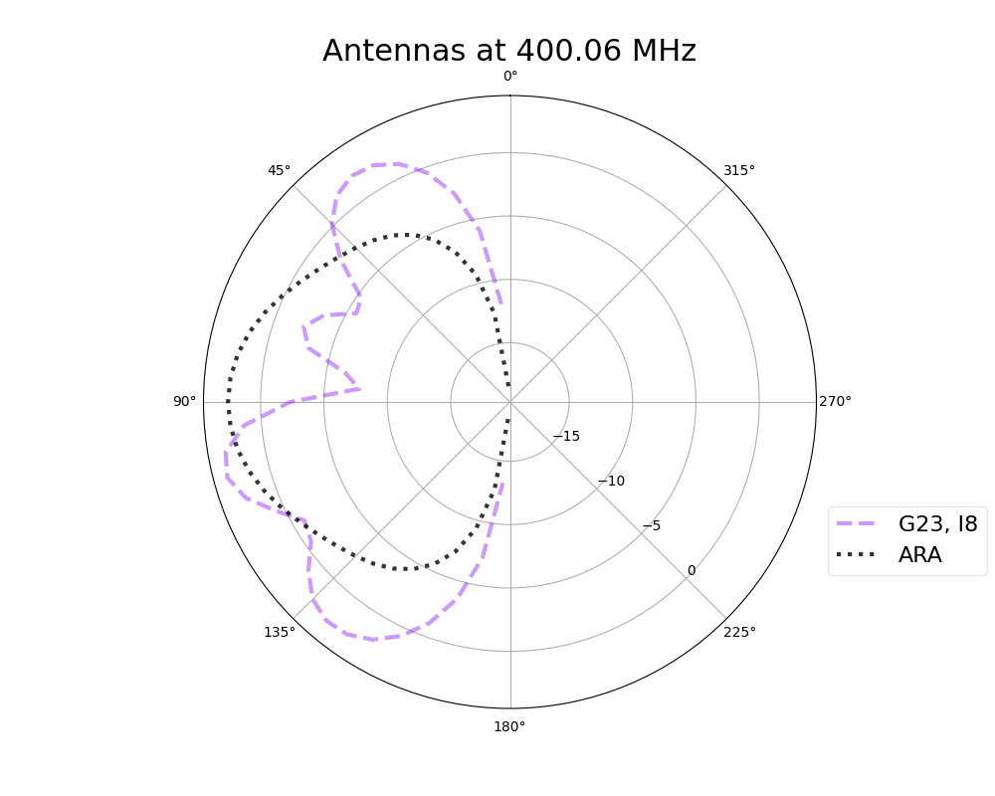
Additional Gain Patterns

Slide 15
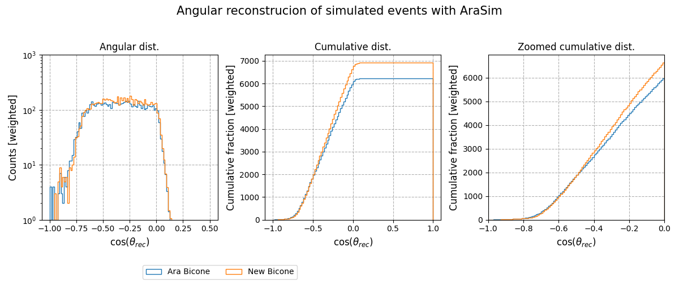
Antenna Comparison in AraSim
Comparing the evolved antenna to the ARA bicone by the number of neutrinos detected and their interaction locations (angle from zenith)
cos(theta) = -1 indicates the event is overhead

