Slide 1
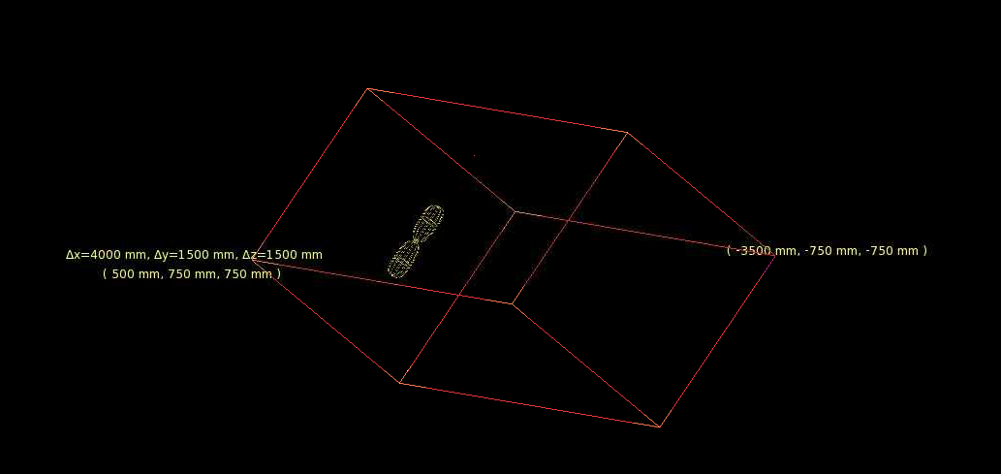
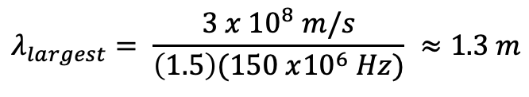
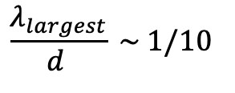
Introduction
Currently, simulations are done with ARA bicone summerged in a column of ice of about the ARA’s dimensions (less than 10 times ARA’s lenght).
ARA detects frequencies of 150 MHz - 850 MHz. This gives:
Here, 1.5 is the used index of refraction for ice.
For our calculations we want:
where d is the distance to the source.
$$λ_{largest}= \frac{3 x {10}^{8} m/s}{\left(1.5\right)(150 x{10}^{6} Hz)} ≈1.3 m$$
$$\frac{λ_{largest}}{d } \sim 1/10$$

Slide 2
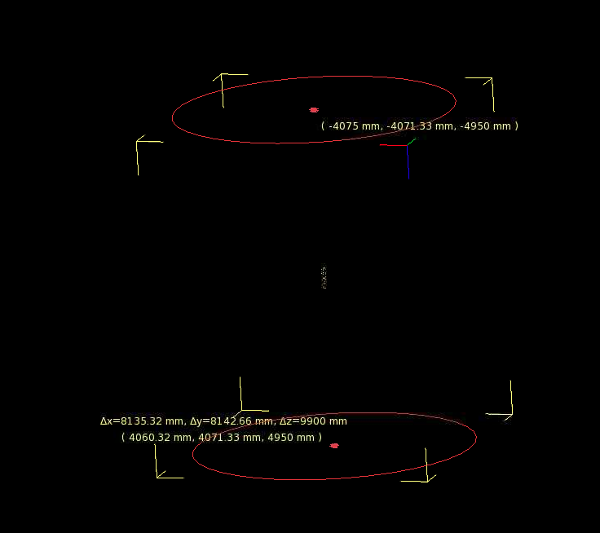
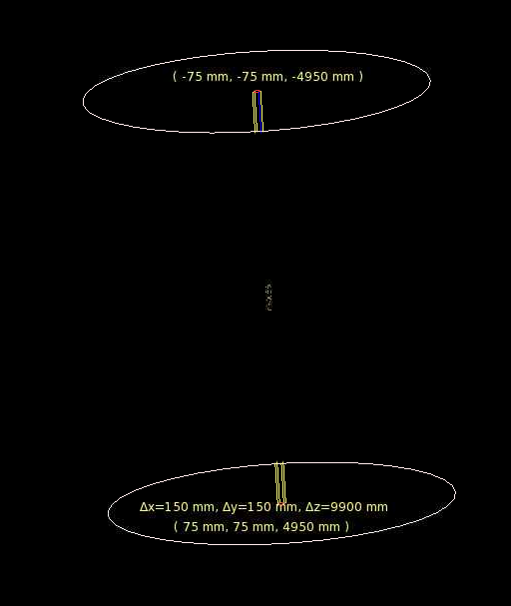
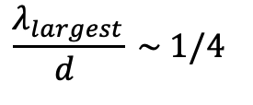
Introduction
More realistic configuration: ARA in a cylinder of air (10 m in height). ARA located in the middle.
Surrounding shell of ice with a radius of 5 m so that:
Good enough ratio?
$$\frac{λ_{largest}}{d } \sim 1/4$$

Slide 3
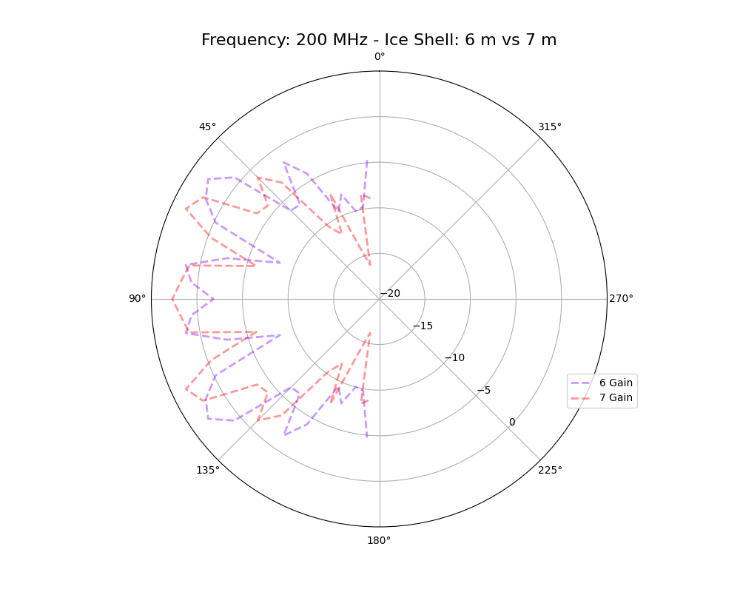
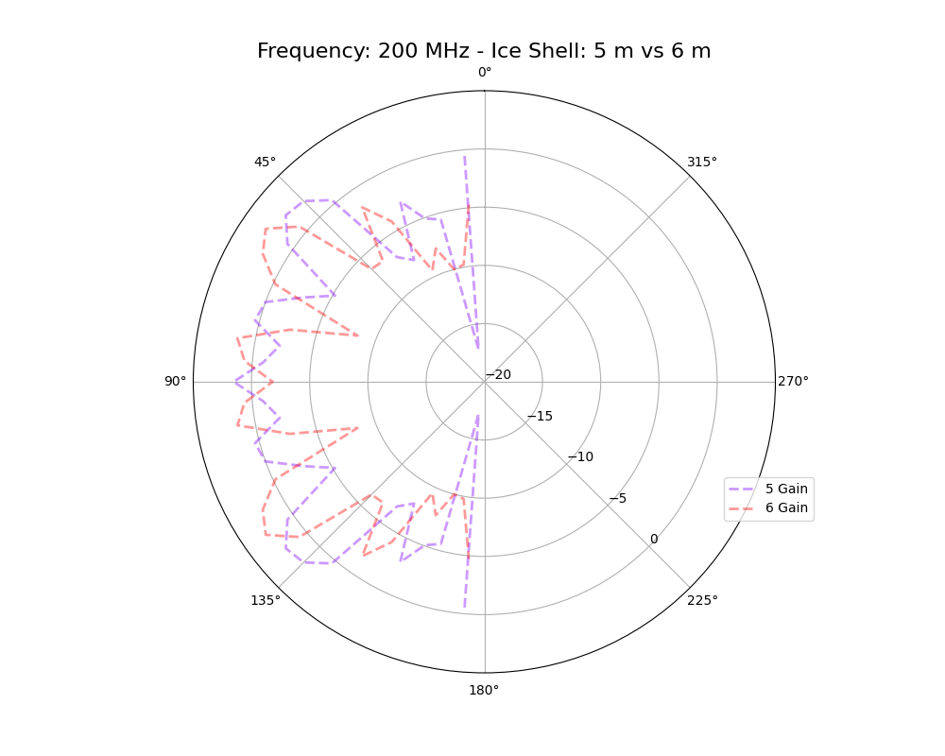
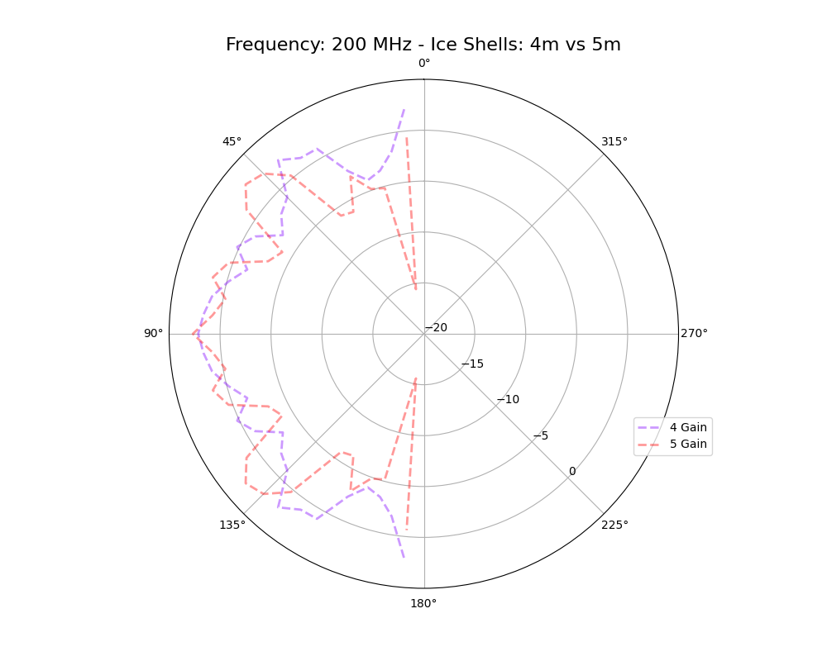
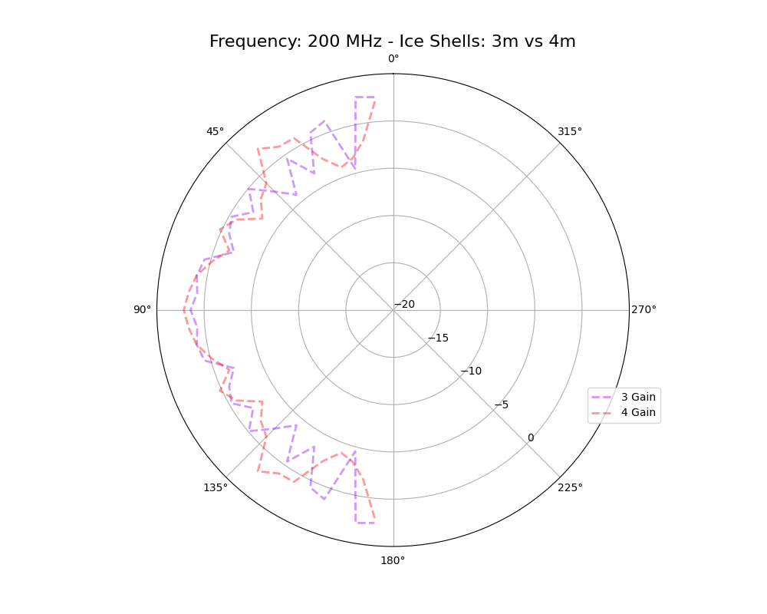
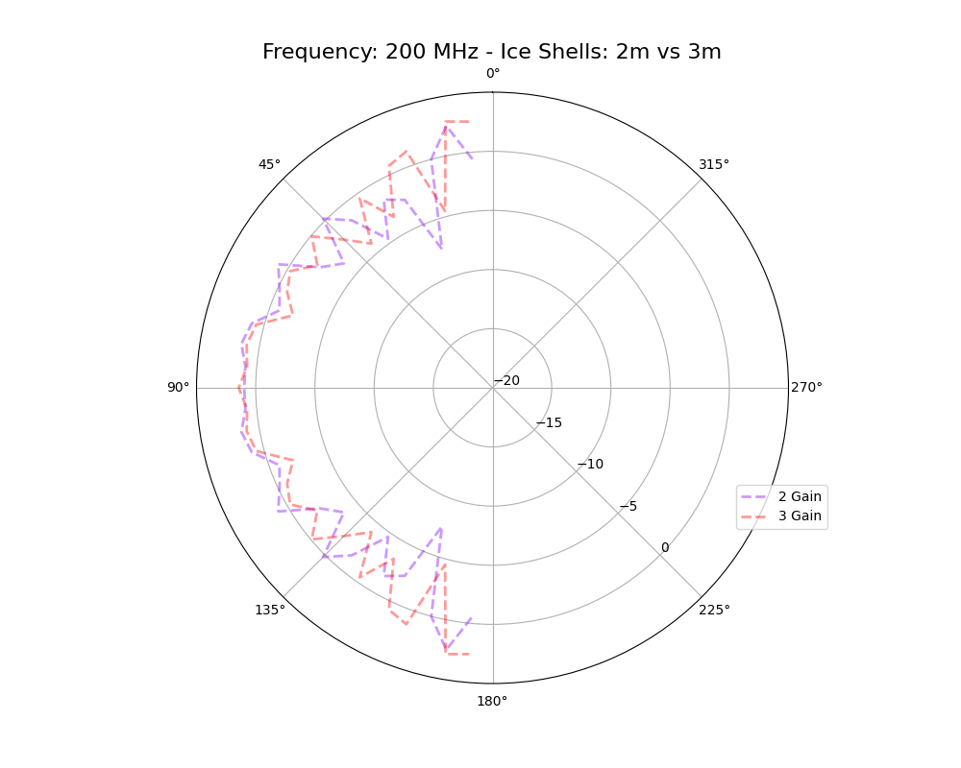
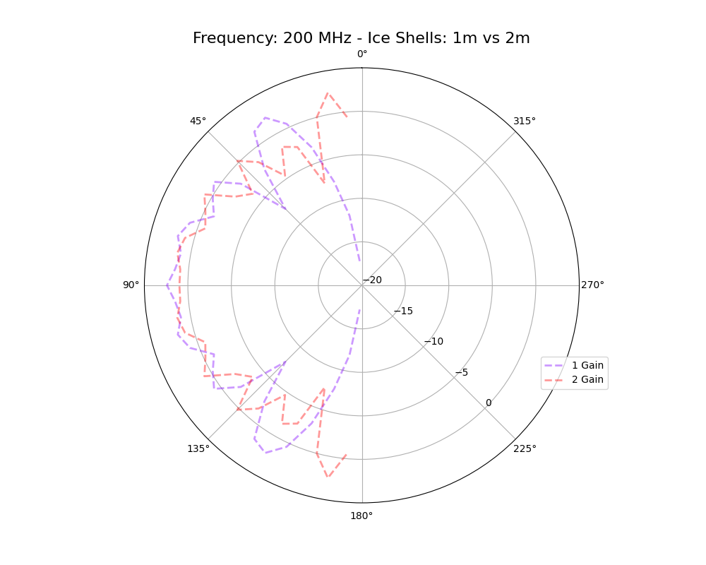
Gain Patterns – Air + Ice Shells w/ different shell radii
@ 200 MHz

Slide 4
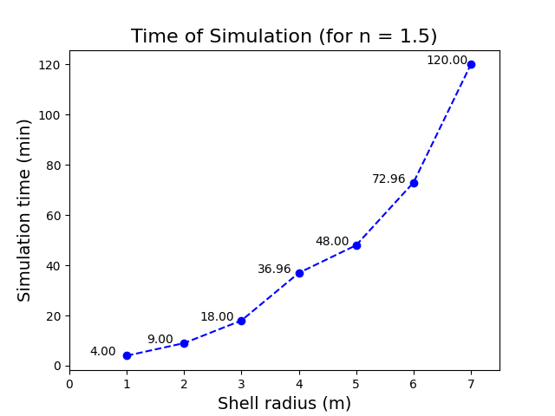
Gain Patterns – Simulation Time

Slide 5
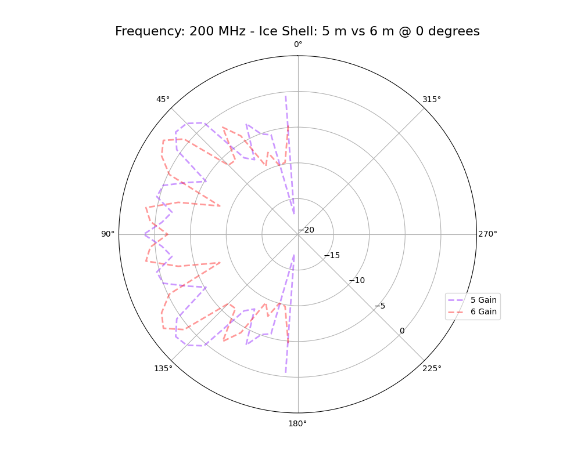
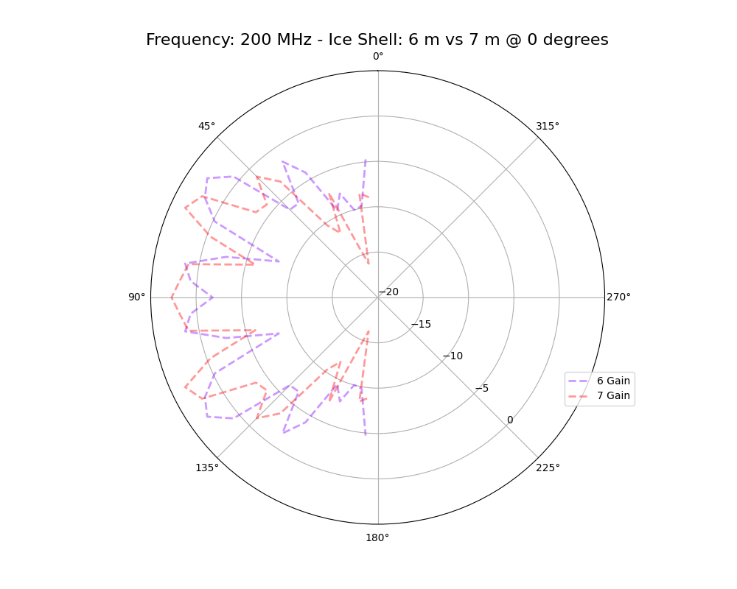
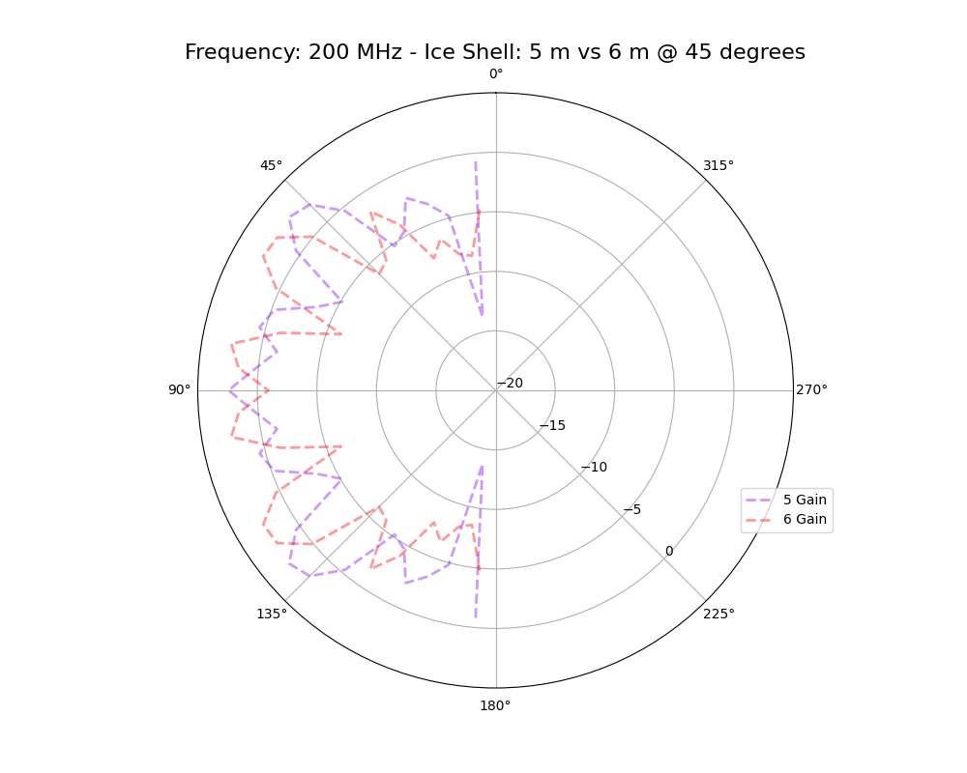
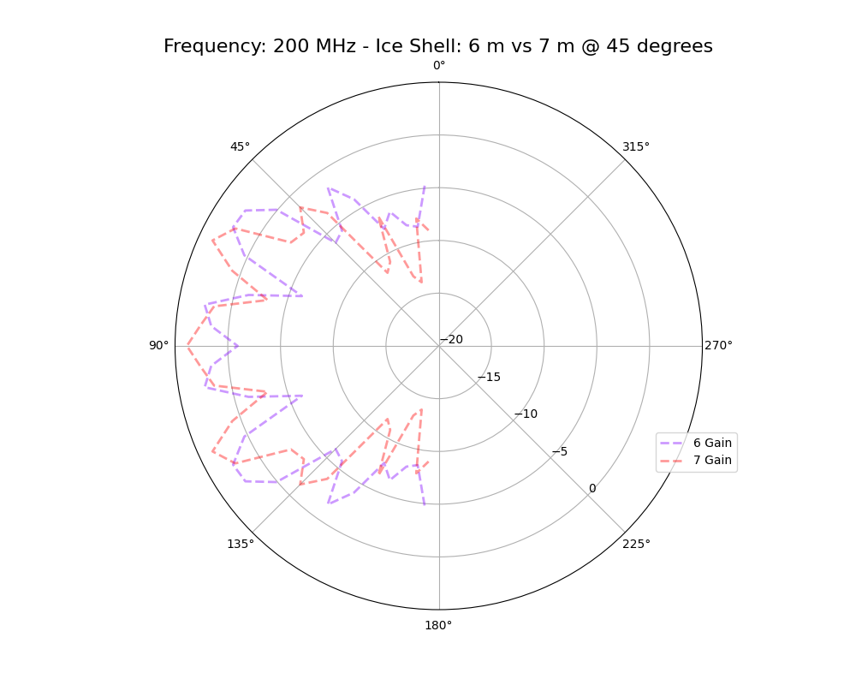
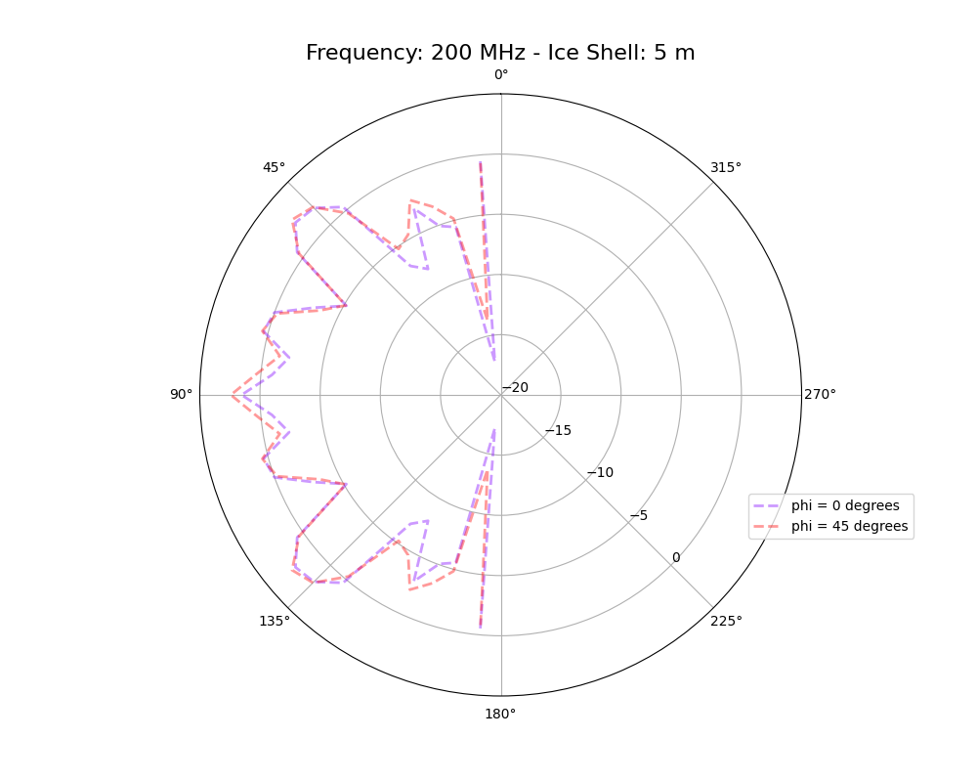
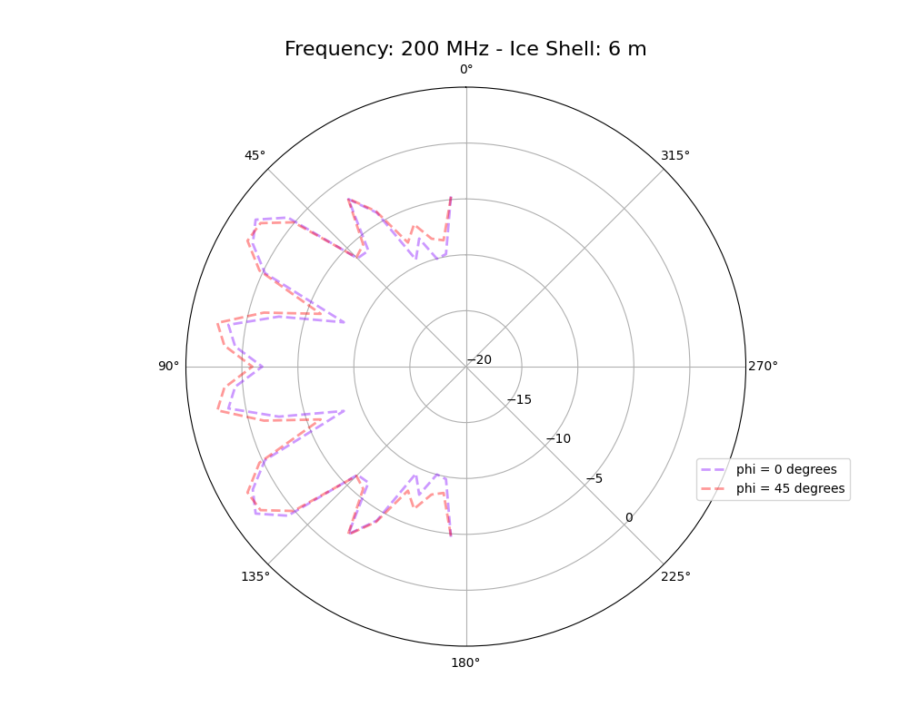
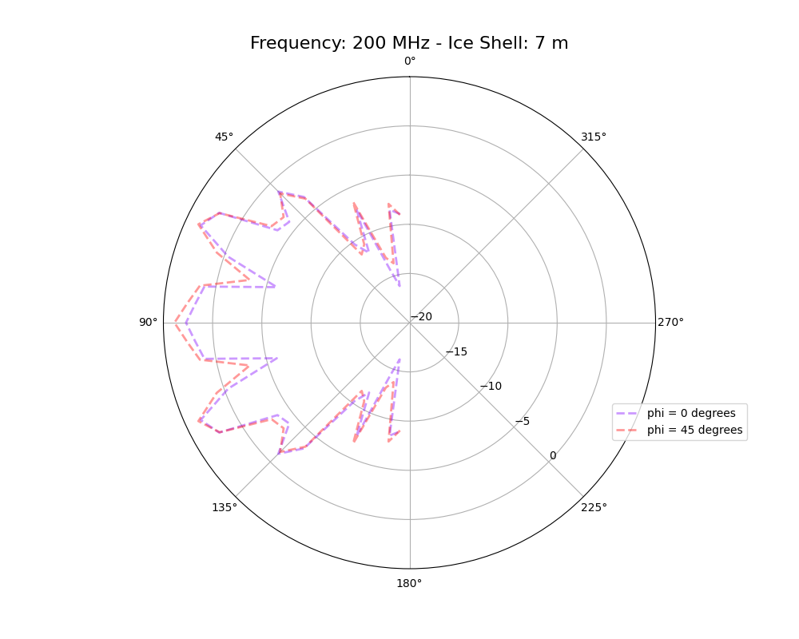
Gain Patterns – Is there azimuthal symmetry? Verify!
@ 200 MHz
Phi = 0
Phi = 45
Differences at constant radii
Yes. Marginal diference! In principle, they should be symmetric. In practice, the grid must be symmetric around the antenna for the calculated response to be symmetric.

Slide 6
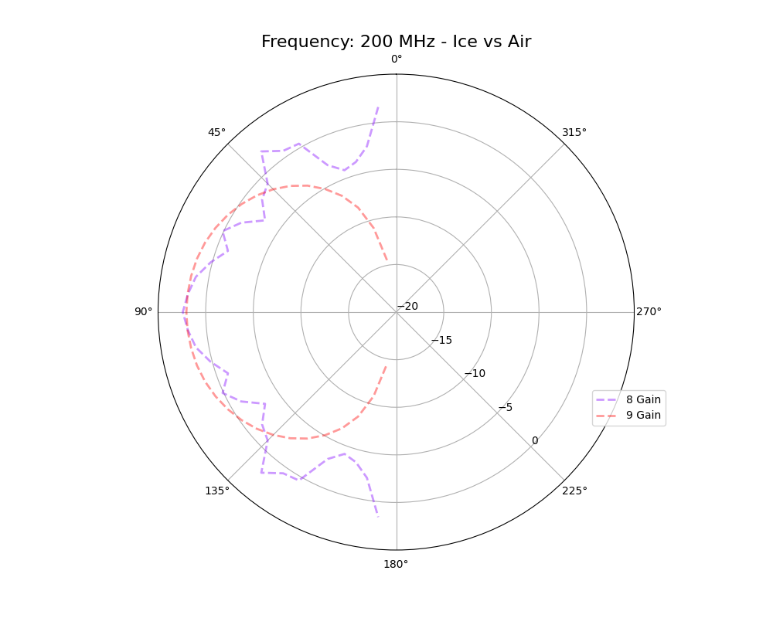
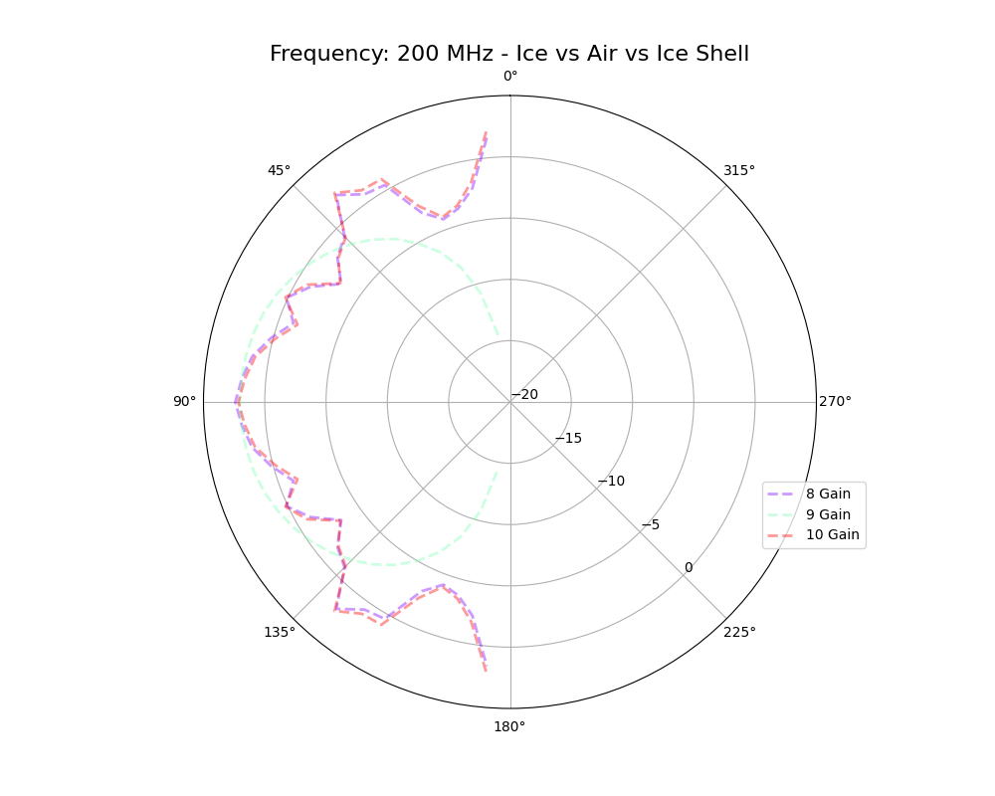
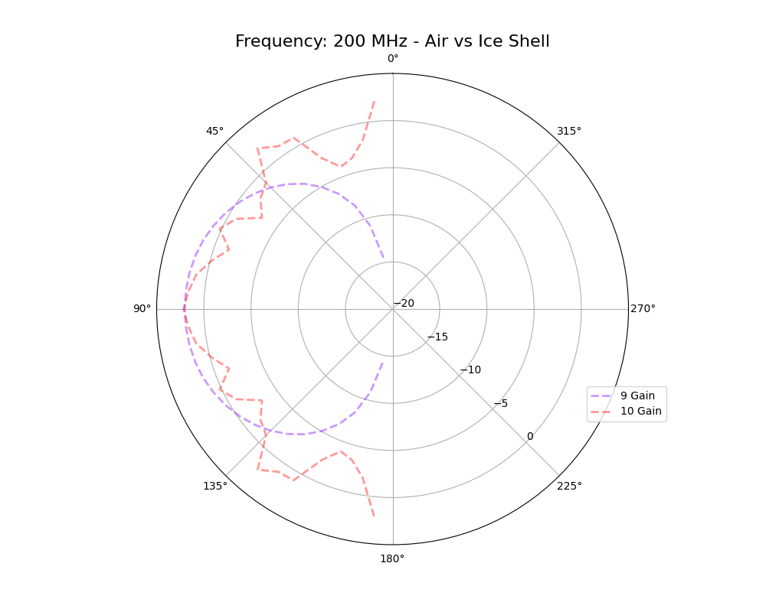
Gain Patterns – Ice vs Air w/ 4 m radii shells
@ 200 MHz
Noticeable difference in gain patter for Air vs Ice.
Marginal change for the presence of an air cylinder in the middle of the ice (borehole is too small to make a difference?)

Slide 7
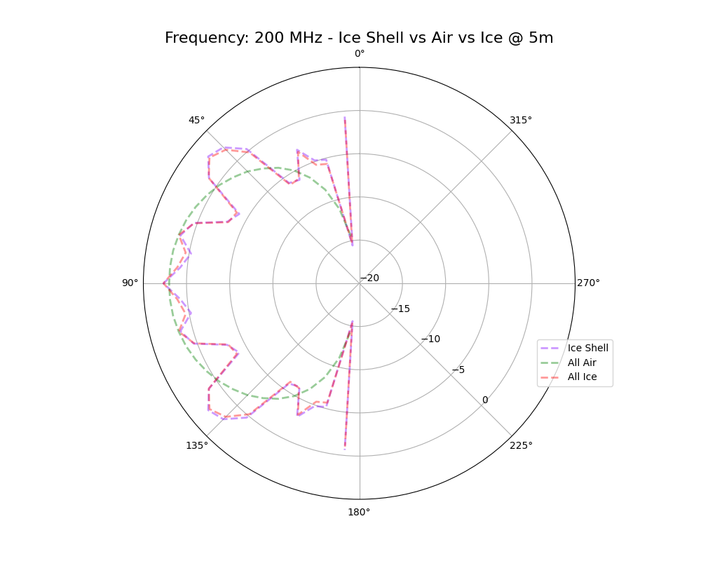
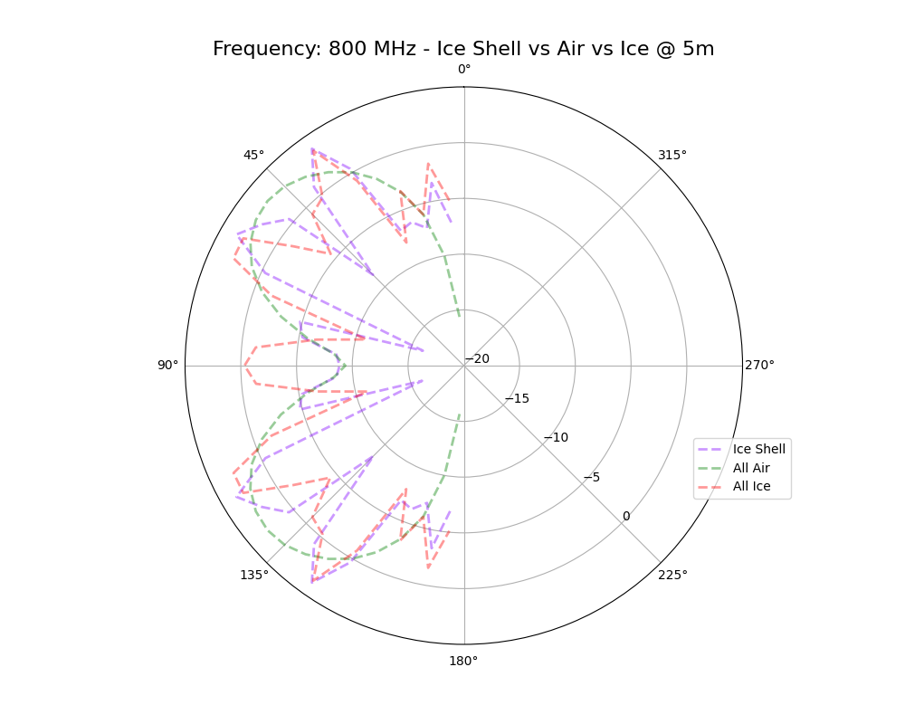
Gain Patterns – Ice vs Air w/ 5 m radii shells
Same conclusions at low frequency (200 MHz).
More noticeable differences at higher frequency, especially at the horizon.

Slide 8
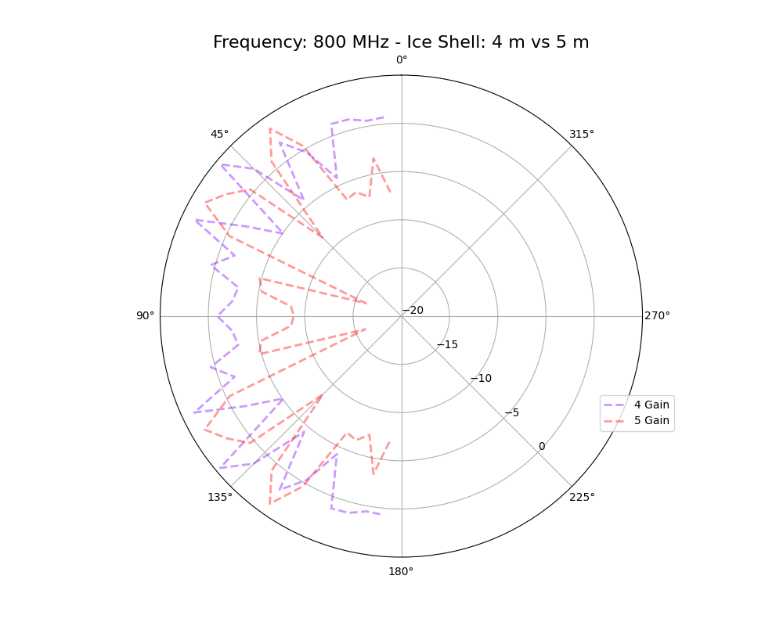
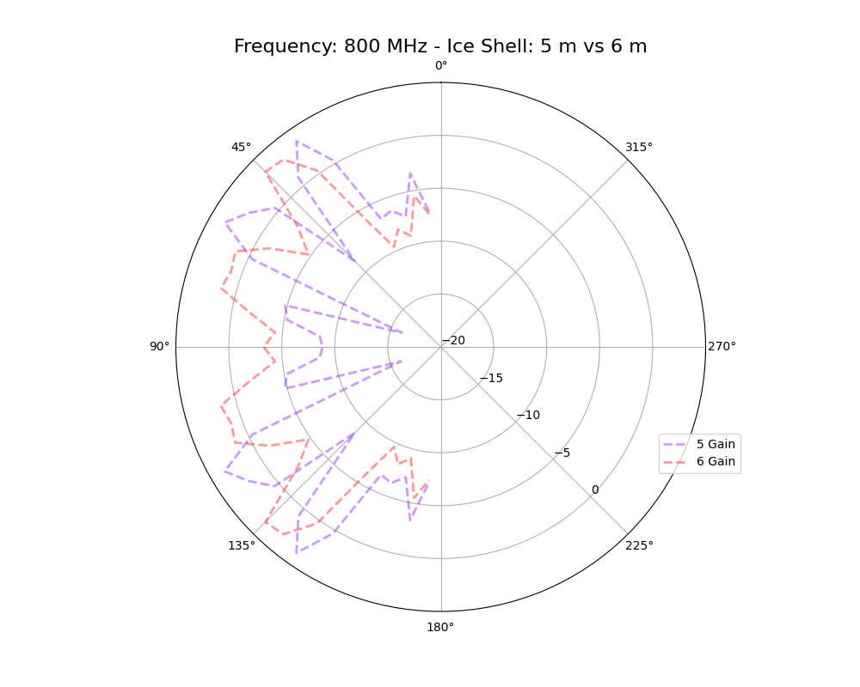
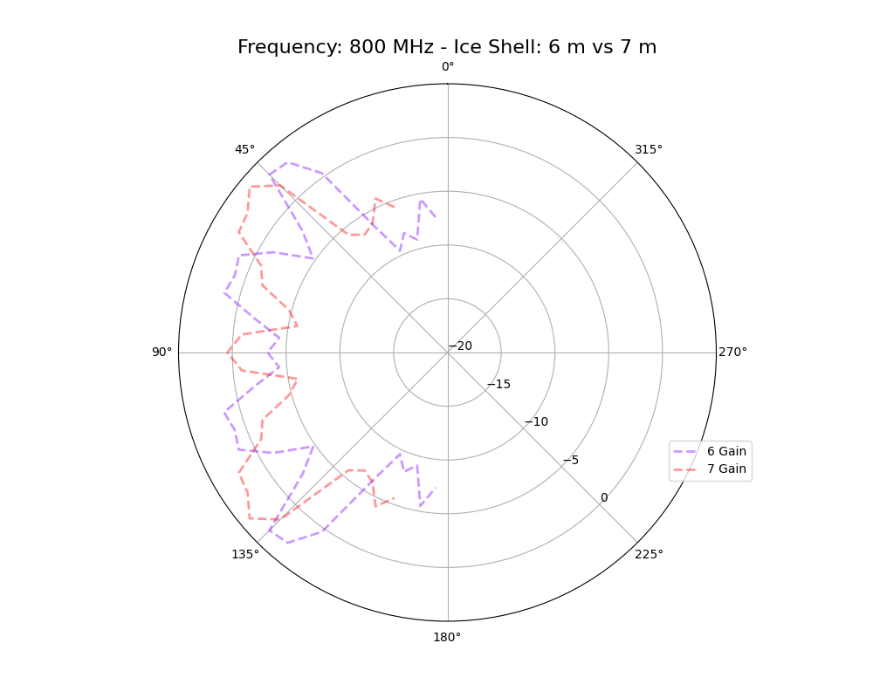
Gain Patterns – Air + Ice Shells w/ different shell radii
@ 800 MHz vs 200 MHz

Slide 9
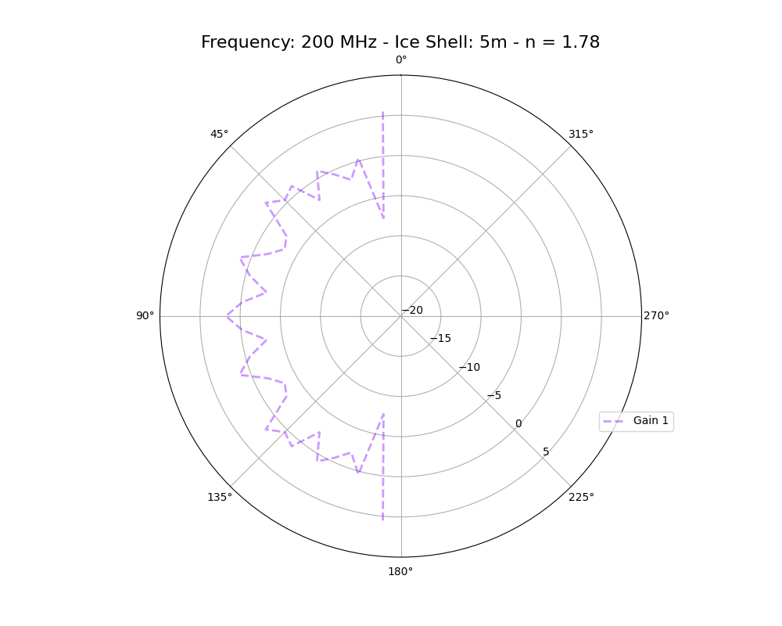
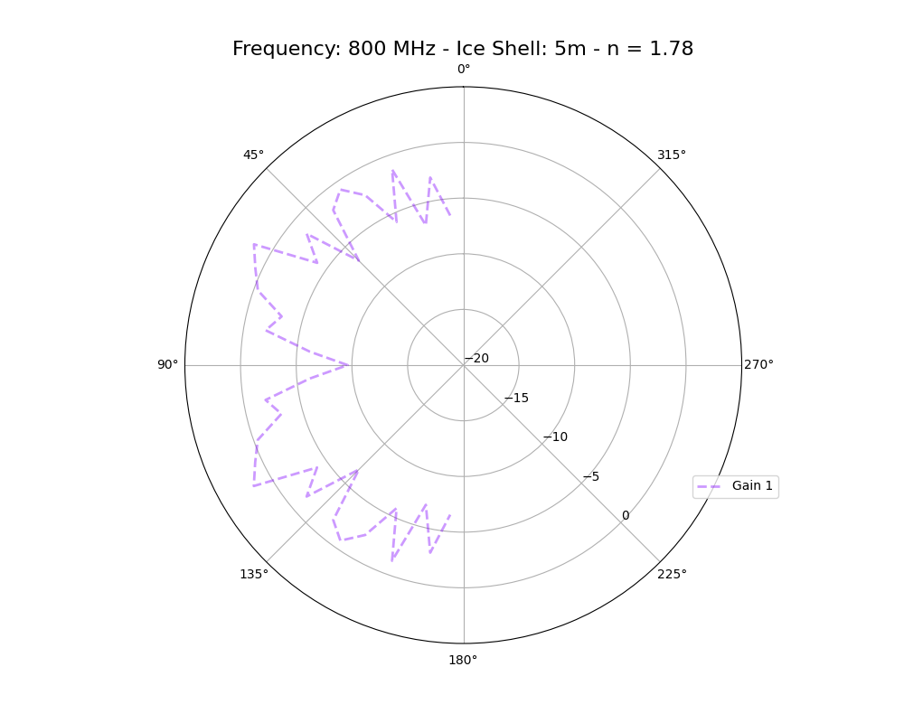
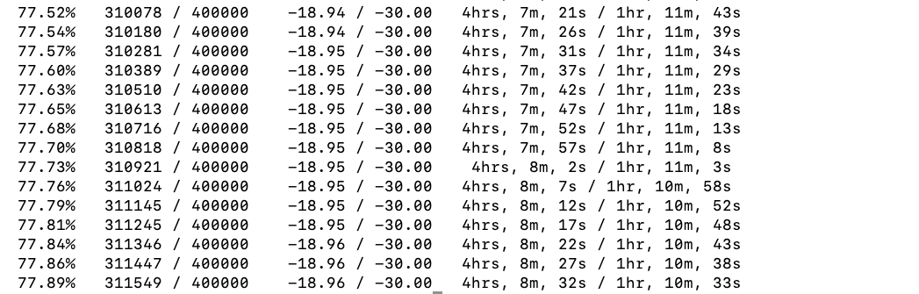
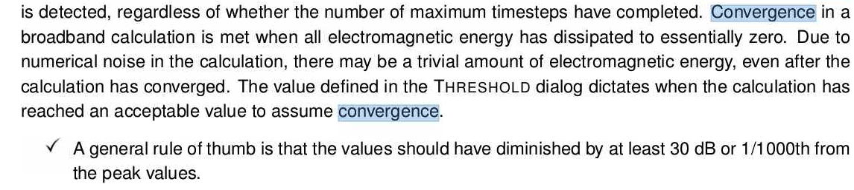
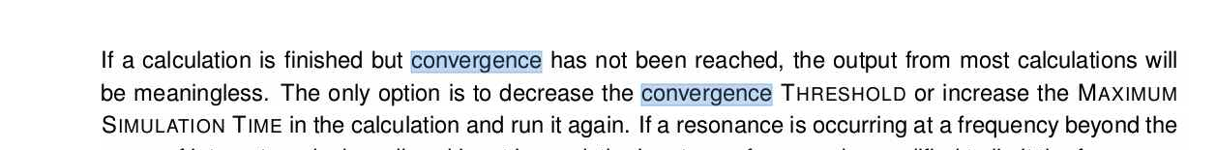
Gain Patterns – Air + Ice Shells - 5 m radii shells w/ n = 1.78 for deep ice (n = 1.5 previously)
Simulation time: 2 hours and 26 minutes.
Largest that has worked out. Radius = 6m, does not converge: larger n, shorther wavelenght, smaller grid size, more computation! I also increased target dB, should I not? Verify possible irrelevance comparing -20 to -30 dB?

