Slide 1
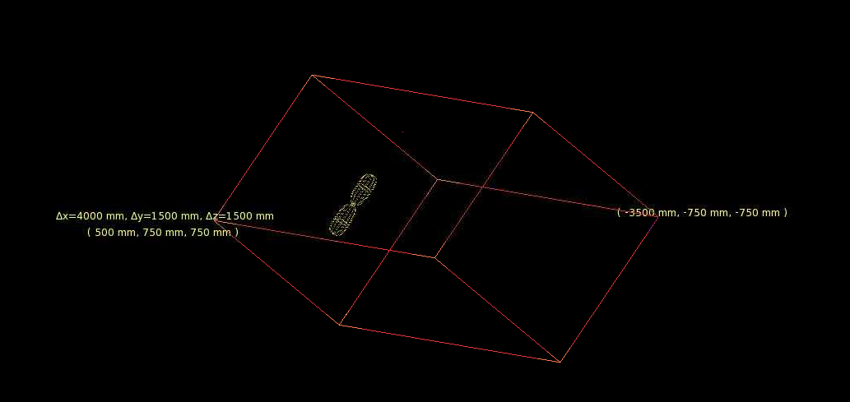
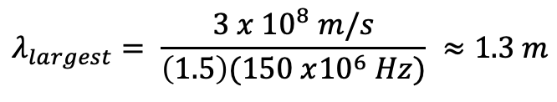
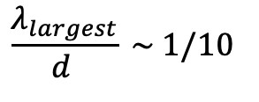
Introduction
Currently, simulations are done with ARA bicone submerged in a column of ice of about the ARA’s dimensions (less than 10 times ARA’s lenght).
ARA detects frequencies of 150 MHz - 850 MHz. This gives:
Here, 1.5 is the used index of refraction for ice.
For our calculations we want:
where d is the distance to the source.
$$λ_{largest}= \frac{3 x {10}^{8} m/s}{\left(1.5\right)(150 x{10}^{6} Hz)} ≈1.3 m$$
$$\frac{λ_{largest}}{d } \sim 1/10$$

Slide 2
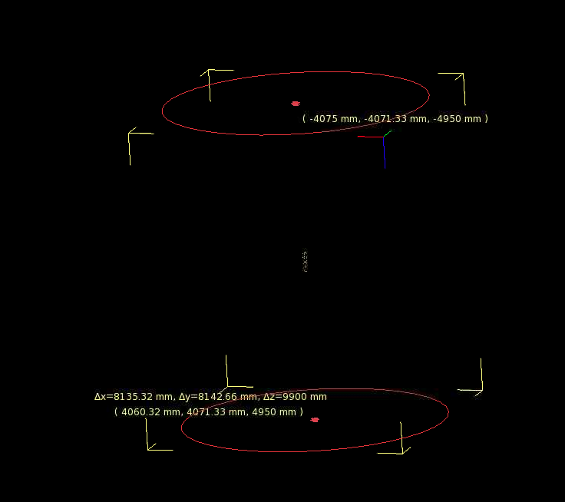
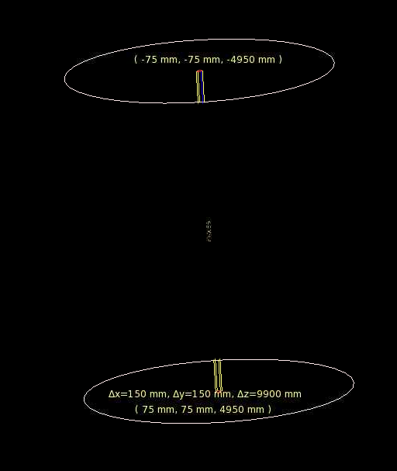
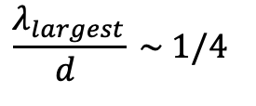
Introduction
More realistic configuration: ARA in a cylinder of air (10 m in height). ARA located in the middle.
Surrounding shell of ice with a radius of 5 m so that:
Good enough ratio?
$$\frac{λ_{largest}}{d } \sim 1/4$$

Slide 3
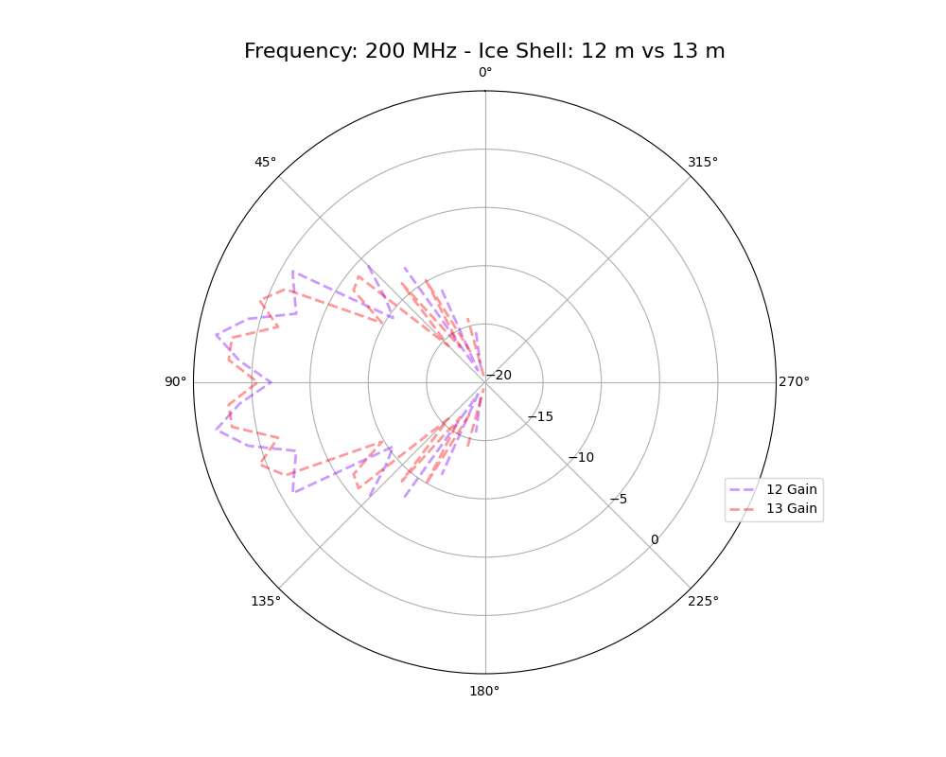
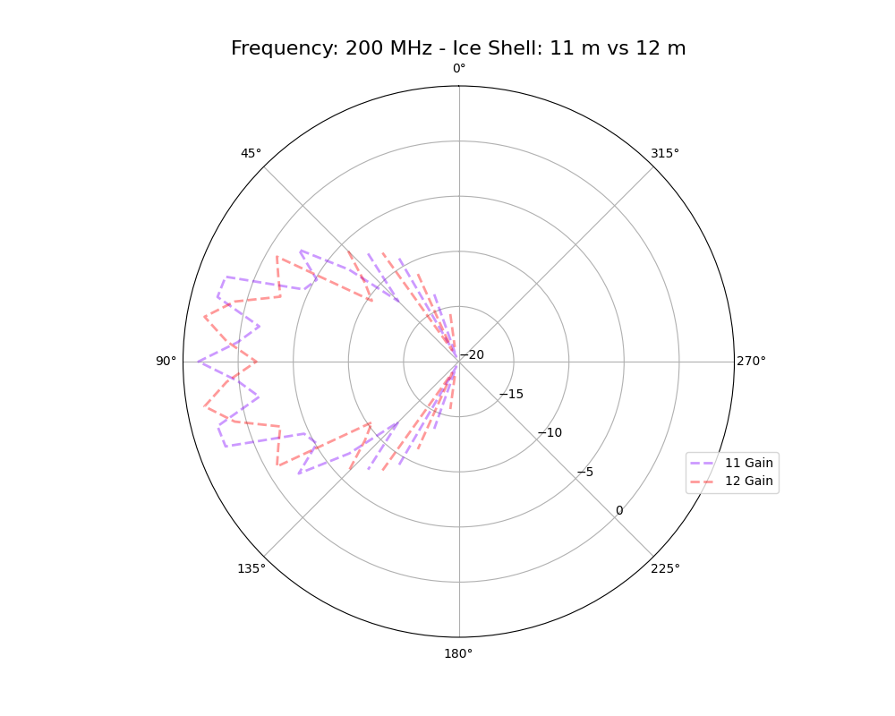
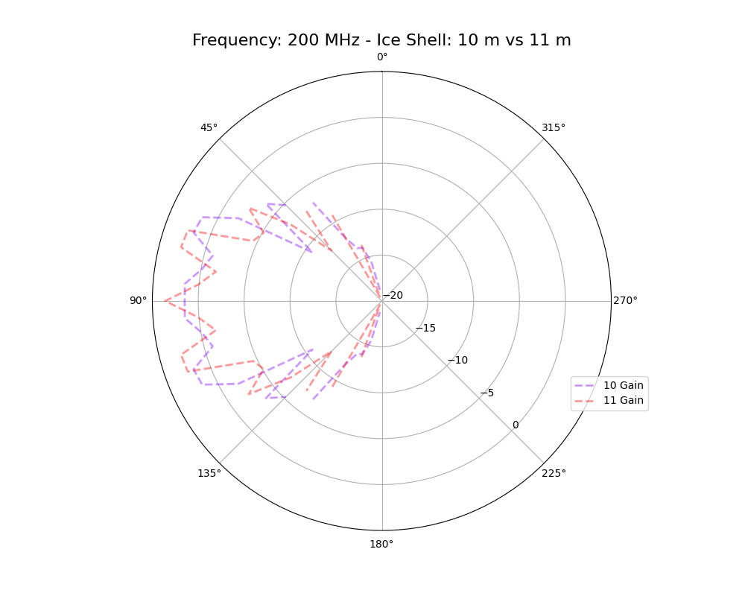
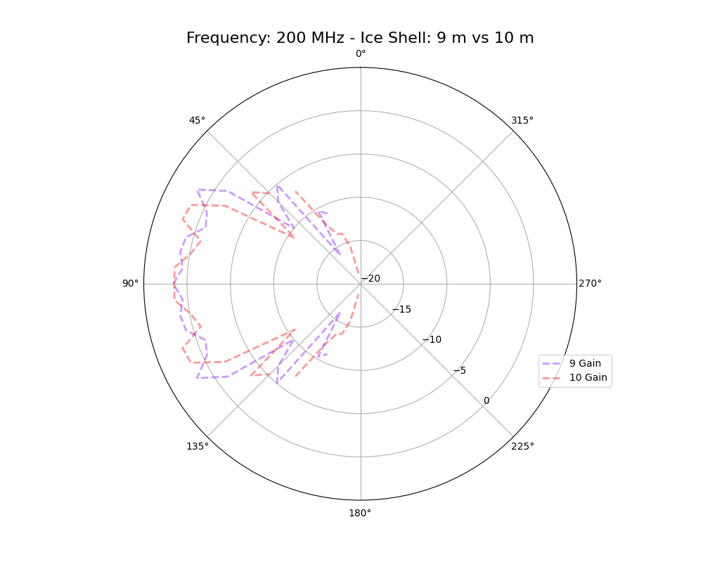
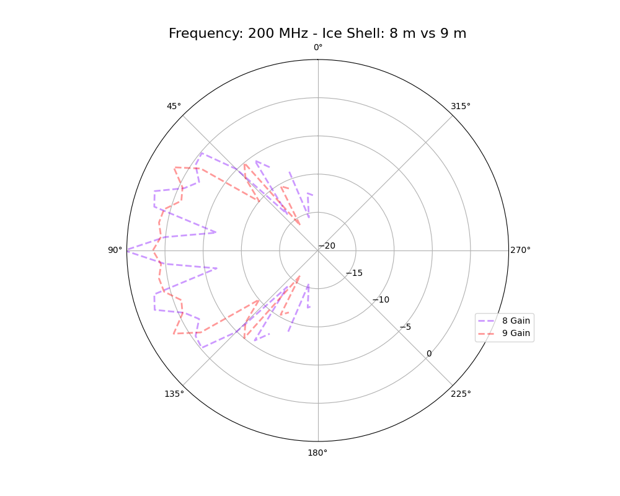
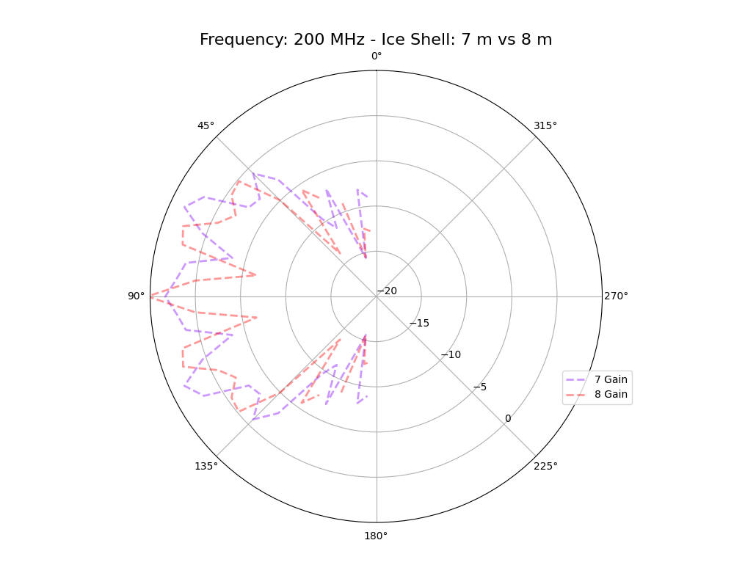
New Slide!
Gain Patterns – Air + Ice Shells w/ different shell radii
@ 200 MHz
10 m - looks as expected
Why is it missing a piece?

Slide 4
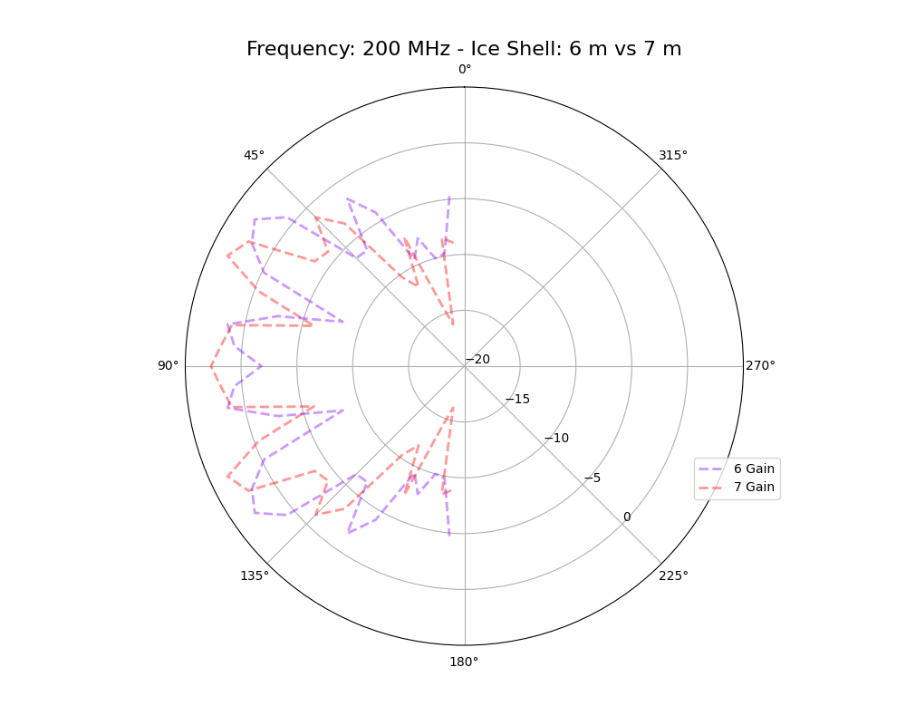
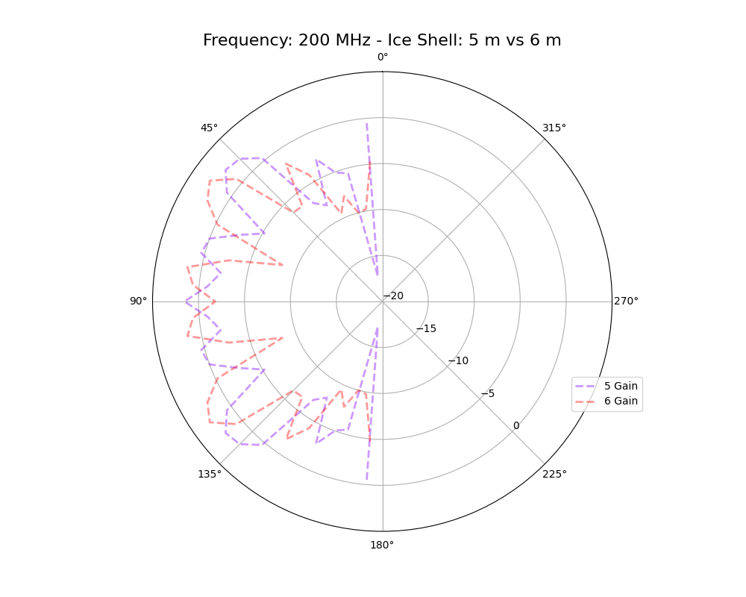
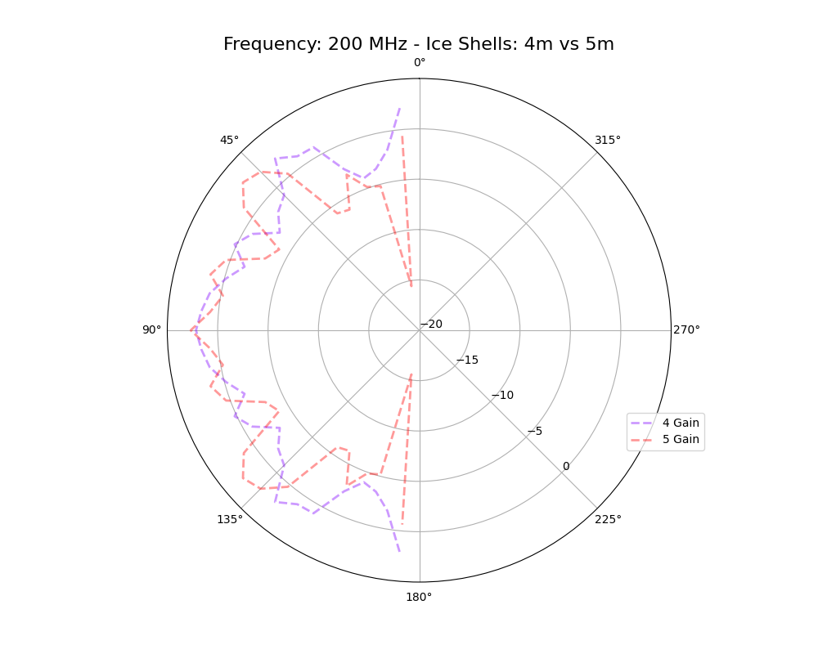
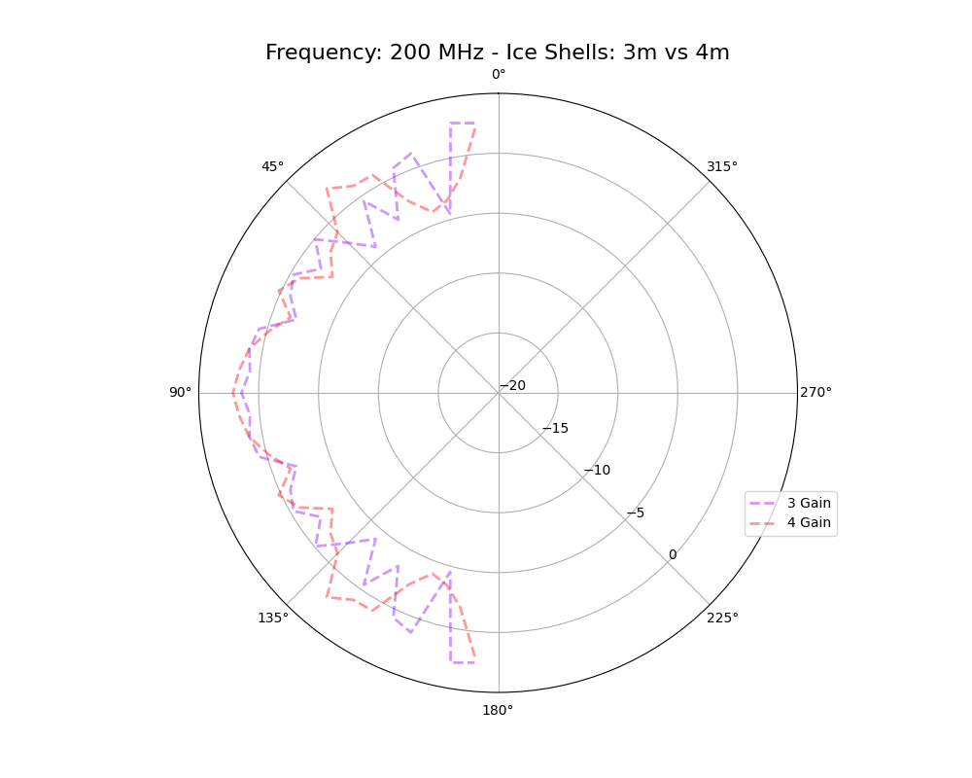
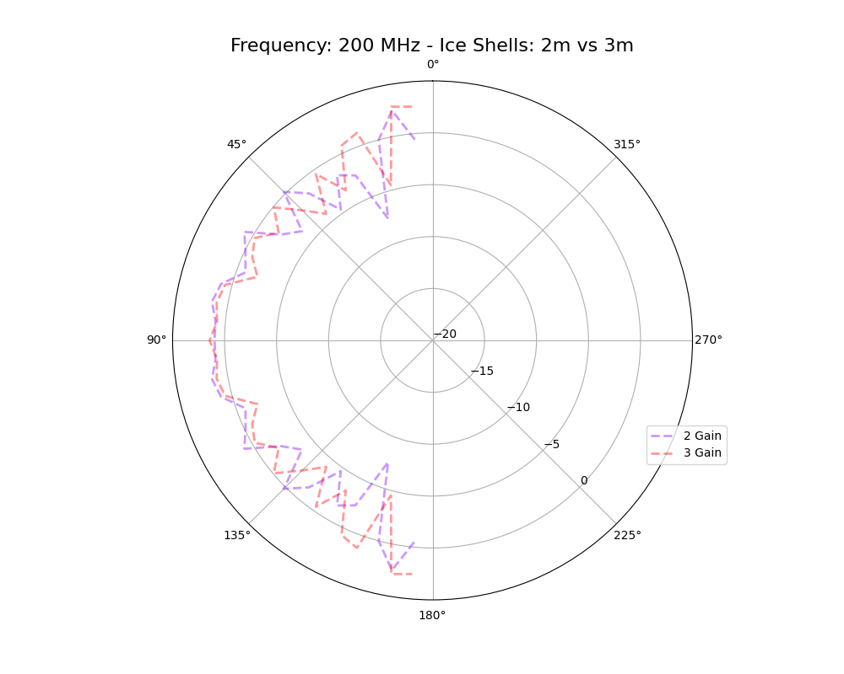
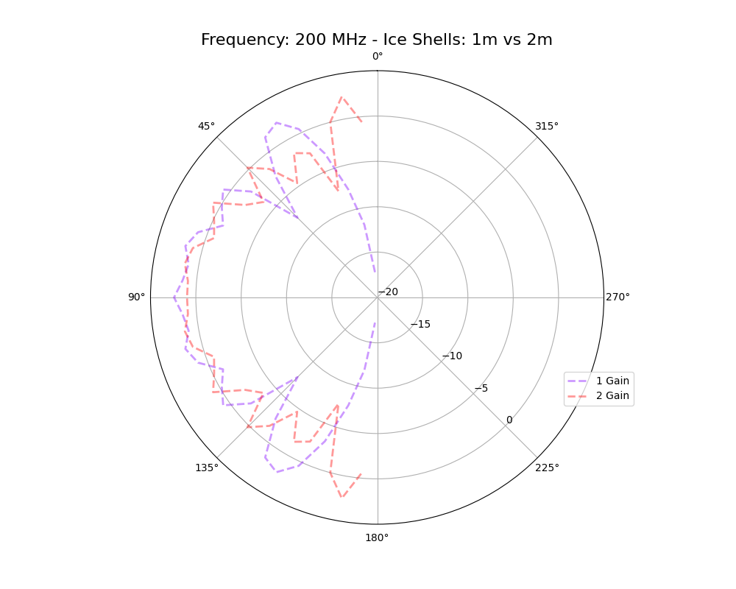
Gain Patterns – Air + Ice Shells w/ different shell radii
@ 200 MHz

Slide 5
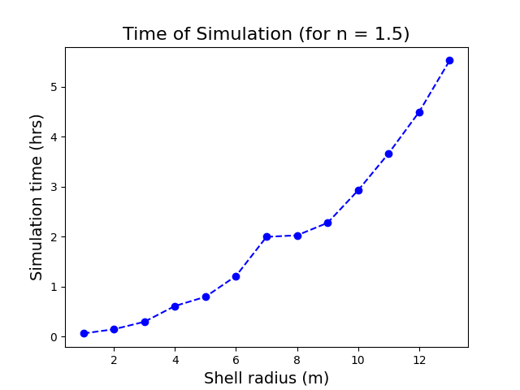
Updated!
Gain Patterns – Simulation Time

Slide 6
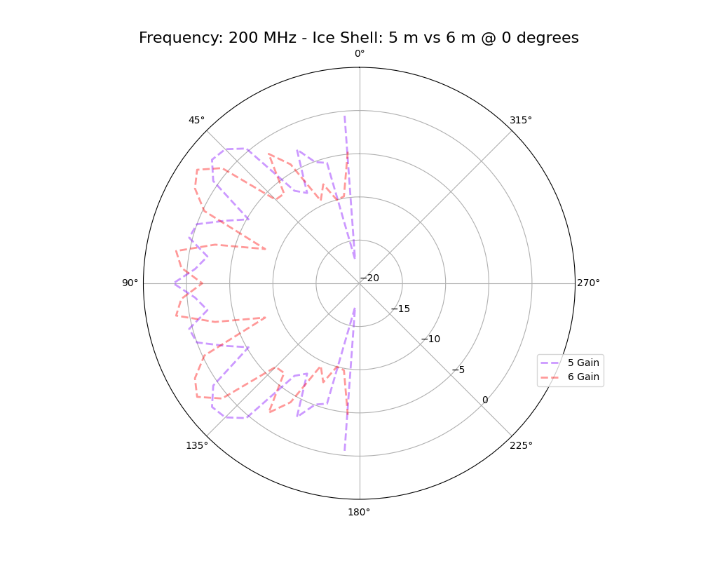
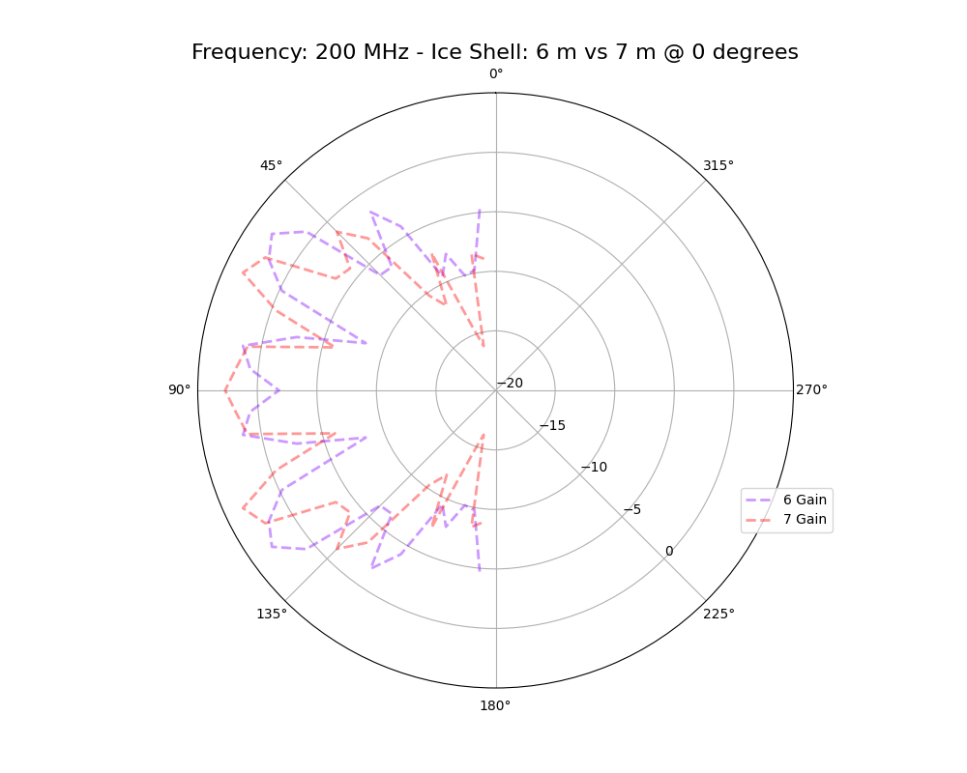
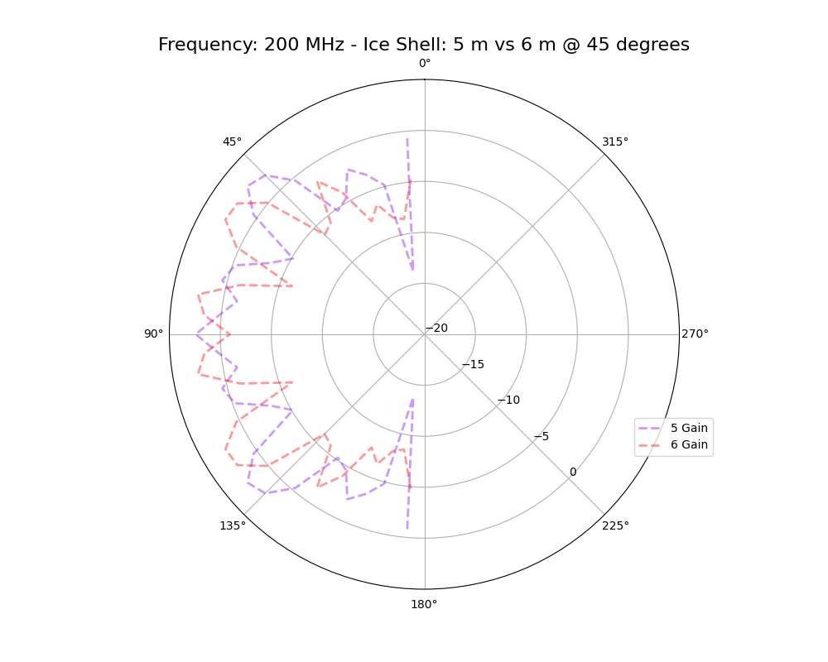
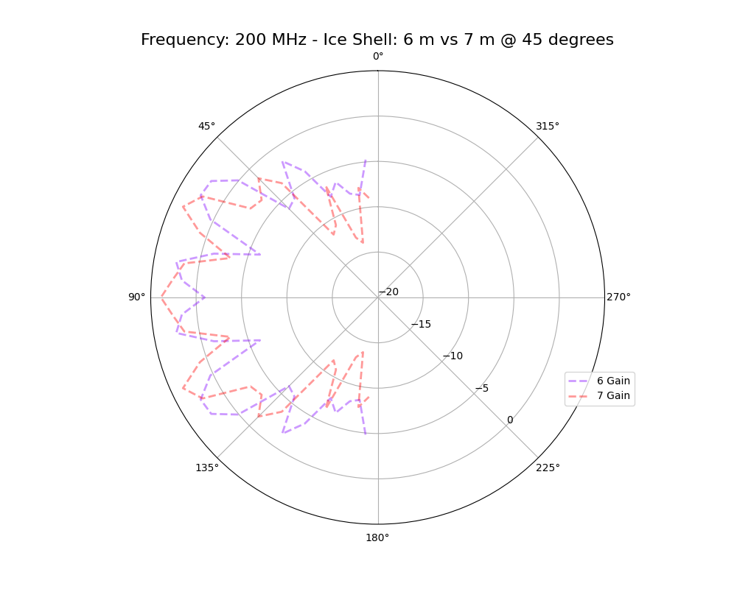


Gain Patterns – Is there azimuthal symmetry? Verify!
@ 200 MHz
$$φ=0^{∘}$$
$$φ={45}^{∘}$$

Slide 7
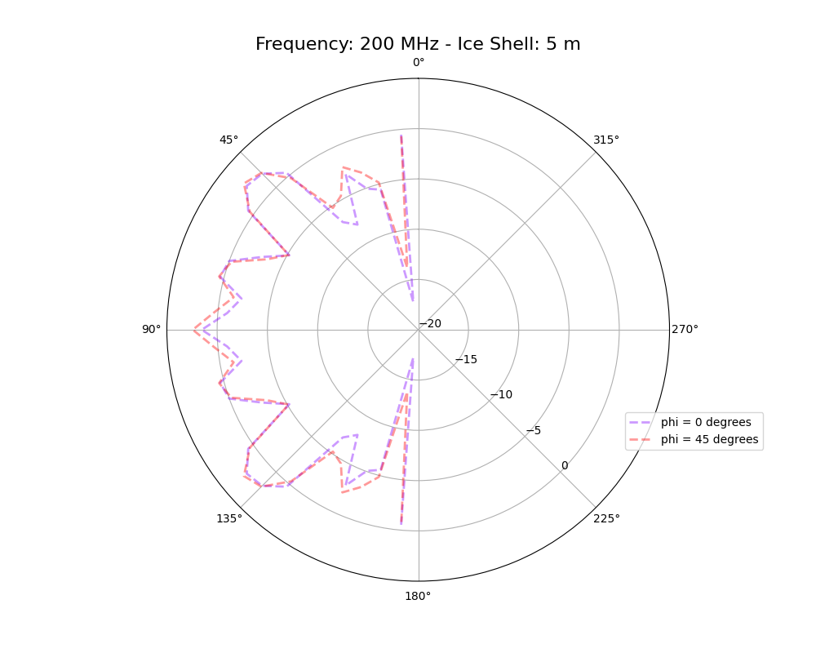
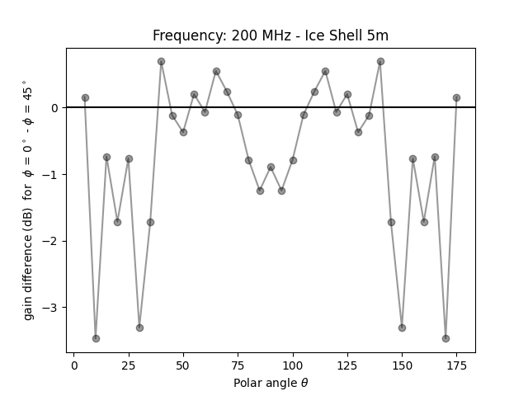
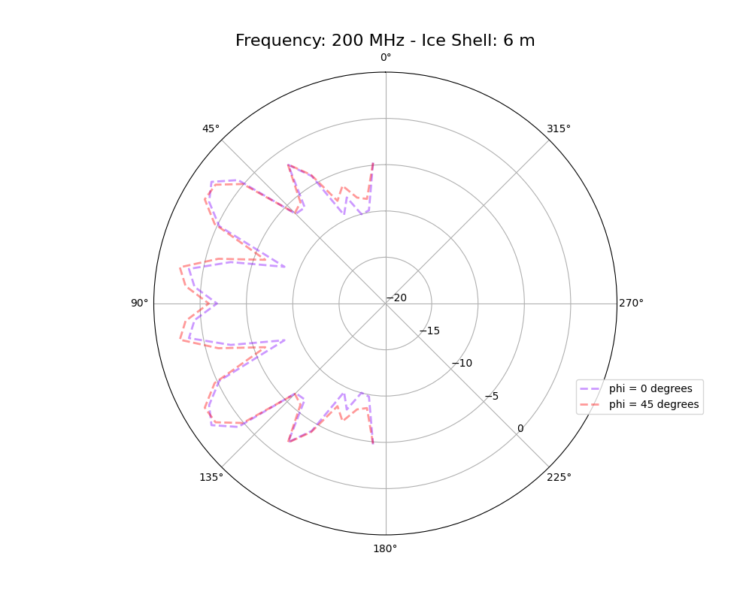
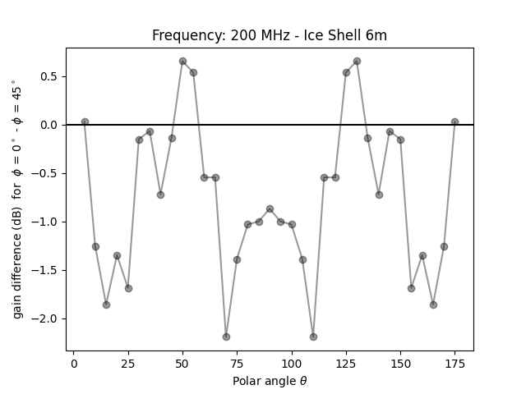
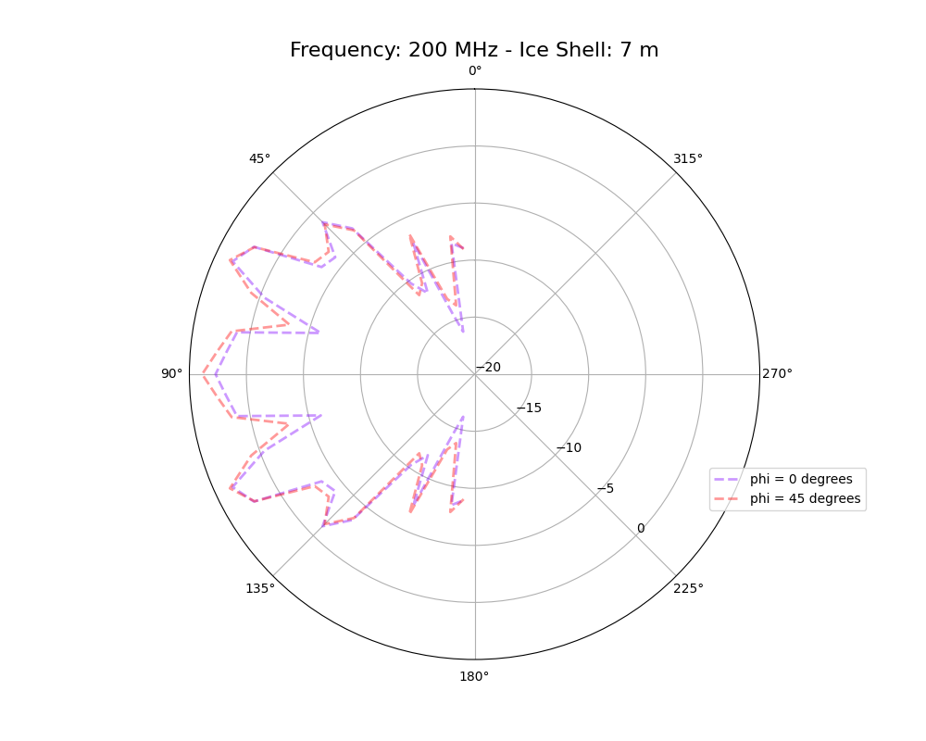
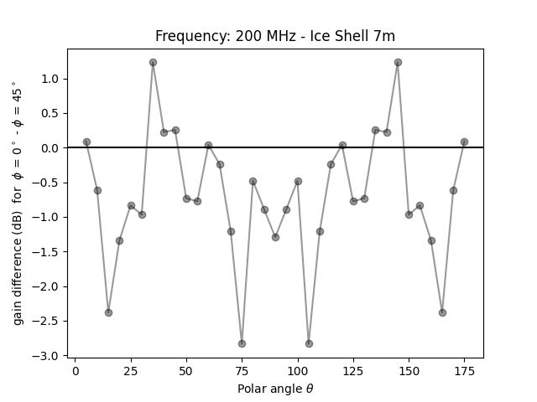
Gain Patterns – Is there azimuthal symmetry? Verify!
@ 200 MHz
Differences at constant radii
Yes. In principle, they should be symmetric. In practice, the grid must be symmetric around the antenna for the calculated response to be symmetric.

Slide 8
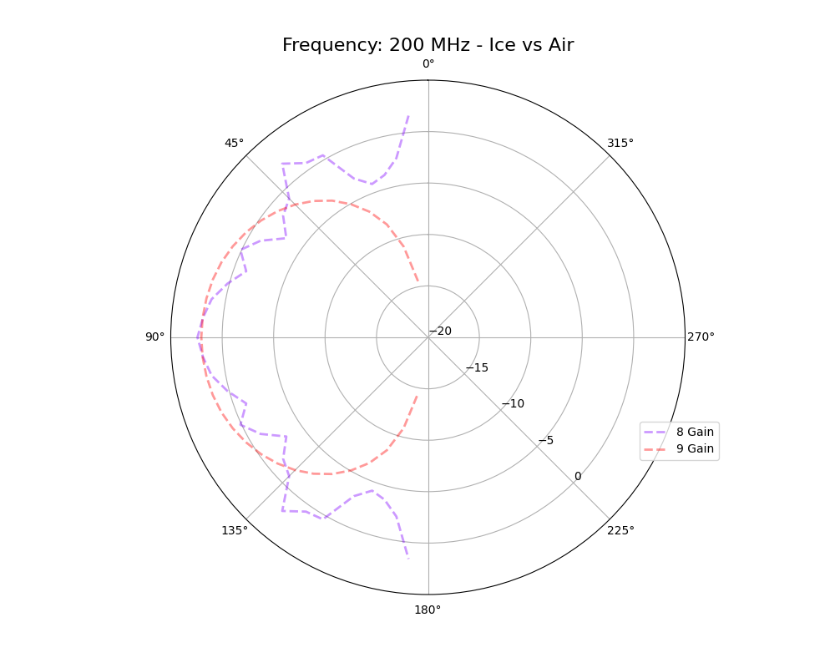
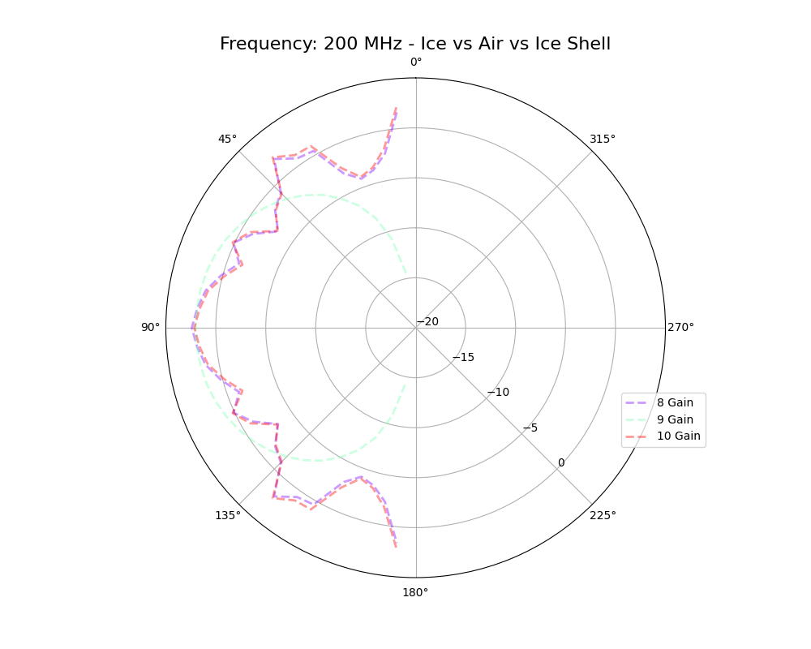
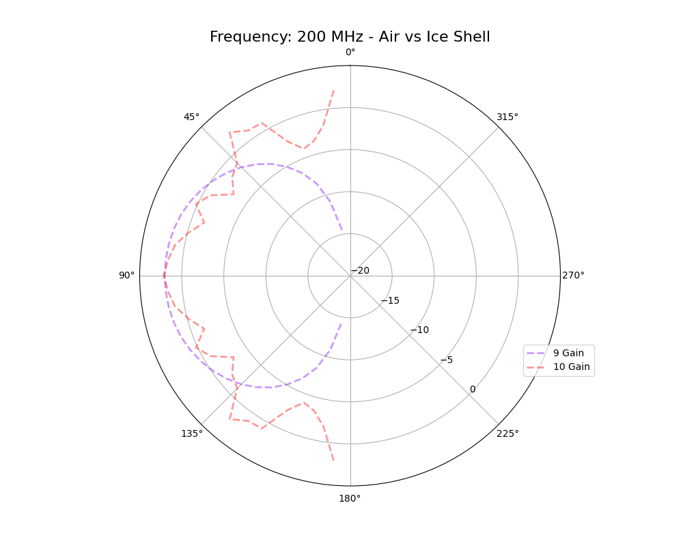
Gain Patterns – Ice vs Air w/ 4 m radii shells
@ 200 MHz
Noticeable difference in gain patter for Air vs Ice.
Marginal change for the presence of an air cylinder in the middle of the ice (borehole is too small to make a difference?)

Slide 9
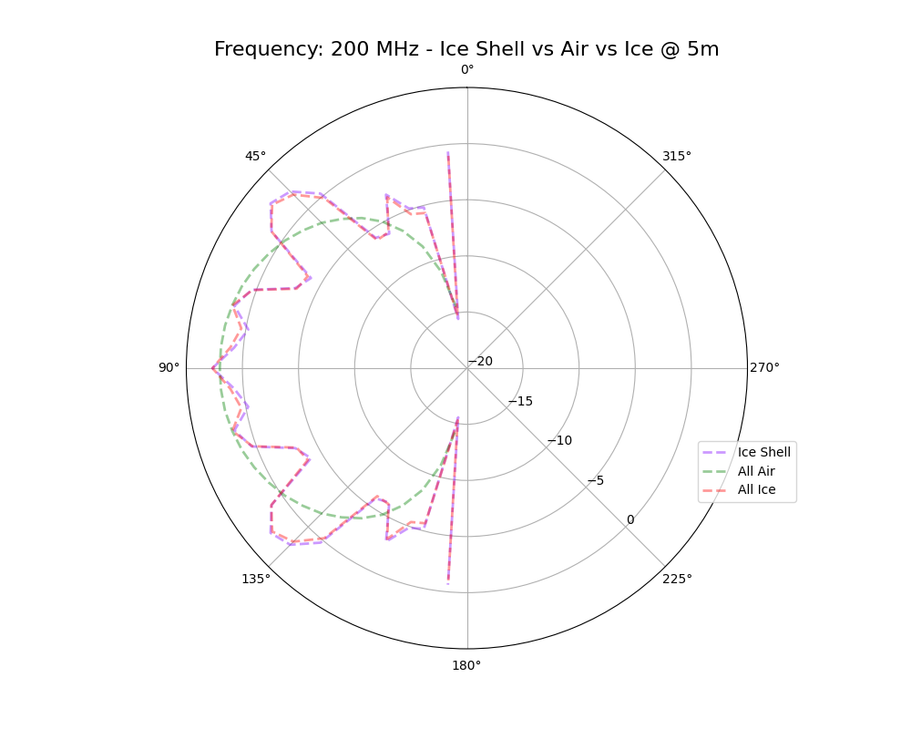
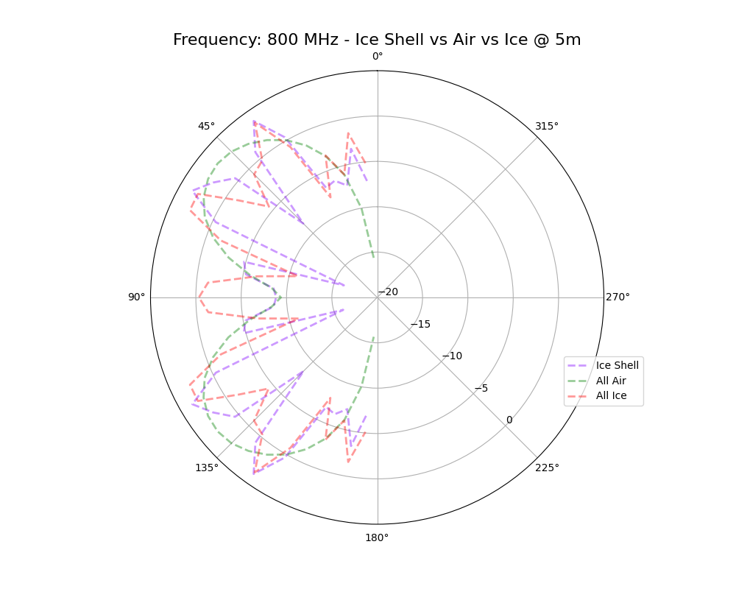
Gain Patterns – Ice vs Air w/ 5 m radii shells
Same conclusions at low frequency (200 MHz).
More noticeable differences at higher frequency, especially at the horizon.

Slide 10
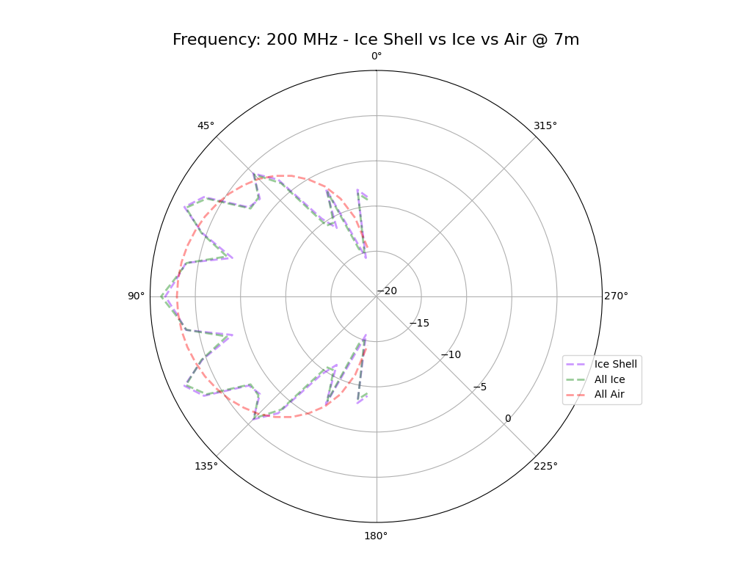
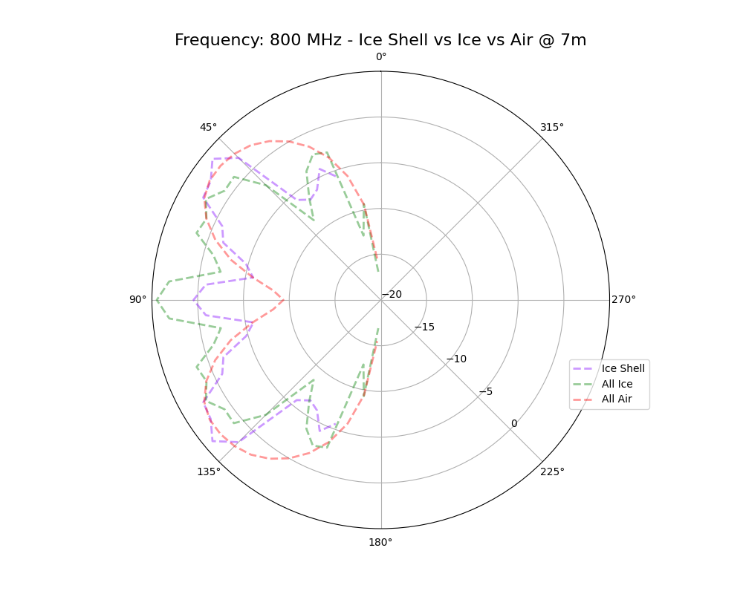
Gain Patterns – Ice vs Air w/ 7 m radii shells

Slide 11
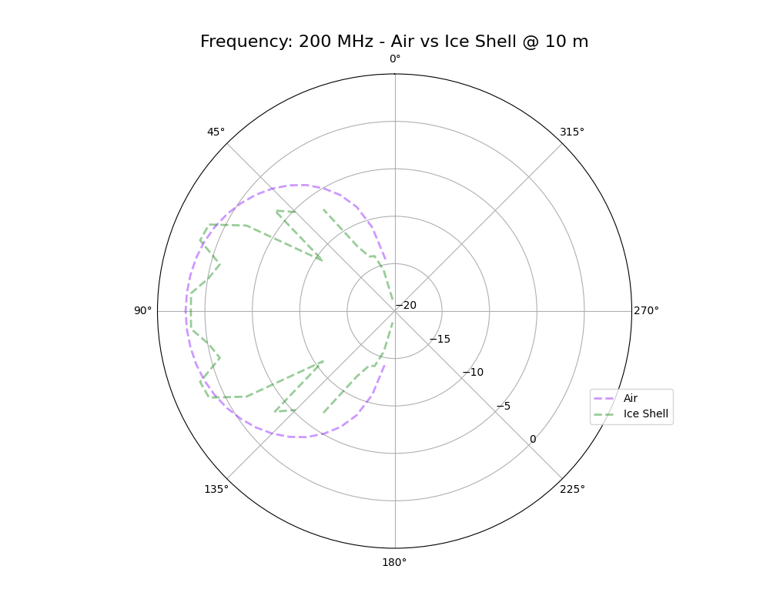
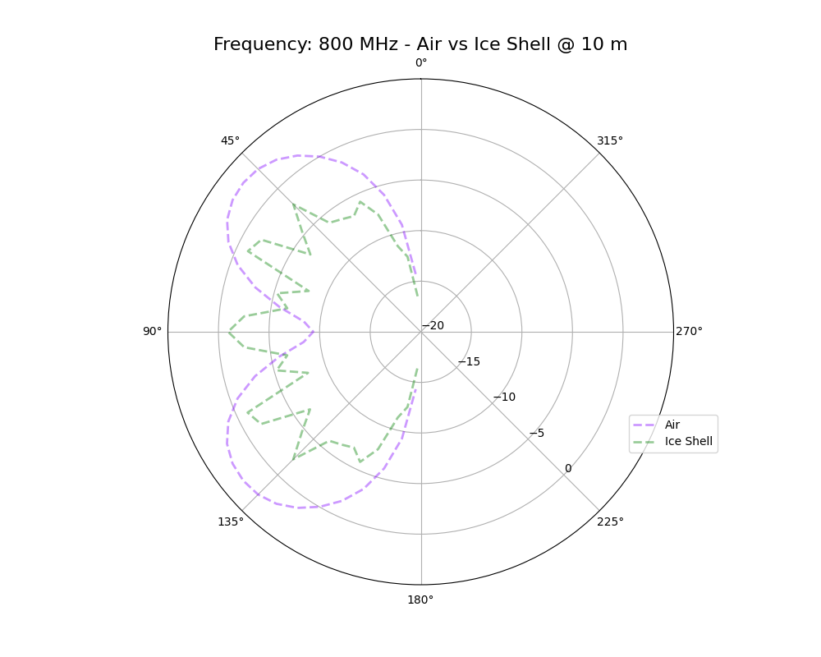
New Slide!
Gain Patterns – Ice vs Air w/ 10 m radii shells

Slide 12
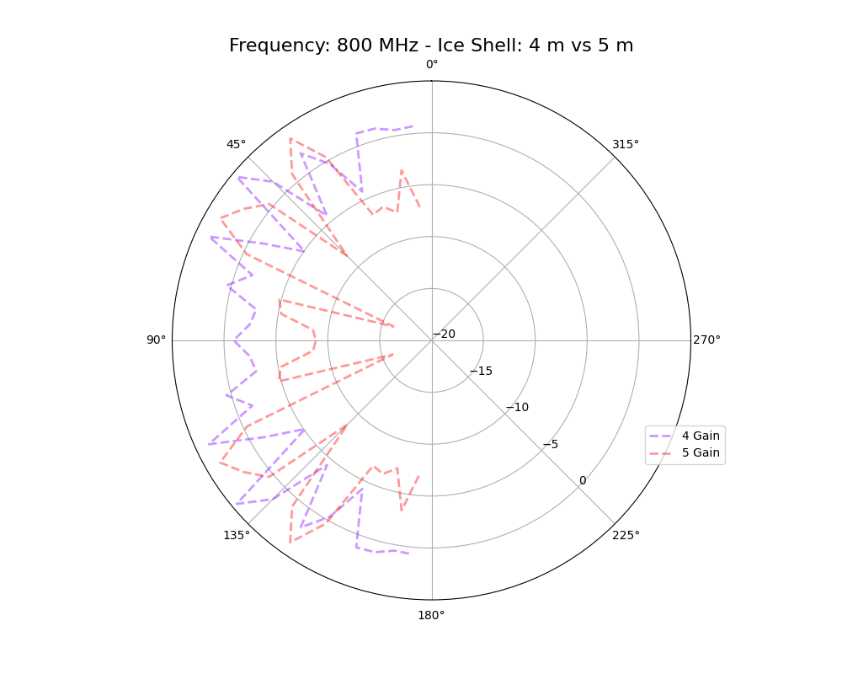
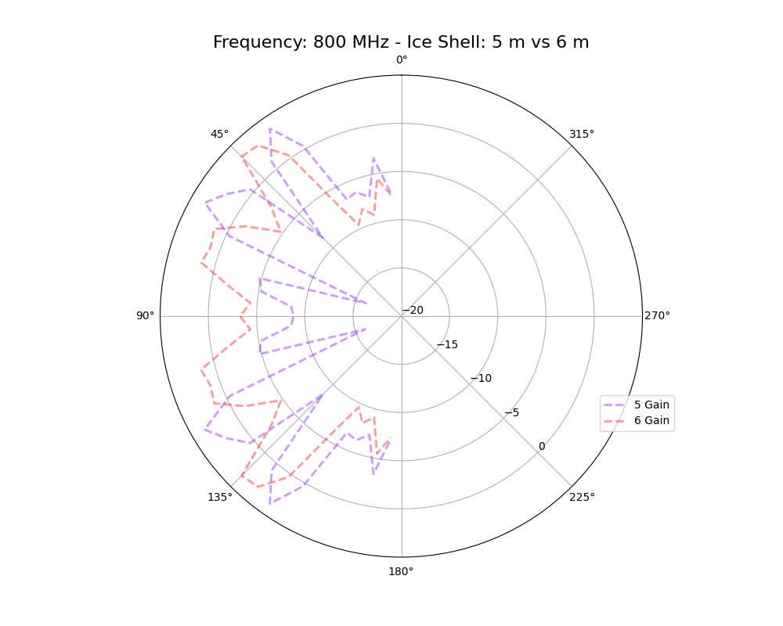
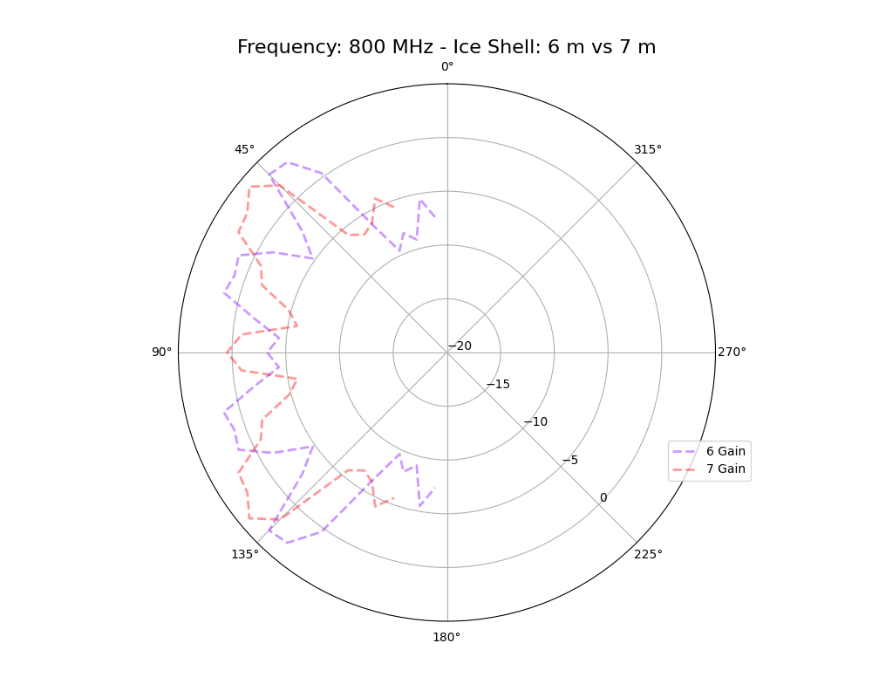
Gain Patterns – Air + Ice Shells w/ different shell radii
@ 800 MHz vs 200 MHz

Slide 13
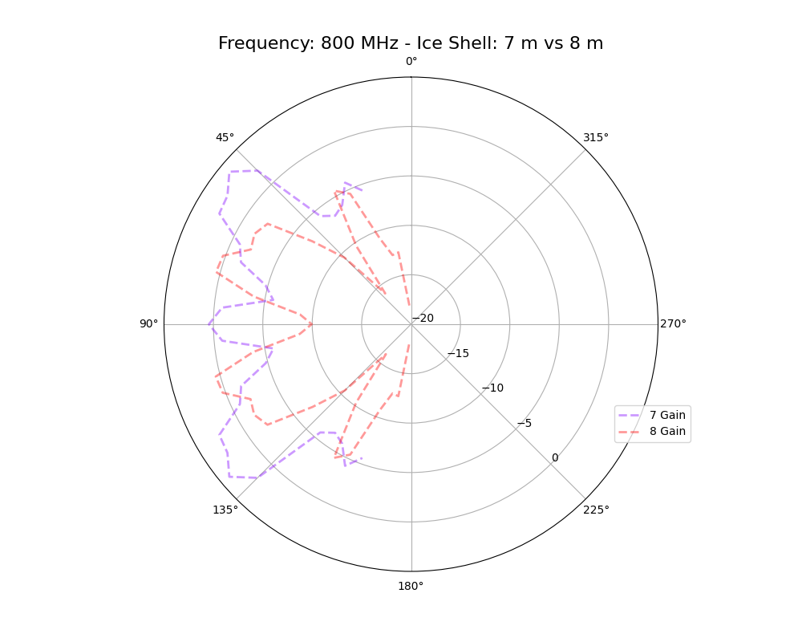
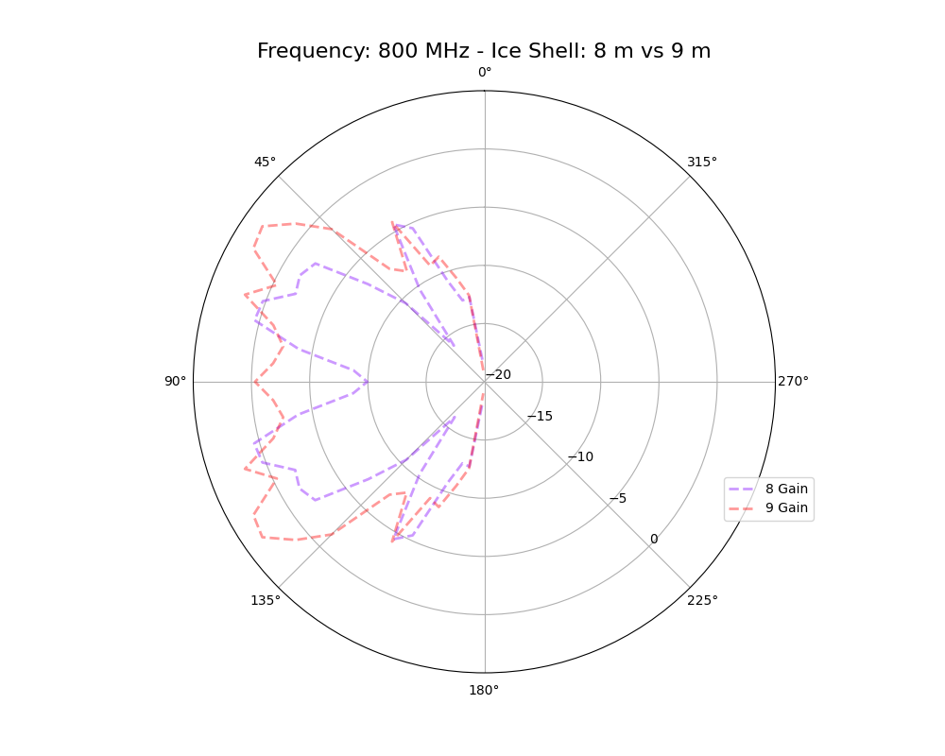
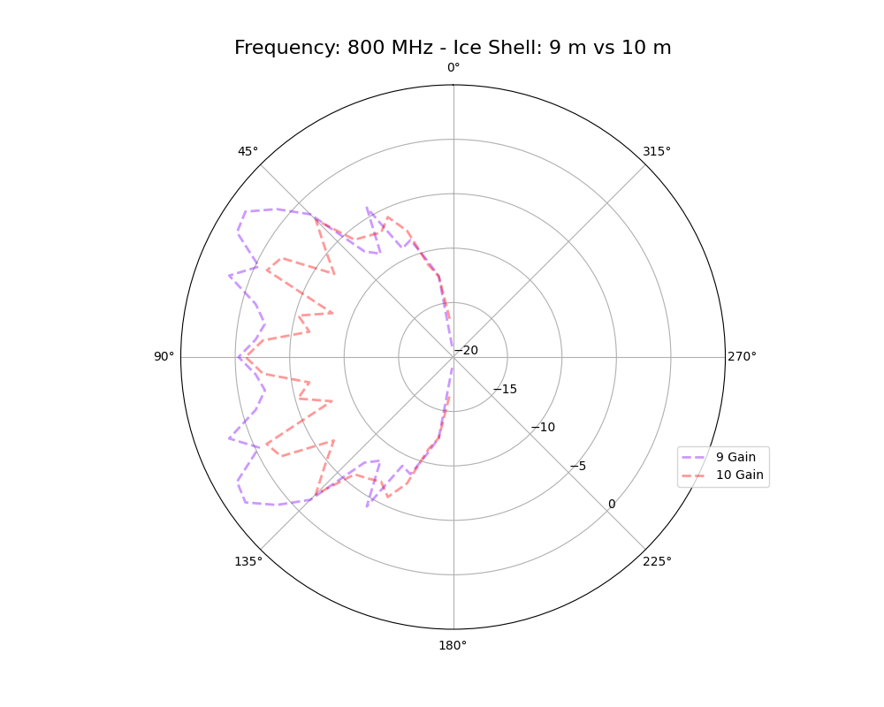
New Slide!
Gain Patterns – Air + Ice Shells w/ different shell radii
@ 800 MHz vs 200 MHz

Slide 14
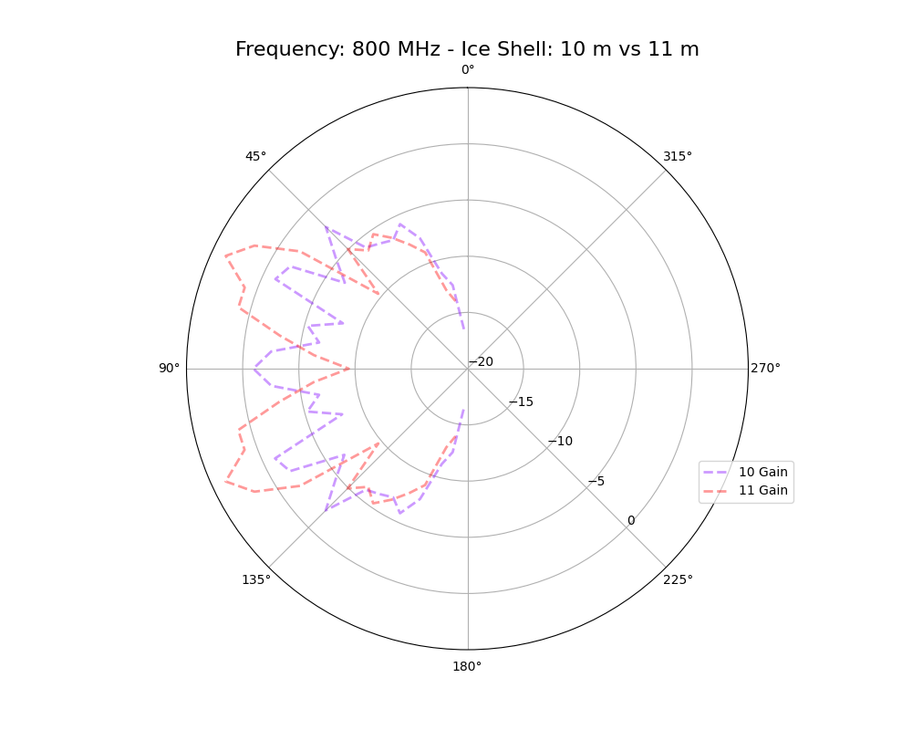
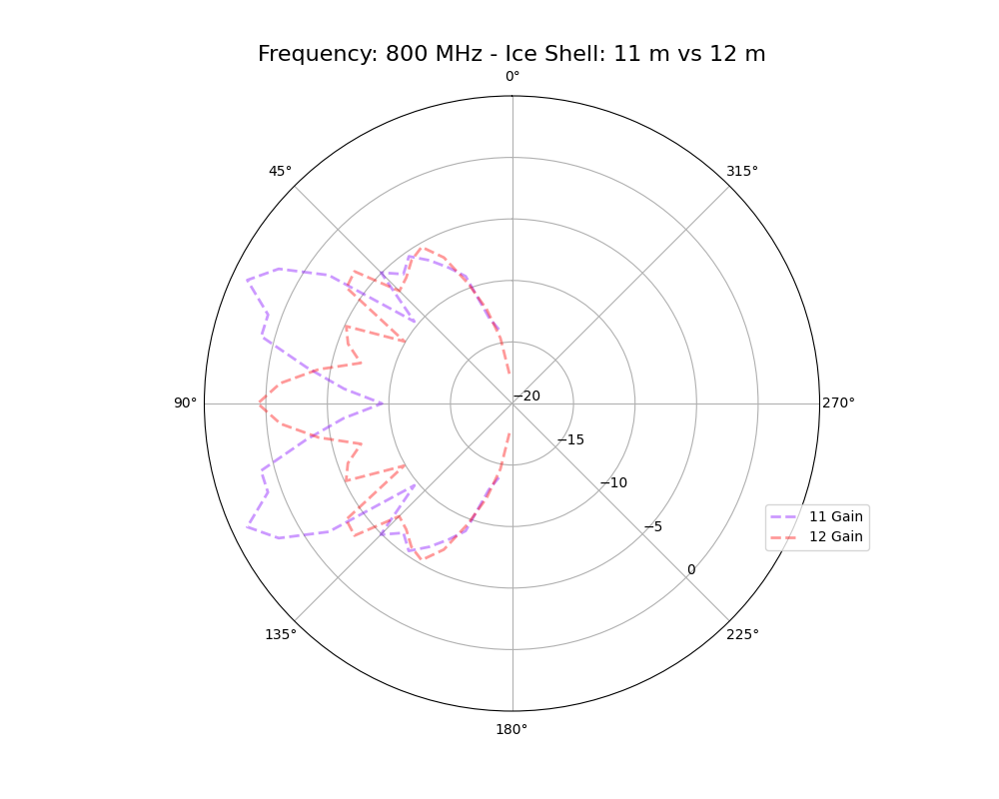
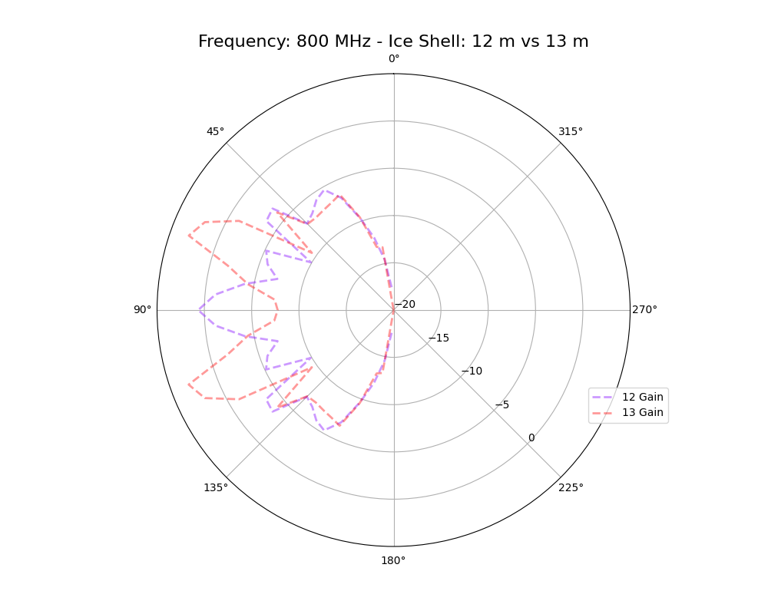
New Slide!
Gain Patterns – Air + Ice Shells w/ different shell radii
@ 800 MHz vs 200 MHz

Slide 15
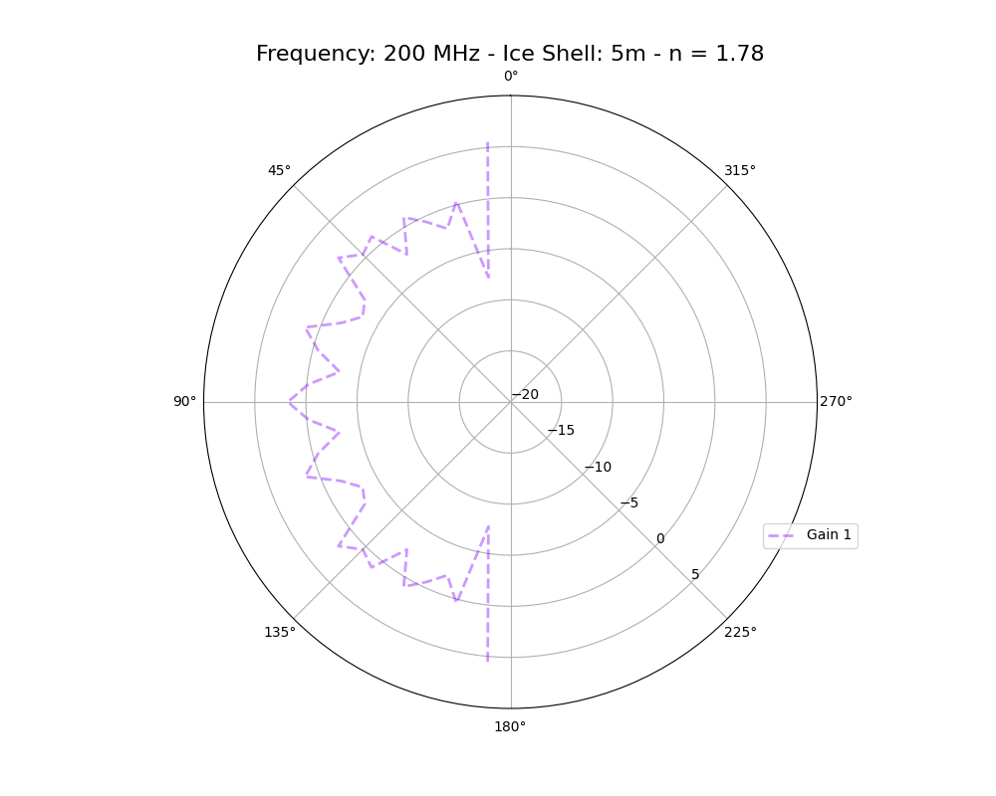
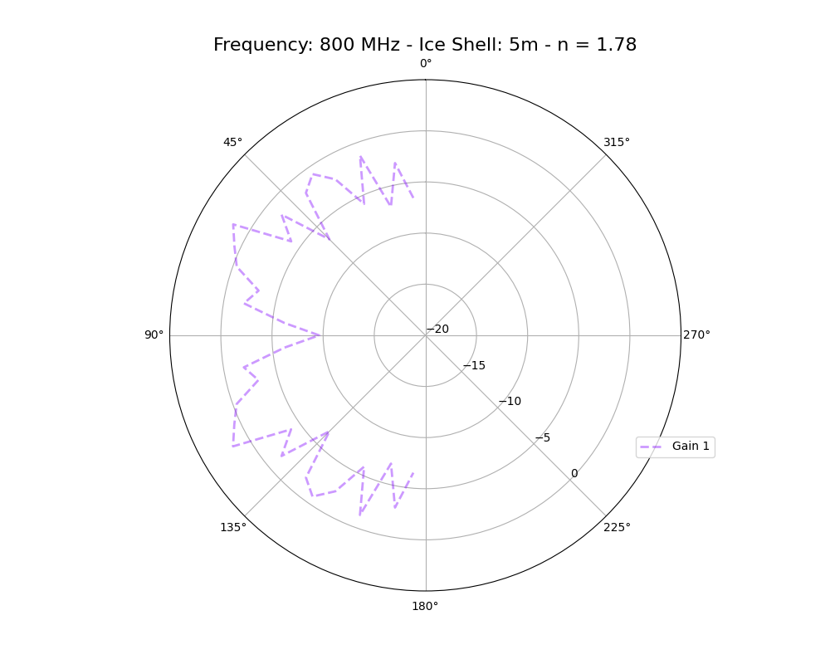
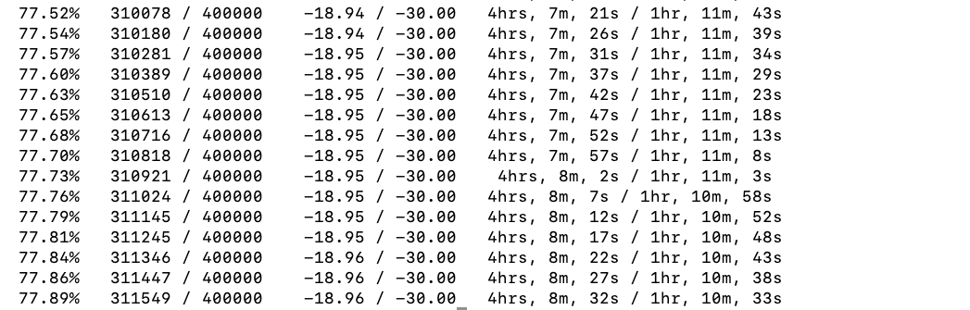


Gain Patterns – Air + Ice Shells - 5 m radii shells w/ n = 1.78 for deep ice (n = 1.5 previously)
Simulation time: 2 hours and 26 minutes.
Largest that has worked out. Radius = 6m, does not converge: larger n, shorther wavelenght, smaller grid size, more computation! I also increased target dB, should I not? Verify possible irrelevance comparing -20 to -30 dB?

Slide 16



VSWR
Similar – Not the same, I checked the numbers

Slide 17


New Slide!
E- Field vs Time (simulations w/ shells of 8 m and 13 m)

Slide 18


New Slide!
E- Field vs Time – Problem? No. There’s only one sensor
How do I get the warning to show up? VDI problem?
Only working for Time 12. Meaning? Met with REMCOM, found the location of the point sensor.
Where do we want a new sensor? Measure E?

Slide 19

New Slide!
Scripting for implementation in GENETIS loop
Work in progress

Slide 20


New Slide!
Problem getting VDI

