Slide 1
Straightened Sides AraSim Results
Jack Tillman

Slide 2
AraSim Results
Antenna Model | Curved Sides | Straightened Sides | Original Bicone | Paper Antenna
Total Events | 2985982 | 3000000 | 3000000 | 3000000
Triggered | 40108 | 36474 | 36510 | 41014
Usable | 40091 | 36459 | 36496 | 40994
Weighted | 16010.76133 | 14367.39220 | 14281.51762 | 15649.63764
Effective Volume | 5.71542 | 5.10482 | 5.07431 | 5.56040
Effective Volume Error | ±0.035 | ±0.028 | ±0.032 | ±0.029

Slide 3
Note: The following plots are of the cosine of the angle of the received radio frequency, theta_rec
Theta_rec results from the conic shower of Askaryan radiation produced by the neutrino in ice
Theta_rec is measured with respect to a vertical axis

Slide 4
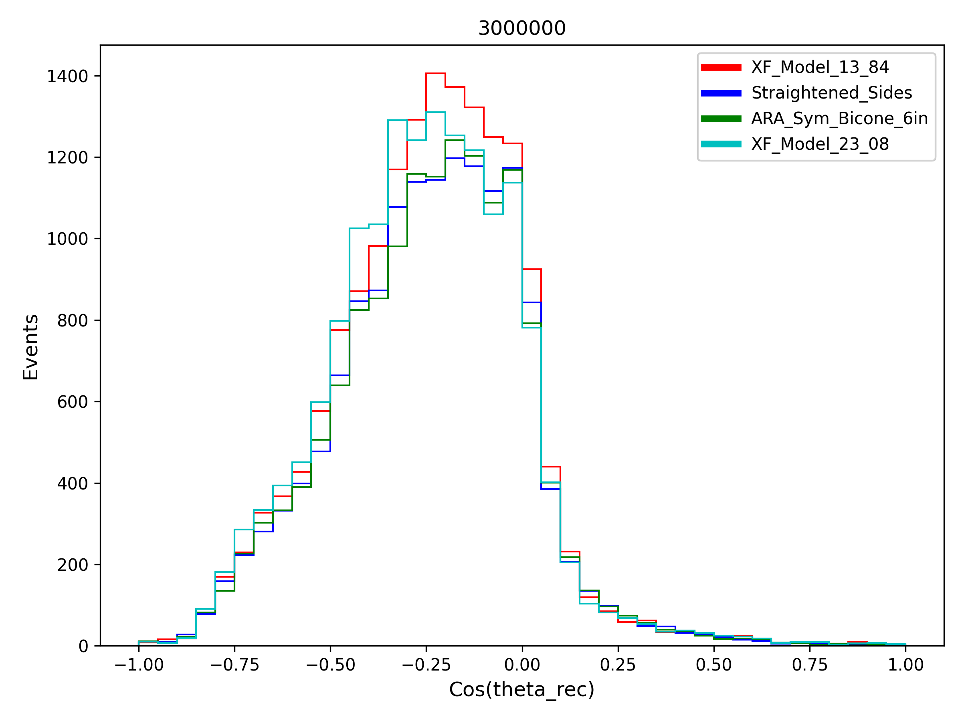

Slide 5
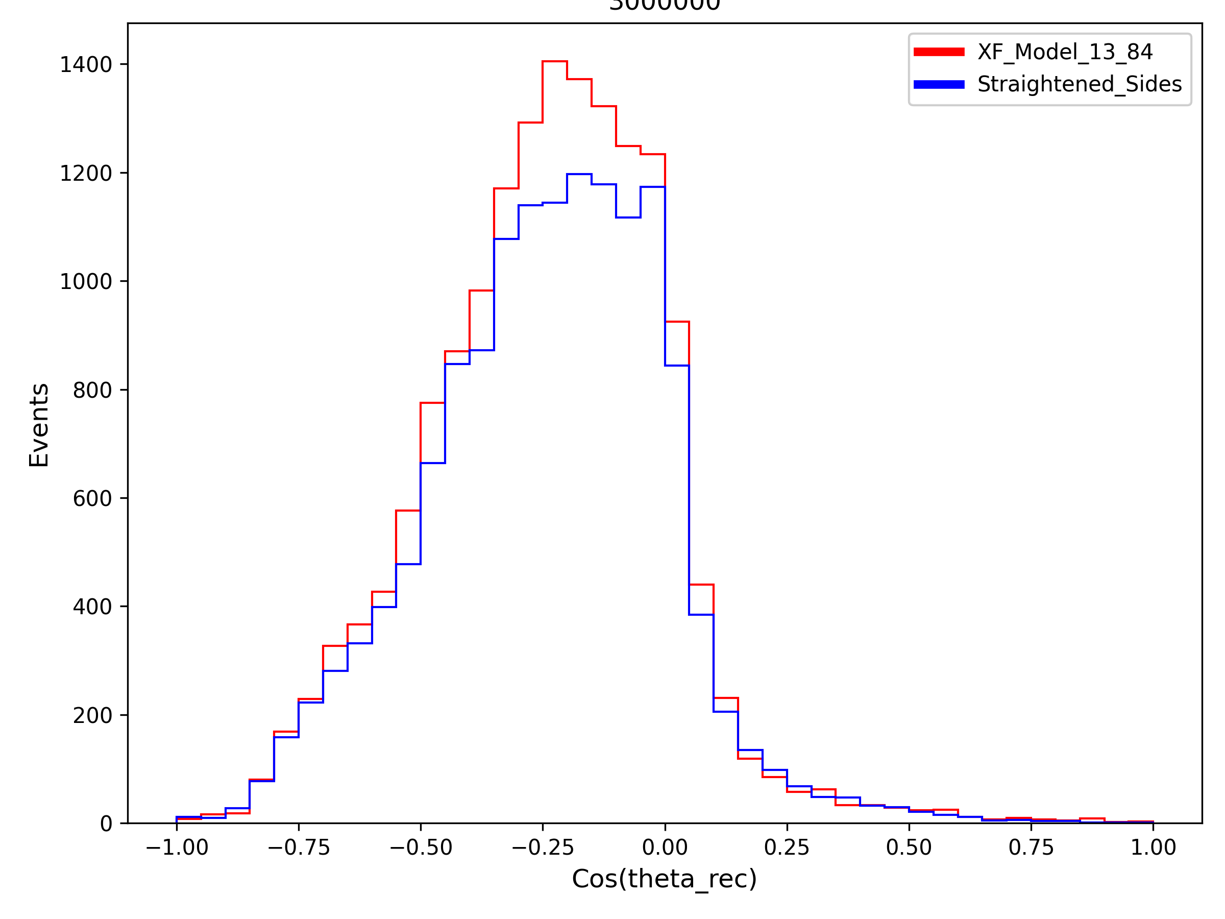

Slide 6
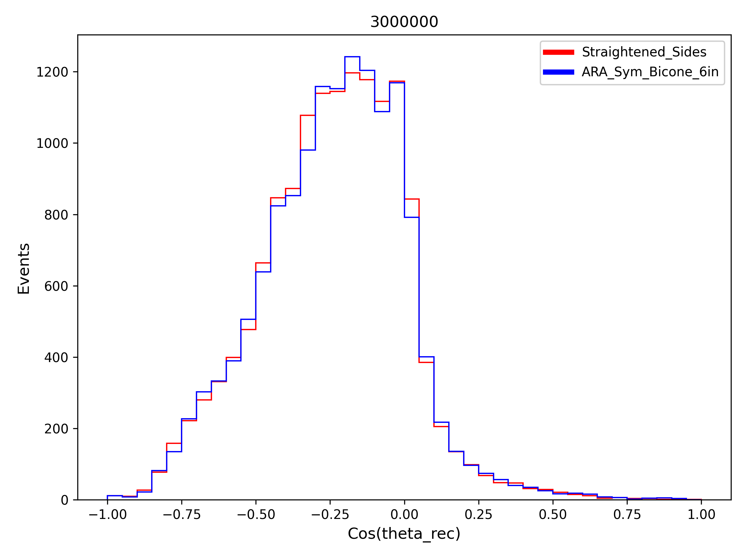

Slide 7
Note: The following plots are of the cosine of the angle of the incoming neutrino, nnu_theta
Nnu_theta represents the angle of the trajectory of the neutrino before interaction when measured with respect to a vertical axis

Slide 8
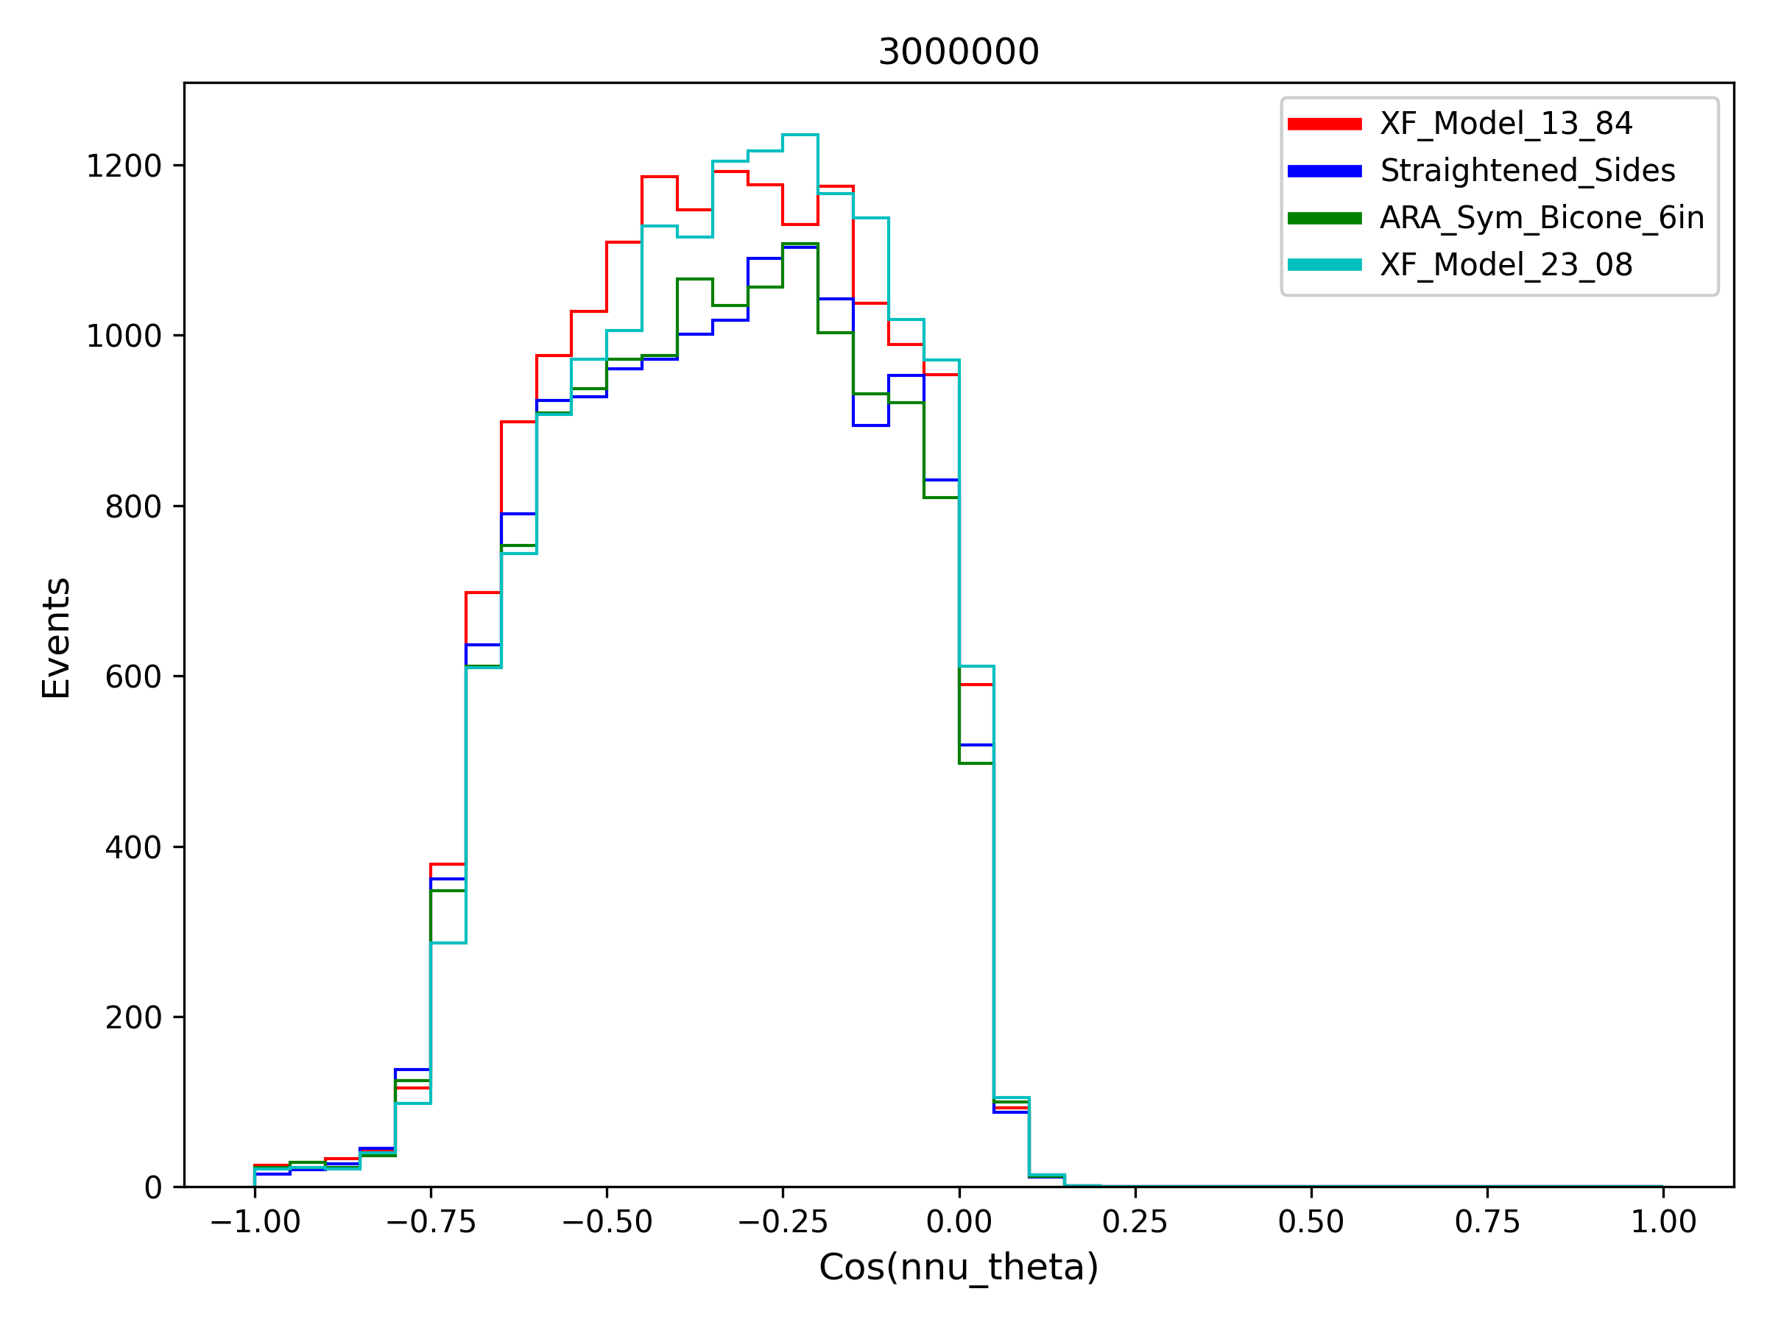

Slide 9
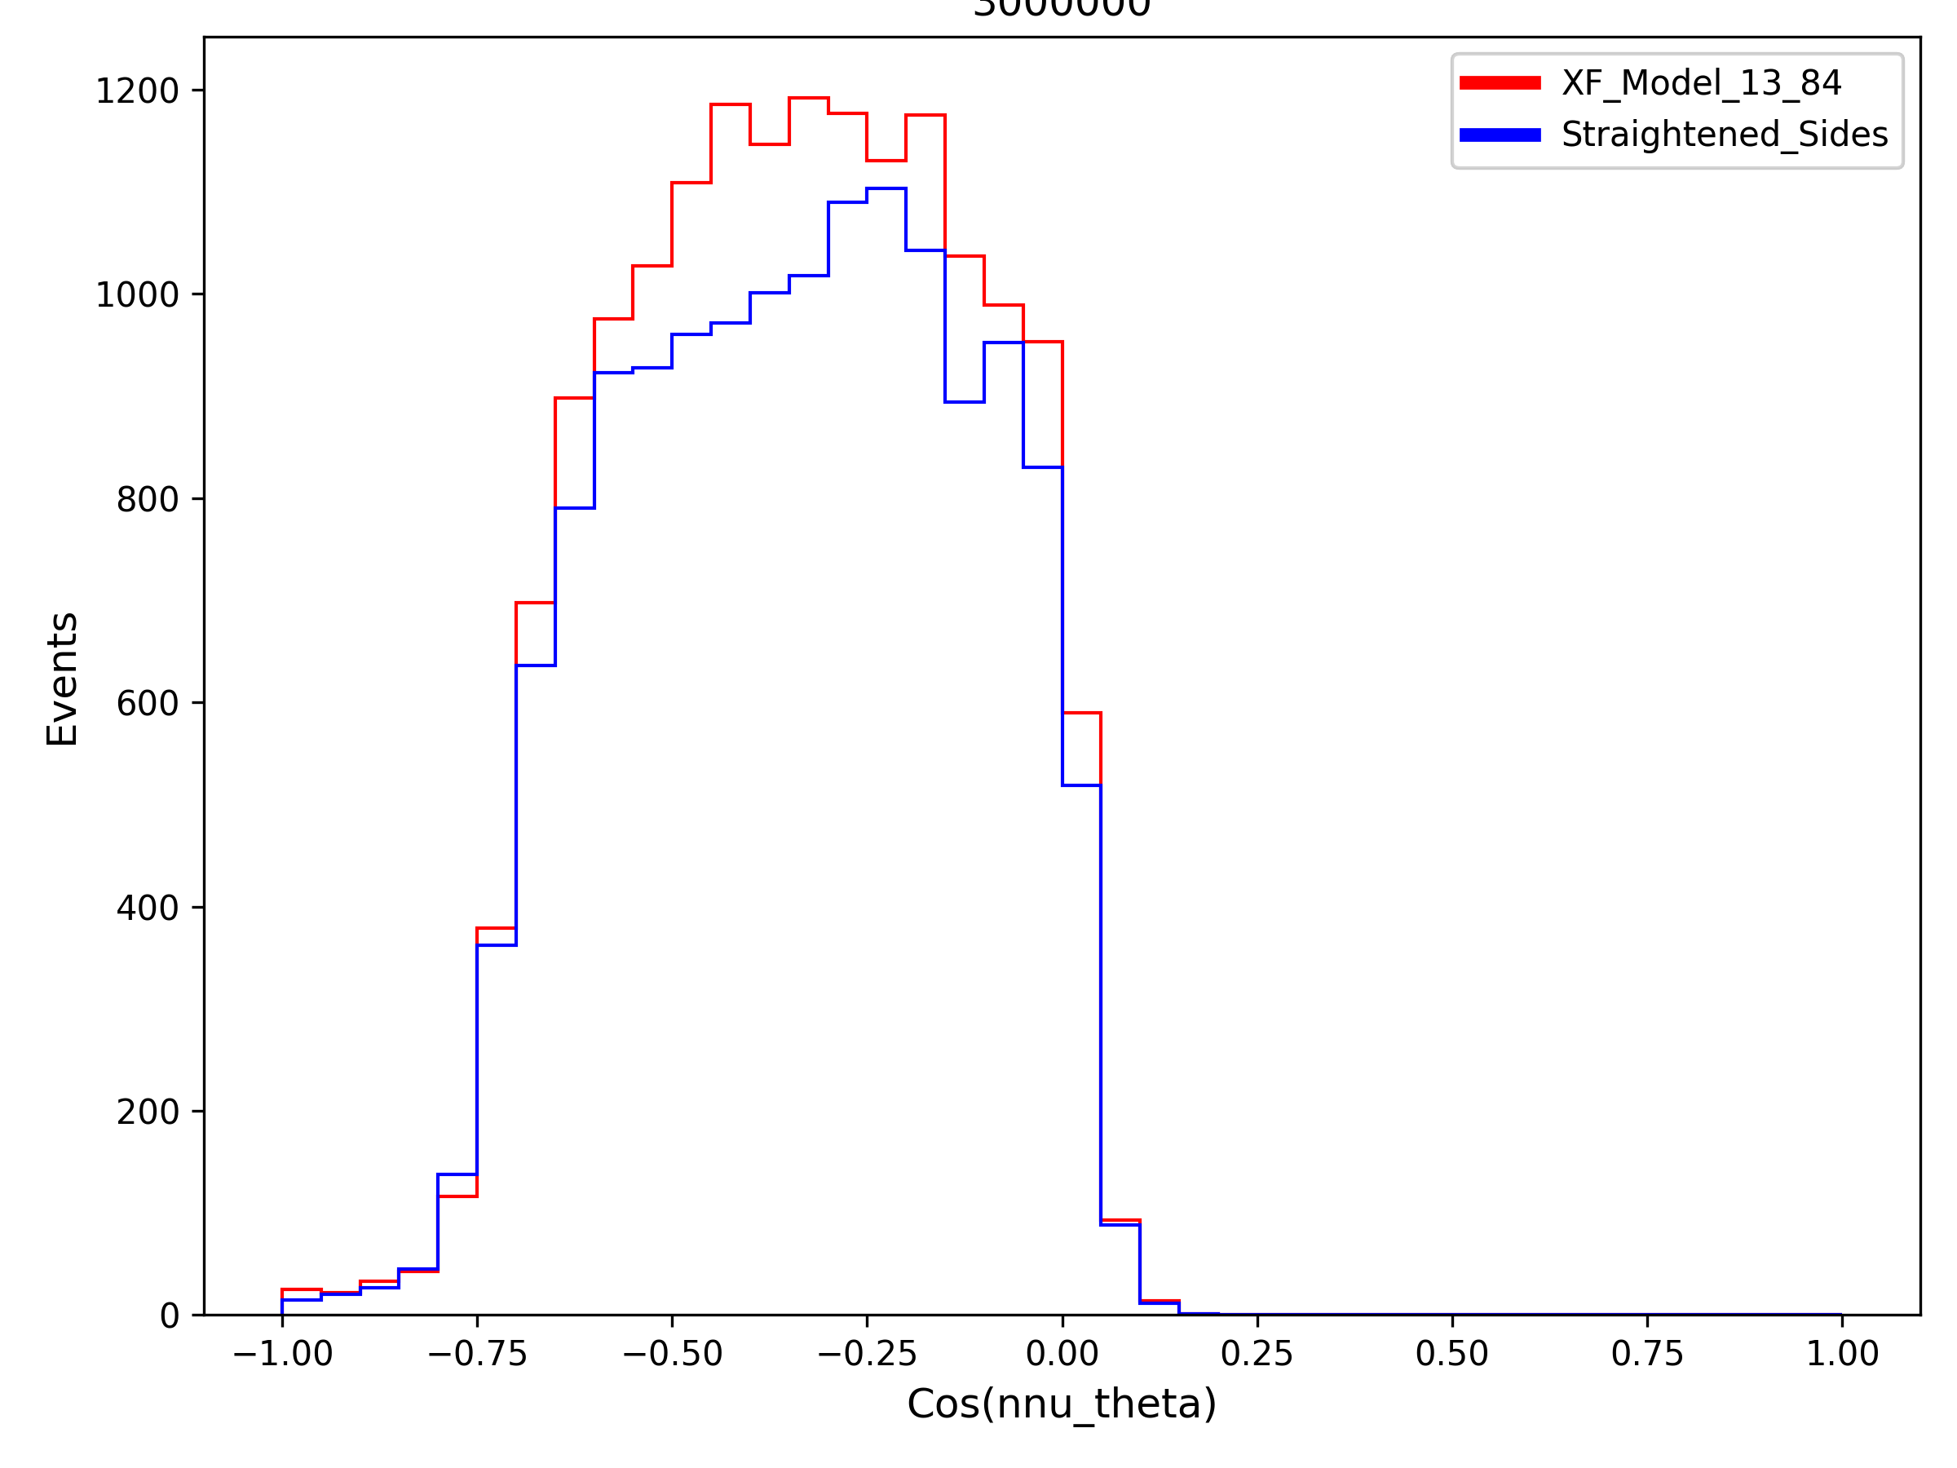

Slide 10
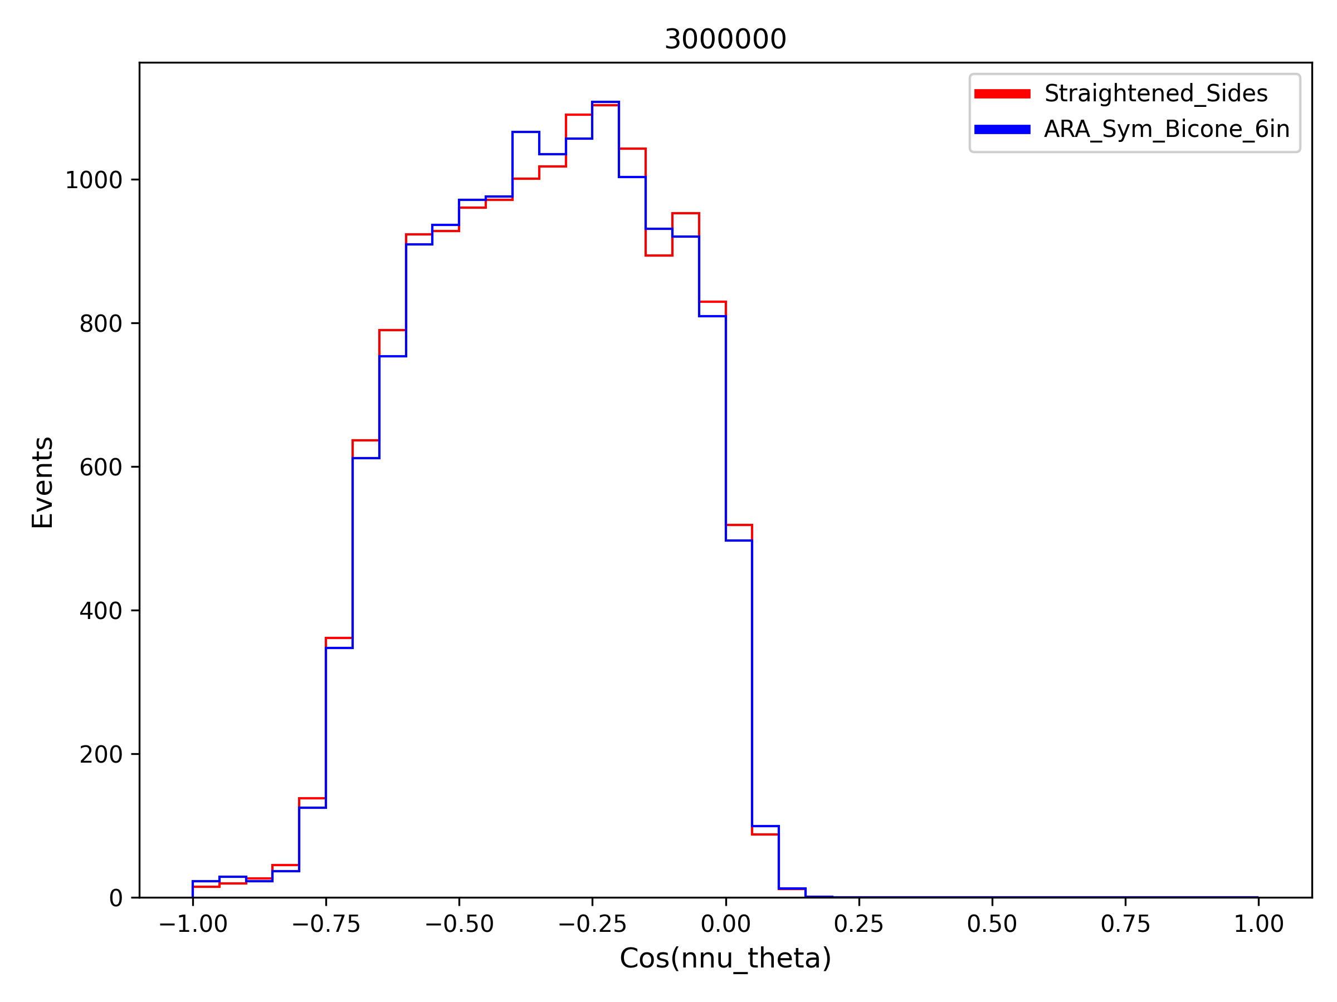

Slide 11
Note: The following plots are beam patterns for the straightened sides antenna
In these plots, 0 degrees is on the right and refers to pointing directly up when the antenna is oriented correctly

Slide 12
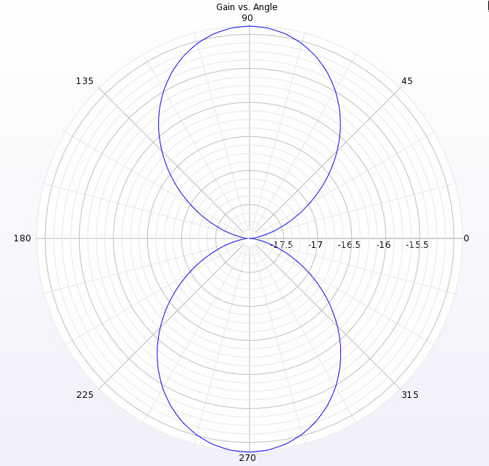
100 MHz Beam Pattern

Slide 13
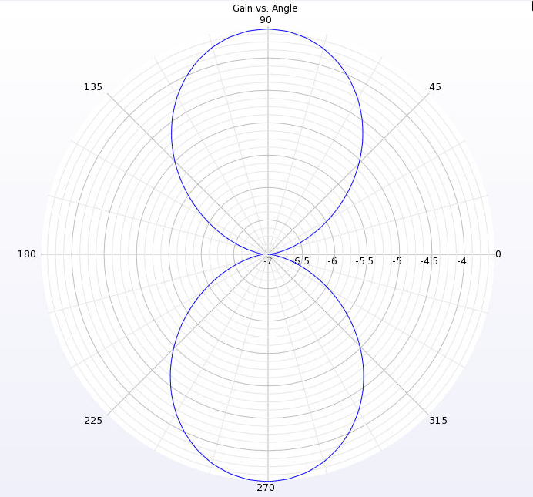
200 MHz Beam Pattern

Slide 14
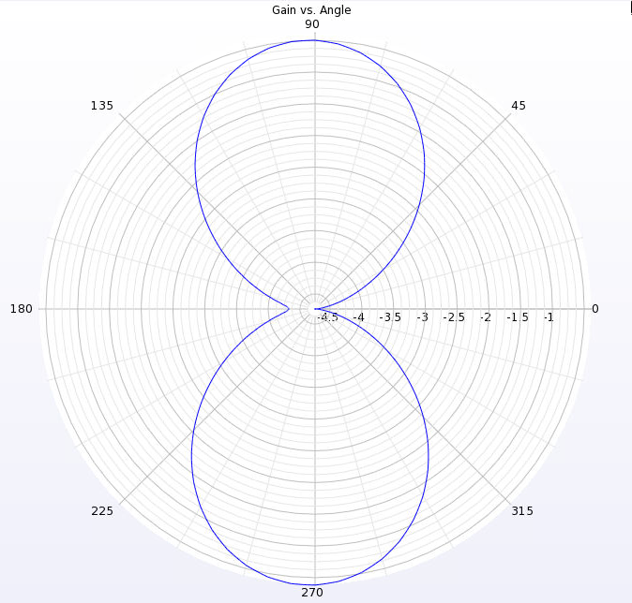
300 MHz Beam Pattern

Slide 15
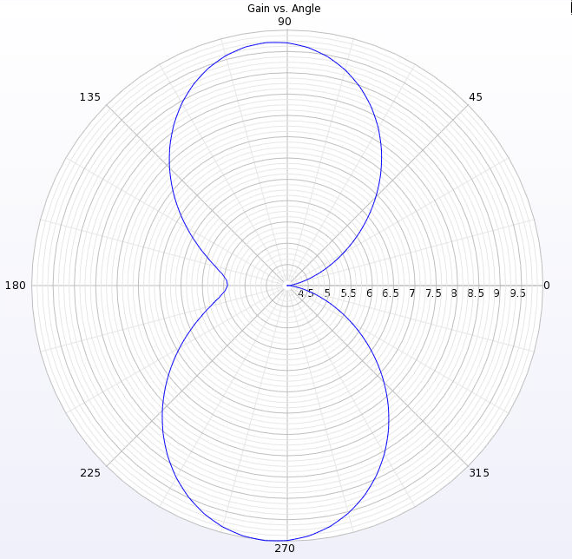
400 MHz Beam Pattern

Slide 16
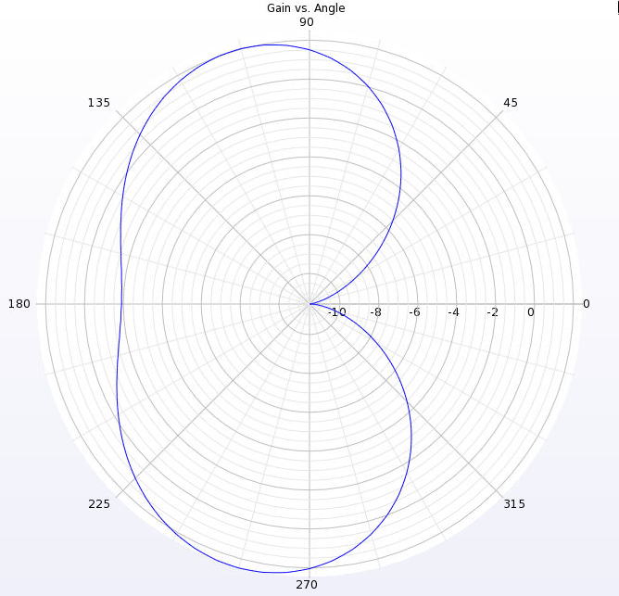
500 MHz Beam Pattern

Slide 17
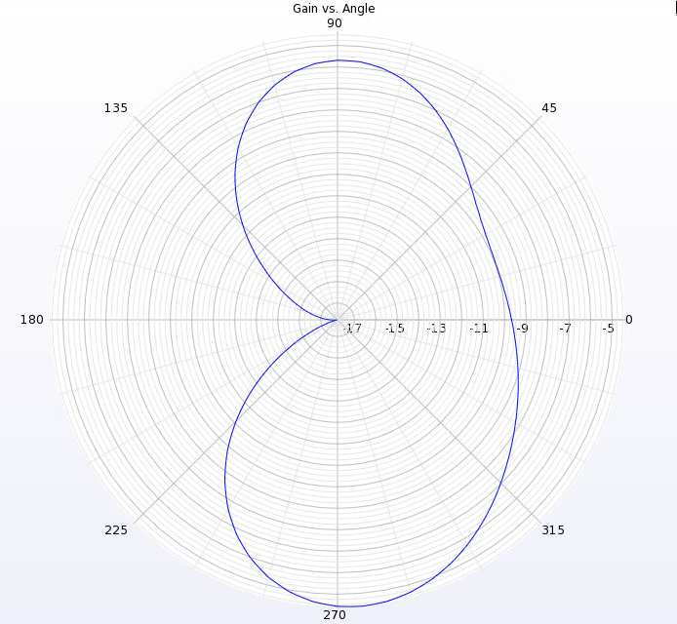
600 MHz Beam Pattern

Slide 18
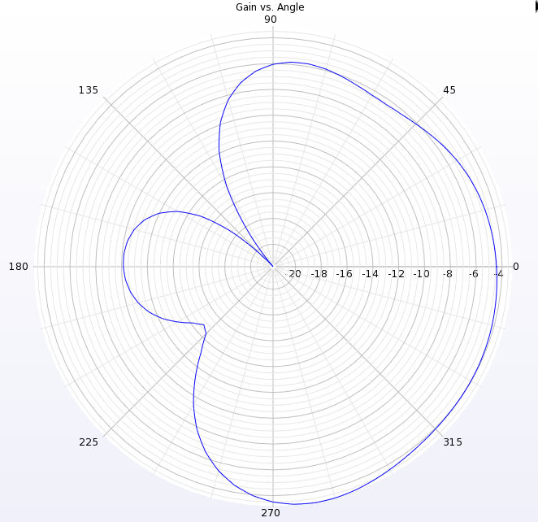
700 MHz Beam Pattern

Slide 19
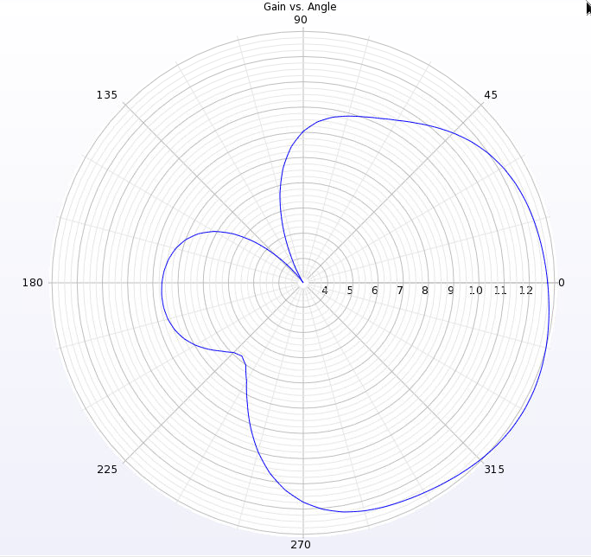
800 MHz Beam Pattern

Slide 20
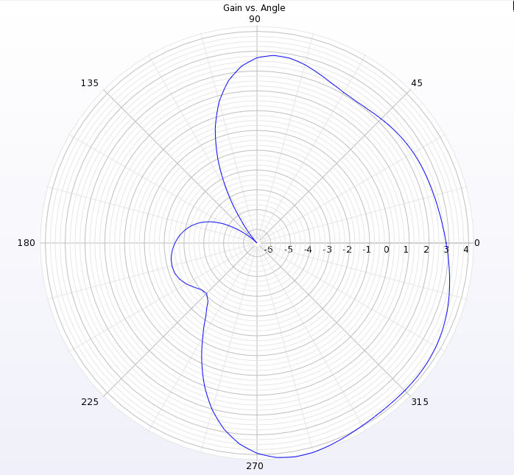
900 MHz Beam Pattern

Slide 21
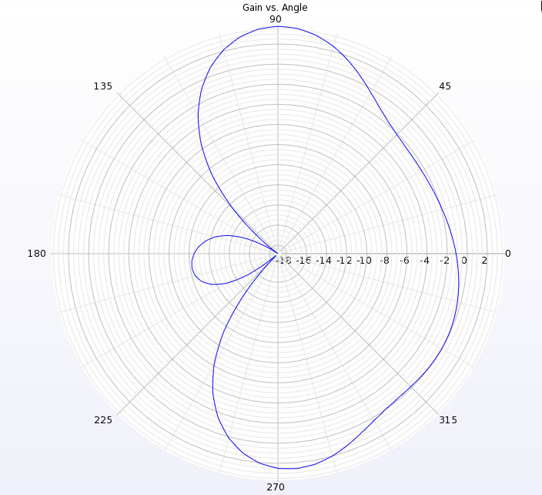
1 GHz Beam Pattern

