Slide 1
Getting Started with ANITA
Brian Clark
Last Updated: May 15, 2019

Slide 2
Step 0: Get Familiar with the Command Line
All of our work will be done on computing clusters
To interact with the computing cluster, we will need to use the command line
It will allow us to go inside files, delete them, make new ones, run programs, etc.
Follow this link to learn how to use it: https://www.codecademy.com/learn/learn-the-command-line

Slide 3
Step 1: Get an OSC Account
For the time being, lets start by having you all do your work on the computing cluster known as ”owens”
It is maintained by the Ohio Supercomputer Center
Ask Amy to get an account

Slide 4
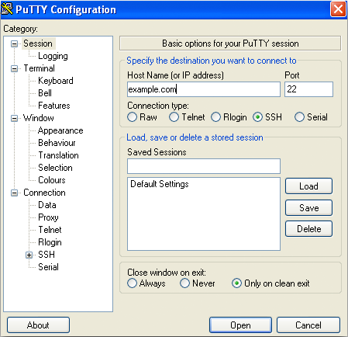
Step 2: Log-In
Okay, now to log in!
On a Linux or Mac:
Open the terminal, and type “ssh name.#@owens.osc. edu”
It might ask you to agree to an SSH security token; say yes
Then enter your password
On a PC:
You will need to download and install an ssh tunneling client
The easiest is one called “putty”: https://www.putty.org/
Install putty, and then open it:
For “Host Name”, put “owens.osc. edu”
For Port choose “22”
For “Connection type” choose “SSH”
Click “Open”
You will then enter your name and password

Slide 5
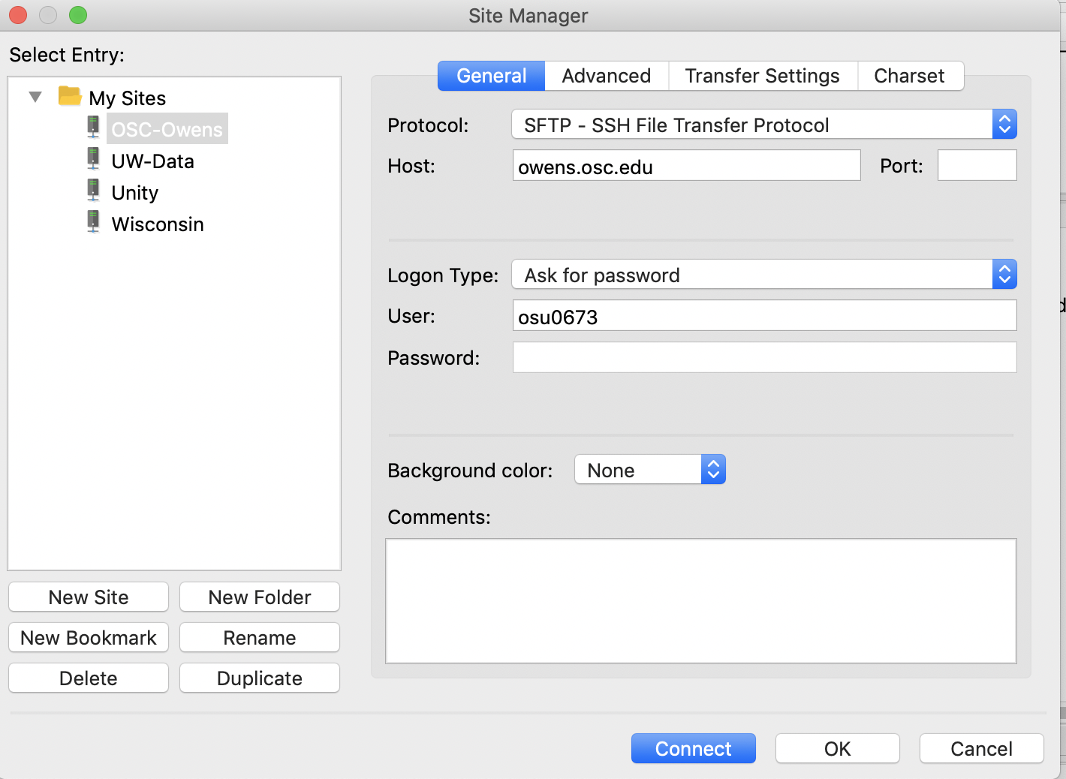
Step 3: Learn How to Transfer Files
Throughout your time working on any supercomputer, you’ll need to transfer files
The easiest way to transfer files is by using a file transfer client
I recommend Filezilla: https://filezilla-project.org/
Download and install it
Then launch it
Click “New Site”
Under “Protocol” select “SFTP”
Under “Host” put “owens.osc.edu”
Under “Logon Type” put “Ask for password”
Under “User” put “yourusername”
Then click “connect”

Slide 6
Step 3: Pt 2
The way FileZilla works is very straightforward
The left panel of your screen is your computer
The right panel of the screen is the remote machine
To transfer files you literally drag them from one screen to the next
That’s it
Here are some nice tutorial:
https://www.youtube.com/watch?v=rUNQphoGVwQ
https://www.youtube.com/watch?v=adxmlHDim6c

Slide 7
Step 4: Download a copy of icemc
To download a copy of icemc we are going to use a piece of software called “git”
This is what’s known as a version control system, which allows developers to track how a piece of code evolves
We won’t use that feature for a while; for now, we’re just gonna use it to access the ANITA Code
Download icemc:
git clone https://github.com/anitaNeutrino/icemc

Slide 8
Step 5: Set Up Your Shell Environment
Your shell environment defines variables you want to use
First, put the files “bashrc_anita.sh” into your home directory.
Open your ”.bashrc” file and copy the contents of “sample_bashrc.sh” into it. Do the same with “.bash_profile”.
I’m having you do this because it will source several pieces of software you will need (like ROOT) that I’ve already installed for you to save time
Make sure to update the variables “ICEMC_SRC_DIR” and “ICEMC_BUILD_DIR” in your .bashrc to wherever you downloaded icemc to in the previous slide

Slide 9
Step 6: Compile icemc
Next go inside the icemc directory by typing: cd icemc
Then build by typing “make”
If the make fails, you should follow the instructions on https://github.com/anitaNeutrino/icemc#getting-icemc

Slide 10
Step 7a: Fix a few things
Make an “outputs” directory (mkdir outputs)
Open the “inputs.anita.3.conf” file, and scroll down to the lines with “Digitizer path impulse response” and “Trigger path impulse response” and change the “1” after those lines to “0”
Scroll further down to the lines “Digitizer noise from flight” and “Trigger noise from flight” and change the “1” after those lines to “0” also
Because these instructions circumvent the installation of the anitaBuildTool (which real impulse response and noise requires) we have to disable those features

Slide 11
Step 7b: Fix a few more things
Go into the icemc directory, and open the Makefile
Go down near line 19 and 20, and comment out (put a “#” in front of) the lines that say ANITA3_EVENTREADER and ANITA3_EVENTCORRELATOR”

Slide 12
Step 8: Test Run icemc
Now, we’ll make our first set of simulated results!
Now, execute the command “./icemc –i inputs.anita3.conf -o outputs/ -n 50000”
This will simulate 50,000 neutrinos
See if it execute successfully; also, you should check the outputs directory for a bunch of new files
If it did, well done!

Slide 13
Step 9: Make your First Plot
Okay, now that we have data, we can make our first plot!
Move the following two files into your icemc directory:
“test_plot.mk: the makefile, which tells the computer how to put together your code
“test_plot.cc”: the code to be put together
Run ”make –f test_plot.mk” (the –f says “use this file”)
Then, execute the plot making code: “./test_plot outputs/icefinal.root”
This will produce a plot! Revel in your brilliance.
You should actually read “test_plot.cc” very carefully to understand everything it’s doing (the explanations are in the comments)

