Slide 1
Getting Started with ARA
Brian Clark
Last Updated: May 15, 2019

Slide 2
Step 0: Get Familiar with the Command Line
All of our work will be done on computing clusters
To interact with the computing cluster, we will need to use the command line
It will allow us to go inside files, delete them, make new ones, run programs, etc.
Follow this link to learn how to use it: https://www.codecademy.com/learn/learn-the-command-line

Slide 3
Step 1: Get an OSC Account
For the time being, lets start by having you all do your work on the computing cluster known as ”owens”
It is maintained by the Ohio Supercomputer Center
Ask Amy to get an account

Slide 4
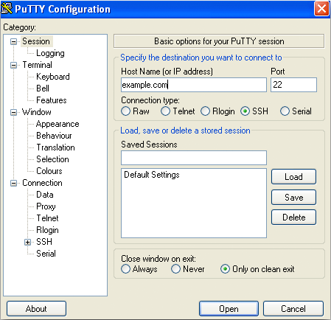
Step 2: Log-In
Okay, now to log in!
On a Linux or Mac:
  Open the terminal, and type “ssh name.#@owens.osc. edu”
  It might ask you to agree to an SSH security token; say yes
  Then enter your password
On a PC:
  You will need to download and install an ssh tunneling client
  The easiest is one called “putty”: https://www.putty.org/
  Install putty, and then open it:
    For “Host Name”, put “owens.osc. edu”
    For Port choose “22”
    For “Connection type” choose “SSH”
    Click “Open”
    You will then enter your name and password

Slide 5
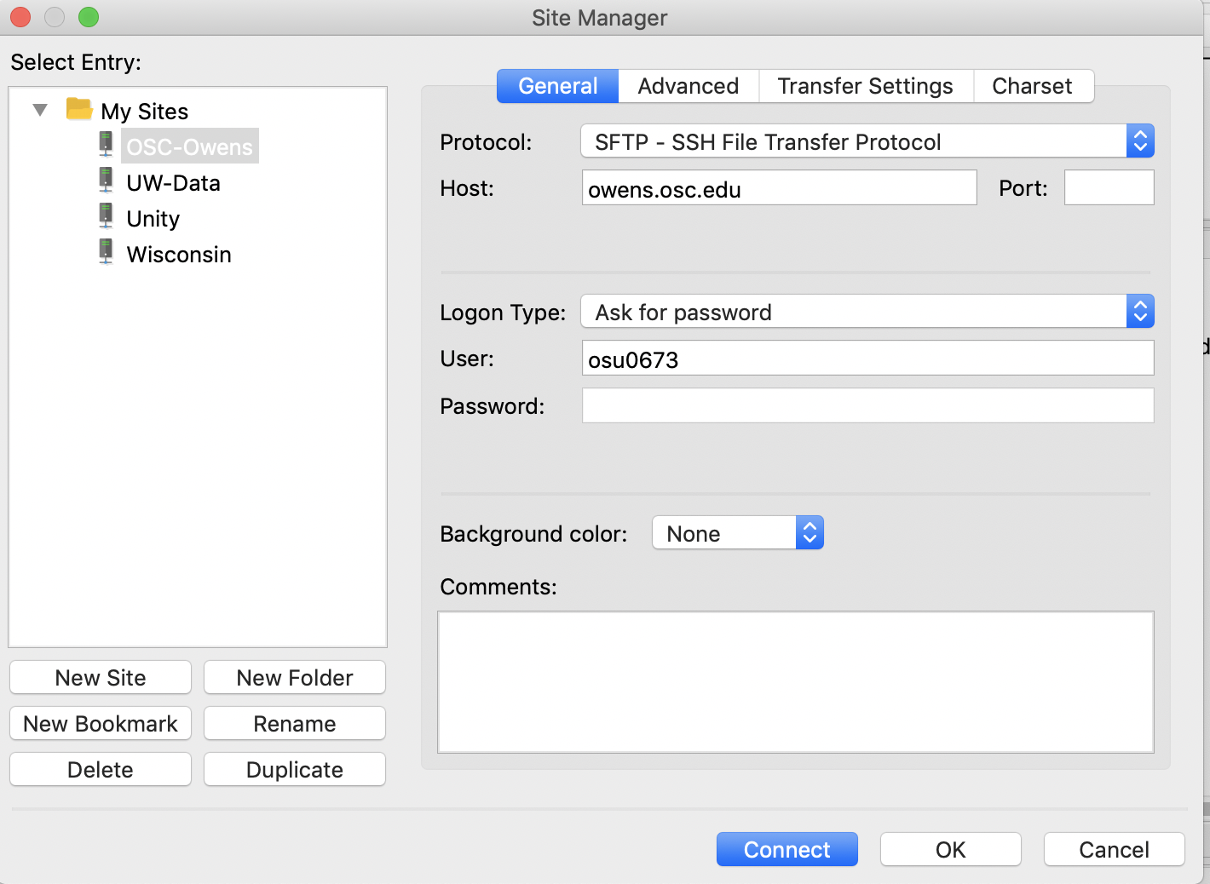
Step 3: Learn How to Transfer Files
Throughout your time working on any supercomputer, you’ll need to transfer files
The easiest way to transfer files is by using a file transfer client
I recommend Filezilla: https://filezilla-project.org/
Download and install it
Then launch it
Click “New Site”
  Under “Protocol” select “SFTP”
  Under “Host” put “owens.osc.edu”
  Under “Logon Type” put “Ask for password”
  Under “User” put “yourusername”
  Then click “connect”

Slide 6
Step 3: Pt 2
The way FileZilla works is very straightforward
The left panel of your screen is your computer
The right panel of the screen is the remote machine
To transfer files you literally drag them from one screen to the next
That’s it
Here are some nice tutorial:
  https://www.youtube.com/watch?v=rUNQphoGVwQ
  https://www.youtube.com/watch?v=adxmlHDim6c

Slide 7
Step 4: Download a copy of AraSim
To download a copy of icemc we are going to use a piece of software called “git”
This is what’s known as a version control system, which allows developers to track how a piece of code evolves
We won’t use that feature for a while; for now, we’re just gonna use it to access the ARA Code
Download icemc:
  git clone https://github.com/ara-software/AraSim

Slide 8
Step 5: Set Up Your Shell Environment
Your shell environment defines variables you want to use
First, put the files “bashrc_anita.sh” into your home directory. Yes, I know this says it’s for ANITA—but I’ve designed it work for both!
Open your ”.bashrc” file and copy the contents of “sample_bashrc.sh” into it. Do the same with “.bash_profile”.
I’m having you do this because it will source several pieces of software you will need (like ROOT) that I’ve already installed for you to save time

Slide 9
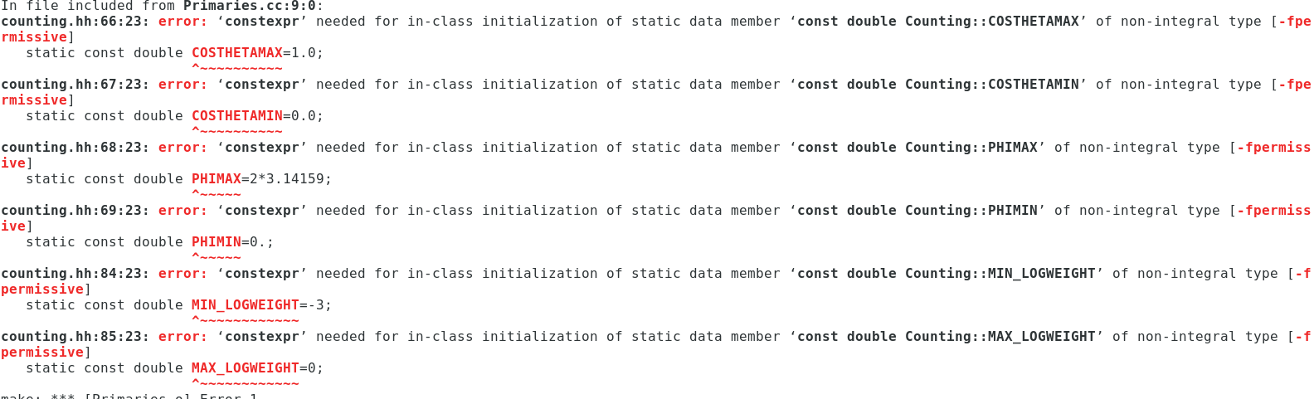
Step 6: Compile AraSim
Next go inside the AraSim directory by typing: cd AraSim
Then build by typing “make”
The make will almost certainly fail with errors that look like this

Slide 10
Step 7a: Fix constexpr issue
We need to make a change to AraSim to let it compile with C++11 and ROOT6
Open the counting.hh file, and uncomment (remove the “//”) all the lines that say “constexpr static const double” and comment out (add the “//”) to all the lines without it
Do this for all variables causing problems—there should be ~6
Uncomment these lines
Comment out these

Slide 11
Step 8: Test Run icemc
Now we’ll run a basic test of AraSim
First, move the file “test_setup.txt” into your AraSim directory
Now, execute the command “./AraSim test_setup.txt”
  This will simualte 100 neutrinos at the energy of 10²¹ eV
See if it executes successfully; also, you should check the outputs directory for a file called AraOut.root
If it did, well done!

Slide 12
Step 9: Make your First Plot
Okay, now that we have data, we can make our first plot!
Move the following two files into your AraSim/trunk directory:
  “plotting_example.mk”: the makefile, which tells the computer how to put together your code
  “plotting_example.cc”: the code to be put together
Run ”make –f plotting_example.mk” (the –f says “use this file”)
Then, execute the plot making code: “./plotting_example outputs/AraOut.root”
This will produce a plot! Revel in your brilliance.
Put your result in our Dropbox folder, under Daily Updates, in a folder with the date and your name.
You should actually read “plotting_example.cc” very carefully to understand everything it’s doing (the explanations are in the comments)

