Slide 1
IceCube/ARA Coincident Simulation Events Analysis
Alan Salcedo G
Department of Physics

Slide 2
Coincident Events
Provided the events are detected by ARA, we can have:
Coincident $ν_{e}:$ have to interact inside of IceCube.
Coincident $ν_{μ}:$ $can interact inside or outside of IceCube$.
Coincident ${ ν}_{τ}$: can interact inside or outside of IceCube (if outside, take into account tau decay).
Notes:
Add references on the bottom of figures.

Slide 3








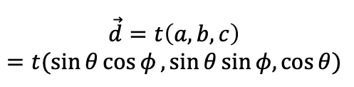


Geometry of Coincident $ν_{μ}$
$$ARA$$
$$IceCube$$
$$R$$
$$(a_{0}, b_{0}, c_{0})$$
$$ν_{μ}$$
$$(x,y,z)$$
$$\vec{d}=t\left(a, b, c\right)$$
$$=t(\sin{θ}\cos{φ},\sin{θ\sin{φ,\cos{θ)}}}$$
At the walls IceCube:
$${\left(x−x_{0}\right)}^{2}+{\left(y −y_{0}\right)}^{2}=R^{2}$$
where
$$x=a_{0}+at$$ $$y=b_{0}+bt$$
$$(x_{0}, y_{0}, z_{0})$$
$$μ^{−}$$
Notes:
Add references on the bottom of figures.

Slide 4

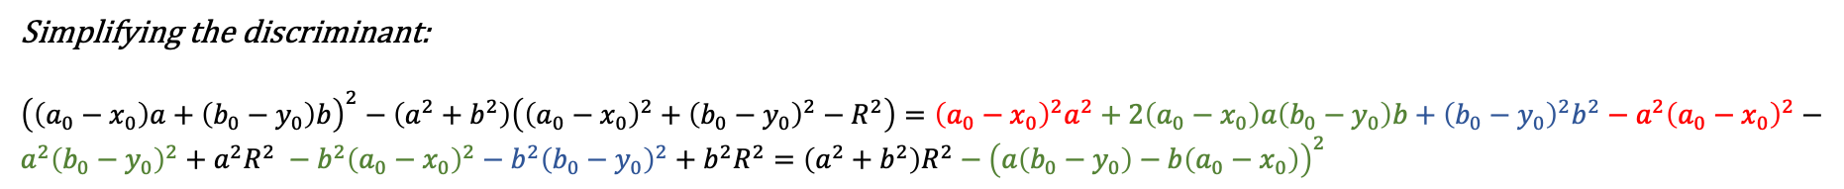
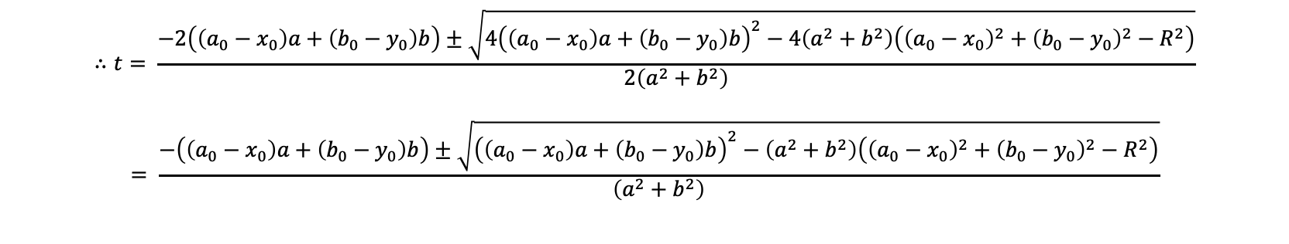

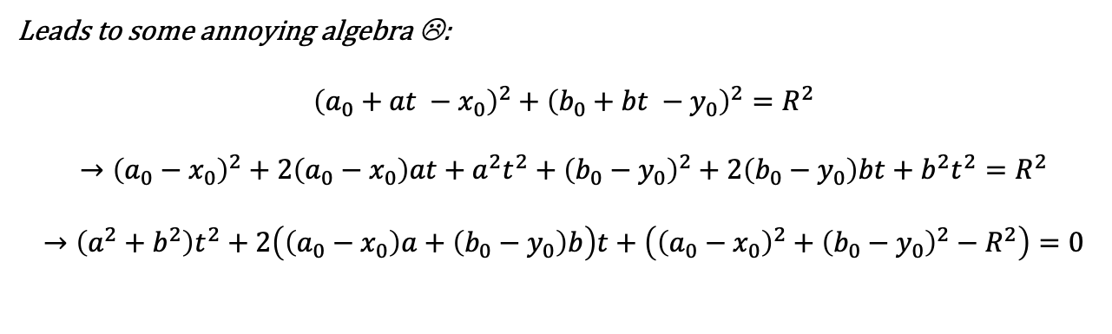
Geometry of Coincident $ν_{μ}$
At the walls IceCube:
$${\left(x−x_{0}\right)}^{2}+{\left(y −y_{0}\right)}^{2}=R^{2}$$
where
$$x=a_{0}+at$$ $$y=b_{0}+bt$$
Leads to some annoying algebra ☹:
$${\left(a_{0}+at −x_{0}\right)}^{2}+{\left(b_{0}+bt −y_{0}\right)}^{2}=R^{2}$$
$$→{\left(a_{0}−x_{0}\right)}^{2}+2\left(a_{0}−x_{0}\right)at+a^{2}t^{2}+{\left(b_{0}−y_{0}\right)}^{2}+2\left(b_{0}−y_{0}\right)bt+b^{2}t^{2}=R^{2}$$
$$→\left(a^{2}+b^{2}\right)t^{2}+2\left(\left(a_{0}−x_{0}\right)a+\left(b_{0}−y_{0}\right)b\right)t+\left({\left(a_{0}−x_{0}\right)}^{2}+{\left(b_{0}−y_{0}\right)}^{2}−R^{2}\right)=0$$
$$∴t= \frac{−2\left(\left(a_{0}−x_{0}\right)a+\left(b_{0}−y_{0}\right)b\right)±\sqrt{4{\left(\left(a_{0}−x_{0}\right)a+\left(b_{0}−y_{0}\right)b\right)}^{2}−4\left(a^{2}+b^{2}\right)\left({\left(a_{0}−x_{0}\right)}^{2}+{\left(b_{0}−y_{0}\right)}^{2}−R^{2}\right)}}{2\left(a^{2}+b^{2}\right)}$$
$$= \frac{−\left(\left(a_{0}−x_{0}\right)a+\left(b_{0}−y_{0}\right)b\right)±\sqrt{{\left(\left(a_{0}−x_{0}\right)a+\left(b_{0}−y_{0}\right)b\right)}^{2}−\left(a^{2}+b^{2}\right)\left({\left(a_{0}−x_{0}\right)}^{2}+{\left(b_{0}−y_{0}\right)}^{2}−R^{2}\right)}}{\left(a^{2}+b^{2}\right)}$$
Simplifying the discriminant:
${\left(\left(a_{0}−x_{0}\right)a+\left(b_{0}−y_{0}\right)b\right)}^{2}−\left(a^{2}+b^{2}\right)\left({\left(a_{0}−x_{0}\right)}^{2}+{\left(b_{0}−y_{0}\right)}^{2}−R^{2}\right)={\left(a_{0}−x_{0}\right)}^{2}a^{2}+2\left(a_{0}−x_{0}\right)a\left(b_{0}−y_{0}\right)b+{\left(b_{0}−y_{0}\right)}^{2}b^{2}−a^{2}{\left(a_{0}−x_{0}\right)}^{2}−a^{2}{\left(b_{0}−y_{0}\right)}^{2}+a^{2}R^{2} −b^{2}{\left(a_{0}−x_{0}\right)}^{2}−b^{2}{\left(b_{0}−y_{0}\right)}^{2}+b^{2}R^{2}=\left(a^{2}+b^{2}\right)R^{2}−{\left(a\left(b_{0}−y_{0}\right)−b\left(a_{0}−x_{0}\right)\right)}^{2}$
Notes:
Add references on the bottom of figures.

Slide 5

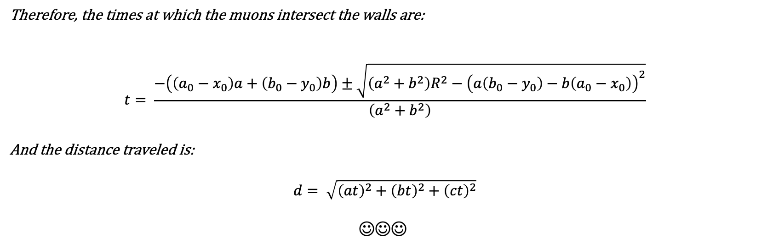
Geometry of Coincident $ν_{μ}$
Therefore, the times at which the muons intersect the walls are:
$$t= \frac{−\left(\left(a_{0}−x_{0}\right)a+\left(b_{0}−y_{0}\right)b\right)±\sqrt{\left(a^{2}+b^{2}\right)R^{2}−{\left(a\left(b_{0}−y_{0}\right)−b\left(a_{0}−x_{0}\right)\right)}^{2}}}{\left(a^{2}+b^{2}\right)}$$
And the distance traveled is:
$$d= \sqrt{{\left(at\right)}^{2}+{\left(bt\right)}^{2}+{\left(ct\right)}^{2}}$$
$$☺☺☺$$
Notes:
Add references on the bottom of figures.

Slide 6
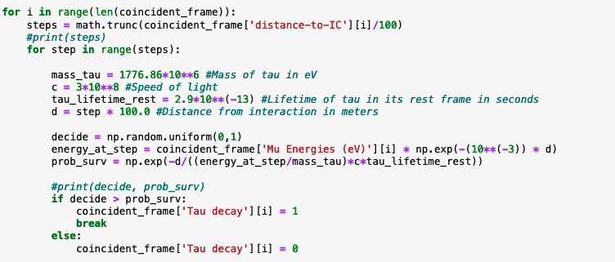

Correct for $τ$ decay
Divide distance to interaction in steps of 100 m
Find energy at that step
Take random number between 0 and 1
Calculate probability of survival to decay at that step
Loop over all steps
Decide if the tau survives the decay
Notes:
Add references on the bottom of figures.

Slide 7
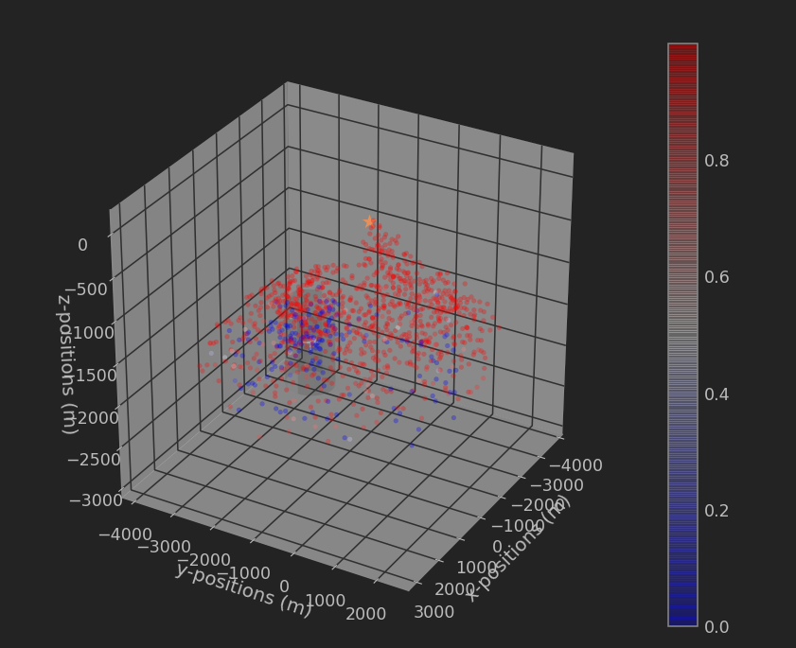
Plots Explained
This one is just plotting events that we know are coincident
The gradient is the weight of the event
Notes:
Add references on the bottom of figures.

Slide 8
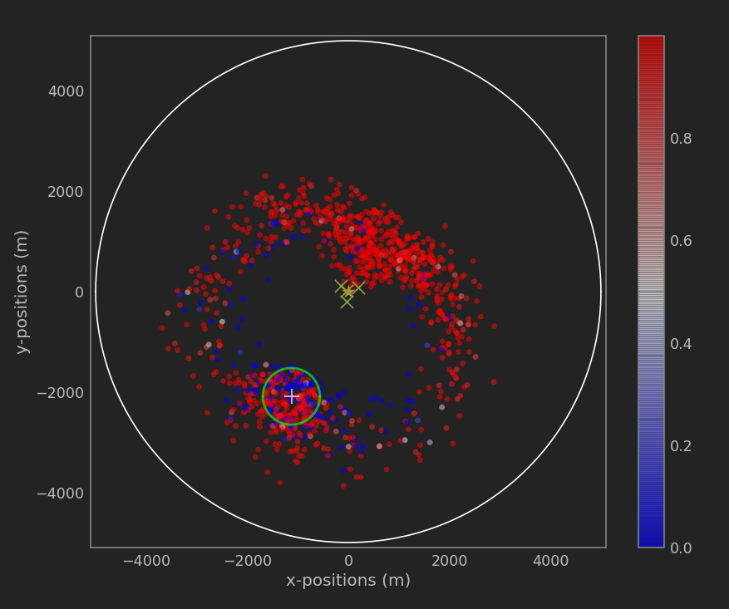
Plots Explained
Top view of the previous plot
Notes:
Add references on the bottom of figures.

Slide 9
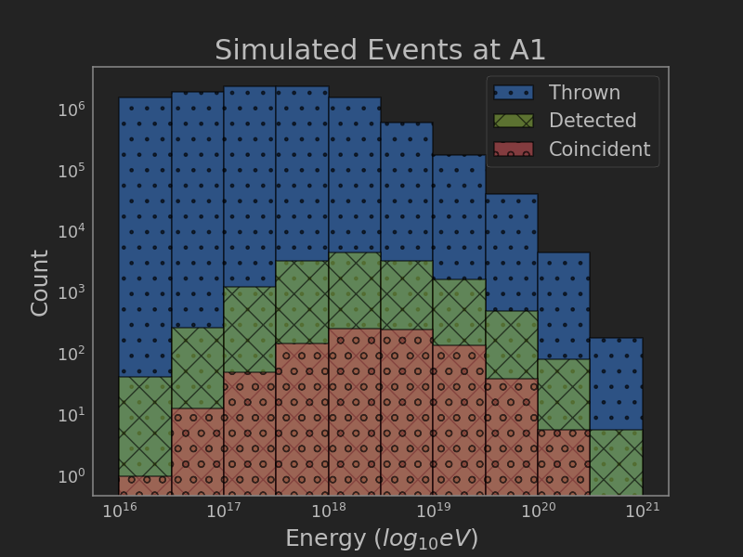
Plots Explained
Neutrino events binned in energy Thrown means events generated by ARASim around ARA 1.
Detected means detected events by ARA 1.
Coincident means detected by both ARA 1 and IceCube.
Notes:
Add references on the bottom of figures.

Slide 10
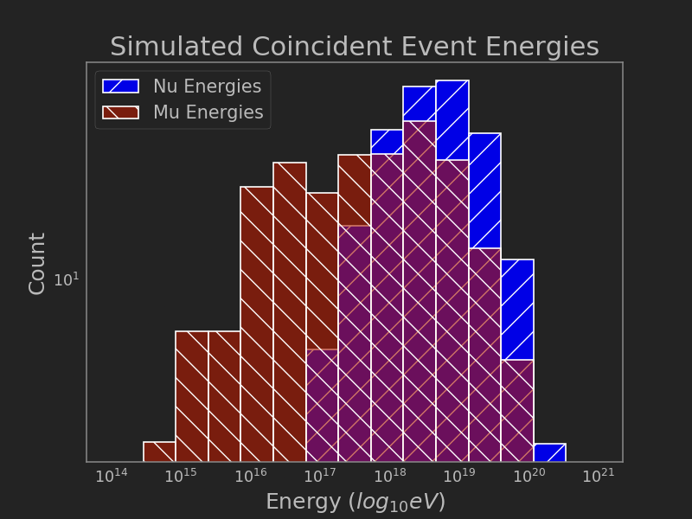
Plots Explained
Neutrino events seen by IceCube binned in energy
Notes:
Add references on the bottom of figures.

Slide 11
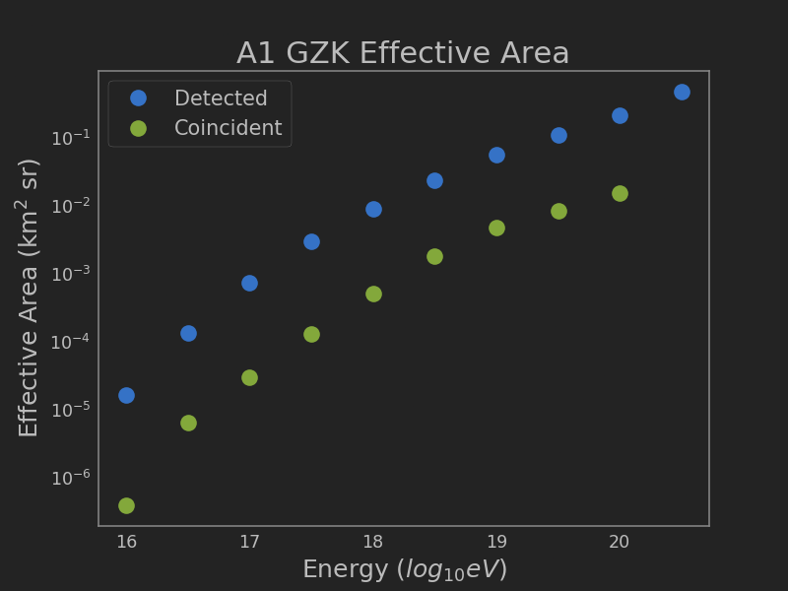
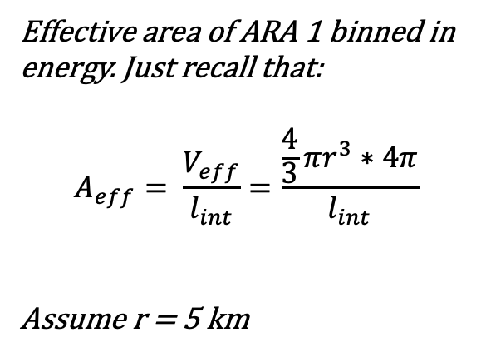
Plots Explained
Effective area of ARA 1 binned in energy. Just recall that: $$A_{eff}= \frac{V_{eff}}{l_{int}}=\frac{\frac{4}{3}πr^{3}∗4π}{l_{int}}$$
Assume r = 5 km
Notes:
Add references on the bottom of figures.

Slide 12
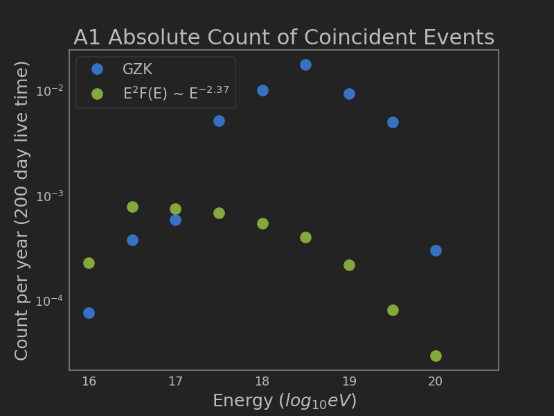
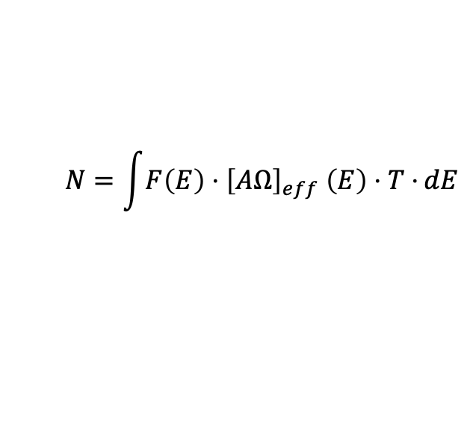
Plots Explained
This is an energy-binned count of coincident events with flux models by ARA compared to IceCube’s
For ARA 1, we have the GZK flux from: https://arxiv.org/pdf/1912.00987.pdf
For IceCube, we have the flux is in: https://arxiv.org/pdf/1607.08006.pdf
Recall that to get the count of events:
$$N=\int{F\left(E\right){⋅\left[AΩ\right]}_{eff}\left(E\right)⋅T⋅}dE$$
Notes:
Add references on the bottom of figures.

Slide 13
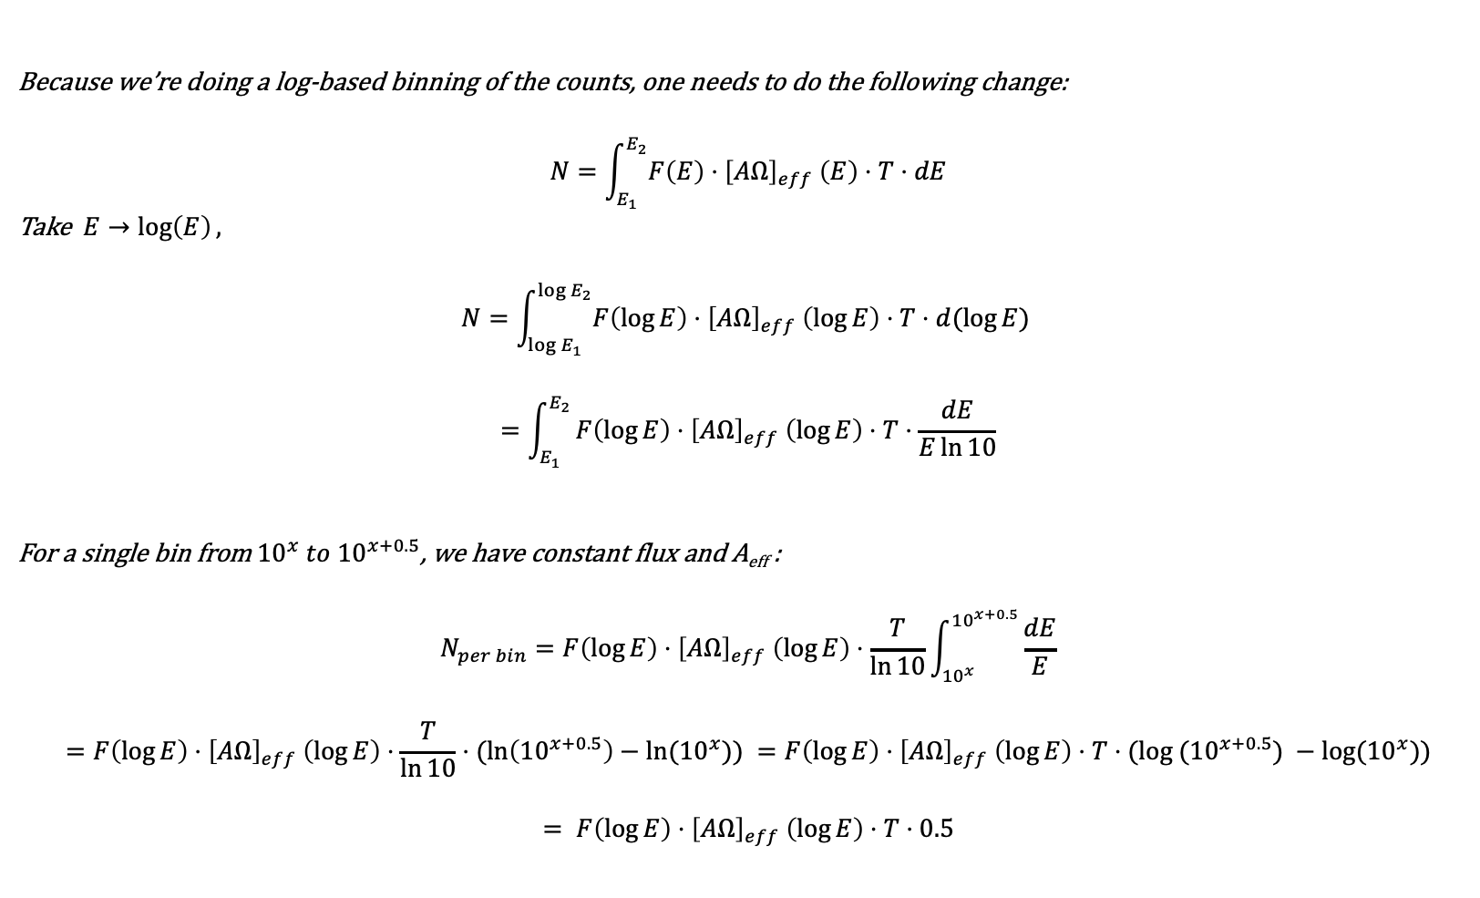
Plots Explained
Because we’re doing a log-based binning of the counts, one needs to do the following change:
$$N=\int_{E_{1}}^{E_{2}}{F\left(E\right){⋅\left[AΩ\right]}_{eff}\left(E\right)⋅T⋅dE}$$
Take $E→\log\left(E\right),$
$$N=\int_{\log{E_{1}}}^{\log{E_{2}}}{F\left(\log{E}\right){⋅\left[AΩ\right]}_{eff}\left(\log{E}\right)⋅T⋅d(\log{E)} }$$
$$=\int_{E_{1}}^{E_{2}}{F\left(\log{E}\right){⋅\left[AΩ\right]}_{eff}\left(\log{E}\right)⋅T⋅\frac{dE}{E\ln{10}}}$$
For a single bin from ${10}^{x} to {10}^{x+0.5}$, we have constant flux and A_{eff} :
$$N_{per bin}=F\left(\log{E}\right){⋅\left[AΩ\right]}_{eff}\left(\log{E}\right)⋅\frac{T}{\ln{10}}\int_{{10}^{x}}^{{10}^{x+0.5}}{\frac{dE}{E}}$$
$$=F\left(\log{E}\right){⋅\left[AΩ\right]}_{eff}\left(\log{E}\right)⋅\frac{T}{\ln{10}}⋅(\ln\left({10}^{x+0.5}\right)−ln⁡({10}^{x})) =F\left(\log{E}\right){⋅\left[AΩ\right]}_{eff}\left(\log{E}\right)⋅T⋅(log⁡ ({10}^{x+0.5}) −log⁡({10}^{x}))$$
$$= F\left(\log{E}\right){⋅\left[AΩ\right]}_{eff}\left(\log{E}\right)⋅T⋅0.5$$
Notes:
Add references on the bottom of figures.

