Slide 1
Above the Ice: The Data Acquisition Stack
By: Suren Gourapura
Date: 3/22/17
10-Minute Talk
Connolly Group Meeting

Slide 2
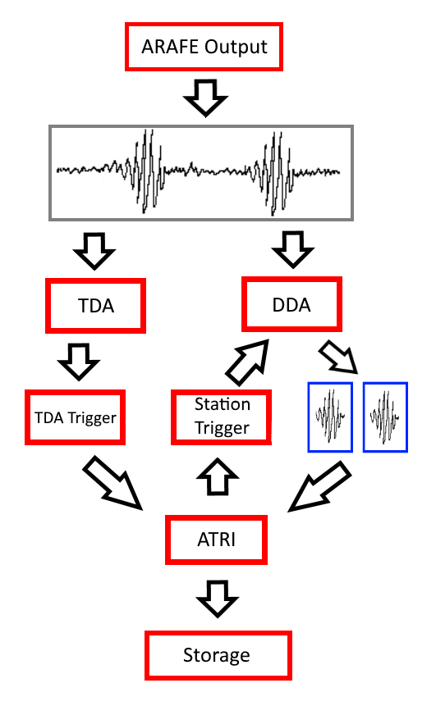
Overview
Signal is sent to Triggering and Digitizing Daughter boards for the Askaryan Radio Array (TDA and DDA)
TDA identifies signals of interest and informs the Field-Programmable Gate Array (FPGA).
DDA digitizes the waveform when the FPGA issues a full-station trigger.
Advanced Triggering and Readout Interface (ATRI) packages and sends signals of interest to storage
x4

Slide 3

Triggering Daughter Board (TDA)
The TDA is what identifies events of interest. It tells the FPGA to tell the DDA to digitize these events.
The trigger path signal is squared by a tunnel diode. This converts the voltage over time signal into power over time, which is sent to the TDA
Signals that trigger the station:
  Have a rising edge in their power that crosses a 6 $σ$ threshold
  Arrive from at least 3 antennae of the same polarization in a 120 ns window of time

Slide 4
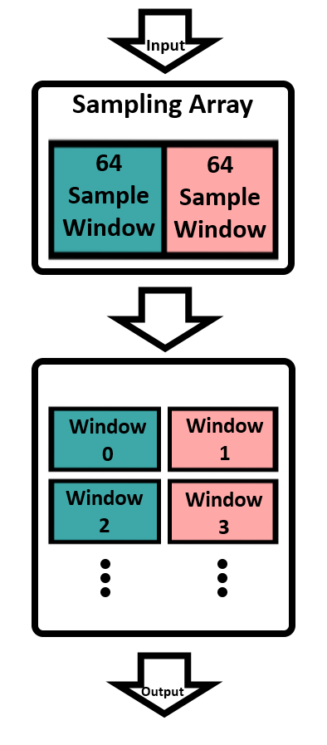
Digitizing Daughter Board (DDA)
Switched Capacitor Array (SCA) continuously stores and dumps signal
When the full station trigger arrives, the IRS2 Application Specific Integrated Circuit (ASIC) digitizes a block of the SCA at 3.2 GS/s
Data is sent to ATRI board
Storage Array

Slide 5
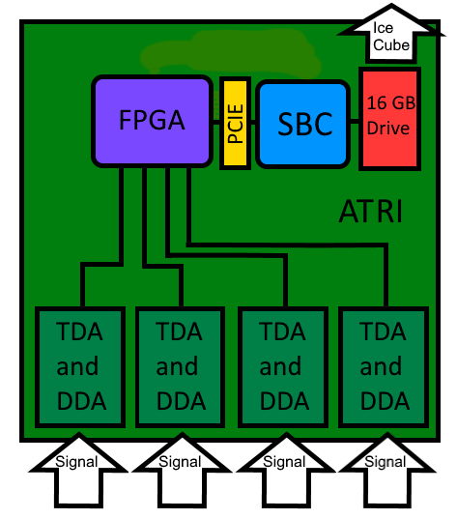
ARA Triggering and Readout Interface (ATRI)
Data packaged by Spartan-6 FPGA
Sent via PCIE to the Com-Express Single Board Computer (SBC)
SBC stores data on a 16 GB SATA drive, then sends it to hard drives in IceCube Lab.

Slide 6
Future Goals
Continuous digitization starting from the antennae output
Removing FX2 chip (In charge of communication to the FPGA)

Slide 7
Sources
Background Picture: http://theconversation.com/the-antarctica- diaries-week-four-4947
Information: Design and Initial Performance of the Askaryan Radio Array Prototype EeV Neutrino Detector at the South Pole
Performance of two Askaryan Radio Array stations and first results in the search for ultra-high energy neutrinos

