Slide 1



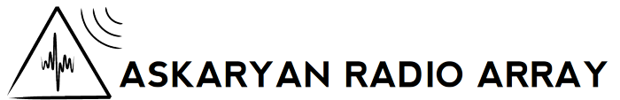
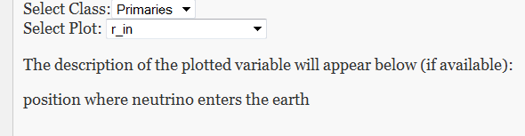
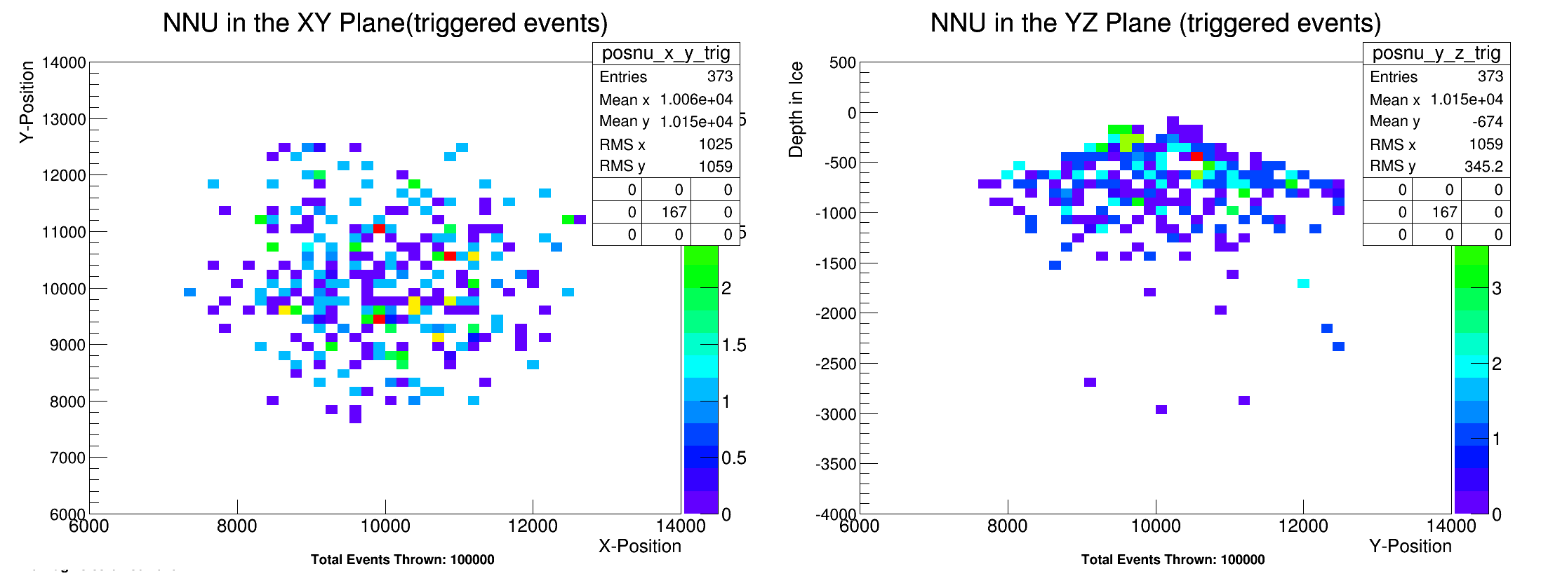

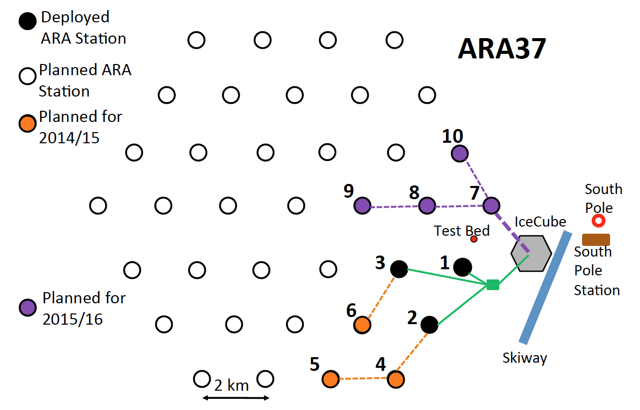
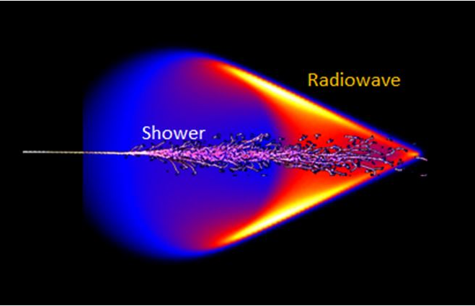
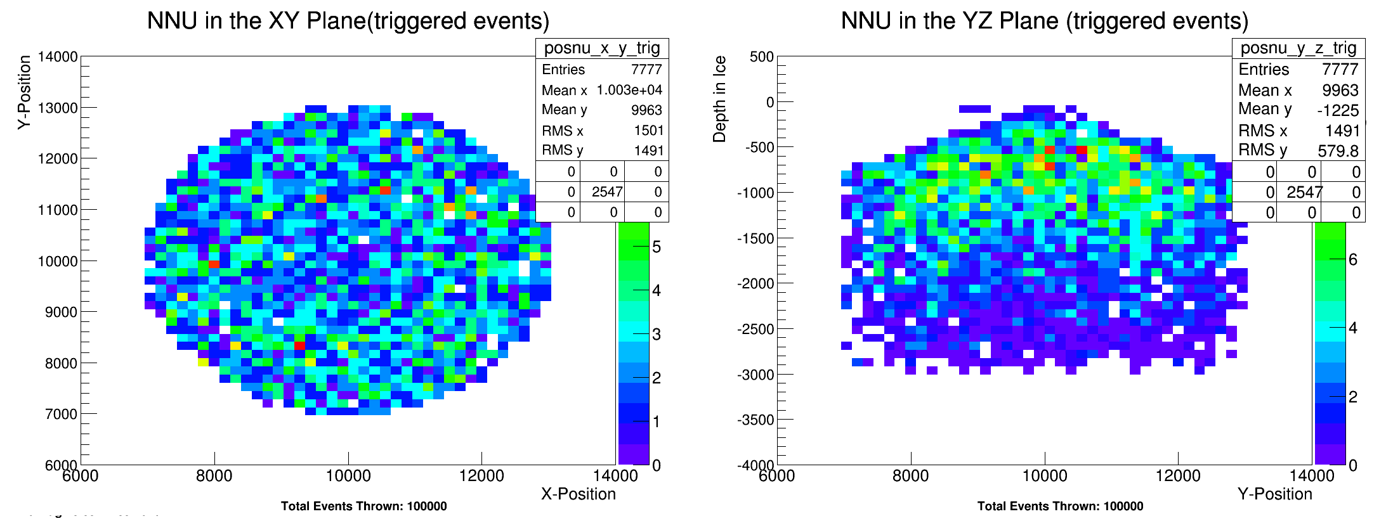
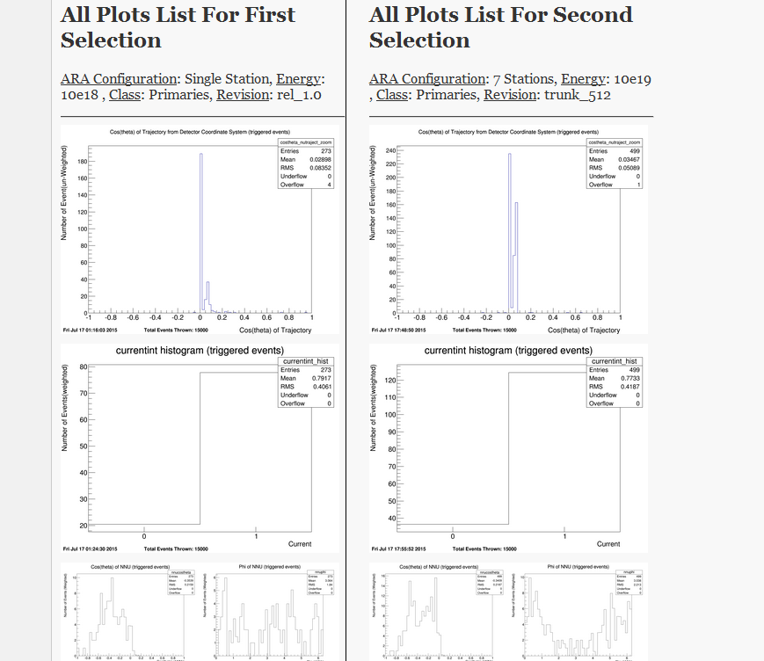
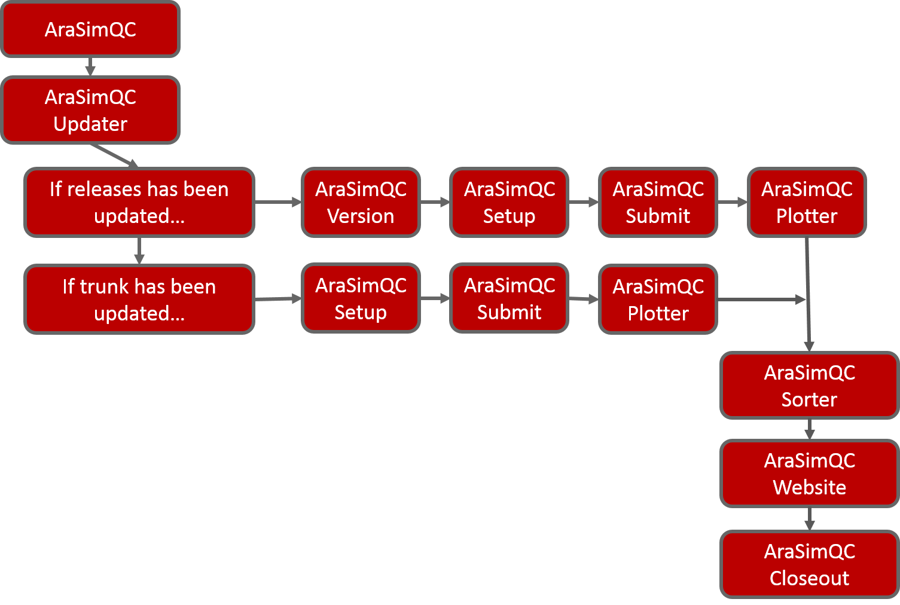

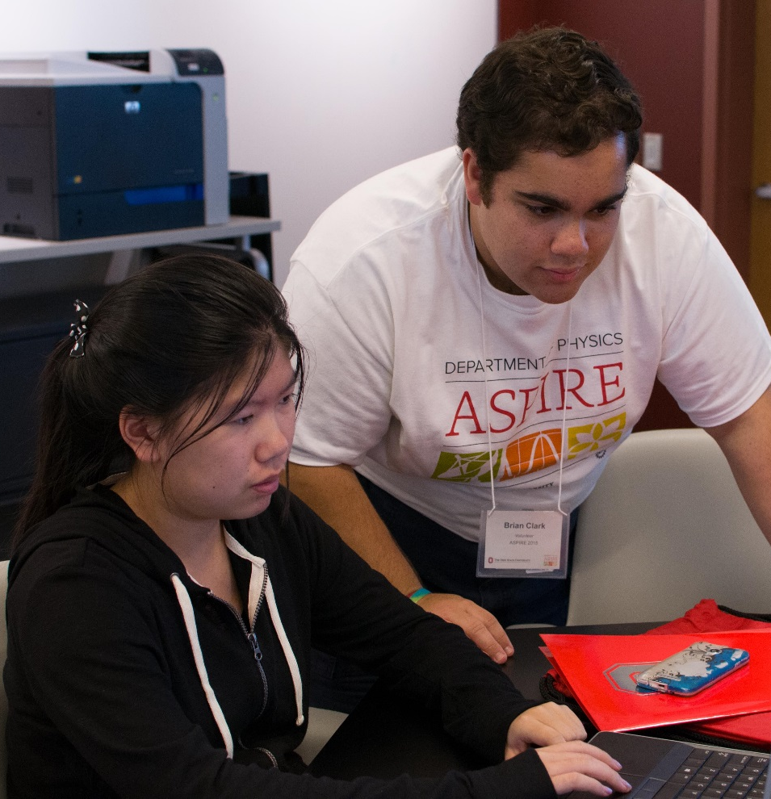
The Ohio State University – College of Arts and Sciences – Department of Physics
AraSimQC
Simulation Quality and Control for the Askaryan Radio Array
Brian Clark, Kaeli Hughes, Dr. Carl Pfendner, Prof. Amy Connolly
–
Introduction
The Askaryan Radio Array (ARA) is a teraton in-situ ultra-high energy neutrino detector buried in the radio-clear ice at the South Pole
Looks for the Askaryan signal: the bipolar impulsive radio signal produced when neutrinos interact with Antarctic Ice
The simulation software for ARA, AraSim, is constantly being updated by various collaboration members, often 2-3 updates per month.
Need a way to ensure basic functionality as the code evolved
Track how simulation changes affected physics outcomes (fig 1)
AraSimQC is a software automation package designed to fill this need
About AraSimQC (cont.)
Code Updating
If AraSim code updates are found
  AraSimQC downloads and runs the latest version of AraSim
  Makes a standard set of plots
  Uploads these plots to a website for viewing
If AraSim code updates are not found
  AraSimQC checks for new plotting programs
  If new programs are found, new plots are made for all existing version of AraSim
  Updates are appended to the website
Website Features
Plot Comparison
Easily compare plots across revisions, station configurations, and energies
Useful “all plots” feature: shows all available plots for a single classification of variables (primary interaction variables, detector variables, etc.) (fig 3)
Can easily download a PNG or PDF of each plot
Doxygen Comment Support
Doxygen is a tool that generates documentation from annotated C++ sources
Website displays a Doxygen comment, drawn from AraSim source code, for selected variables (fig 4)
New Plots Submission
Website supports submission of plots by the collaboration; makes AraSimQC more diverse
Adding plots is straightforward
  Collaboration member submits a .cc file and M. file through website
  Super-user places both files in specified directory
  AraSimQC handles the rest
Figure 4: Doxygen Comments
An example of the doxygen comment support; when a variable is selected, a description appears.
Website Features (cont.)
Collaboration Simulation Sets
Simulations are resource intensive (need lots of time and computing power)
AraSimQC generates collaboration simulation sets
  Several energies (10¹⁷ eV → 10²¹ eV), with option of injection spectrum
  Several station configurations (Testbed prototype, one-station, seven-stations, etc.)
Figure 1: Plot Comparison Example for Single Station
10¹⁷ eV
10¹⁷ eV
Acknowledgements
Full acknowledgement to Khalida Hendricks for the initial writing of the AraSimQC code. Many thanks to Kaeli Hughes for collaboration and development of IcemcQC, and also to Dr. Carl Pfendner for guidance and mentorship on software development. We acknowledge funding through NSF CAREER Award 1255557 and BigData Grant 1250720. Further thanks to the OSU Department of Physics for supporting my summer research.
10²⁰ eV
10²⁰ eV
Figure 3: All Plots Comparison
About AraSimQC
Purpose and Goals
Quick visual comparisons between
  Different versions of AraSim
  Different detector configurations
  Different neutrino energies and flux models
Easily browse all plots/histograms of variables from a given simulation run
Automatically generate general purpose simulation sets for each version of AraSim
Create webpage for viewing of simulation output
Design
AraSimQC is a collection of shell scripts (fig 2)
Checks for updates to AraSim code
Generates a set of plots when changes are found
Automatically posts plots to a website for viewing
Saves simulation output so it can be repurposed
The simulated positon of the primary neutrino interaction in the ice for a single station, where the energy of the neutrinos are 10¹⁷ eV (top) and 10²⁰ eV (bottom). The signal strength is much greater when the energy of the neutrino is 10²⁰ eV, leading to a far higher number of triggered events.
ASPIRE 2015
Achieving in Science through Physics Instrumentation, Research, and Exploration Camp
Led Mathematica workshop for 26 high school girls
Campers practiced basic data analysis using various Mathematica applets
Figure 2: Flow of AraSimQC Executables
The flowchart of how the various shell scripts are executed when AraSimQC is run in “automatic” mode. The software checks if changes have been made to either the releases or trunks, prepares the simulations, generates plot output, sorts the resultant files, and posts requisite plots to the website before performing housekeeping and clean-up.
An example of the “All Plots” feature, which displays all of the plots available for a certain classification of variables. Here is a comparison of several plots between a single station detector set-up, and a seven-station detector set-up.
ara.physics.ohio-state.edu | u.osu.edu/connolly

