Slide 1
The GZK Effect
Brian Clark
Oct 12, 2015
Connolly Group Meeting

Slide 2
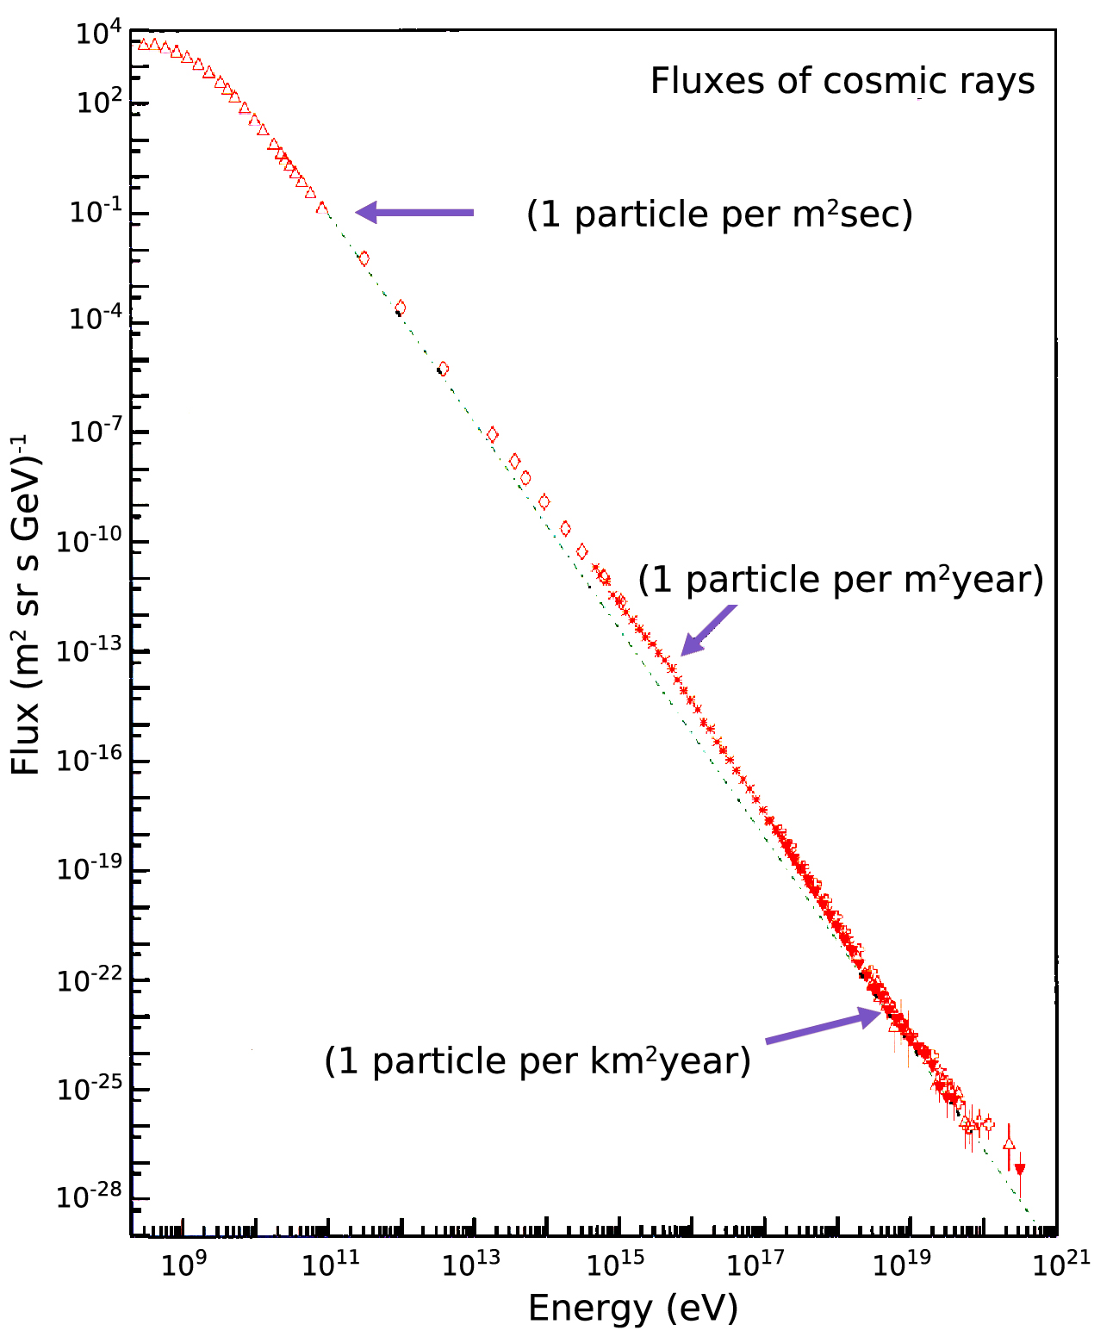
Missing Cosmic Rays
  Cosmic ray spectrum has steep drop-off above ~10^{19.5} eV
  Where did all the CR go?
  Historical Sidenote: The cutoff was experimentally observed only in the last twenty years. It serves as nice motivation for the calculation, but only so in hindsight.
12 October 2015
The GZK Effect

Slide 3
GZK Effect
  In 1966, Greisen¹ and Zatsepin & Kuz’min ² gave a theoretical explanation
  What if the protons were interacting with the CMB?
  Calculation went as follows:
      Assume the CR spectrum is primarily protons
      Calculate at what energy the protons would interact with the CMB
      Does this “cutoff energy” match the losses observed?
12 October 2015
The GZK Effect

Slide 4
Step 1: Energy of CMB Photon
  Universe is blackbody with energy density
  Get total energy by integrating over all frequencies, with variable substitution for simplicity of the integral
  Plug in numbers (temperature of CMB is ~3K), find:
12 October 2015
The GZK Effect

Slide 5
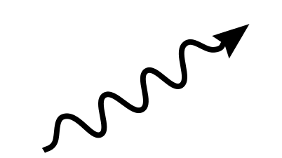
Step 2: COM Collision
  Threshold calculation: COM collision between proton and photon, outgoing proton/pion have no kinetic energy
  In COM: proton & pion are at rest
  In LAB: proton & pion have equal velocities
12 October 2015
The GZK Effect

Slide 6
Step 2: COM Collision (cont)
  Write down energy and momentum conservation in COM frame (energy and three momenta of a photon are the same)
  Write down the corresponding on-shell conditions
  Write down equal velocity condition of outgoing particles
12 October 2015
The GZK Effect

Slide 7
Step 3: Ultra-Relativistic Assumption
  This is three equations for three unknowns:
  BUT, a priori hard to solve (the radicals are very messy to untangle)
  Utilize that the particles are ultra-relativistic, and Taylor expand their momenta
12 October 2015
The GZK Effect

Slide 8
Step 4: Solve
  With these simplified momenta, we can solve for the particle energies
  Eliminate , solve for
12 October 2015
The GZK Effect

Slide 9
Conclusion
  Compute the final numbers:
  Which is right where we saw the drop off in the CR flux (but GZK just wanted to show you wouldn’t measure them)
  Sidenote: those pions and neutrons live on to provide the neutrino flux we hope to measure
12 October 2015
The GZK Effect

Slide 10
Thanks! Questions?
12 October 2015
The GZK Effect

Slide 11
References
  Greisen, Kenneth (1966). “End to the Cosmic-Ray Spectrum?”. Physical Review Letters 16 (17). 748-750.
  Zatsepin, G.T.; Kuz’min, V.A. (1966). “Upper Limit of the Spectrum of Cosmic Rays”. Journal of Theoretical Physics Letters 4: 78-80.
  QFT 8808.01 at OSU
12 October 2015
The GZK Effect

