Slide 1
Ultra-High Energy Neutrino Astrophysics with the Askaryan Radio Array (ARA)
Brian Clark
The Ohio State University
Department of Physics and the Center for Cosmology and Astroparticle Physics (CCAPP)
April 8, 2016
Spring OSAPS Meeting—University of Dayton

Slide 2
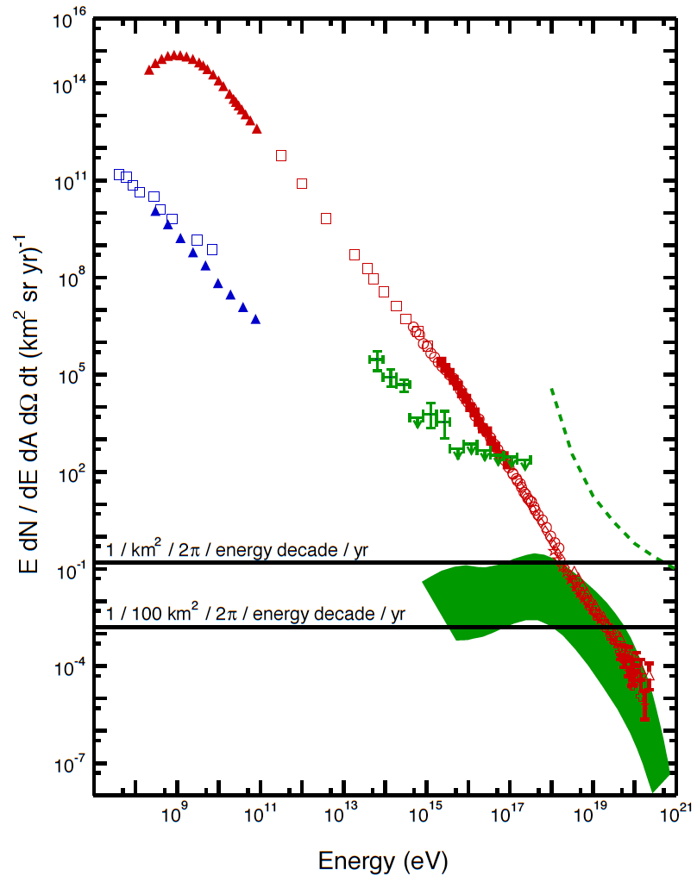
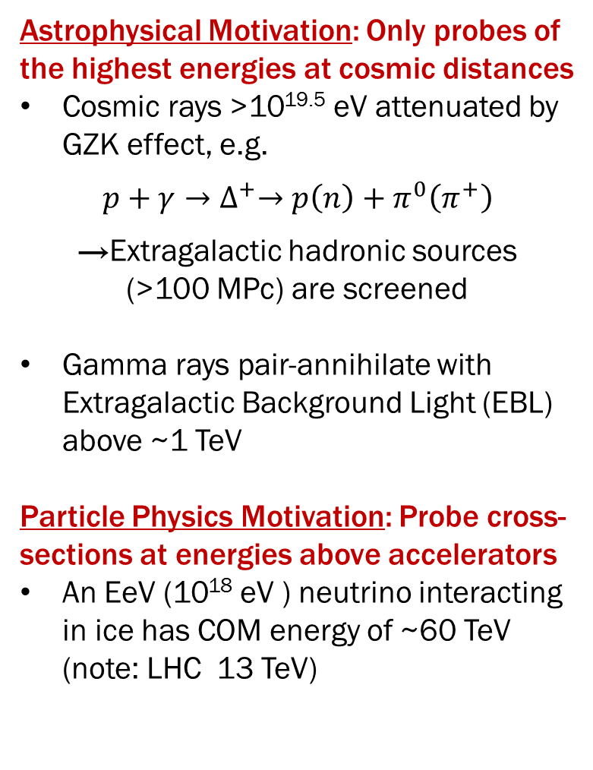
Why Study Neutrinos?
Astrophysical Motivation: Only probes of the highest energies at cosmic distances
Cosmic rays >10^{19.5} eV attenuated by GZK effect, e.g.
$$p+γ→∆^{+}→p\left(n\right)+π^{0}\left(π^{+}\right)$$
→Extragalactic hadronic sources (>100 MPc) are screened
Gamma rays pair-annihilate with Extragalactic Background Light (EBL) above ~1 TeV
Particle Physics Motivation: Probe cross-sections at energies above accelerators
An EeV (10¹⁸ eV ) neutrino interacting in ice has COM energy of ~60 TeV (note: LHC 13 TeV)
cosmic-rays
𝛾-rays
neutrinos
Plot by A. Connolly,
Adapted from S. Swordy
Notes:
Curve is Ahlers 2010 with 10E18.5 eV cutoff

Slide 3
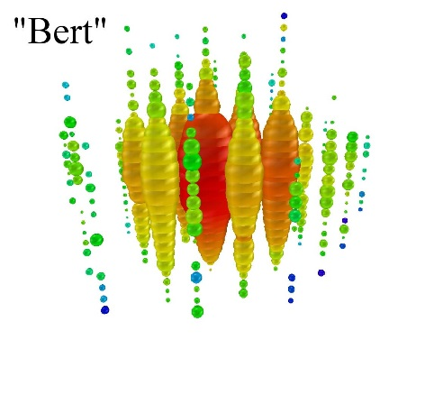
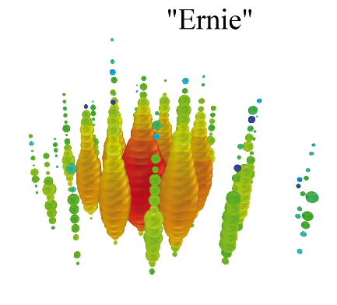
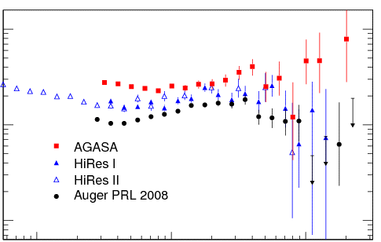
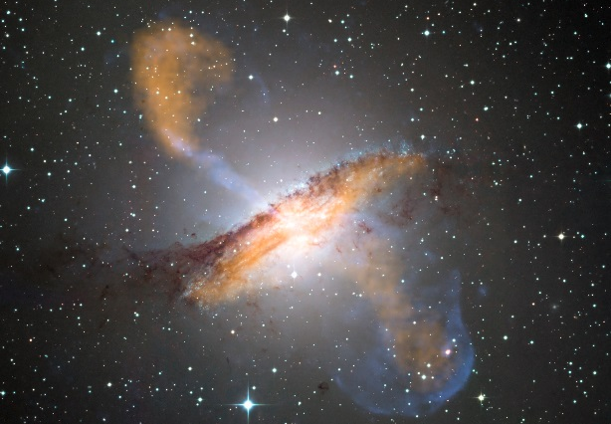
Cosmic Neutrinos
They Exist!
2012: IceCube experiment first saw PeV neutrinos which appeared to be of cosmic origin
Today’s discussion: neutrinos x10³ more energetic—the “UHE” regime
Two Sources of Neutrinos
“BZ Flux”: The pions from the GZK process decay into neutrinos
“Source Flux”: Neutrinos from the CR accelerators
  Gamma Ray Bursts (GRB)
  Active Galactic Nuclei (AGN)
Neutrinos have attractive properties
Weakly interacting: travel cosmic distances unattenuated
Chargeless: not deflected by (inter) galactic magnetic field → point back to source!
LUNASKA (Radio)
10²⁵
S. Petrera, Arxiv 0810.4710
E³ J(E) [m⁻² s⁻¹ sr ⁻¹ eV²]
10²⁴
10²³
10¹⁸
10¹⁹
10²⁰
Energy [eV/particle]
AGN
Centaurus A. (ESO public image release)
Notes:
Orange = sub-mm (APEX)
Blue = x-rays (Chandra)
All else = visible (ESO 2.2m telescope)

Slide 4
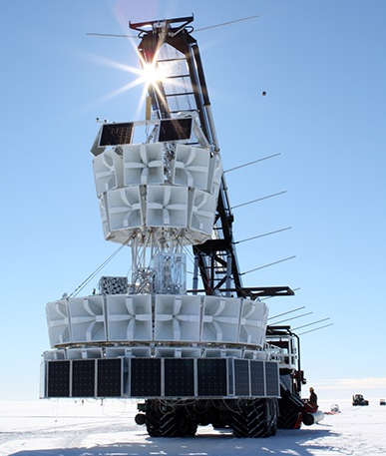
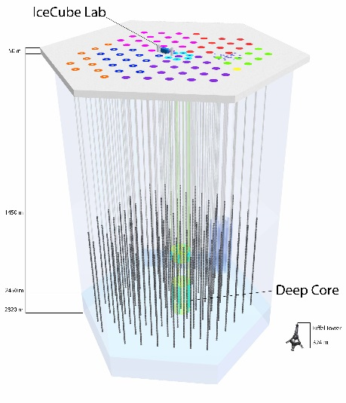
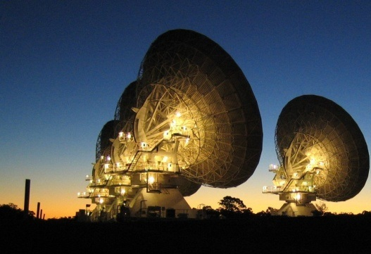
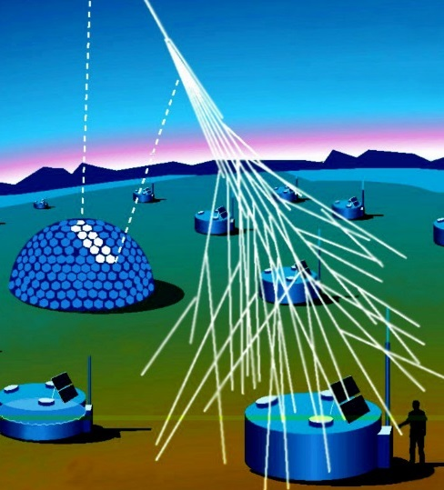
Detecting an UHE Neutrino
ANITA-III (radio)
IceCube (optical)
Rare Signal
UHE Neutrinos have low fluxes (~10/km³/yr) and low cross-sections (interaction length ~300km in rock)
Need hundreds of km³ of target volume to enable detection (e.g., dozens per year)
Several Options:
  Balloon experiments: radio
  In-Situ experiments: optical, radio
  Ground based arrays: air shower, radio
In-situ experiments (like ARA) must instrument the volume sparsely to achieve these large detector volumes
LUNASKA (Radio)
LUNASKA (radio)
Auger (air shower)
Notes:
Cross sections relevant are (<10⁻⁷ mb). For scale, the Higgs is produced with a total cross section of 100 pb or 100E-9 b or 10E-7 b. Ie, neutrinos interact with about the same interaction probability as you need to make the Higgs

Slide 5
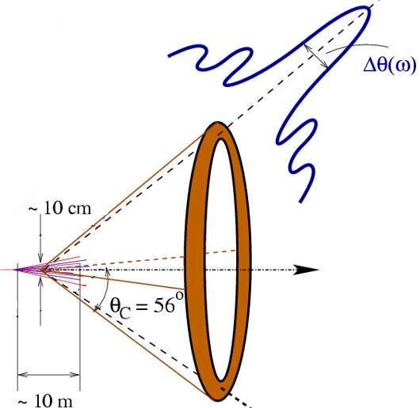
Radio: Askaryan Effect
Neutrino interaction in dense media creates shower of charged particles
~20% more electrons than positrons —”bunch” of particles moving through media and radiating
Wavelengths the size of the bunch (~cm) add coherently, producing a characteristic broadband (200 MHz → 1GHz), bipolar, impulsive radio signal
  Conical emission, strongest signal
  “on cone”
Polar diagram of E-Field
Two requirements for successful experiment
  Radio transparent medium: ice
  Enormous volume: Antarctica
J. Alvarez-Muñoz & E. Zas (2005)

Slide 6
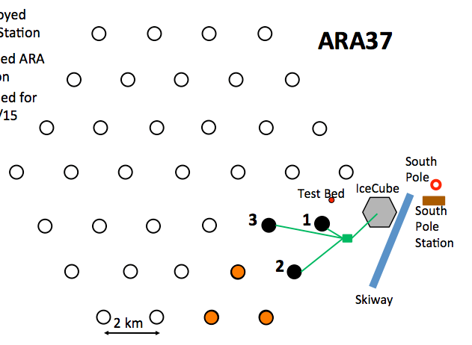
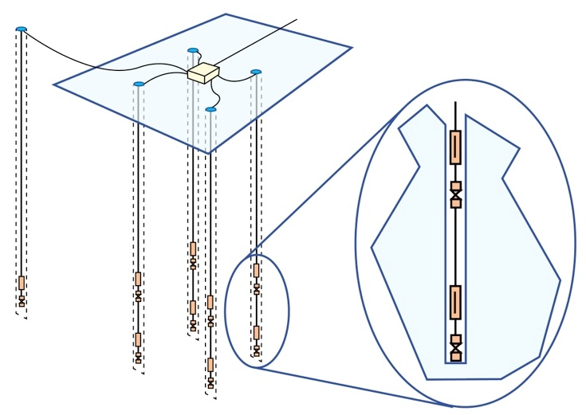
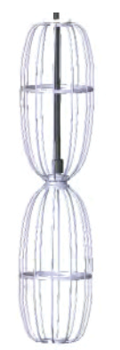
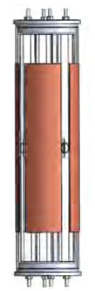
Askaryan Radio Array (ARA)
Deployed Station
To be Deployed in 2017
Planned ARA 37
DAQ, Power box
ARA Station Layout
40 m
14 m
Top
V-pol
2 m
Top
H-pol
200 m
15 m
2 m
Bottom
H-pol
Bottom
V-pol
Calibration Pulsers
V-Pol
Antenna
H-Pol
Antenna
Station Design
  16 antennas deployed on 4 strings; mix of V-pol and H-pol
  Buried 200 meters deep, all connected to central DAQ with ~3 GHz sampling
ARA is under phased construction in the ice near South Pole
  Prototype (“Testbed”) + 3 stations deployed so far
  Next two stations to be deployed in 2017
  Full array will have 37 stations, cover ~100 km² ice
Notes:
H-pol antenna is like the dual of a dipole (it’s a magnetic dual, captures the magnetic field, not the electric). Babinet’s principle: swap all conductors for free space, and free space for conductors. By making the flip, make it sensitive to H-pol signals.

Slide 7
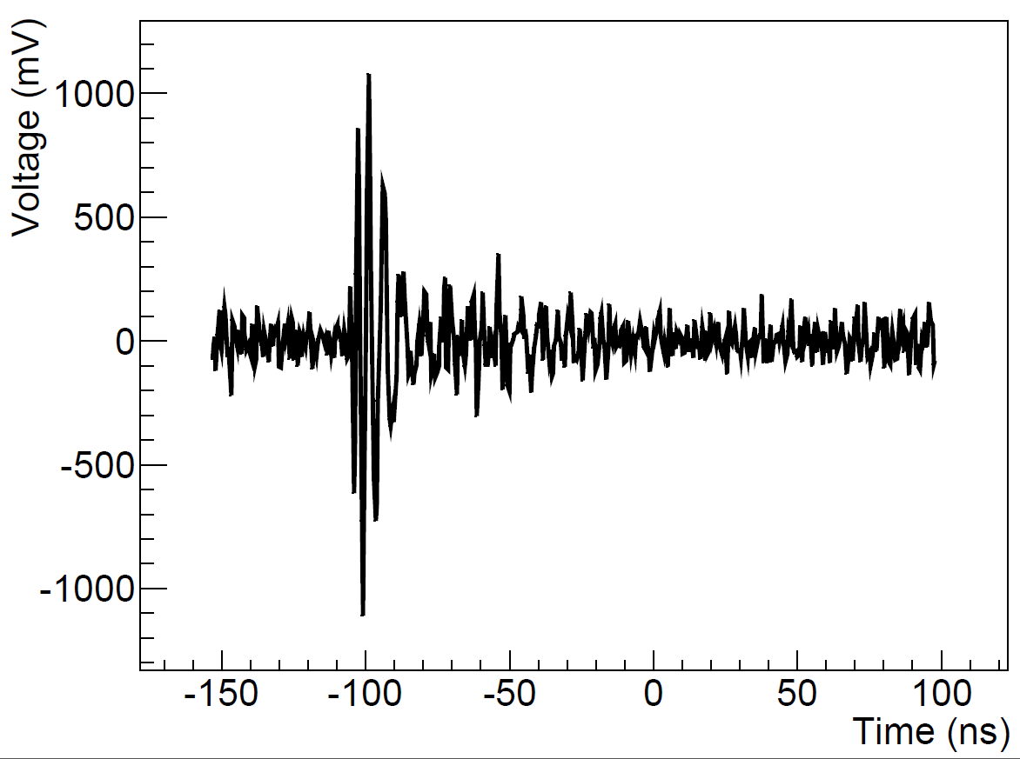
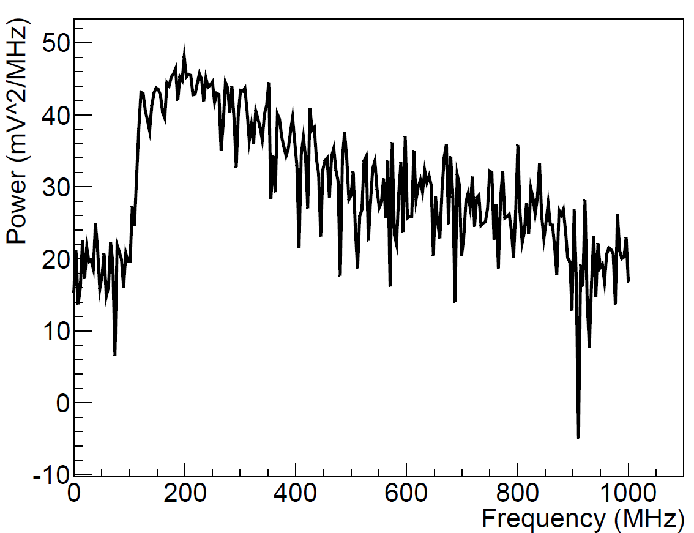
Signal Identification
Calibration Pulser Event
Testbed Station
In Hardware: Signal Should be Impulsive
ARA Triggers on Power: integrated power over ~10ns must be > threshold
  Coincident requirement: requires impulses in multiple antennas within a time window
Effective at identifying neutrinos: pulses have large integrated power over small time windows
Good at rejecting thermal noise: noise would have to fluctuate high in multiple channels
In Software: Signal Must be Broad in Frequency
Impulsive signals are broadband
Anthropogenic backgrounds are usually narrow band (people talking on radio, for example)
Notes:
We expect the neutrinos to look something like
Put spectrum of noise on the spectrum plot too. Say that it’s a cal pulser on the slide.

Slide 8
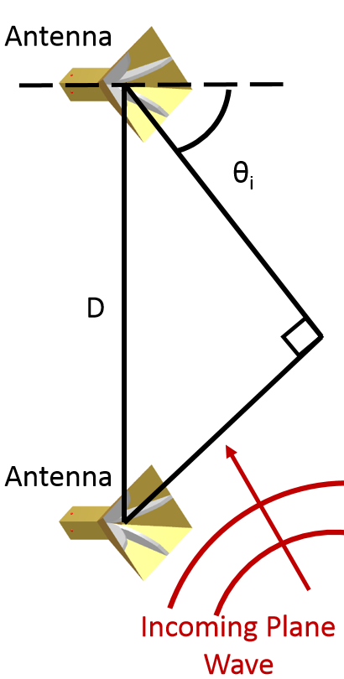
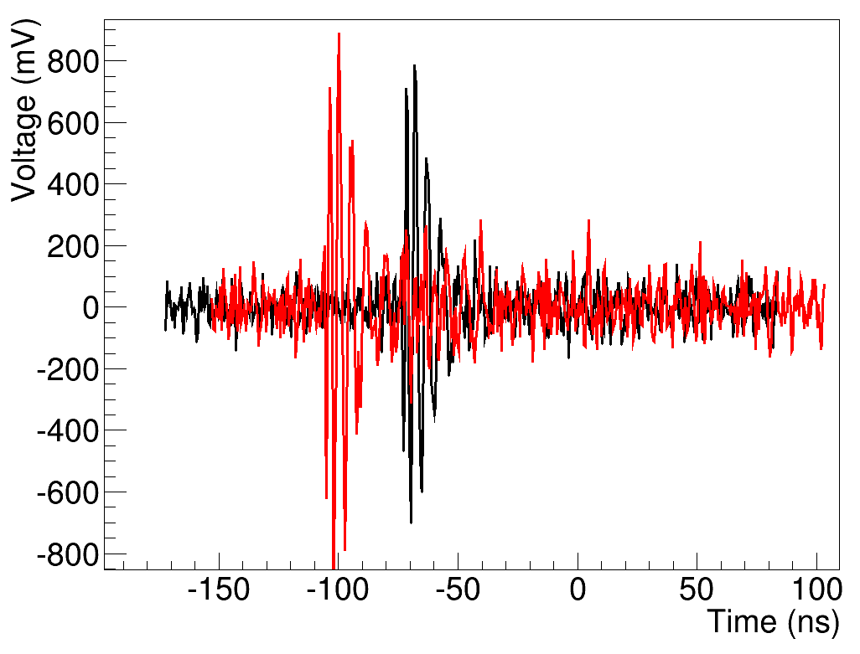
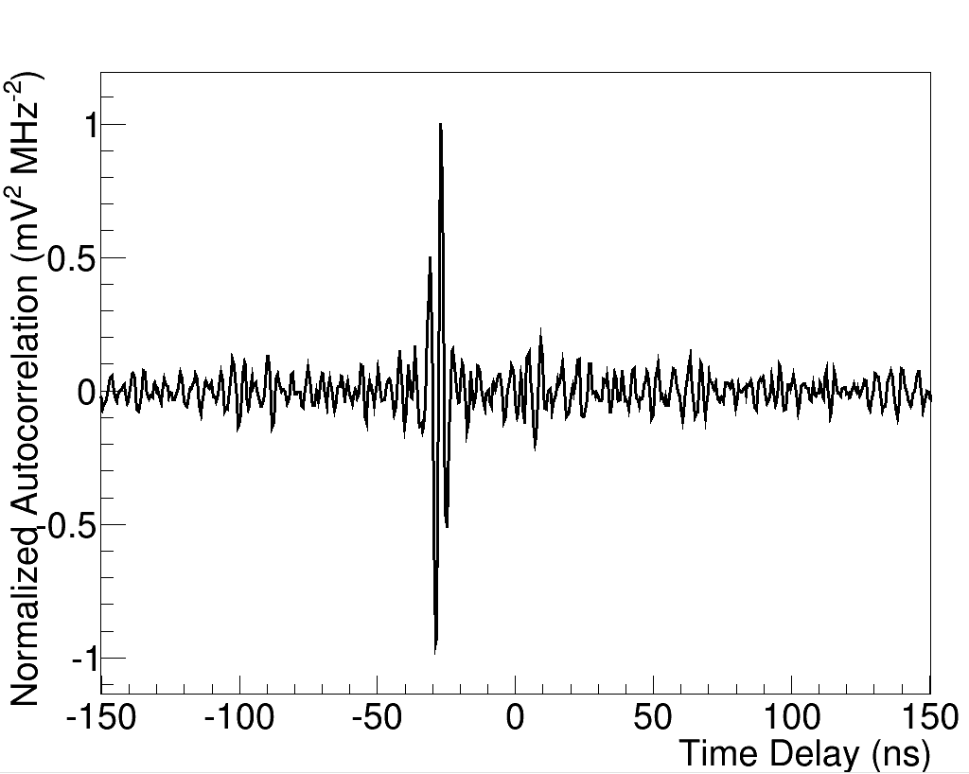
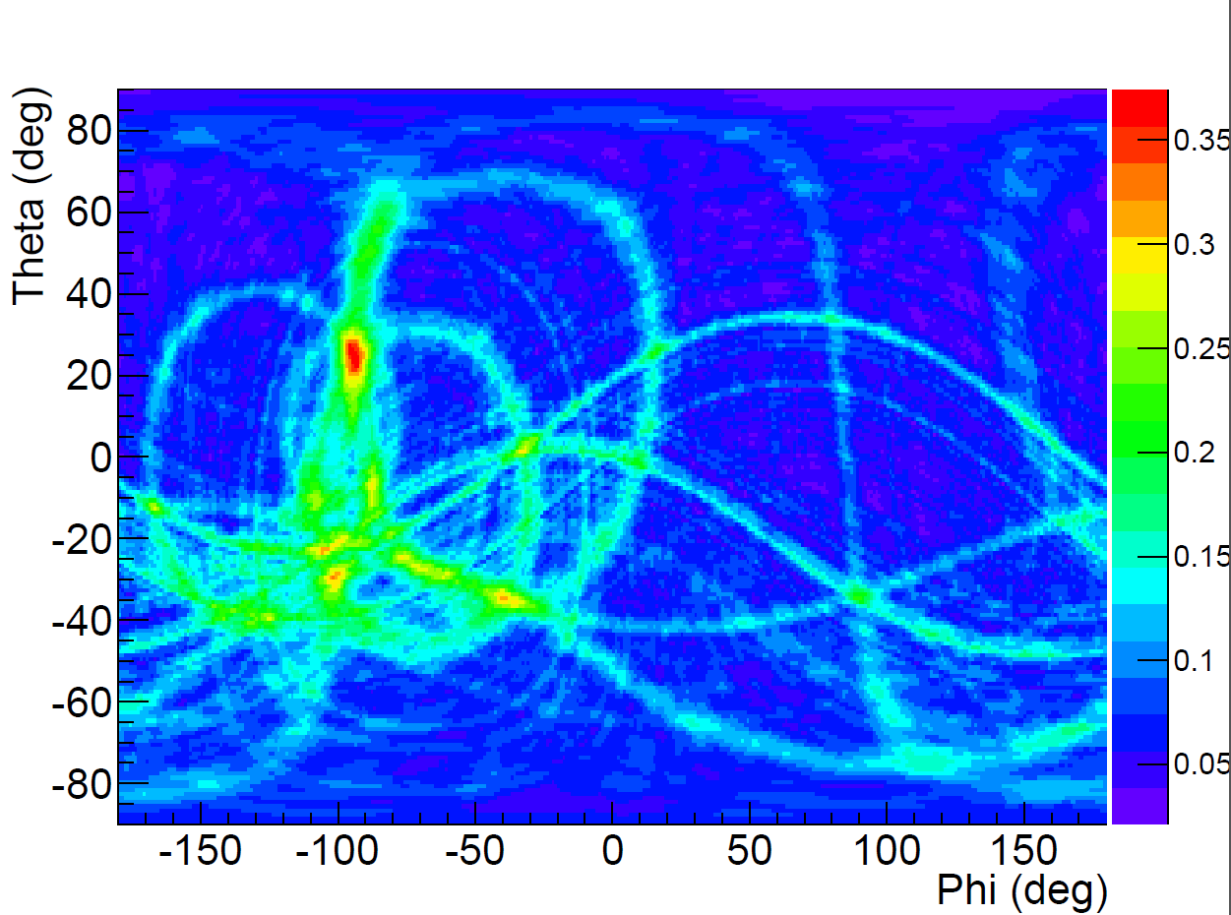

Interferometric Maps
$$θ_{i}=\arcsin\left(\frac{c Δt}{D}\right)$$
Anatomy of an Interferometer
Timing information translates into geometry information
The peak of the waveform cross correlation (CCW) identifies the time delays and possible RF source angles
Plotting the strength of the CCW in 2D (θ,ϕ) for multiple pairs of antennas gives an interferometric map—this identifies a single reconstruction point
Usefulness of Interferometry
Used to reject noise in ARA’s first diffuse and GRB searches
  Diffuse neutrinos should not generate repeating RF directions
  Neutrino RF should not reconstruct to known human campsites
Antenna 2 Waveform
Antenna 3 Waveform
Antenna 2 & 3
Waveform Correlation
All Antenna Pairs
Interferometric
Map

Slide 9
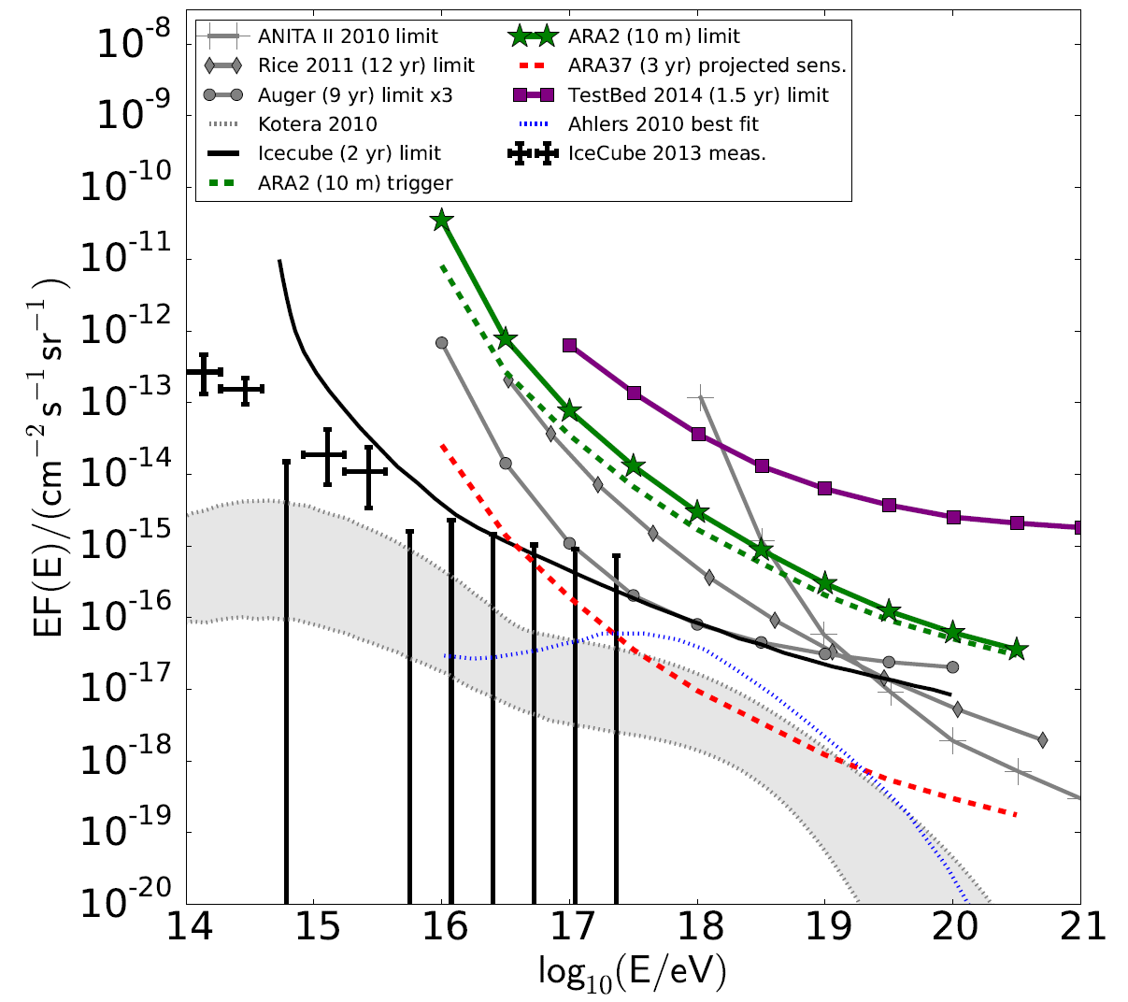
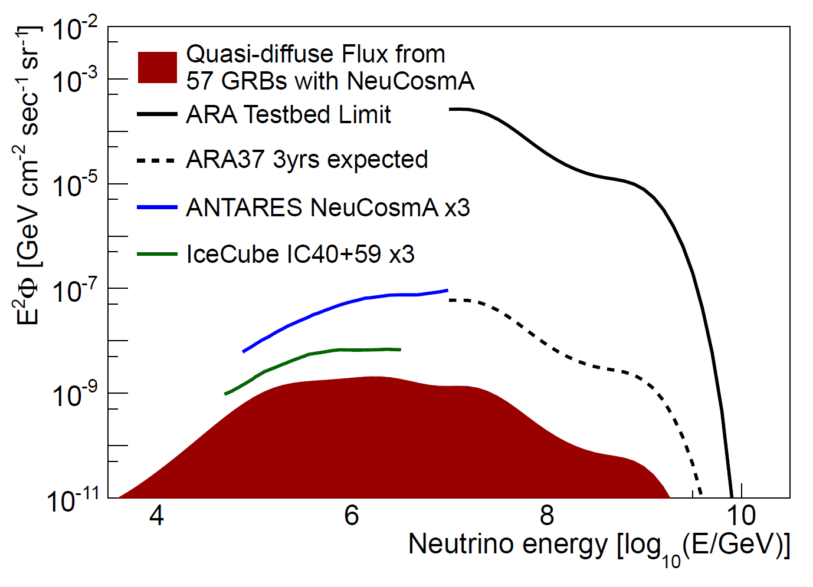
Testbed GRB Limit
Two Stations Diffuse Limit
Limits on diffuse neutrino flux from 10 months of two stations.
Predictions for ARA 37 limits (red line) are competitive and capable of model discrimination.
P. Allison et al, for the ARA Collaboration.
Arxiv 1507.08991, accepted to PRD.
Limit on the GRB flux from 57 GRBs from 224 days of ARA testbed.
P Allison et al, for the ARA Collaboration.
Arxiv 1507.00100v1
Notes:
Put photo of diffuse and the GRB flux

Slide 10

Summary
Neutrinos are key windows to fundamental physics—important for both astroparticle physics and particle physics purposes
Next generation detectors like ARA employ radio techniques to instrument the large target volumes necessary for practical detection
The performance of two ARA stations predicts the full ARA37 will be able to discriminate between leading models for the UHE neutrino flux
The OSU ARA Team is generously supported by:
NSF CAREER Award 1255557
NSF Grant 1404266 and NSF BigData Grant 1250720
The Ohio Supercomputer Center
The OSU Department of Physics
The OSU Center for Cosmology and Astroparticle Physics
US-Israel Binational Science Foundation Grant 2012077

Slide 11
Back-up Slides

Slide 12
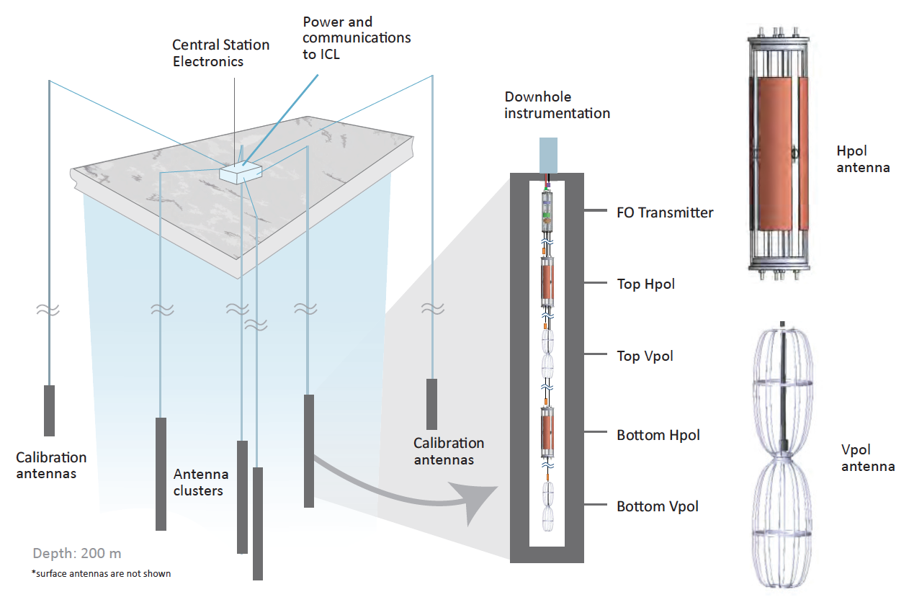
Backup: Alternate Station Schematic

Slide 13
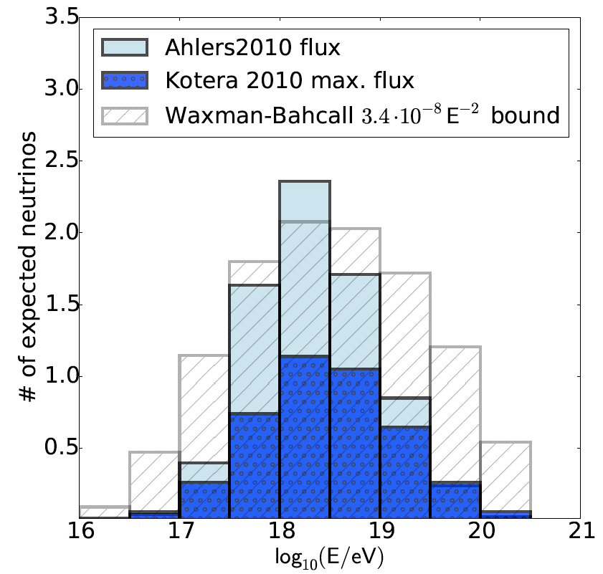
Predicted Fluxes for ARA37
Projected event numbers for three models of the UHE neutrino flux with 37 stations and 3 years livetime.
Power to discriminate between models after 3 years livetime.
T. Mueres et al, for the ARA Collaboration.
Arxiv 1507.08991, accepted to PRD
Notes:
WB flux is the flux that if you exceeded it you would violate the CR energy budget (only muon neutrinos), just assuming some connection between CR and neutrinos. Ahlers and Kotera are GZK fluxes
Ahlers assumes all protons.

