Slide 1
Attenuation
Kaeli Hughes

Slide 2
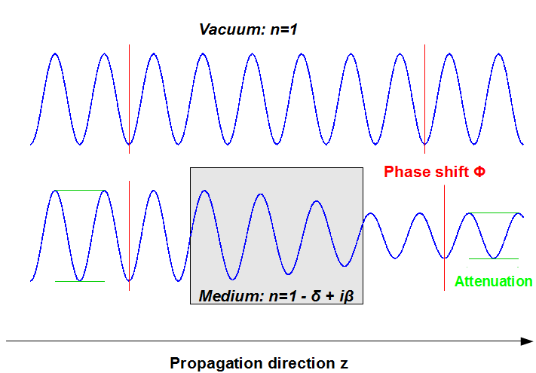
What is Attenuation?
Decrease in amplitude, intensity as waves pass through material
Measured by measuring power difference
Frequency, temperature dependent

Slide 3
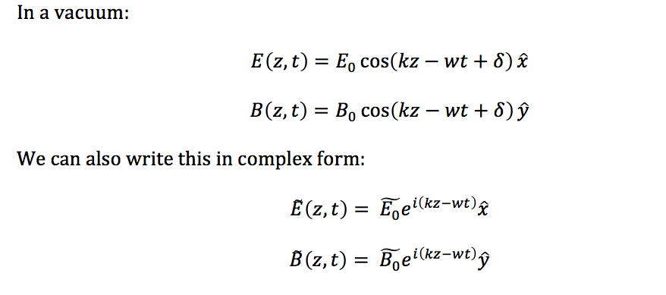
E&M Review:

Slide 4
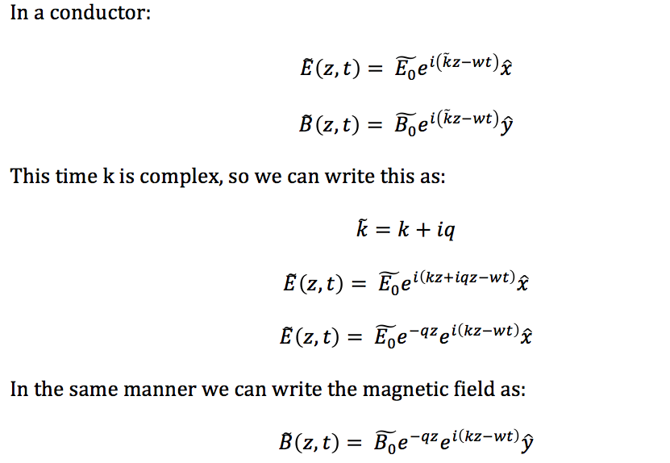
E&M Review:

Slide 5
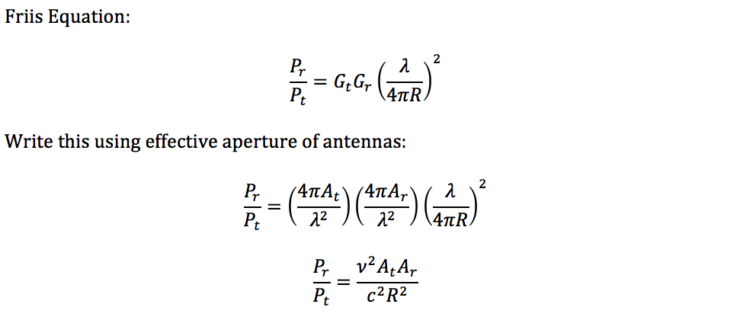
Attenuation Length

Slide 6
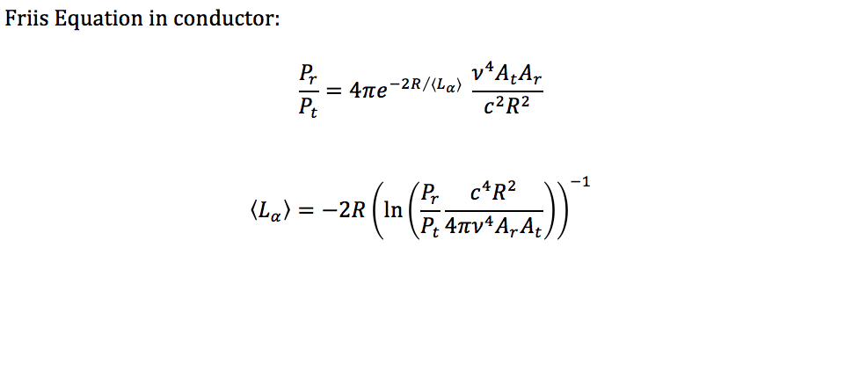
Attenuation Length

Slide 7
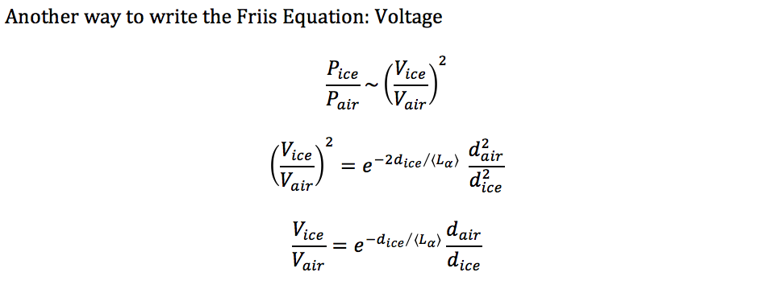
Attenuation Length

Slide 8
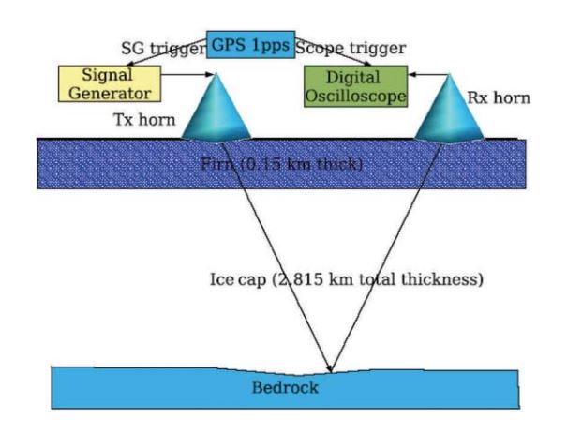

Past attenuation calculations
Barwick, S. et al. J.Glaciol. 51 (2005) 231-238
December 2003-January 2004:
RF signals broadcast vertically (see right)
Pros:
simple setup
no large cable losses
Con:
ice is at varying temperature
Horizontal broadcast was also attempted
Plot showing average attenuation length decreases as frequency increases

Slide 9
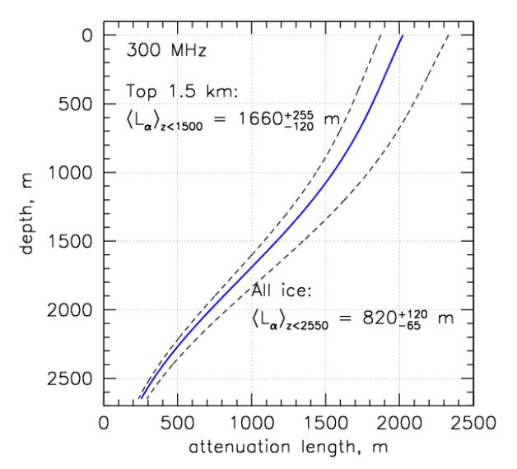
Past attenuation calculations
2010-2011
ARA needed data for full range of angles, not just vertical
Pulse generators deployed on last string of IceCube
ARA-testbed measured signal strength
Above: average attenuation length as a function of depth
(ARA Collaboration, 2011)

Slide 10
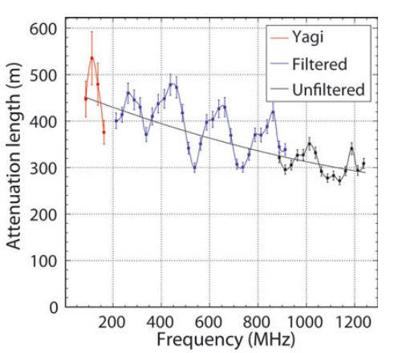
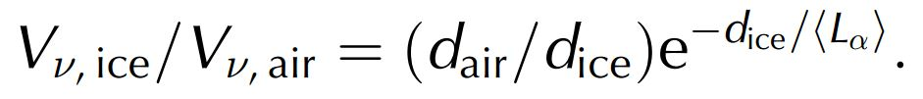
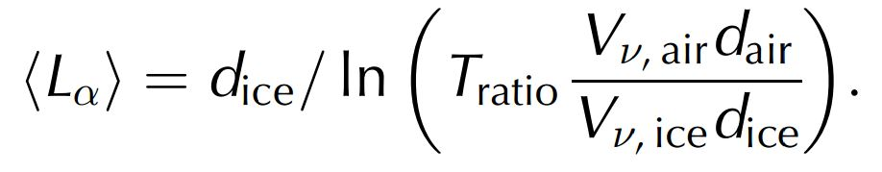
Past attenuation calculations
Barrella, T., S. Barwick, and D. Saltzberg (2011), Ross Ice Shelf (Antarctica) in situ radio-frequency attenuation,J. Glaciol., 57(201), 61–66.
2011, Ross Ice Shelf, Antarctica
Measured attenuation in Ross Ice Shelf
High-voltage impulse transmitted vertically into ice
Note: average attenuation length because of varying temperature

Slide 11
Attenuation in icemc, AraSim
Attenuation files stored in the “data” directory
“icemodel.cc” takes that data and incorporates it into simulation
What will I work on?
Updating attenuation files
Making sure both icemc and AraSim are using the most recent files
Improve attenuation calculations
Include attenuation variations based on frequency changes

