Slide 1
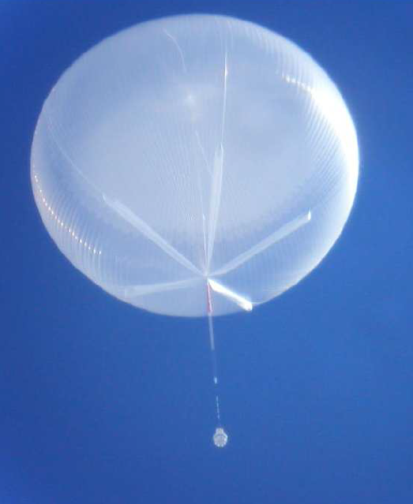
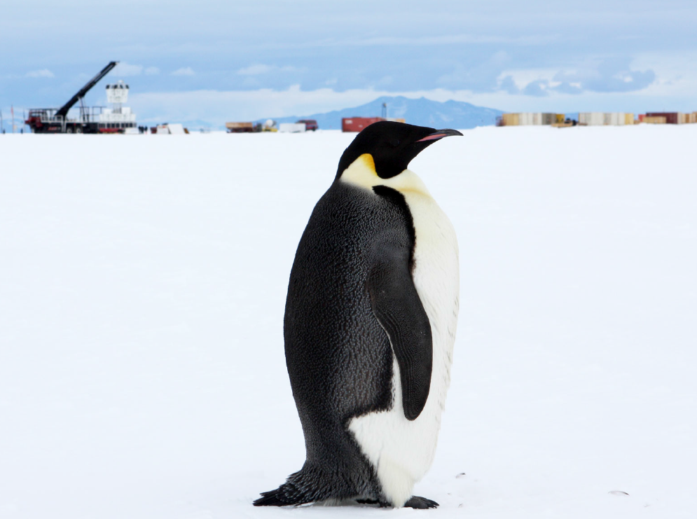
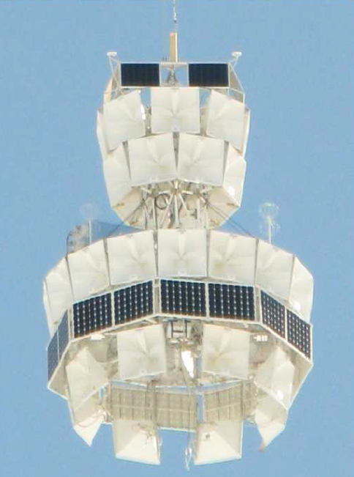
ANITA 4: A TUFF new mission to discover ultra-high energy neutrinos
Oindree Banerjee
CCAPP Seminar
August 2 2016

Slide 2
MOTIVATION
We know ultra-high energy ( > 10¹⁸ eV ) particles exist..
BUT.. What are their astrophysical origins and acceleration mechanisms?
Need reliable way of observing ultra-high energy particles to learn physics at astrophysical sites

Slide 3
ASTROPHYSICAL MESSENGERS
PHOTONS
- pair produce with CMB above 100 TeV ☹
COSMIC RAYS
- get deflected by cosmic magnetic fields ☹
NEUTRINOS
- weakly interacting, no charge
- traverses cosmic distances w/o getting attenuated
- unaffected by magnetic fields
- in theory, most reliable messenger of distant astrophysical sources

Slide 4
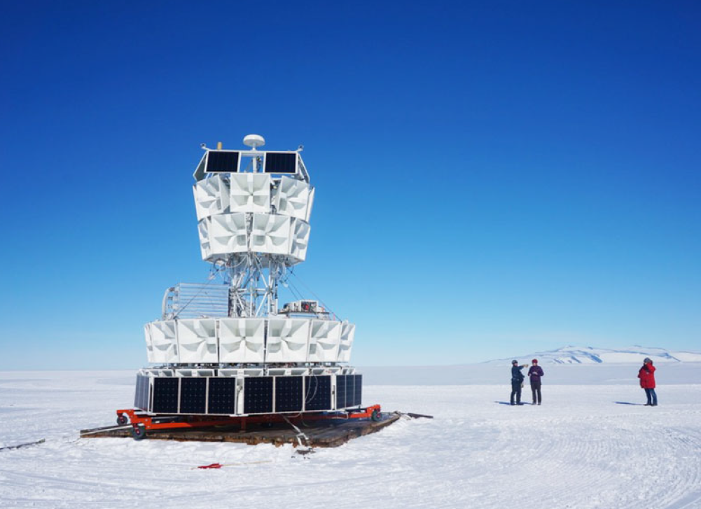
Our neutrino observatory: ANITA
Launching ANITA 4 at the end of this year!
ANITA 1: 2006-2007
ANITA 2: 2008-2009
ANITA 3: 2014-2015

Slide 5
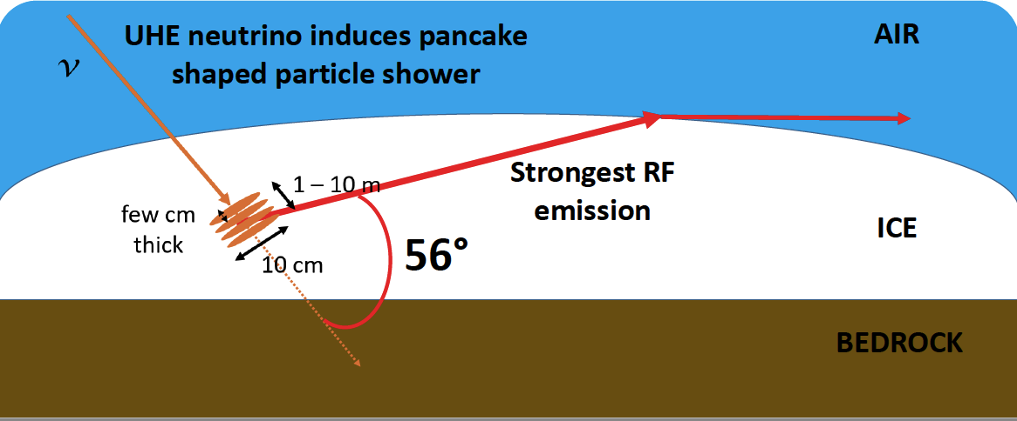
Askaryan Effect
Particle shower acquires ~ 20% negative charge excess
If charge excess moving at velocity > phase velocity of light in ice
Cherenkov radiation is emitted by ice
Coherent at wavelengths greater than Moliere radius → frequencies <~ 1 GHz
Moliere radius
cosθ = 1/n
n = 1.78 for radio in ice

Slide 6
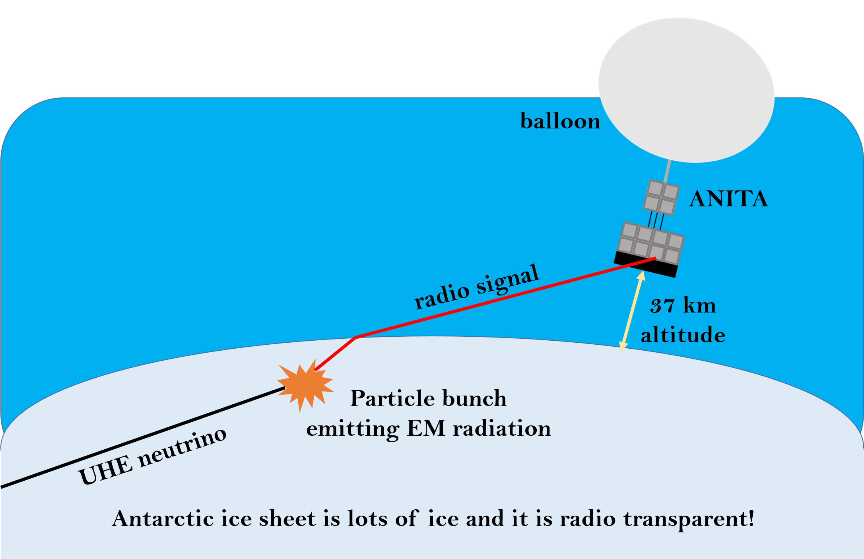
ANTARCTIC IMPULSIVE TRANSIENT ANTENNA
NASA Long Duration Balloon borne
array of 48 radio horn antennas
with both vertical and horizontal pols.
observing Antarctic ice sheet
searching for Askaryan radio emission
200 – 1200 MHz frequency range
from ultra-high energy neutrinos interacting in ice

Slide 7
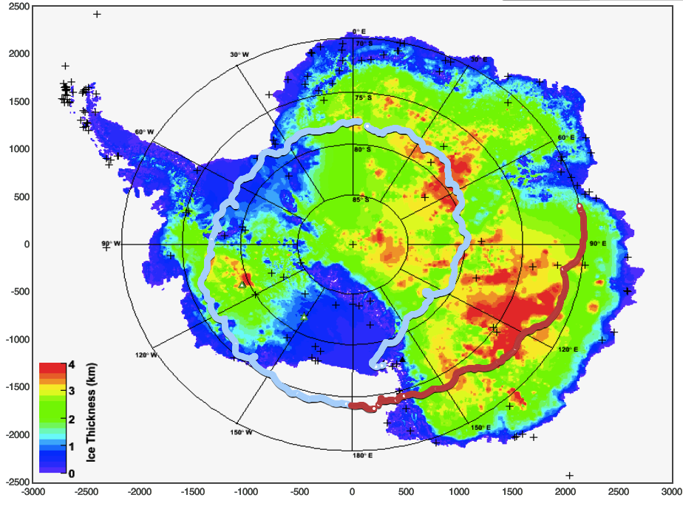
km
Dakshin Gangotri
run 208
Dome Fuji
run 342
South Pole
Siple Station
Vostok
ANITA 3
flight path
+ base
Byrd
Concordia
McMurdo
km

Slide 8
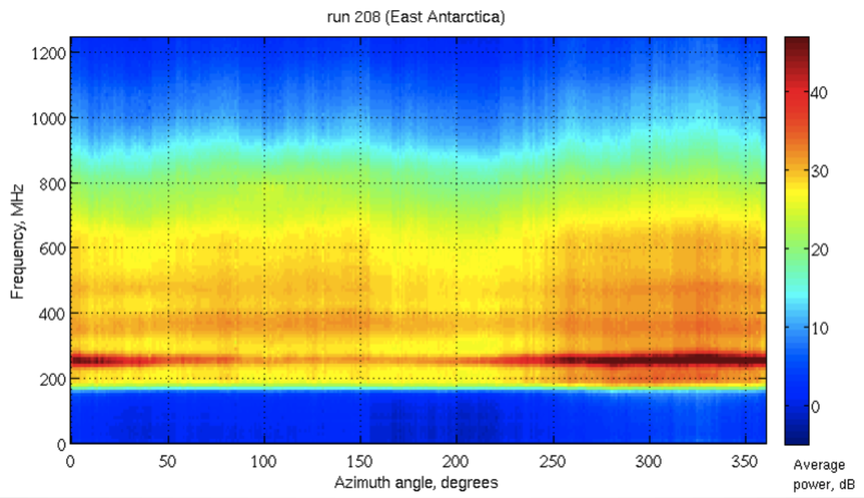
run 208, East Antarctica
Frequency, MHz
Average power, dB
Azimuth angle, degrees
plot credit: Peter Gorham
Notes:
payload coordinates? here?
do a north correction???
figure out how the phi angle works here? any correction or not??
where in the continent CW is coming from?

Slide 9
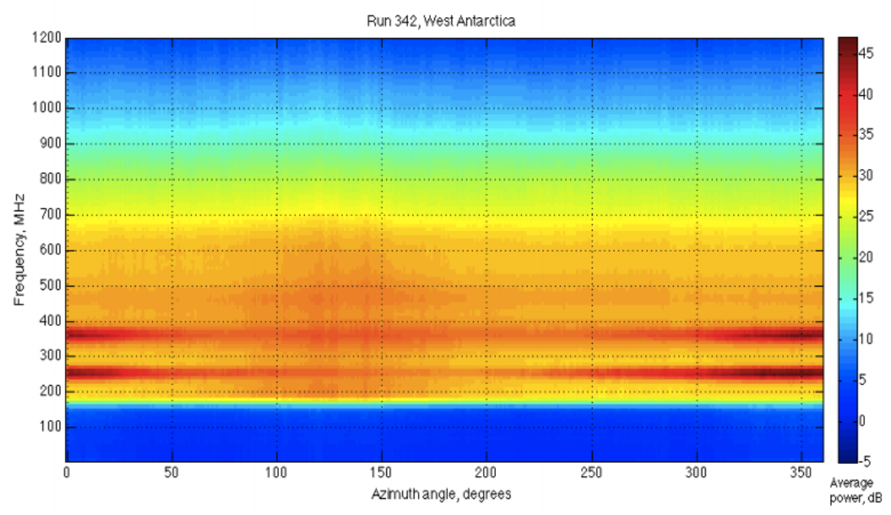
run 342, West Antarctica
Frequency, MHz
Average power, dB
Azimuth angle, degrees
plot credit: Peter Gorham
Notes:
next time show that anita 3 trigger could not tell between neutrino signal and noise from mil sats

Slide 10
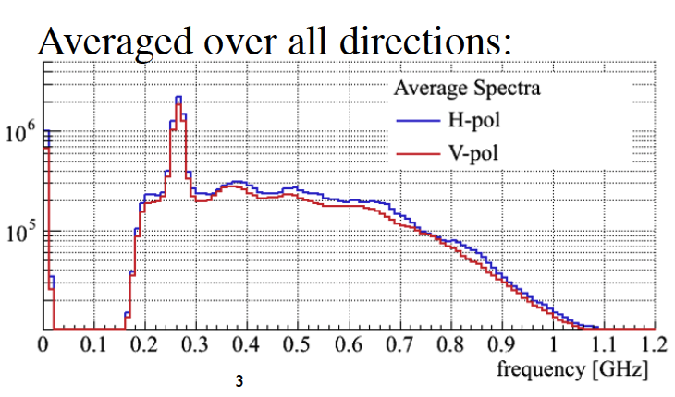
Narrow Band Noise
anthropogenic sources
lots of power in “narrow” frequency bands
led to 50% less livetime in ANITA 3
Power (arbitrary units)
plot credit: Harm Schoorlemmer

Slide 11
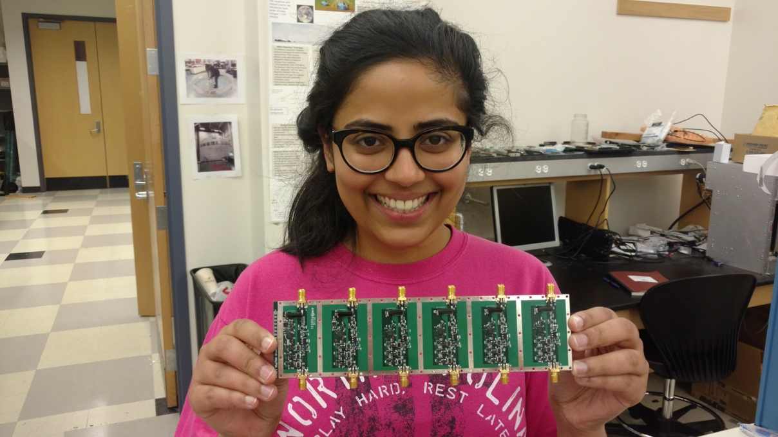
TUFF
Tunable Universal Filter Frontend
Main functions:
  Second-stage amplification ~ 45 dB
  Tunable, Switchable Notch filtering (default 260, 380 and 461.3 MHz)
    Notch filter is made of an RLC circuit (more later)
  Powers antenna amplifier with bias tee
How it will help science
  Will increase livetime of similar flight by factor of ~ 2
Notes:
draw cartoon of TUFF
system diagram
need pic of notches
based on LNA
thermal noise
payload sees 174 + 90 dB
-84 dBm (power measurement) milliWatt
LNA gain = 33 dB
push you to -61 dBm
right level for the SURFs
2nd stage
getting rid of
CW triggered events
so better efficiency
main issue is livetime
saturation problem
wasting time writing down junk
3dB = log10(X)
power
x will either 2 or ½
54 MHz
narrow notches cannot switch

Slide 12
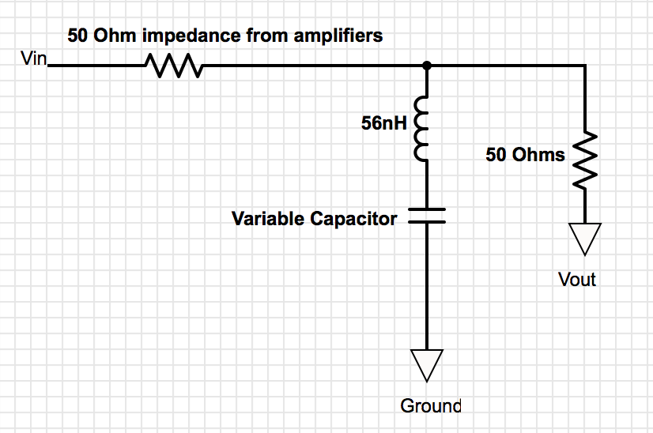
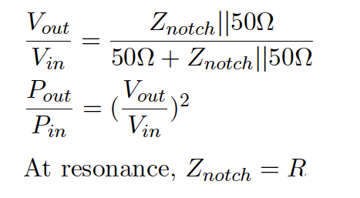

Notch filter: set resonance frequency of RLC equal to frequency we want to filter
notch filter
where R is parasitic resistance of notch filter ~ 6 or 7 Ω
we get notches ~ 13 dB deep
Notes:
13 dB
makes this noise little below thermal
so just like trigger on thermal

Slide 13
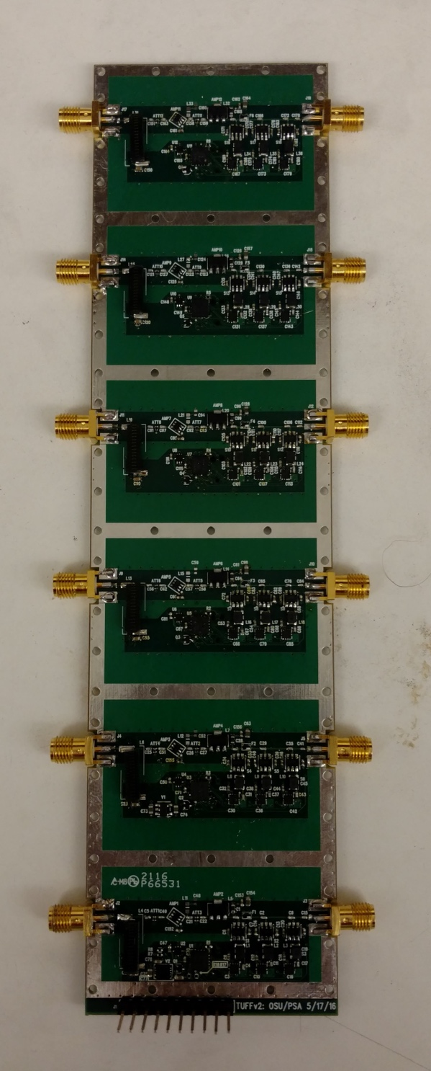
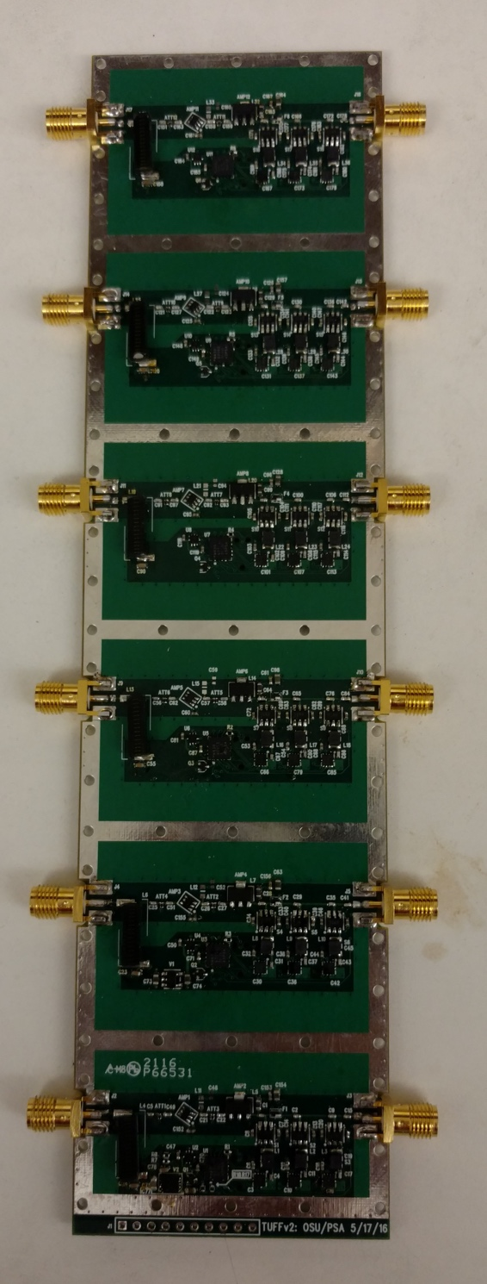
TUFF facts
TUFF 6
TUFF 7
ch 5
ch 11
16 total TUFFs for ANITA 4
6 channels each
16 x 6 = 96 channels
for 48 antennas x 2 pols = 96 RF channels
Microcontroller on each channel
Each board powered by 5 V
Draws ~ 0.4 A
ch 4
ch 10
ch 3
ch 9
ch 2
ch 8
ch 1
ch 7
ch 0
ch 6
pins
pin-holes

Slide 14
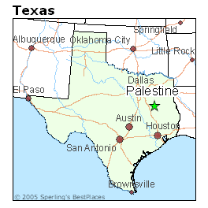
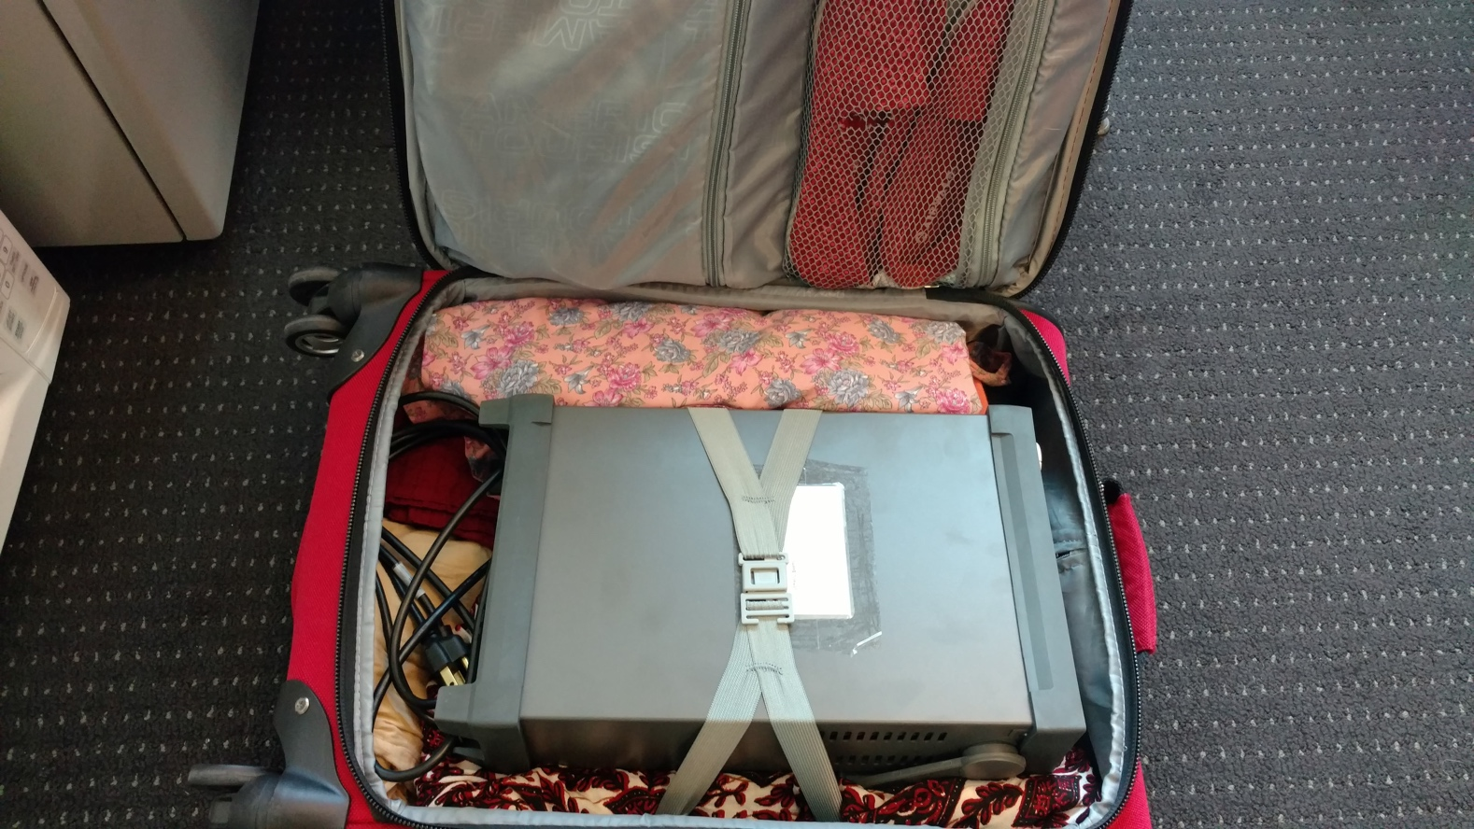
After building and testing TUFFs at OSU, we flew to Palestine, Texas for ANITA integration at NASA CSBF
I packed a small power supply for the TUFFs because the last thing we needed was a fight over power supplies with collaborators

Slide 15

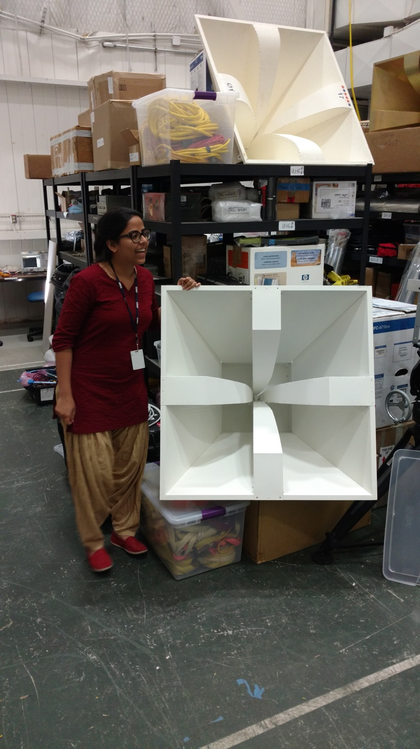
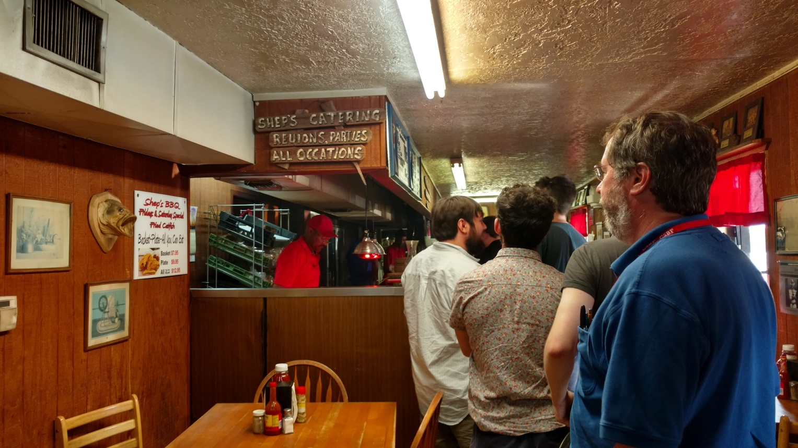
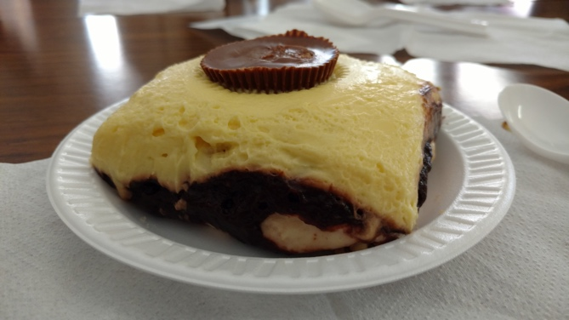
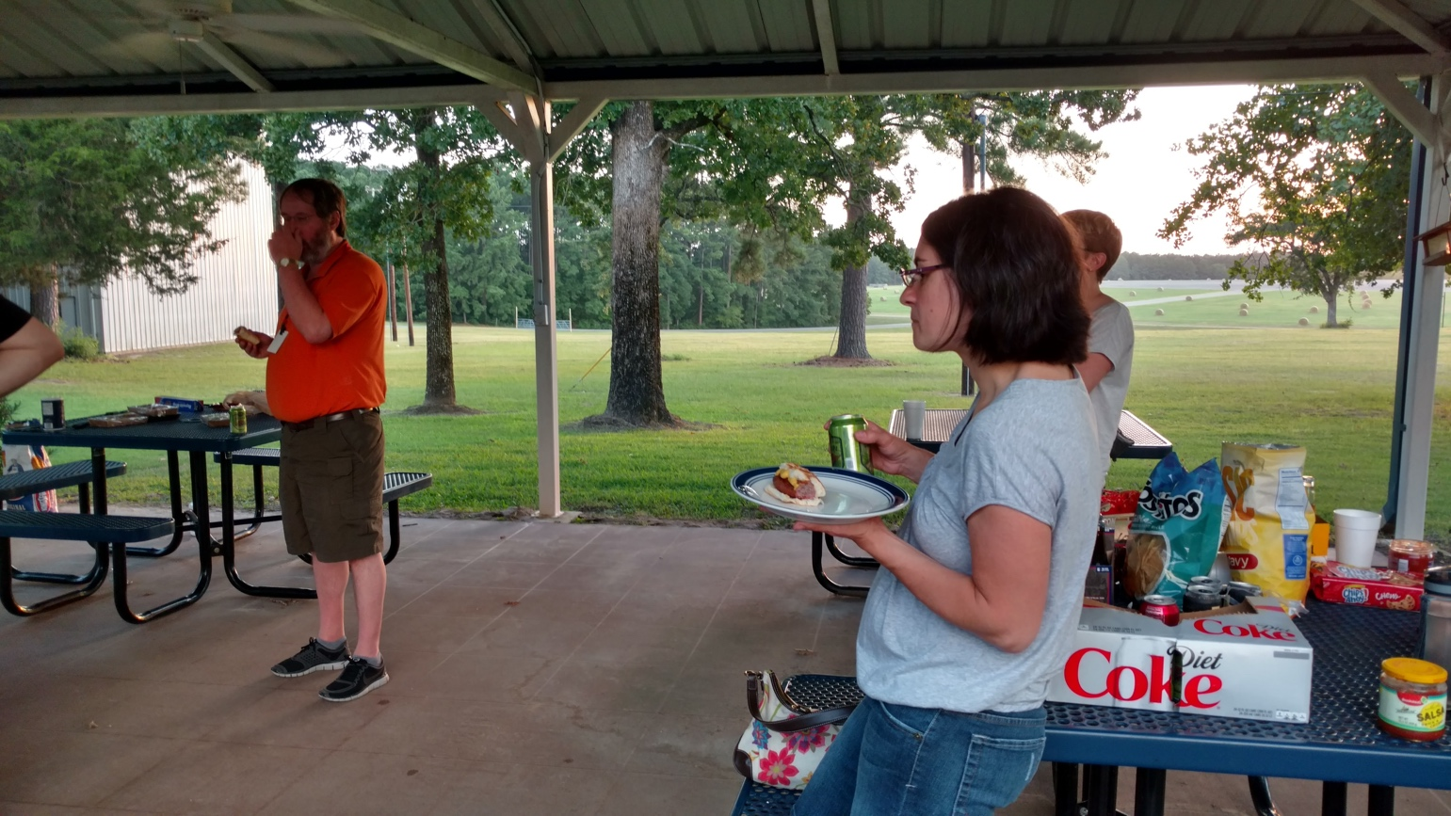
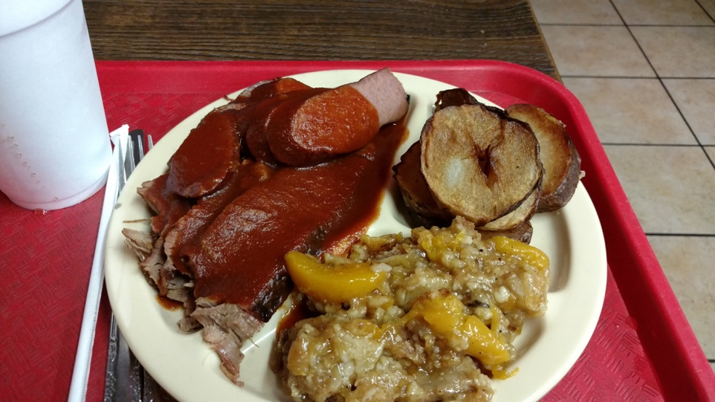
Work hard, eat lots!

Slide 16
What we learned in Palestine / this summer
Denatured ethanol is bad for boards, always use Isopropanol
When in trouble, blame the power supply! Aka, the last thing you changed duh (our first day in Palestine)
Everyone hates button cap screws, loves socket cap screws
Re-solder. Reflow. Re-solder and use some darned flux this time
Become best friends with network analyzer. Test, anything…, re-test
Just a dab of lock tight goes a long way.. and be gentle-firm for god’s sakes!

Slide 17
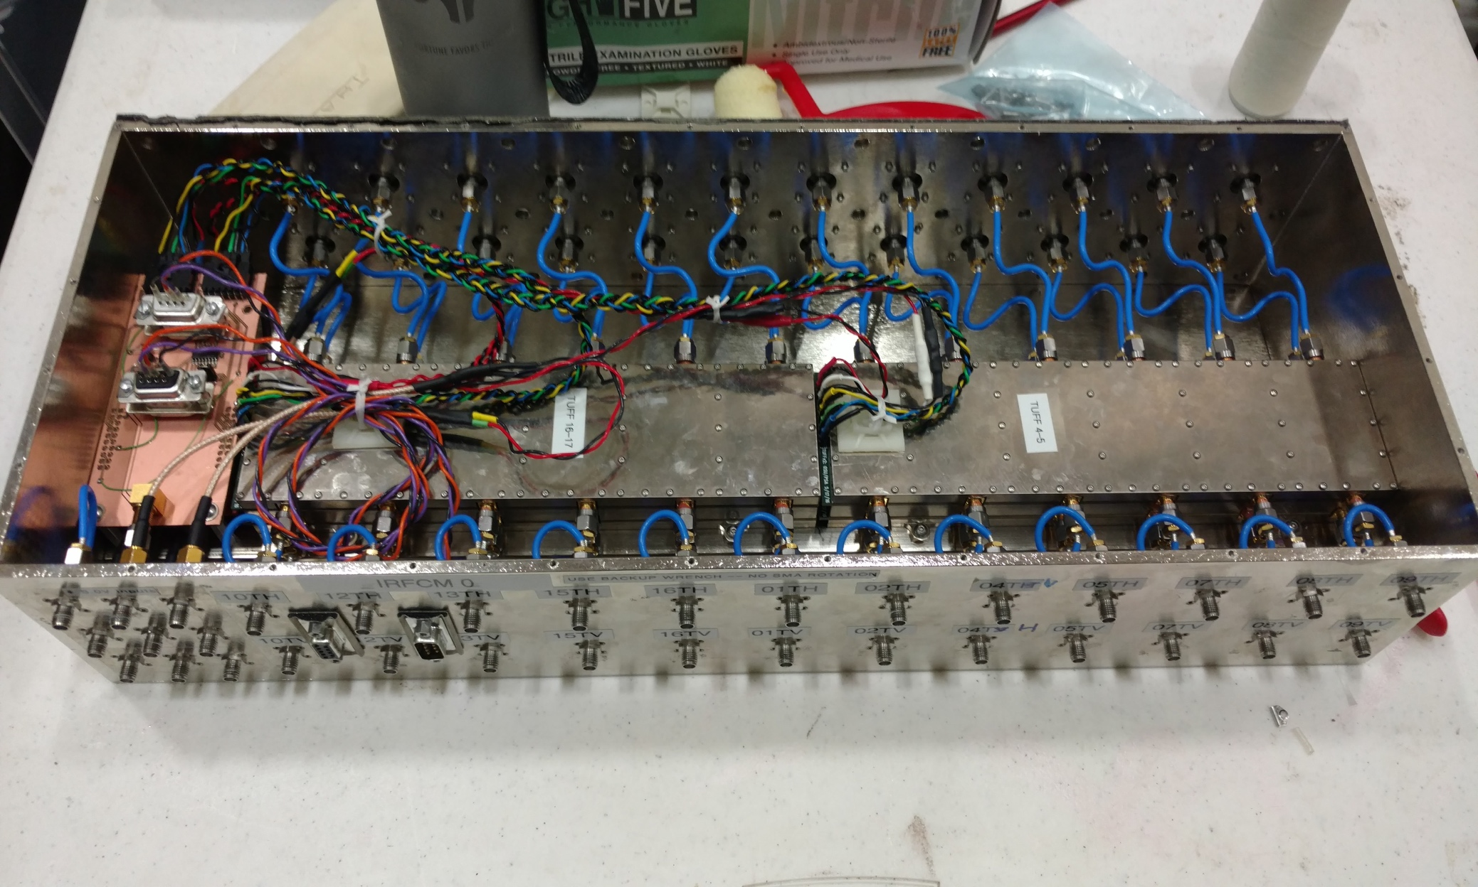
After many rounds of testing, fixing, buttoning and unbuttoning, we installed the TUFFs in the IRFCMs
TUFFs stacked in pairs of odd and even inside aluminum casing with RF padding in between to make TUFF “sandwich”
2 sandwiches go in each Internal Radio Frequency Conditioning Module (IRFCM)
Flight computer talks to TUFF master which talks to TUFF microcontrollers
TUFF master
TUFF 4-5
TUFF 16-17
RF channel
1 of 4 IRFCMs for ANITA 4

Slide 18
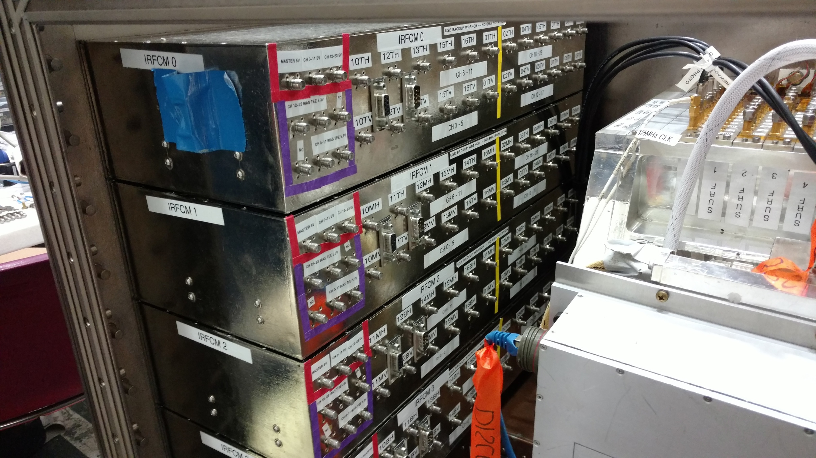
IRFCMs installed in Instrument Box of ANITA 4

Slide 19
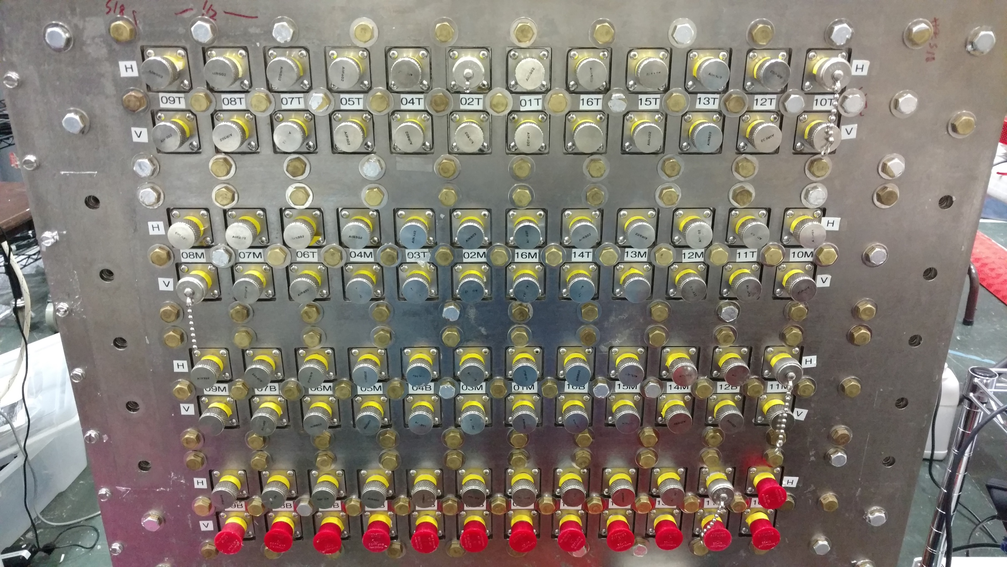
IRFCM 0
IRFCM 1
IRFCM 2
IRFCM 3
View of IRFCMs in Instrument Box from RF in side

Slide 20
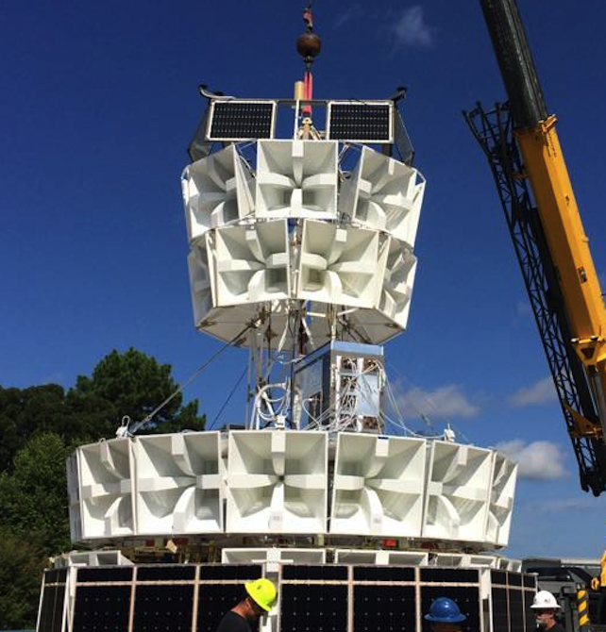
Picture is from hang test at NASA Columbia Scientific Balloon Facility,
July 30 2016
ANITA 4 passed hang test!
Ready to ship to Antarctica!
Instrument Box where our TUFFs are installed
Image credit: Christian Miki

Slide 21
TUFF notch summary
TUFF notches are tunable and switchable, can decide to turn on or off during flight
Notches are currently set to filter default frequencies 260, 380 and 461.3 MHz in the firmware
Tunable notches meant we could decide closer to ANITA integration in Palestine what the notches had to be
Bit painful to re-tune 96x3 notches but can be done

Slide 22
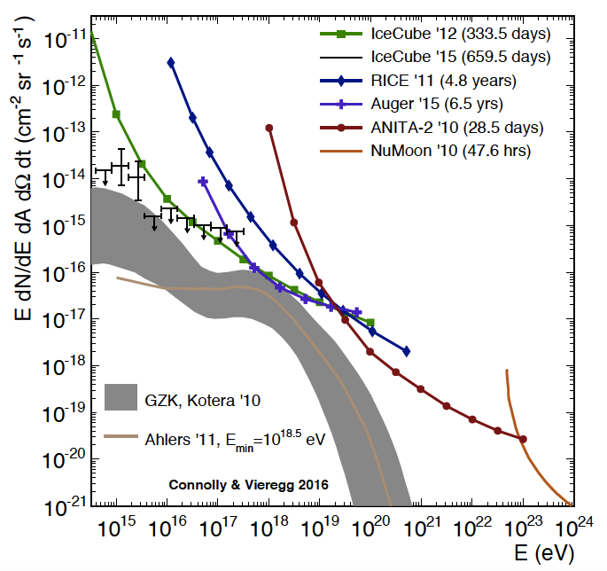
Two ways to improve our sensitivity:
move curve down
move curve to the left
Hardware improvements of ANITA 4:
  TUFF boards (move curve down)
  new trigger scheme based on LCP/RCP coincidence (move curve left)
LCP = Left Circular Polarization

Slide 23
Thank you
Any questions?

