Slide 1
Linear Discriminant Analysis(LDA) & Function Discriminant Analysis(FDA)

Slide 2
What is LDA?
A classification model used to find a linear combination of variables (or predictors) that separates two or more classes (or targets)

Slide 3
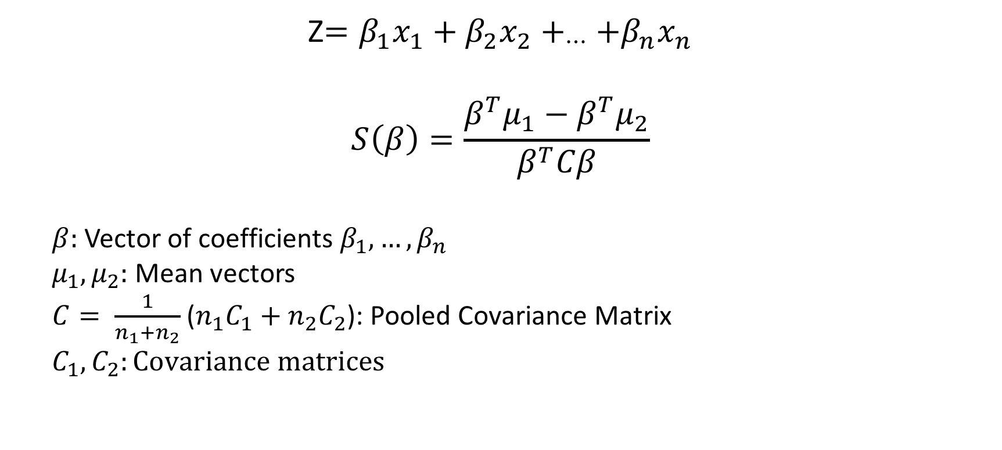
How does LDA work?
Z$=β_{1}x_{1}+β_{2}x_{2}+_{⋯}+β_{n}x_{n}$
$$S\left(β\right)=\frac{β^{T}μ_{1}−β^{T}μ_{2}}{β^{T}Cβ}$$
$β:$ Vector of coefficients $β_{1},{…,β}_{n}$
$μ_{1},μ_{2}:$Mean vectors
$C= \frac{1}{n_{1}{+n}_{2}}$ ($n_{1}C_{1}+n_{2}C_{2}$): Pooled Covariance Matrix
$$C_{1},C_{2}:Covariance matrices$$
Score Function

Slide 4
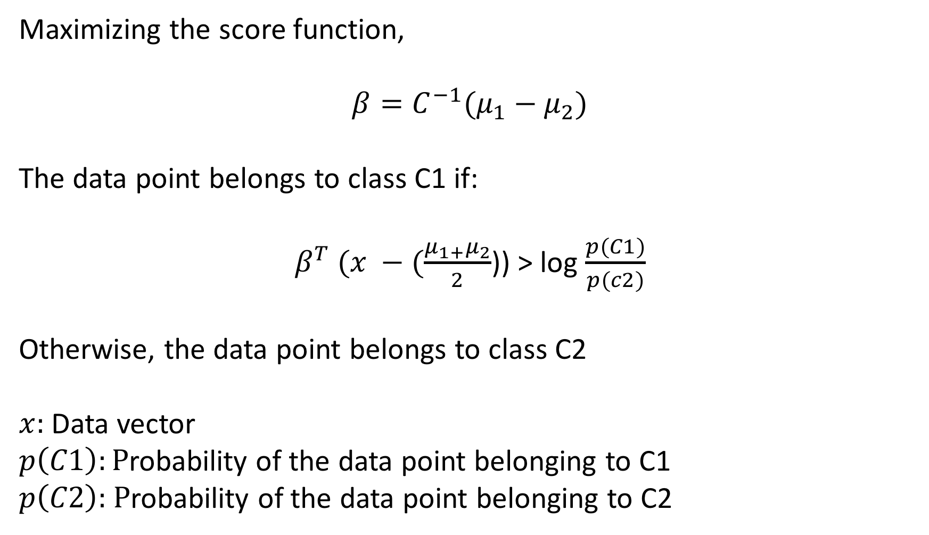
Maximizing the score function,
$$β=C^{−1}(μ_{1}−μ_{2})$$
The data point belongs to class C1 if:
$β^{T} (x −(\frac{μ_{1+}μ_{2}}{2}$)) > log $\frac{p(C1)}{p(c2)}$
Otherwise, the data point belongs to class C2
$x:$Data vector
$p\left(C1\right):P$robability of the data point belonging to C1
$p\left(C2\right):$ $P$robability of the data point belonging to C2

Slide 5
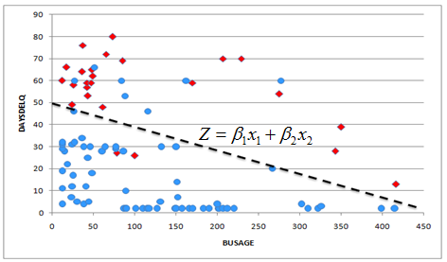
Graphical representation of LDA

Slide 6
Features of LDA
All variables must be normally distributed, continuous and hold
numeric values
LDA does not work on categorical variables
Dimensionality reduction algorithm
Goal of LDA to “find a line in feature space on which to project all
samples such that they are maximally separated” – cs.rit.edu
Notes:
Body text: https://www.cs.rit.edu/~rlaz/prec20092/slides/LDA_PCA.pdf

Slide 7
What is FDA-GA?
Goal: “To determine an optimal separating function in the
multivariate space of all input variables”-TMVA User’s Guide
Finding the parameters using evolutionary algorithms
Genetic algorithm: A method for solving both constrained and
unconstrained optimization problems based on a natural selection
process that mimics biological evolution
Invented by John Holland

Slide 8
Genetic Algorithm Flowchart
INITIALIZATION OF POPULATION
FITNESS CALCULATION
CROSSOVER
LOOP UNTIL TERMINATION CRITERION REACHED
MUTATION
REPLACE POPULATION
TERMINATE AND RETURN BEST

Slide 9
Features of GA
Population size important in determining the quality of results
Very good in dealing with complex problems
Large search space
Arbitrary constraints
Large number of parameters
Does not require derivative information
Faster, more efficient compared to traditional methods: exploit historical
information
Computationally expensive

