Slide 1
Gamma-Ray Bursts in ANITA-4
Oindree Banerjee
Department of Physics
The Ohio State University
Advisor: Prof. Amy Connolly
February 22, 2017

Slide 2


What are Gamma Ray Bursts (GRBs)?
Most luminous explosions: Luminosity ~ 10⁵² erg s⁻¹ (entire galaxy: 10⁴⁵ erg s⁻¹)
Brief: 0.1 s to several 100s s
Far: most occur at ~ 1 Gpc from us
Isotropically distributed in the sky
Rare: ~ 0.3 Gpc⁻³ yr⁻¹ (per volume per year)
$$1 erg = {10}^{−7} J$$
$$\text{p}\text{c}\text{ = 3.26 }\text{light} \text{years}$$
Notes:
Size of galaxy: 100,000 light years ~ 30 kpc
Earth to center of galaxy: 10 kpc
Distance between stars: 1 kpc

Slide 3
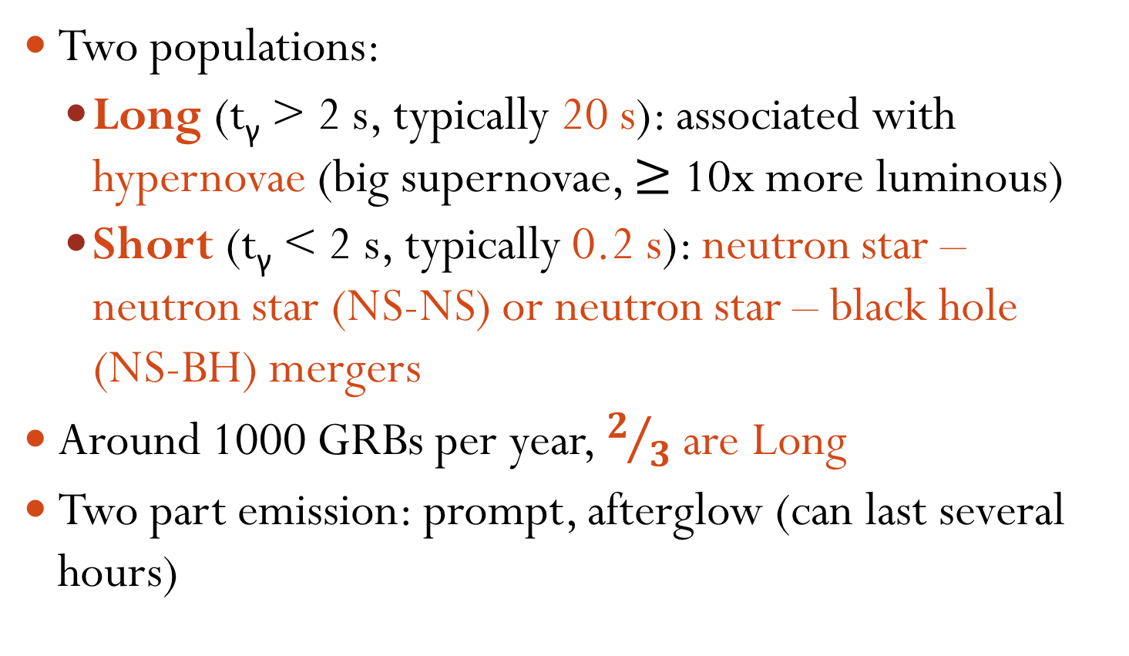
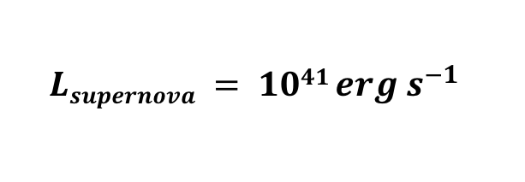
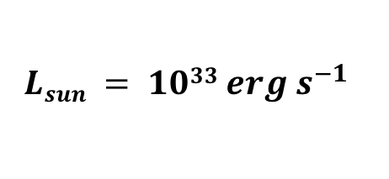
What are Gamma Ray Bursts (GRBs)?
Two populations:
  Long (t_{γ} > 2 s, typically 20 s): associated with hypernovae (big supernovae, $≥$ 10x more luminous)
  Short (t_{γ} < 2 s, typically 0.2 s): neutron star – neutron star (NS-NS) or neutron star – black hole (NS-BH) mergers
  Around 1000 GRBs per year, $2/3$are Long
  Two part emission: prompt, afterglow (can last several hours)
$$Lsupernova = 1041 erg s^{−1}$$
$$Lsun = 1033 erg s^{−1}$$
Notes:
Size of galaxy: 100,000 light years ~ 30 kpc
Earth to center of galaxy: 10 kpc
Distance between stars: 1 kpc

Slide 4
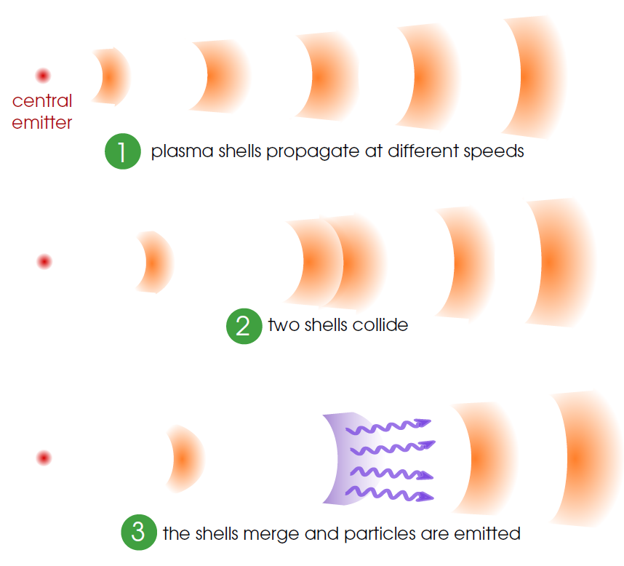


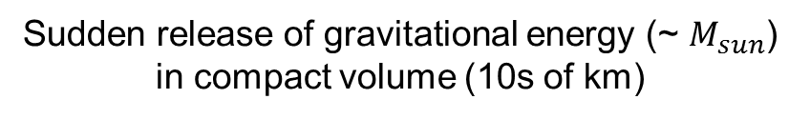
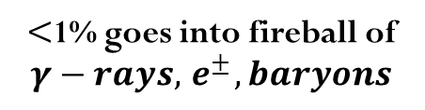
Fireball model
Cataclysmic stellar event resulting in NS or BH
Neutron star (NS) or Black Hole (BH)
Sudden release of gravitational energy (~ $M_{sun}$) in compact volume (10s of km)
Image credit: Mauricio Bustamante
$<$1% goes into fireball of $γ−rays, { e}^{±}, baryons$
Kinetic energy of relativistically expanding fireball
hadronic model
shock accelerated electrons
shock accelerated
protons
$$pγ → π^{+}, ..$$
1. synchrotron
High energy neutrinos
2. inverse-Compton
$$γ−rays$$
Notes:
Black Hole: escape velocity greater than speed of light
Neutron star: 10 km radius, 1.4 Msun
($γ−rays, e^{±}, baryons)$

Slide 5
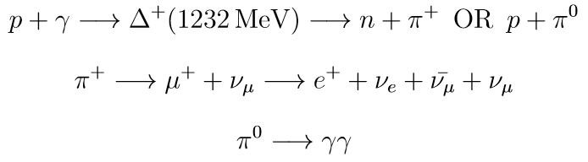
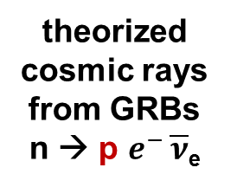
Theory: Photo-meson interaction that dominates neutrino production in GRBs
theorized cosmic rays from GRBs
n → p $e^{−}$ $\overline{ν}$_{e}
(1232 MeV/c²)
theorized neutrinos produced by GRBs

Slide 6

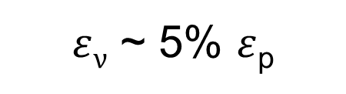

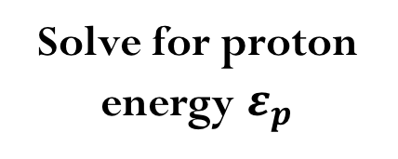
WB Theory: Particle kinematics relation tells us expected GRB neutrino energies
$$≅$$
Step 2
Solve for proton energy $ε_{p}$
Step 1b
Step 1a
Insert typical observed gamma-ray energy of 1 MeV (prompt emission) OR 100 eV (afterglow emission)
Insert Lorentz factor of 100
Result
Prompt emission: neutrino energy ~ 10¹⁴ eV
Afterglow emission: neutrino energy ~ 10¹⁸ eV
Step 3
$ε$_{ν} ~ 5% $ε$_{p}

Slide 7
Past GRB search by ANITA collaboration
Abby, Kim et al. paper is here
Using ANITA-2 data
31 day flight, 26 GRBs recorded by Swift or Fermi
Only 12 GRBs (that had thermal-like background periods) were analyzed
None had altitude angle between −25◦ and the horizon (considered good geometry for ANITA)
GRB with most promising geometry had altitude of -25.7◦
Notes:
10min / whole flight

Slide 8
Past GRB search by ANITA collaboration
Assumed input E⁻⁴ spectrum (theorized afterglow spectrum)
Constrained search in time which reduced background, analysis threshold
  GRB signal allowed to be in 10min window each so total 120mins
  Reduced background by (120mins/31days) = 0.002 (compared to diffuse search) and therefore allowed for reduction in threshold
  But 10mins only allows for quick afterglows

Slide 9
Possible ANITA-4 GRB search
Search in constrained, longer time windows
  e.g. per GRB, signal allowed to be in time window: minus 10mins to plus 6hrs = total 370mins
  To have improved opportunity for detection of theorized afterglow neutrinos which ANITA is sensitive to
  Reduce background due to time windows by ((370mins x 26GRBs)/29days) = 0.230
Notes:
take out the background stuff
if after lot of work
if we can constrain nu direction by 20 by 20 for example
then
might not be able to say number for direction yet
0.25*
0.0057050343

Slide 10
New neutrino direction constraint?
Constrain search in neutrino direction also
  This has not been done yet
  Can try to develop techniques as part of my thesis work to constrain direction
  e.g. per GRB, if signal is allowed to be in 20◦ x 20◦ = 400 degrees² window (if we can do that)
  reduce background due to direction windows by (400 sq. degrees /(30degrees (θ range) x 360degrees (ɸ range) )) = 0.037

Slide 11
Result of time and direction constraints
  Reduce background by (0.230 x 0.037) = 0.008 (compared to diffuse search)
Order of magnitude, ~same reduction factor as past search if we can constrain the neutrino direction to 400 degrees²
Plus, sensitivity to longer afterglows which are more likely to produce UHE neutrinos

Slide 12
NeuCosmA
Use NeuCosmA for neutrino flux predictions (like in ARA GRB paper)
  both prompt and afterglow models being upgraded this year to more accurate versions
  can obtain custom spectra for each GRB
  Mauricio Bustamante at OSU is eager to help

Slide 13
Reject fewer GRBs?
  Past ANITA GRB search rejected 14 out of 26 GRBs due to the presence of anthropogenic noise in the time window
  With ANITA-4, we might be able to keep more GRBs due to reduction of anthropogenic noise in triggered events due to TUFFs and LCP/RCP

Slide 14
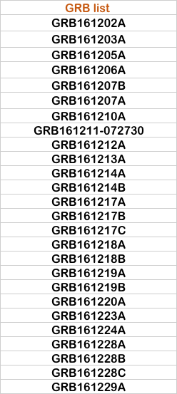
26 GRBs during ANITA-4 flight and their altitudes (θ)
θ = 0◦
ANITA
v
θ = -25◦
v
Good geometry: -25◦ to 0◦
Close to good range
Below horizon, steep
Above horizontal
Past search: GRB with most promising geometry had altitude of -25.7◦
**GRB databases still updating, numbers can change, errors next time

Slide 15
Next Steps
Obtain GRB time durations and photon energy spectra as GRB databases get updated
Contribute to completion of ongoing diffuse search efforts
Learn to generate GRB spectra with NeuCosmA by end of Summer (Mauricio leaves OSU)
Check out noise levels in background regions surrounding each GRB
Start to look at techniques for constraining neutrino direction

Slide 16
Thank you!

Slide 17
Back up slides

Slide 18
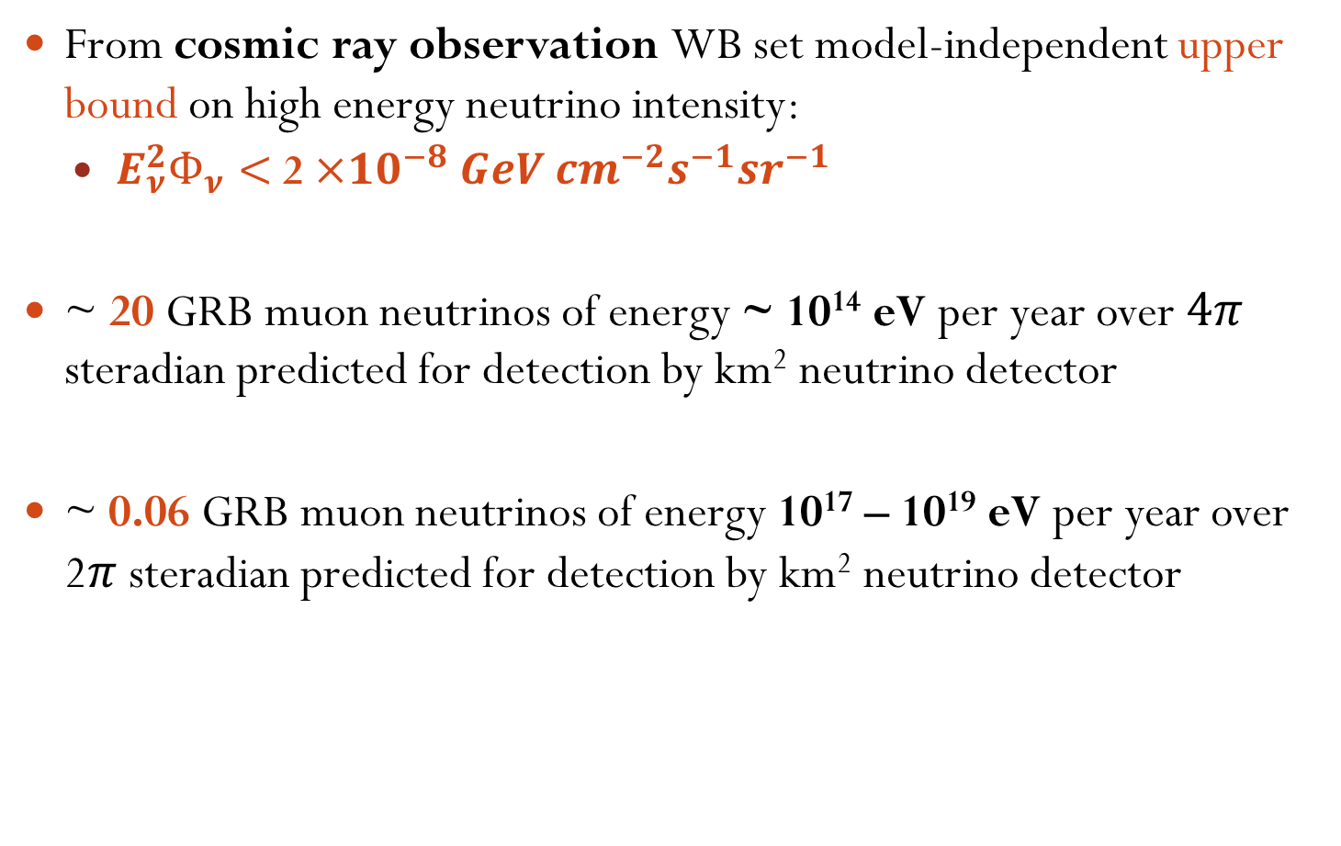
Early (1997-2000) theoretical predictions by Waxman-Bahcall (WB)
From cosmic ray observation WB set model-independent upper bound on high energy neutrino intensity:
  $E_{ν}^{2}Ф_{ν}<$ 2 $×{10}^{−8} GeV cm^{−2}s^{−1}sr^{−1}$
~ 20 GRB muon neutrinos of energy ~ 10¹⁴ eV per year over $4π$ steradian predicted for detection by km² neutrino detector
~ 0.06 GRB muon neutrinos of energy 10¹⁷ – 10¹⁹ eV per year over 2$π$ steradian predicted for detection by km² neutrino detector
Notes:
Importance: observation of high energy neutrinos from GRBs would be unambiguous proof of hadronic acceleration in GRBs.

Slide 19
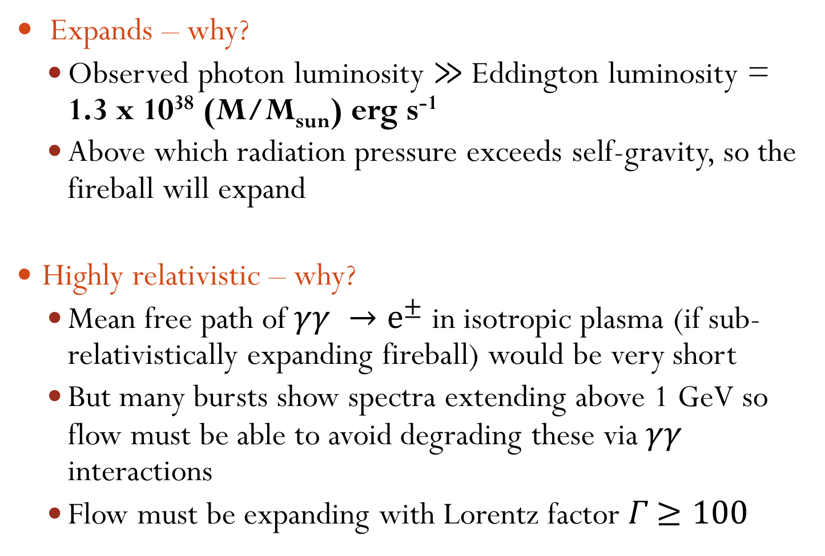
Fireball FAQs
Expands – why?
  Observed photon luminosity $≫$Eddington luminosity = 1.3 x 10³⁸ (M/M_{sun}) erg s⁻¹
  Above which radiation pressure exceeds self-gravity, so the fireball will expand
Highly relativistic – why?
  Mean free path of $γγ →e^{±}$ in isotropic plasma (if sub-relativistically expanding fireball) would be very short
  But many bursts show spectra extending above 1 GeV so flow must be able to avoid degrading these via $γγ$ interactions
  Flow must be expanding with Lorentz factor 𝛤 $≥100$
Notes:
$σ_{T}$ : Thomson scattering cross section $=6.65 ×{10}^{−29} m^{2}$

Slide 20
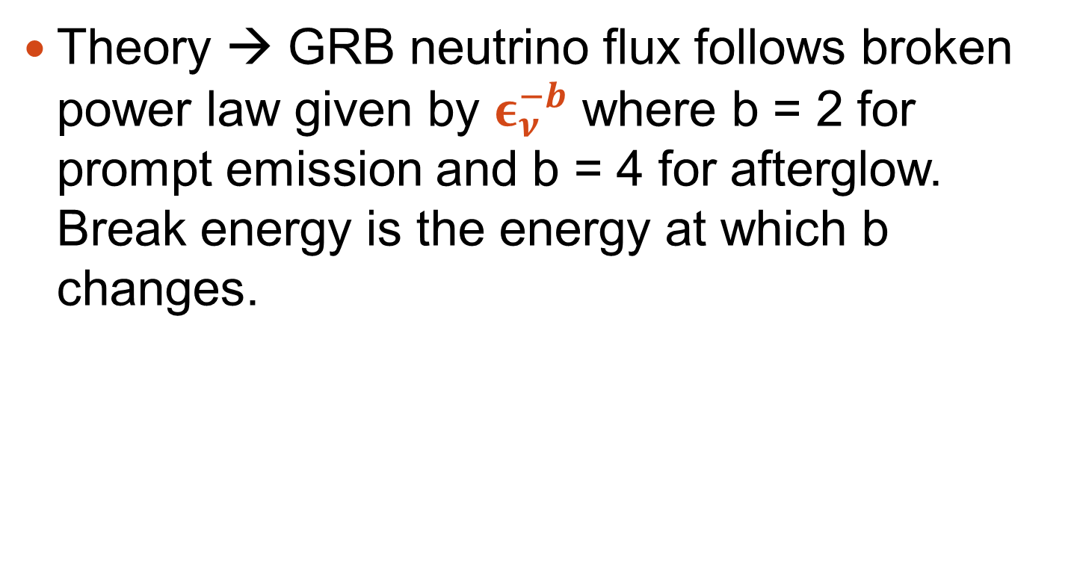
Break energy
Theory → GRB neutrino flux follows broken power law given by $ε_{ν}^{−b}$ where b = 2 for prompt emission and b = 4 for afterglow. Break energy is the energy at which b changes.

Slide 21
time
-10 min
SIGNAL
BACKGROUND
-20 min
0
+6 hr
+24 hr

