Slide 1
Magnetic Monopole Searches in
Astroparticle Physics
Oindree Banerjee
The Ohio State University
June 20, 2016

Slide 2
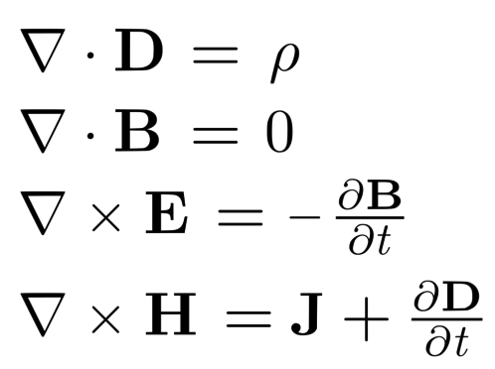
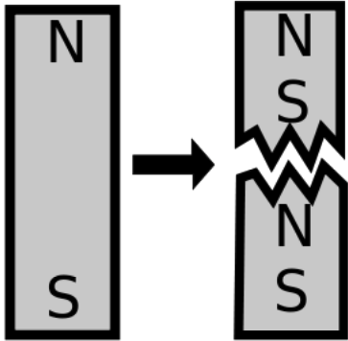
What is a magnetic monopole and why do we look for them?
Magnetic poles always found in pairs
Magnetic monopole would possess one magnetic pole
Asymmetry in Maxwell’s equations
Motivate us to look for magnetic charge

Slide 3
Dirac’s Quantization of Magnetic Charge
Quantization of electric charge is long-standing mystery
Dirac showed that existence of magnetic charge leads to electric charge quantization
Calculated simple relationship between fundamental magnetic charge g and the quantum of electric charge e given by
g = e / 2α
in Gaussian units, where α is the fine structure constant (1/137)

Slide 4
Suppose magnetic charge exists, rewrite Maxwell’s equations with ρ_{m} and J_{m}
e
ρ_{m}
- J_{m}
e

Slide 5

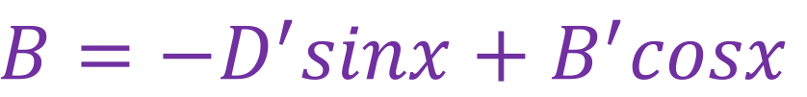
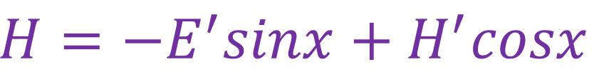

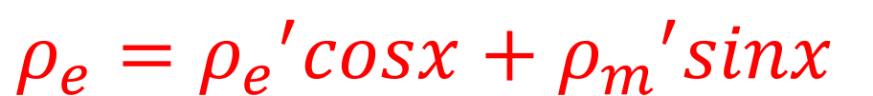
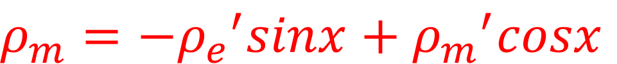

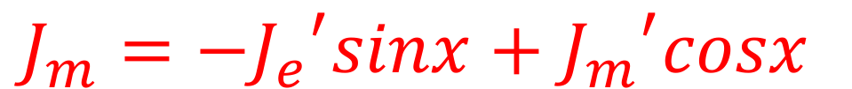
Perform a duality transformation of the fields and the sources
$$E=E^{′}cosx+H^{′}sinx$$
$$ρ_{e}={ρ_{e}}^{′}cosx+{ρ_{m}}^{′}sinx$$
$$B=−D^{′}sinx+B^{′}cosx$$
$$ρ_{m}={{−ρ}_{e}}^{′}sinx+{ρ_{m}}^{′}cosx$$
$$H=−E^{′}sinx+H^{′}cosx$$
$$J_{e}={J_{e}}^{′}cosx+{J_{m}}^{′}sinx$$
$$D=D^{′}cosx+B^{′}sinx$$
$$J_{m}={{−J}_{e}}^{′}sinx+{J_{m}}^{′}cosx$$
Maxwell’s equations with magnetic charge remain invariant under duality transformation
Notes:
lorentz boost E get H
lorentz boost B get D

Slide 6
Invariance under duality transformation means that
it is matter of convention for particle to have electric charge but no magnetic charge
maybe ALL particles have the same ratio of electric to magnetic charge leading to the simple equation g = e / 2α
if they do, we can choose x so that ρ_{m} = 0, J_{m} = 0
to get Maxwell’s equations as we know them, i.e. without magnetic charge
point is: there is lots of motivation to look for magnetic charge

Slide 7
Intermediate Mass Monopole (IMM)
Grand Unified Theory (GUT) predicts magnetic monopoles at energy scale ~ 10¹⁶ GeV
Theorized magnetic charges IMM’s have mass << GUT scale and are ultra-relativistic
  Mass: 10⁵ - 10¹² GeV
  Implies Lorentz factor: 10¹¹ – 10⁴
  Expect Large Cherenkov Emission
  Should be readily detectable by Astroparticle experiments like ANITA, RICE

Slide 8
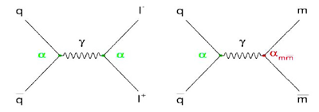


Feynman diagrams
quark
monopole
quark
lepton
m
$$γ$$
$$γ$$
α
α
α_{mḿ}
α
α
α
anti-quark
anti-lepton
anti-quark
anti-monopole

Slide 9
The experiments and corresponding results we discuss here:
ANITA: Antarctic Impulsive Transient Antenna
RICE: Radio Ice Cherenkov Experiment

Slide 10
What is ANITA?
Balloon-borne antenna array primarily designed to detect radio wave pulses caused by neutrino interactions with matter (ice)
From elevation of ∼ 38 km detector scans Antarctic continent in circumpolar trajectory
ANITA has flown thrice so far, ANITA-2 (40 antennas) searched for monopoles
After launching from McMurdo Station, ANITA-2 was aloft for 31 days
Notes:
Because bremsstrahlung falls off by inverse powers of particle mass

Slide 11
ANITA simulation for monopoles
Monte Carlo simulation needed to figure out ANITA’s sensitivity to monopoles (IMM’s)
Model of monopole energy loss based on the muon/tau energy loss model of Dutta et al
− dE/dx = α + βE
α is term for ionization, β is term for bremsstrahlung, pair production, photonuclear effect
Photonuclear effect is the dominant energy loss mechanism at γ > 10⁴, while ionization energy losses dominate below this value of γ

Slide 12
ANITA-2 trigger
ANITA-2 has hierarchical triggering scheme (L0 – L3) and 4 digitizing buffers
allows relatively low neutrino detection trigger threshold while maintaining ∼ Hz thermal noise data rate written to disk
Monopole signature expected to consist of first 4 threshold-crossings (∼500 ns total time) once the monopole comes into view
remaining signal produced by monopole ionization trail not registered due to dead-time as 4 buffers fill
Notes:
This partitioning is performed in order to provide rejection power against narrow-bandwidth anthropogenic backgrounds,
while retaining high efficiency for sharp duration (temporally), large-bandwidth neutrino signals.
In entire data sample, only 4 events contained 4 rapid triggers satisfying the 500 ns maximum total trigger time criterion.

Slide 13
ANITA analysis
In entire data sample, only 4 events contained 4 rapid triggers satisfying the 500 ns maximum total trigger time criterion
all 4 were background dominated by CW lines
whereas monopole signals should exhibit broadband characteristics of temporally-sharp, coherent radio wavelength signals
so no monopoles were found

Slide 14
RICE
RICE consists of 16 data-taking antennas buried in the Antarctic ice ~ 1 km from geographic South Pole
Antennas roughly within a cube of ice ∼ 200 m on a side with its center ∼ 150 m below the surface
have peak sensitivity in the 200–500 MHz regime
Used same model of monopole energy loss (Dutta et al) as ANITA
Trigger occurs if 4 or more antennas register high-amplitude voltages within a time coincidence of 1.25 microseconds
Triggers initiate an 8.192 μs waveform capture, sampled at a rate of 10⁹ samples / second, for all under-ice antennas
did not find any monopoles
Notes:
To produce a bound it is necessary to quantify the sensitivity of RICE to monopoles.
A Monte Carlo simulation code (“monoMC”) was therefore created to evaluate RICE’s monopole detection efficiency, as detailed below.

Slide 15
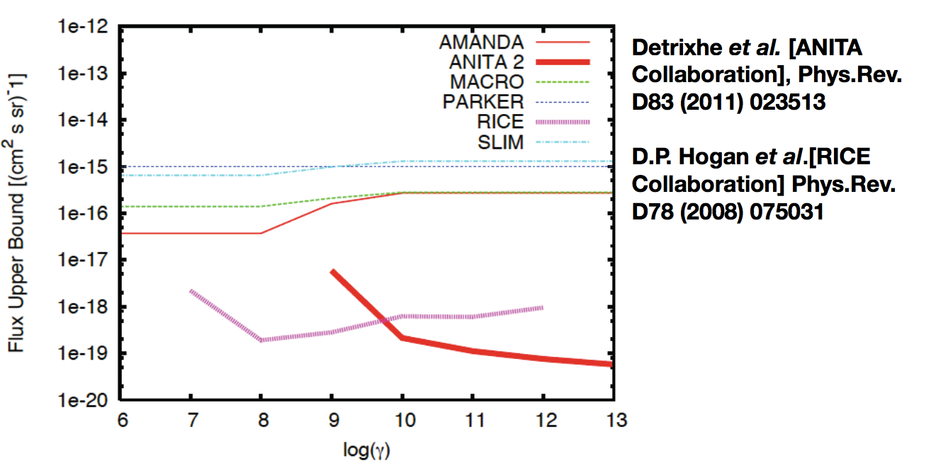
Best Limits on Monopole Flux so far
Log ( Lorentz factor )

Slide 16
Thank you
Questions?

Slide 17
Backup slides

Slide 18
ANITA-2 trigger details
Hierarchical ANITA-II trigger (L0 – L3) allows relatively low neutrino detection trigger threshold, while maintaining ∼Hz thermal noise data rate written to disk
In contrast to ANITA-I, only signals from the VPol channel of the dual-polarization horn antennas contribute to ANITA-II trigger
Following antenna, signals routed through trigger path are tested for their spectral power in 4 frequency bands 200→350, 330→600, 630→1100 and 150→1240 MHz
Frequency-banded signals are then passed through a tunnel-diode, which integrates roughly 7-ns units of data and provides a unipolar (negative) output pulse.
L0 required signal in 1 of 4 frequency bands > 2.3σ_{V} where σ_{V} is the RMS of the typical tunnel-diode output voltage at this point
L1 required 2 of 3 frequency bands + full-band trigger within 10 ns window
L2 issued in 1 of 16 phi sectors when 2 of 3 antennas on or adjacent to that phi sector triggered within 10 ns of each other
L3 required 2 of 3 antenna rings (upper, lower, and nadir) to have an L2 trigger within 10 ns

