Slide 1
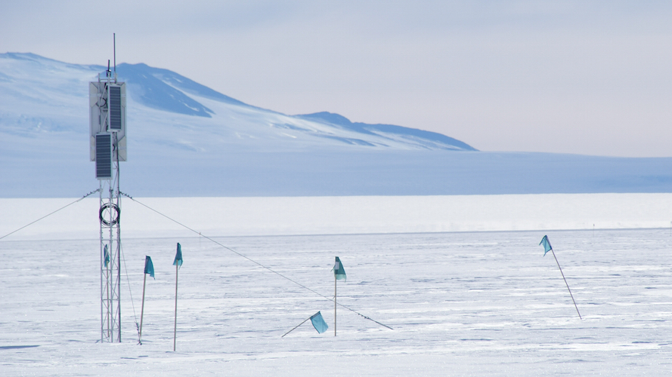
ARIANNA
1
Hannah Hasan & Jude Rajasekera

Slide 2

ARIANNA
ARIANNA (the Antarctic Ross Ice-Shelf ANtenna Neutrino Array) is a neutrino detector that searches for ultra high energy (UHE) cosmic neutrinos
ARIANNA detects the radio pulses emitted when UHE neutrinos interact in Antarctic ice.¹
2

Slide 3
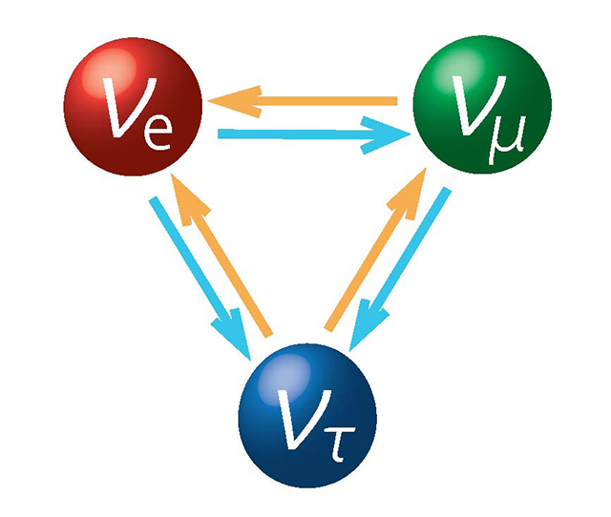
What are neutrinos?
4
Neutrinos are particles that have no charge and almost no mass, and rarely interact with matter.¹
Trillions of neutrinos are flooding out of the sun, the earth, and through the interactions of cosmic rays in our atmosphere from the universe and they pass through us with no observable effects.³

Slide 4
How are they detected?
Neutrinos cannot be detected directly. As such, we must employ other methods of detection
When a neutrino passes through a dielectric –– ice, in our case –– it has a chance of interacting with the medium, producing a cascade of other particles
Some of these particles are charged, and if they move with a velocity greater than the phase velocity of light for the medium, the medium will emit electromagnetic radiation known as Cherenkov radiation.⁶
By detecting the radiation, we can draw conclusions about the original neutrino

Slide 5
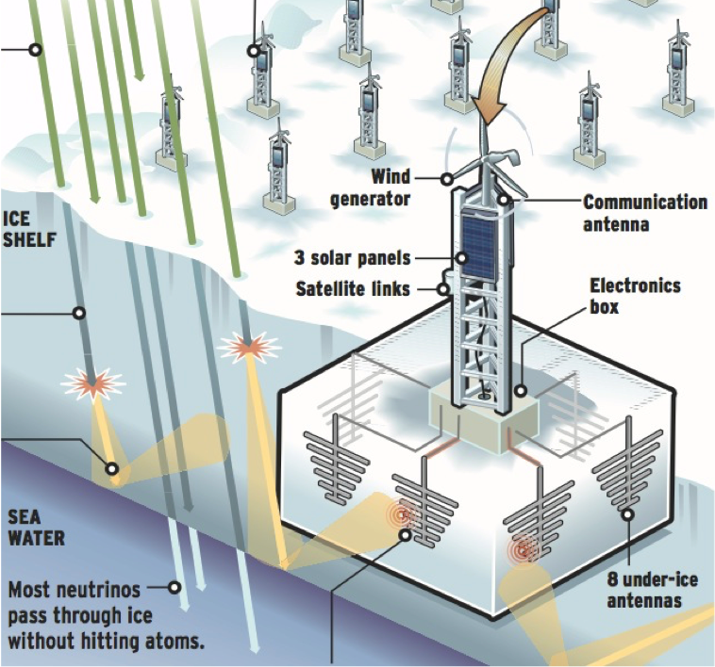
The Detector
1
ARIANNA’s initial design includes 1000 detector stations over a 36 x 36 square kilometer area
A single station has 8 antennas below the ice that detect radio waves
Currently 8 stations are deployed in Moore’s Bay¹
PICTURED: radio waves can reflect off the sea-ice boundary

Slide 6
Why do we care?
Physicists study neutrinos to uncover more about the events and processes that produce the neutrinos
UHE neutrinos are produced in astrophysical events such as Gamma Ray Bursts, and in bodies such as Active Galactic Nuclei.⁵
Since neutrinos have no charge and very low mass, their paths are more or less unaffected as they travel to earth from their sources. This means we can more easily pinpoint the sources and study the processes that produce some of the most energetic particles in the universe.⁶

Slide 7
Simulation using ShelfMC
Computer simulation is used to recreate neutrino-ice interactions at a low cost and at a high speed in order to optimize the efficacy of our experiments. For example, we can use simulations to determine the optimal depth at which a detector should be placed in the ice
ShelfMC models the detection of UHE neutrinos that interact in the ice and generate signals that propagate to the ARIANNA station
ShelfMC is a Monte Carlo simulation (hence the ‘MC’), which is a simulation technique that relies on repeated random sampling

Slide 8
Our Work with ShelfMC
We have been trying to optimize the configuration of the ARIANNA stations using ShelfMC
We are in the process of creating a collection of data from simulation runs with varying parameters for different station configurations and environmental conditions -- Examples include snow depth, attenuation length, and station depth.

Slide 9
Goals
ShelfMC: use simulations to determine optimal configuration for ARIANNA stations
ARIANNA: Detect UHE cosmic neutrinos and trace them back to their source, so that we may learn more about the processes that accelerate particles to such high energies

Slide 10
Sources
http://arianna.ps.uci.edu/
www.darkmatterneutrino.com
https://profmattstrassler.com/2011/09/25/how-to-detect-neutrinos/
www.quantumdiaries.org
http://www.sns.ias.edu/
Connolly, Vieregg. “Radio Detection of High Energy Neutrinos.” (2016). arXiv:1607.08232v1.

