Slide 1


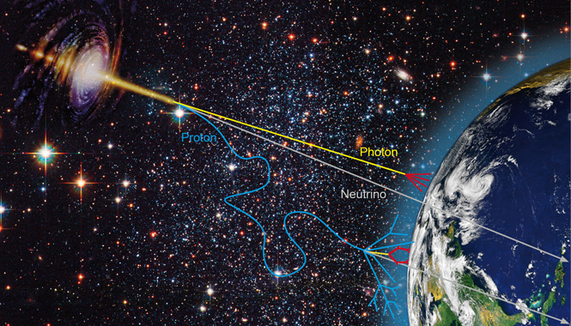
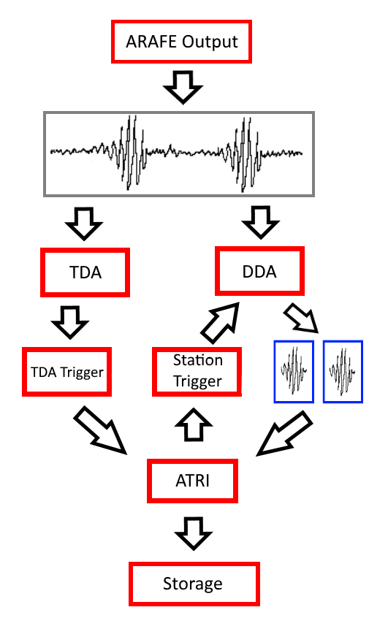
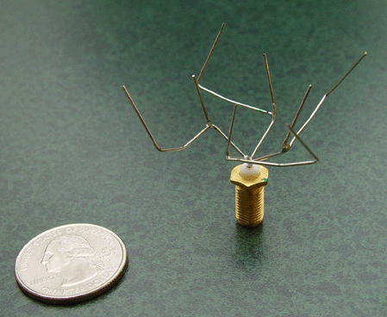
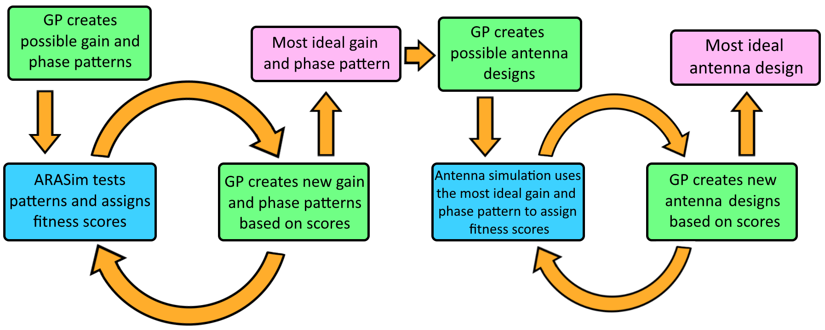
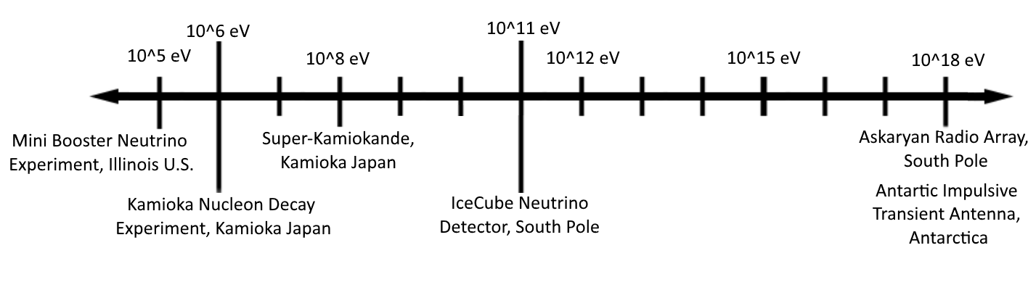
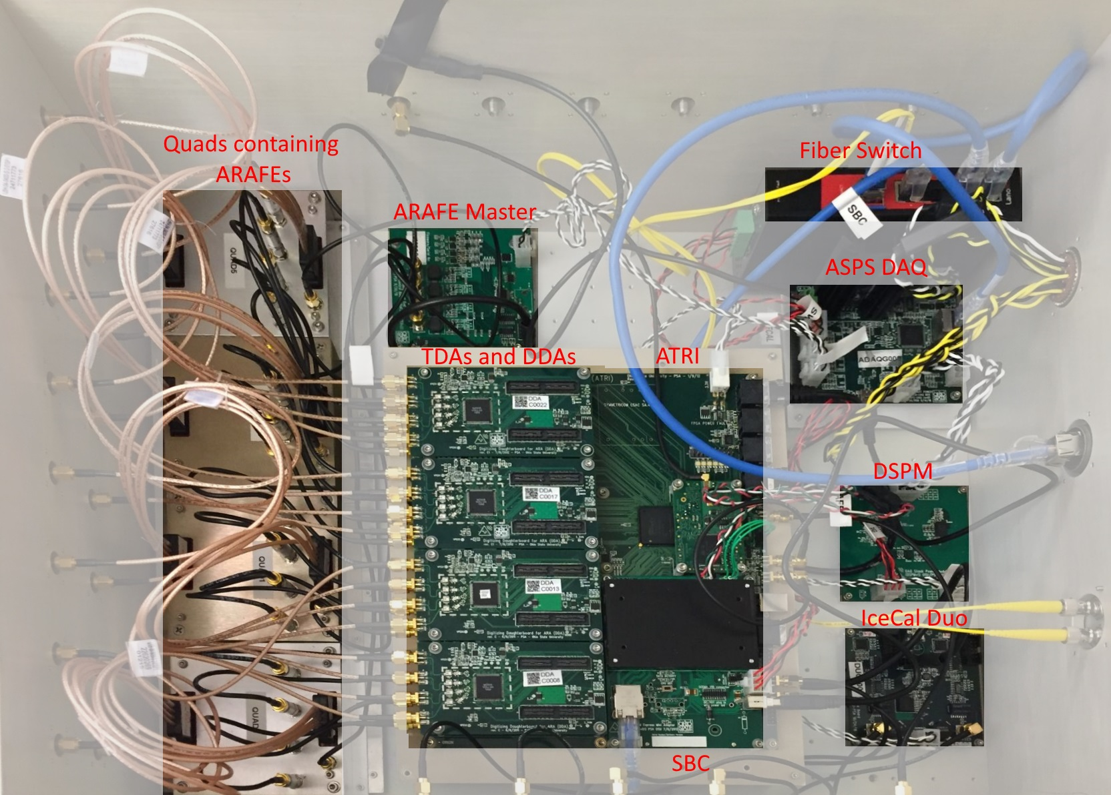
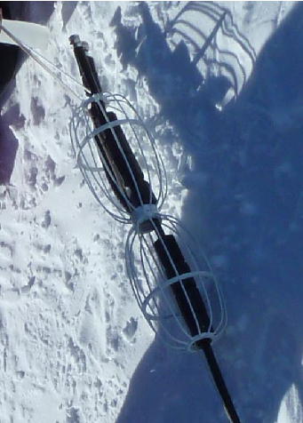
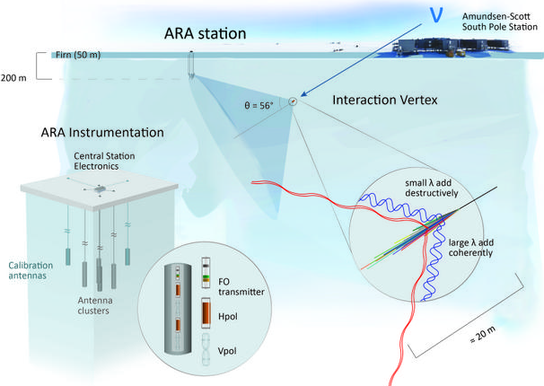
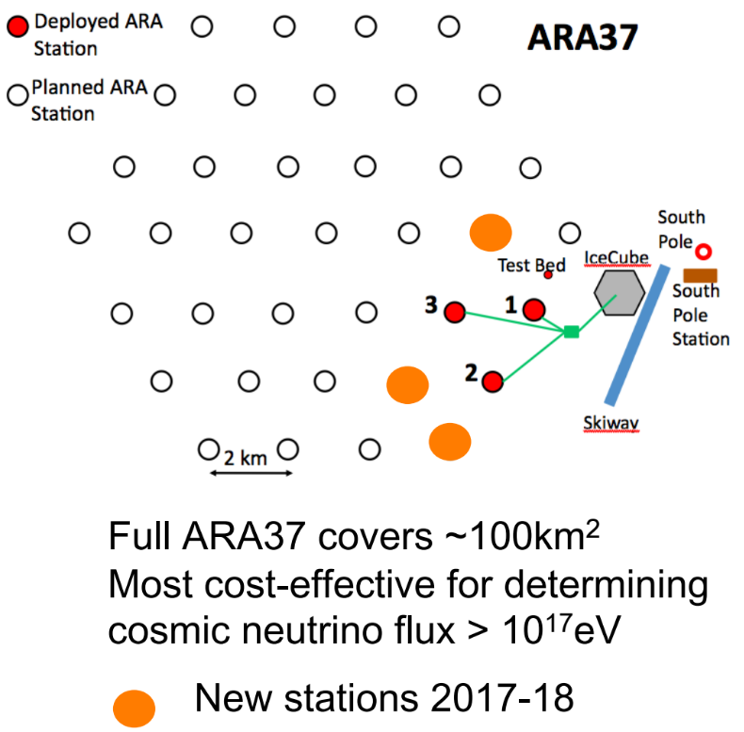
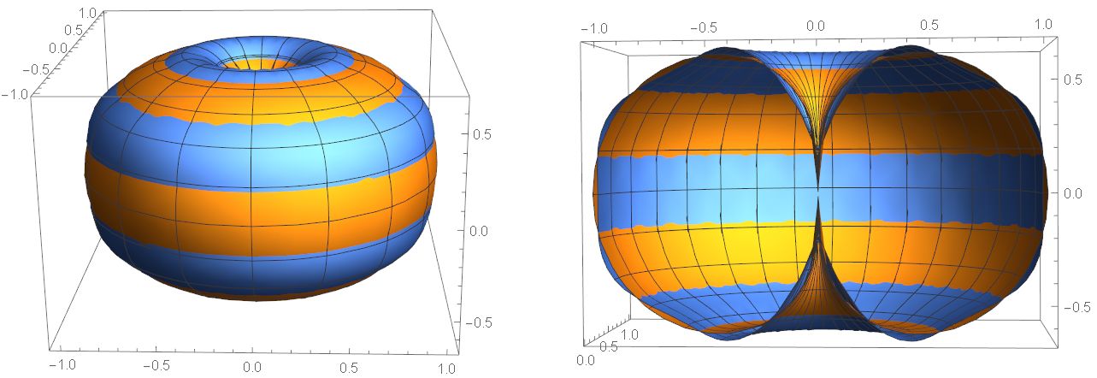

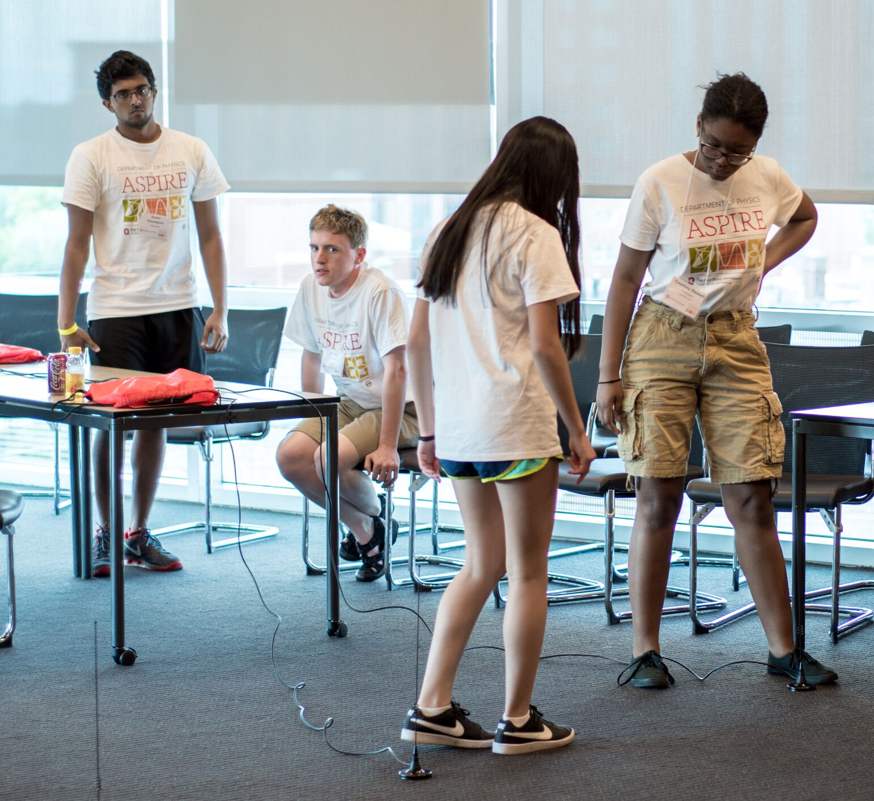
–
–
COLLEGE OF ARTS AND SCIENCES - DEPARTMENT OF PHYSICS
Acknowledgements
The Askaryan Radio Array: Hardware and Modelling
This research is supported by the NSF ARA Grant: 1404266 and NASA Grant: NX15AC20G. Thanks to the Undergraduate Summer Research Program by the OSU Physics Department and the Second-Year Transformational Experience Program for supporting me this summer. I especially thank my STEP Faculty mentor Prof. Sonia Manjon for guiding me through the program, and Prof. Amy Connolly for allowing me to participate in her research group since October 2016.
Suren R Gourapura, Brian Clark, Dr. Carl Pfendner, Dr. Patrick Allison, Prof. Amy Connolly
–
–
–
Detecting Ultra-High-Energy (UHE) Neutrinos
ARA Data Acquisition Box (DAQ Box)
Antenna Creation using Genetic Programming (GP)
Why Neutrinos?
Continuous analog signal from antennas enter the ARA Front End (ARAFE)
ARAFE filters and amplifies the signal
Sends signal to the Digitizing Daughter board (DDA)
Also sends signal through the tunnel diodes and into the Triggering Daughter board (TDA)
TDA issues the TDA trigger to the ATRI board when signal power passes a threshold
If three antennas of the same polarization send TDA trigger in 120 ns, ATRI board tells DDAs to digitize the signal
DDAs send signal data back to the ATRI board and into storage.
NASA designed this antenna in 2006 for the Space Technology 5 Mission [1].
Antenna shape determined by genetic algorithm
Probe energies greater than 100 times the Large Hadron Collider
Travel cosmic distances above 100 Mpc
Light-like travel due to no charge and a low interaction rate
The Goal
http://sites.psu.edu/amon/wp-content/uploads/sites/22842/2016/01/astro-web-titel.jpg
By Improving antenna sensitivity, we can increase neutrino detection efficiency
Genetic programming may help us create such an antenna.
Neutrino Detection Experiments
In the past decade, many neutrino detectors have been built with varying energy bandwidths:
Contents
16 Tunnel Diodes
4 Triggering Daughter Boards (TDA)
4 Digitizing Daughter Boards (DDA)
4 Quads containing ARA Front Ends (ARAFE)
ARA Triggering and Readout Board (ATRI)
Single Board Computer (SBC)
GPS
Fiber Switch
DAQ Stack Power Module (DSPM)
ARA Smart Power System (ASPS)
Antenna Simulation using Spherical Harmonics
Convenient to package information in coefficients that GP software can adjust
Spherical harmonics are ideal: the full set in linear combinations span all 2d surfaces
My goal was to fit the gain and phase pattern of our current antenna
Took excel data that had a gain and phase for 2664 directions, in phi and theta.
Created C++ script to format data into a Mathematica-friendly format
Interpolated data into a function to allow for plotting
Confirmed that spherical harmonics with non-zero m values did not sufficiently affect model (so rotational symmetry)
Mathematica “FindFit” function chose coefficients for the spherical harmonics
Computed the Chi^2 to quantify the agreement between model and data
Askaryan Radio Array (ARA)
Neutrino-ice collision creates a shower of particles that emit broadband Cherenkov radiation through the Askaryan effect
Deploys 16 antennas 200m deep in the ice (Hpol and Vpol)
6 stations by 2018, a planned total of ~37 stations
https://inspirehep.net/record/
900207/files/Antennas.png
Building and Testing
Boards arrive as blank PCBs
All components are soldered by hand
Cables are made and modified as necessary
Mounting plates are made and modified in the machine shop
Boards are tested individually
DAQ box is cabled up and tested along with the power box
Box is sealed and tested in thermal chamber at -40° C
Soldering Components
Cable-making
Machine Shop Work
Hardware Assembly
and LOTS of Troubleshooting!
https://ara.wipac.wisc.edu/home
During my time, I made major contributions to building, testing, and fixing stations that will be deployed in the ice this coming season.
Freq: 83.33 MHz Orange = Gain Data Blue = L 0-8 Model Chi^2: 35.42
–
–
Achieving in Science through Physics Instrumentation, Research and Exploration
Future Goals
The ARA 6 DAQ box will have its parts finished, mounted, cabled, and tested before being sent to the University of Wisconsin (one of our collaborators) for further testing
Completed and tested stations will be deployed this winter (2017-2018)
The rest of the antenna frequencies will have their gain and phase fitted to test Spherical Harmonic fitting effectiveness
The optimal gain and phase pattern will be found using spherical harmonic fitting before evolving the optimal antenna shape
Detect UHE astrophysical neutrinos!
Workshop to introduce high school women to STEM fields, including physics
Supported by NSF, coordinated by Prof. Connolly’s group
5 days from 9 am to 5 pm, approximately twice a year
Draws young minds to physics, provides an idea of what our group does, provides a tour of OSU, and supplies students with future projects
This year was my first time volunteering. I ran the Antenna Pulser experiment along with Dr. Allison and two other undergraduates.
Sources
–
Lohn, J. D., Hornby, G. S., & Linden, D. S. (2005). In Genetic Programming Theory and Practice II (pp. 301-315). Pg. 11. Springer US.

