Slide 1
Machine Learning Using Karoo GP
ASPIRE Workshop
SUMMER 2017
The ohiO state university

Slide 2
What is machine learning?
Machine learning (ML) gives computers the ability
to learn without explicit programming
The goal is to find a structure that maps a
given input to a desired output
Examples of problems ML could solve:
  Netflix movie recommendations
  Categorizing images
  Online advertising
  Fitting data to a function
Car
Tree

Slide 3
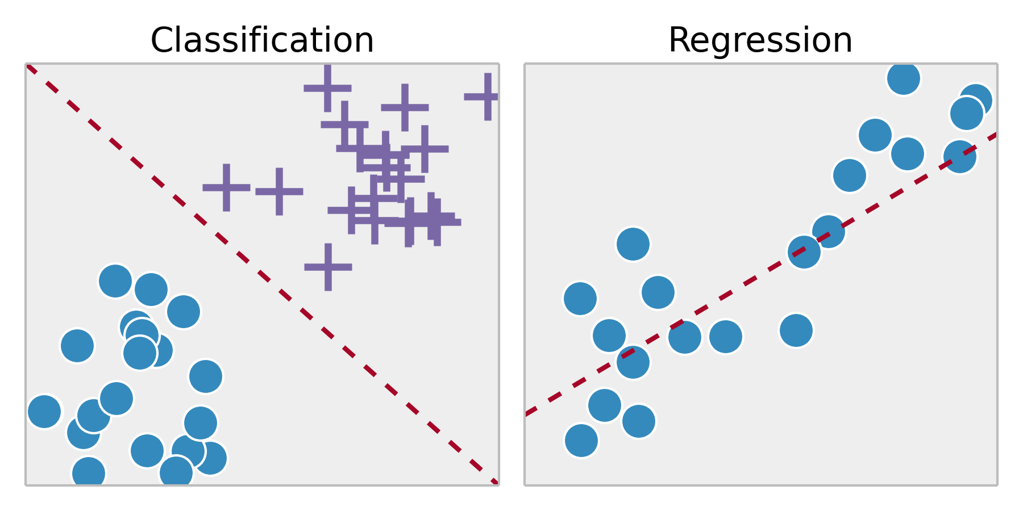
Regression vs. Classification

Slide 4
Some approaches to machine learning
Artificial Neural Networks:
They work like neurons in our
brains!
The hidden layer uses
a series of operations to take a
set of inputs and turn it into
the desired output, similar to
how a brain processes data

Slide 5
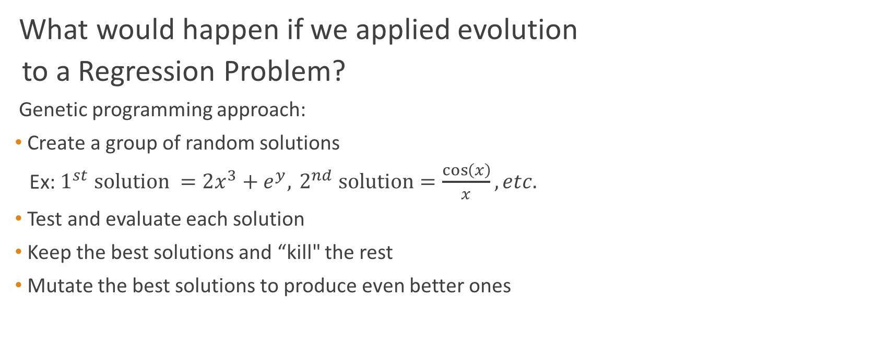
Genetic Programming (GP)
What would happen if we applied evolution
to a Regression Problem?
Genetic programming approach:
Create a group of random solutions
Ex: $1^{st} solution =2x^{3}+e^{y},{ 2}^{nd} solution=\frac{\cos\left(x\right)}{x}, etc.$
Test and evaluate each solution
Keep the best solutions and “kill" the rest
Mutate the best solutions to produce even better ones

Slide 6
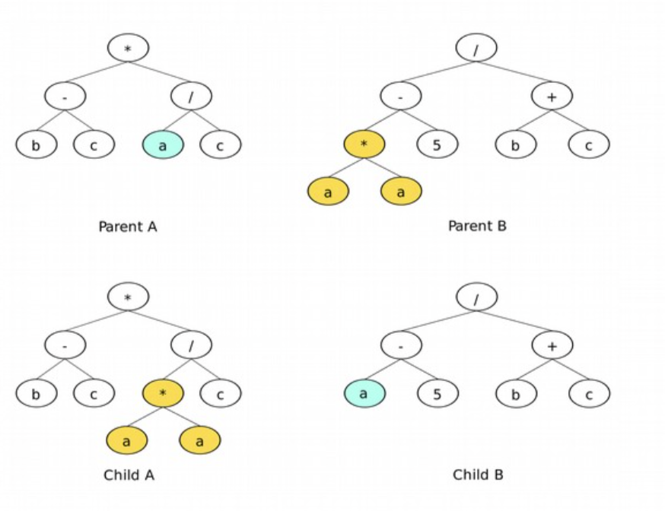
Genetic Programming (Cont.)
Each solution is tested based on a fitness function
  For Regression: Uses a least squares method
  For Classification: Uses a relative absolute error
The best solutions are chosen through a tournament selection
The mutation process works like the following:
  Reproduction: The function is copied to the next generation
  Point Mutation: One thing is change ex: 2*t/(x+y) to 2*t/(x+t)
  Branch Mutation: A full branch is changed ex: 2*t/(x+y) to 2*t/(y^2*t)
  Crossover: 2 parents combine to produce offspring (see picture)

Slide 7
Karoo GP
Kai Staats created a GP software
called Karoo GP
Karoo was Kai’s master’s thesis
at the University of Cape Town
Karoo is used to mitigate backgrounds
for the LIGO gravitational wave observatory
In addition to Genetic Programming Kai also
enjoys rock climbing, making documentaries,
creating radio telescopes and attending Space University

Slide 8
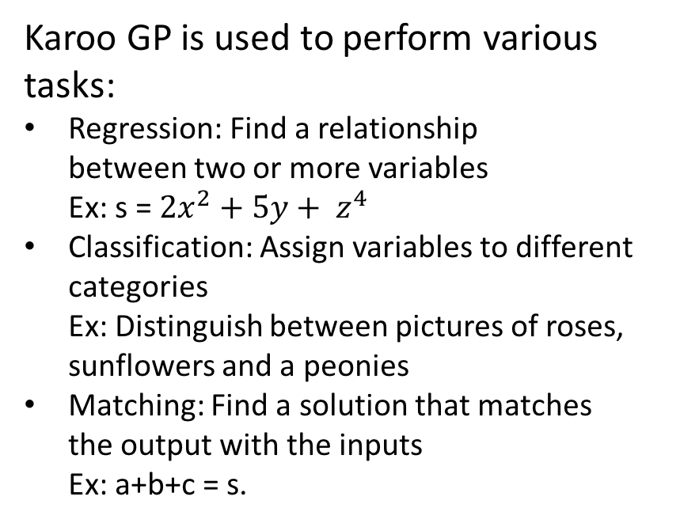
Karoo GP Cont.
Karoo GP is used to perform various tasks:
Regression: Find a relationship between two or more variables
Ex: s = ${2x}^{2}+5y+ z^{4}$
Classification: Assign variables to different categories
Ex: Distinguish between pictures of roses,
sunflowers and a peonies
Matching: Find a solution that matches
the output with the inputs
Ex: a+b+c = s.

