Slide 1
Lorentz Invariance Violation
Hannah Hasan

Slide 2
Where are the neutrinos?
It is believed that UHE cosmogenic neutrinos (10¹⁷ eV and above) are produced in astrophysical processes such as the GZK effect, in which UHECRs interact with the CMB
These particles will afford us the chance to test relativity at energies higher than ever before
However, we have yet to observe UHE neutrinos!

Slide 3
Lorentz Invariance violation (LIV)
One possible reason for this absence is that the neutrinos may be violating Lorentz Invariance (principles of relativity should hold)
Violation has not been previously observed; however, even small violations will greatly reduce UHE neutrino flux
Why test it? Reconcile GR with quantum

Slide 4
Superluminal behavior
Coleman and Glashow have calculated that the maximum attainable velocity for a particle depends on the particle, and the velocity may exceed c
If neutrinos exhibit non-tachyonic superluminal behavior, this would violate relativity
Tachyons are particles that permanently travel faster than c (they live in the shaded area at left)
Non-tachyonic superluminal neutrinos would be accelerated above c then slow back down
t
Tachyons
x

Slide 5



Is this liv?
If neutrinos were to travel above c, they would need to somehow lose energy to return to velocities below c
Energy loss might be possible if the neutrino were to decay into other particles, or radiate photons
$$γ$$
$$ν$$
$$ν′$$

Slide 6
superluminal neutrinos are rule breakers
However, neutrinos have mass, so we can view interactions in their frame
If we move to a frame where the neutrino is initially at rest, then photon emission appears as a system with no kinetic energy that gains kinetic energy without any change in the rest mass energy
Similarly, a stationary neutrino cannot decay into other particles (such as an electron-positron pair) because it has a very small rest mass

Slide 7
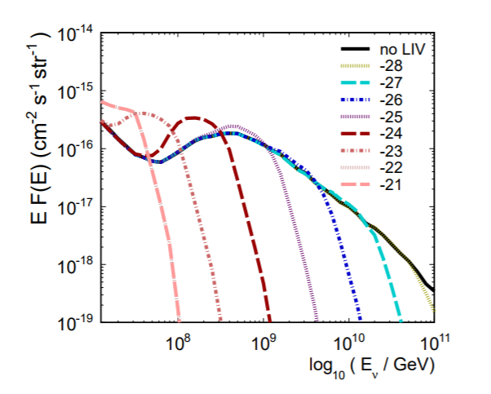
Effects
If neutrinos do indeed violate relativity through superluminal behavior, we expect to see a pileup of lower-energy neutrinos, and a sharper cutoff on higher-energy ones

Slide 8
conclusion
We haven’t seen UHE neutrinos yet!
A possible explanation is that SR might be violated

Slide 9
Sources
Gorham, P.W.; et al. Implications of ultrahigh energy neutrino flux constraints for Lorentz-invariance violating cosmogenic neutrinos,arXiv:1207.6425
F. W. Stecker, Testing Lorentz symmetry using high energy astrophysics observations, arXiv:1708.05672
Coleman, S.R.; Glashow, S.L. High-energy tests of Lorentz invariance, arXiv:hep-ph/9812418

