Slide 1
Convolutional Neural Networks (CNN)
By Abdullah Alhag

Slide 2
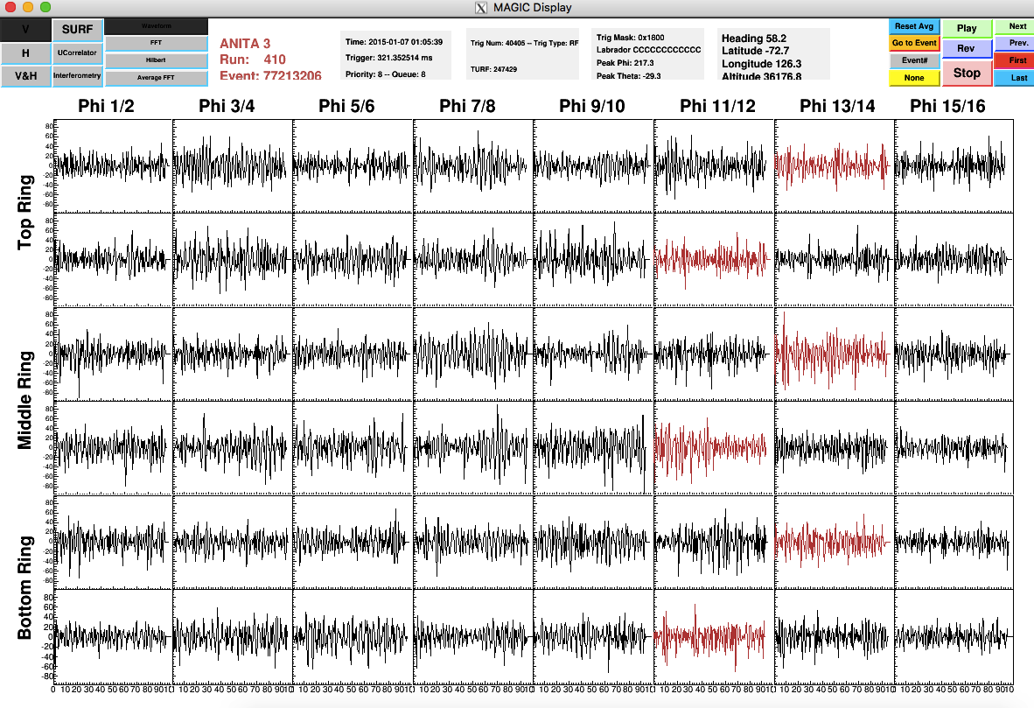
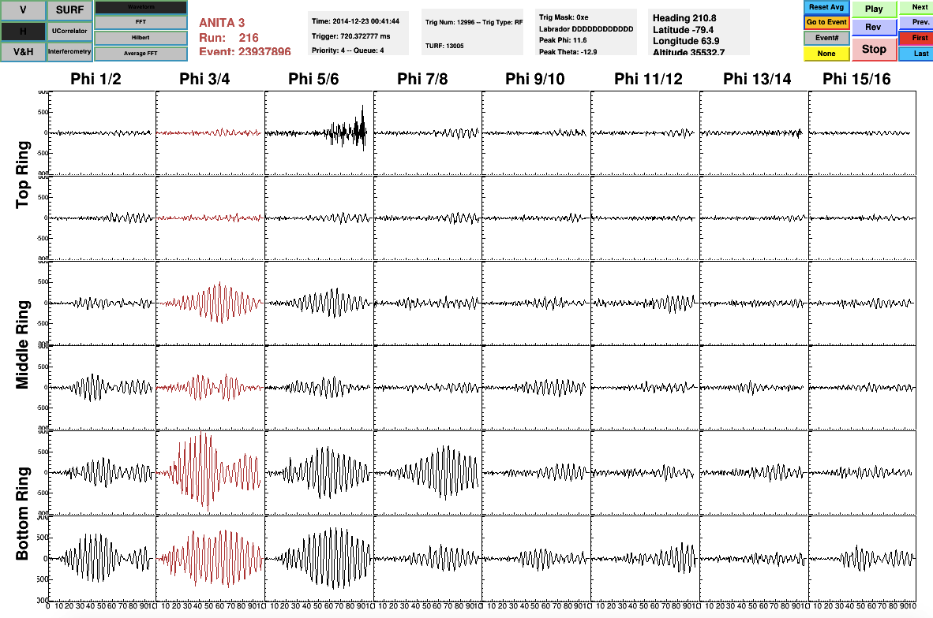
Motivation
Payload Blasts are background noises caused by the equipmentmen of ANITA flight.
They are problematic as they pass the final analysis cuts that only UHE Neutrinos and cosmic rays are meant to.
Payload blasts have a very unique waveform and are easy to distinguish by eye. One of the figure below is of a payload blast (right), the other is not.
Goal is to able to classify payload blasts and remove them from data.

Slide 3
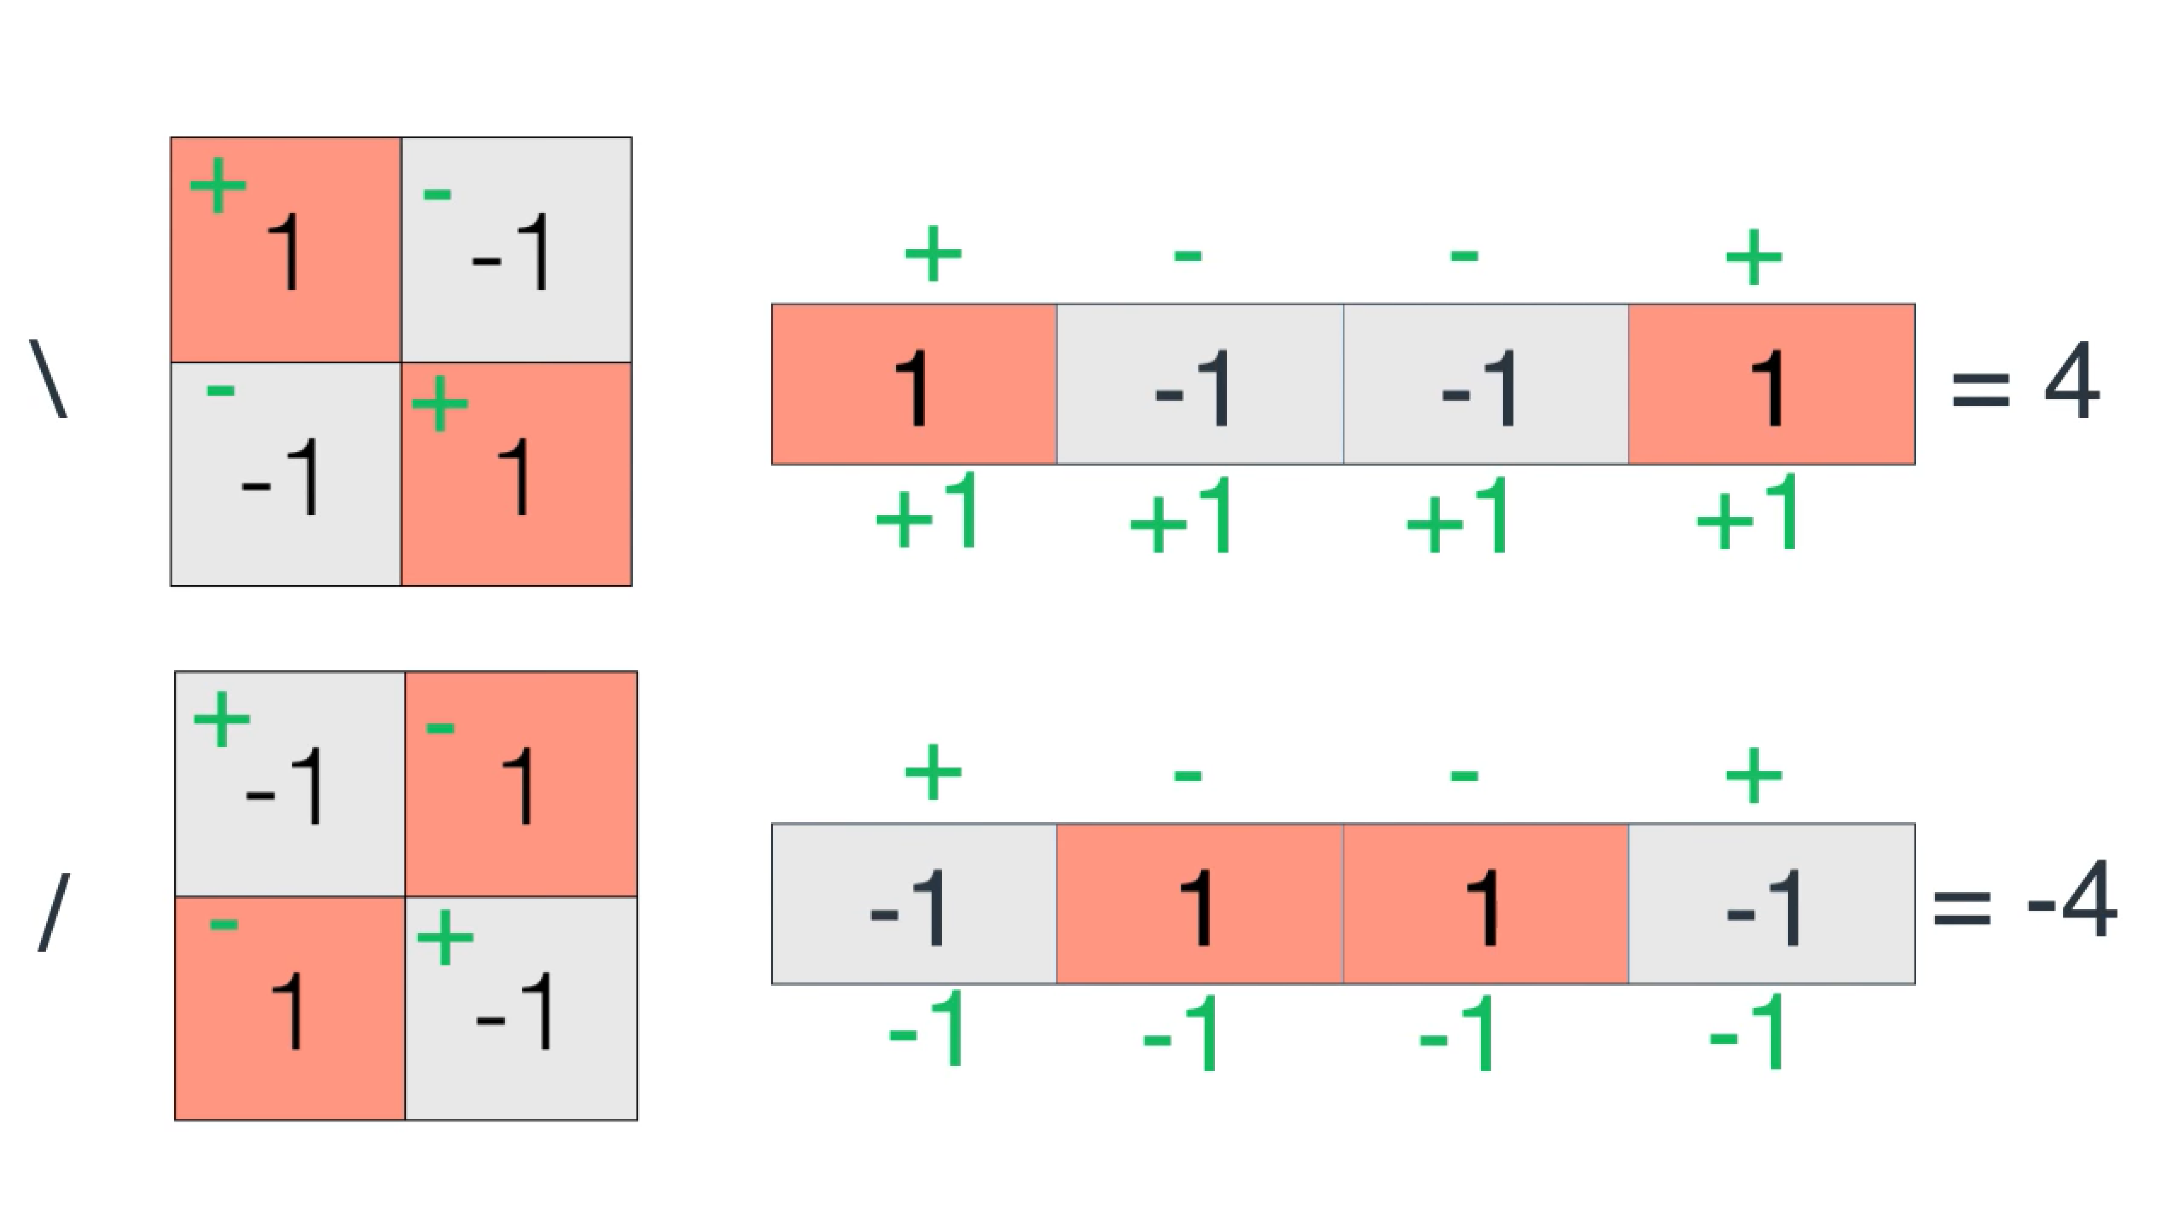
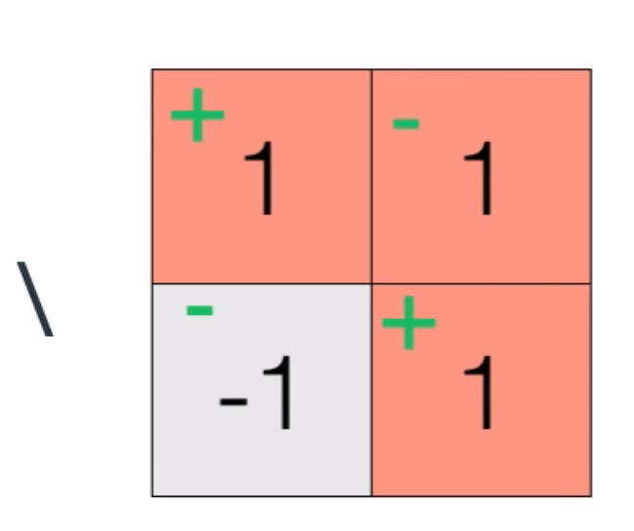
4 Pixels model
To simplify the idea, I will start with a 4 pixels model where only two characters are allowed, in particular \ and /.
The computer however does not see these the way we are. In particular, these could be thought of as image array from the machine perspective and stored as such.
It is then very straight forward to identify which is which if we used the simple model below where red pixels reads 1 in the machine and –1 else wise.
All the machine need to do to identify the character is to follow the mathematical steps shown.
This works very well, for example:

Slide 4
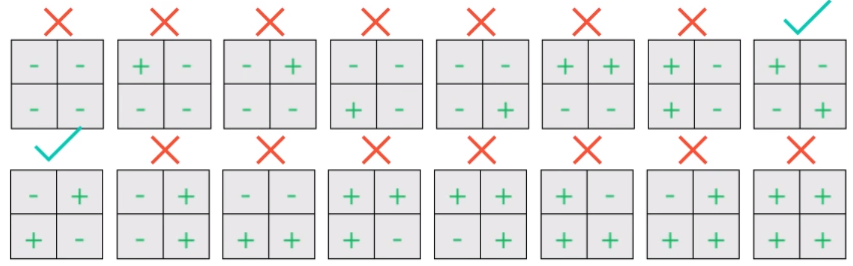
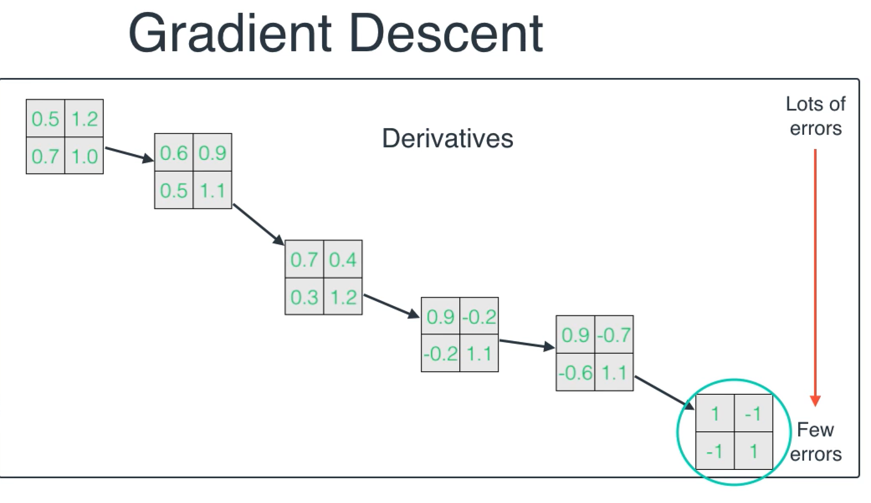
What the machine does to determine the classifier?
To come up with the classifier we came up with, the machine will need to check many possibilities. There is 16 possible models if we only consider integers, that is only for two colors and 4 pixels.
There is ways to over come this however, we start by randomly guessing a classifier and adjust it classifier by taking the derivative of an error function until we get a desired classifier as shown.
Error function is what measure how many errors the classifier makes and can be chosen to be anything.
Taking the gradient of the error function is how the machine determine the desired classifier.

Slide 5
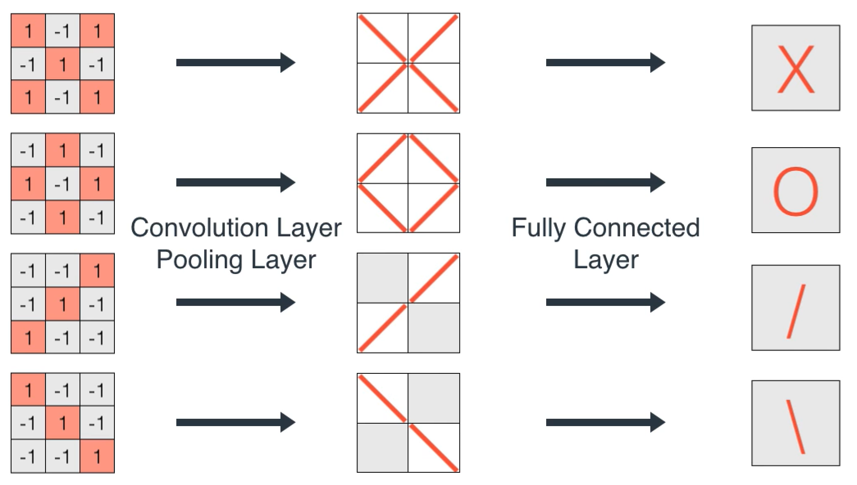
9 Pixels model
To further demonstrate the concept, I will use a 9 pixels model where now 4 characters are allowed, in particular \, /, X, and O.
It is easy notice that our previous classifier would not do us any good here.
To come up with a classifier, it is best if we describe our 3*3 pixels characters in terms of the previous 2*2 pixels character.
This is done by a Convolution Layer together with a Pooling Layer.
We will also need to design a filter based on these 2*2 images.
For this we need what is called a Fully Connected Layer.

Slide 6
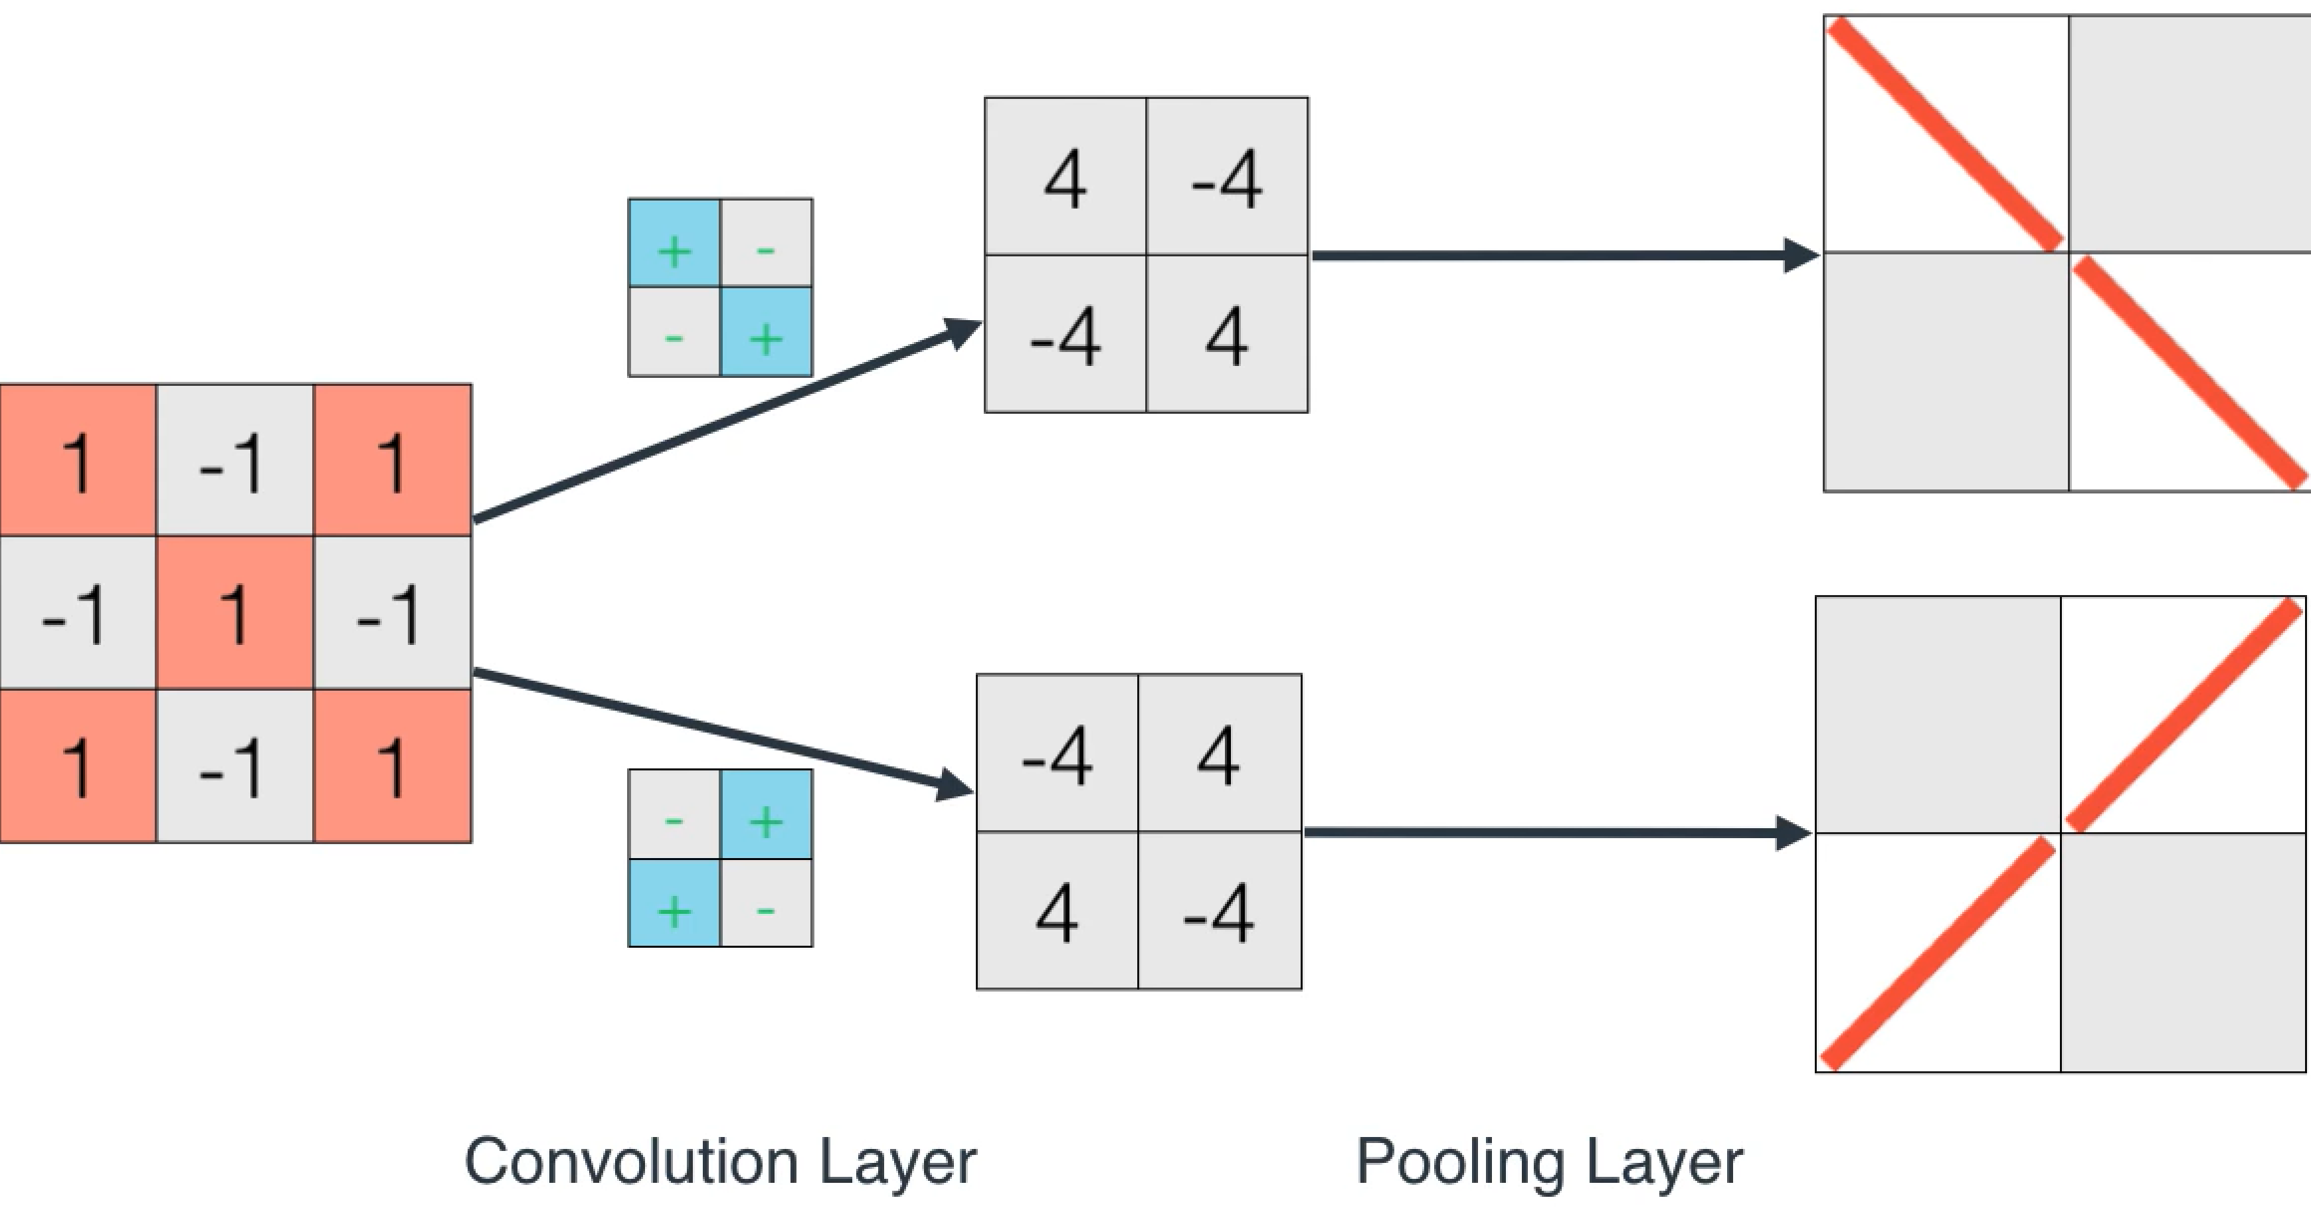
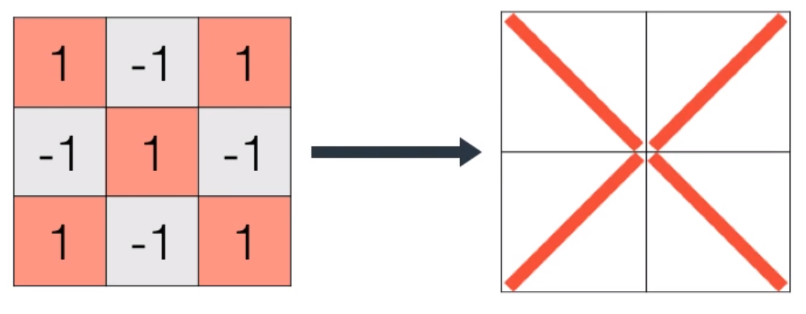
Further demonstration of the concept
To demonstrate the Convolution and the Pooling Layer we take the X character as an example.
We start by picking up filters, for this example we pick / and \ filters.
The Convolution Layer will pass the two filters over the X character and see how it fits. It will then construct a 2 by 2 weighted array based on the filters.
The Pooling Layer will then based on a threshold value will decide whether it found something or not, here either characters / or \.
The last steps is to over impose the two images.

Slide 7
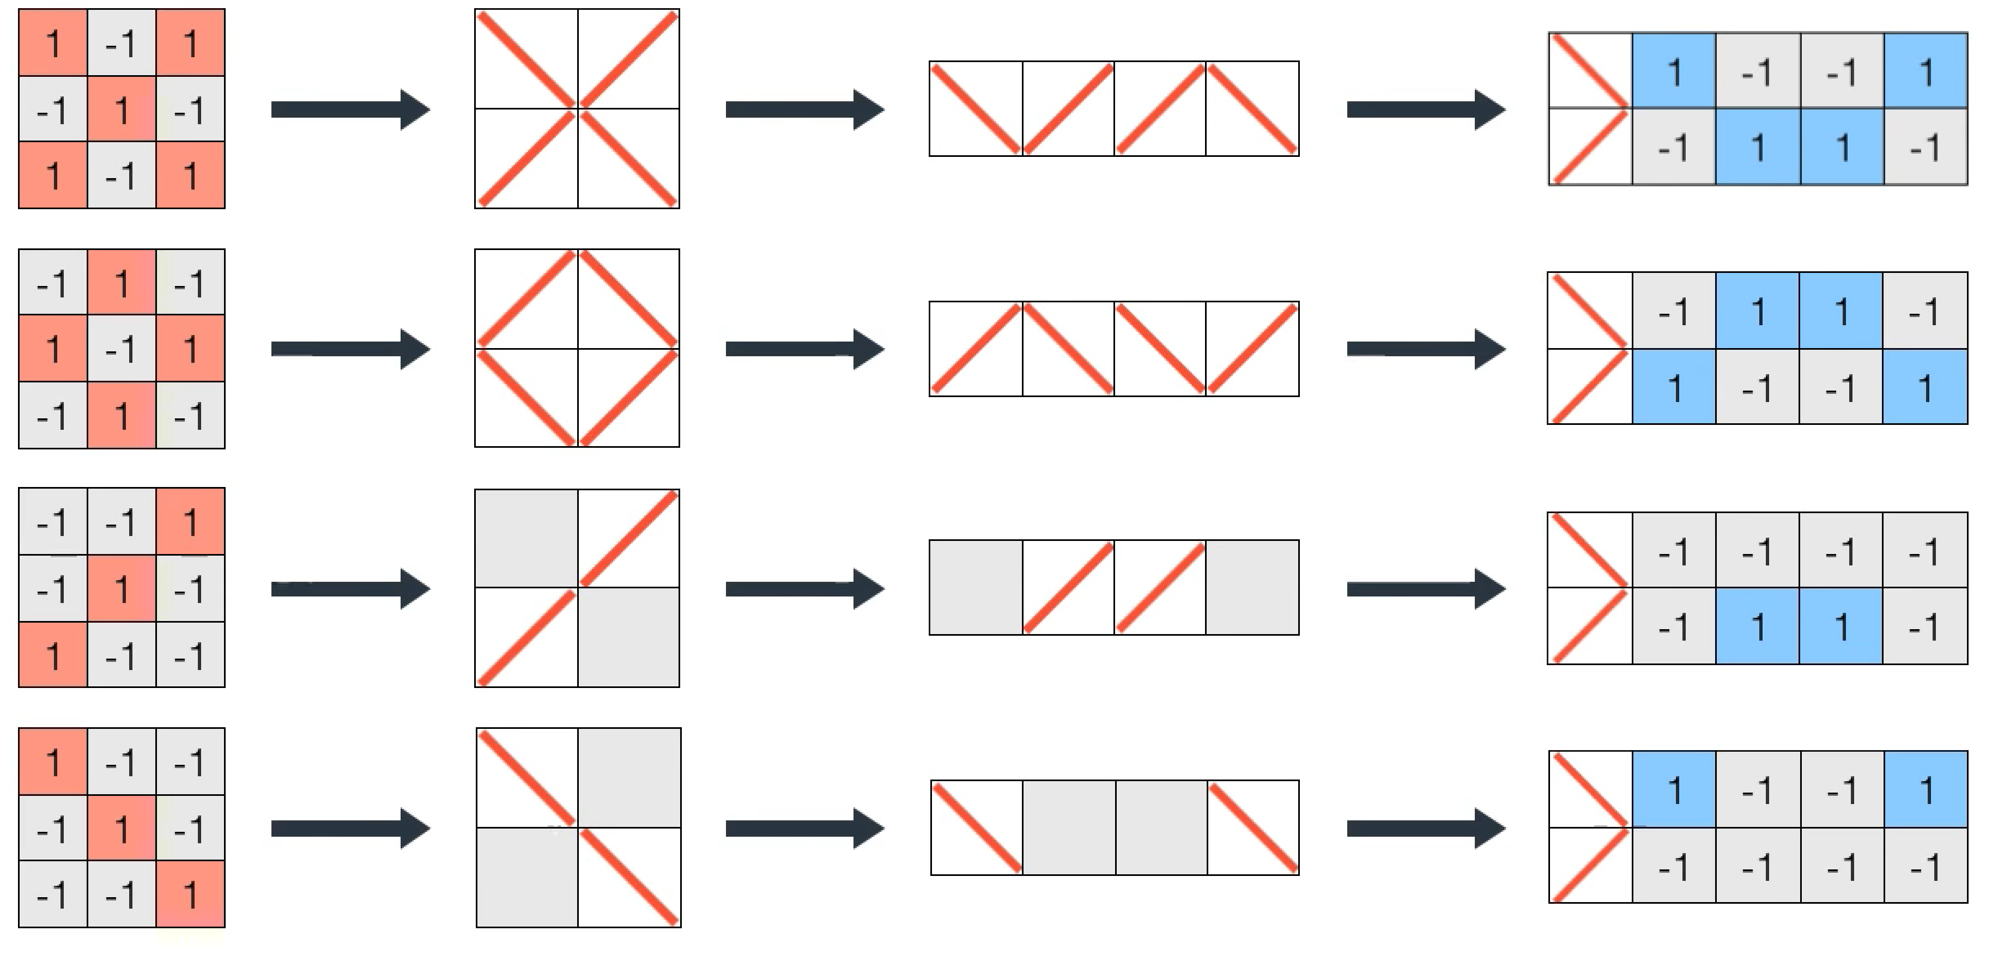
Further demonstration of the concept
The final step is to classify our characters through The Fully Connected Layer using our simplified images.
We start by representing the images from the previous layers as a string which is how the machine sees them.
Now we build our final filters by encoding our character as matrix in / and \ vector space, equivalent to passing / and \ filters over the string and giving the values 1 (same) and -1 to the elements of the final filters.
That is it, doing the same for the the other characters will give us four filters that will yield different score based on the character being passed over.

Slide 8
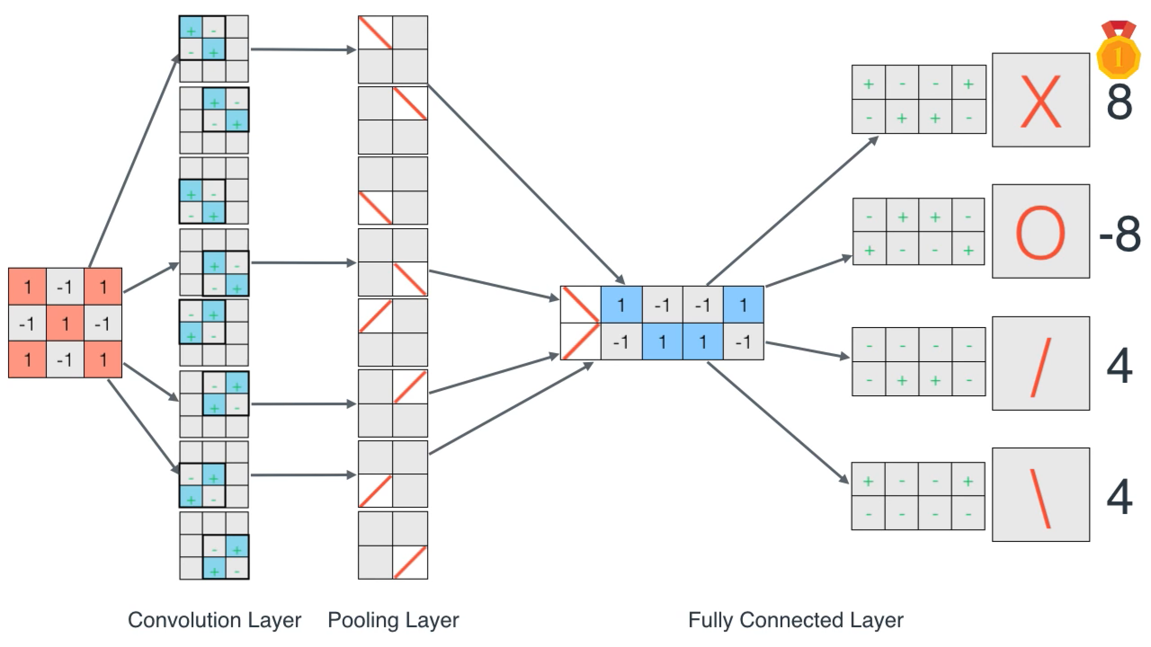
Further demonstration of the concept
Each of the four filters will yield a different score and the one that yield the highest score when passed over any specific character will win.
To summarize:

Slide 9
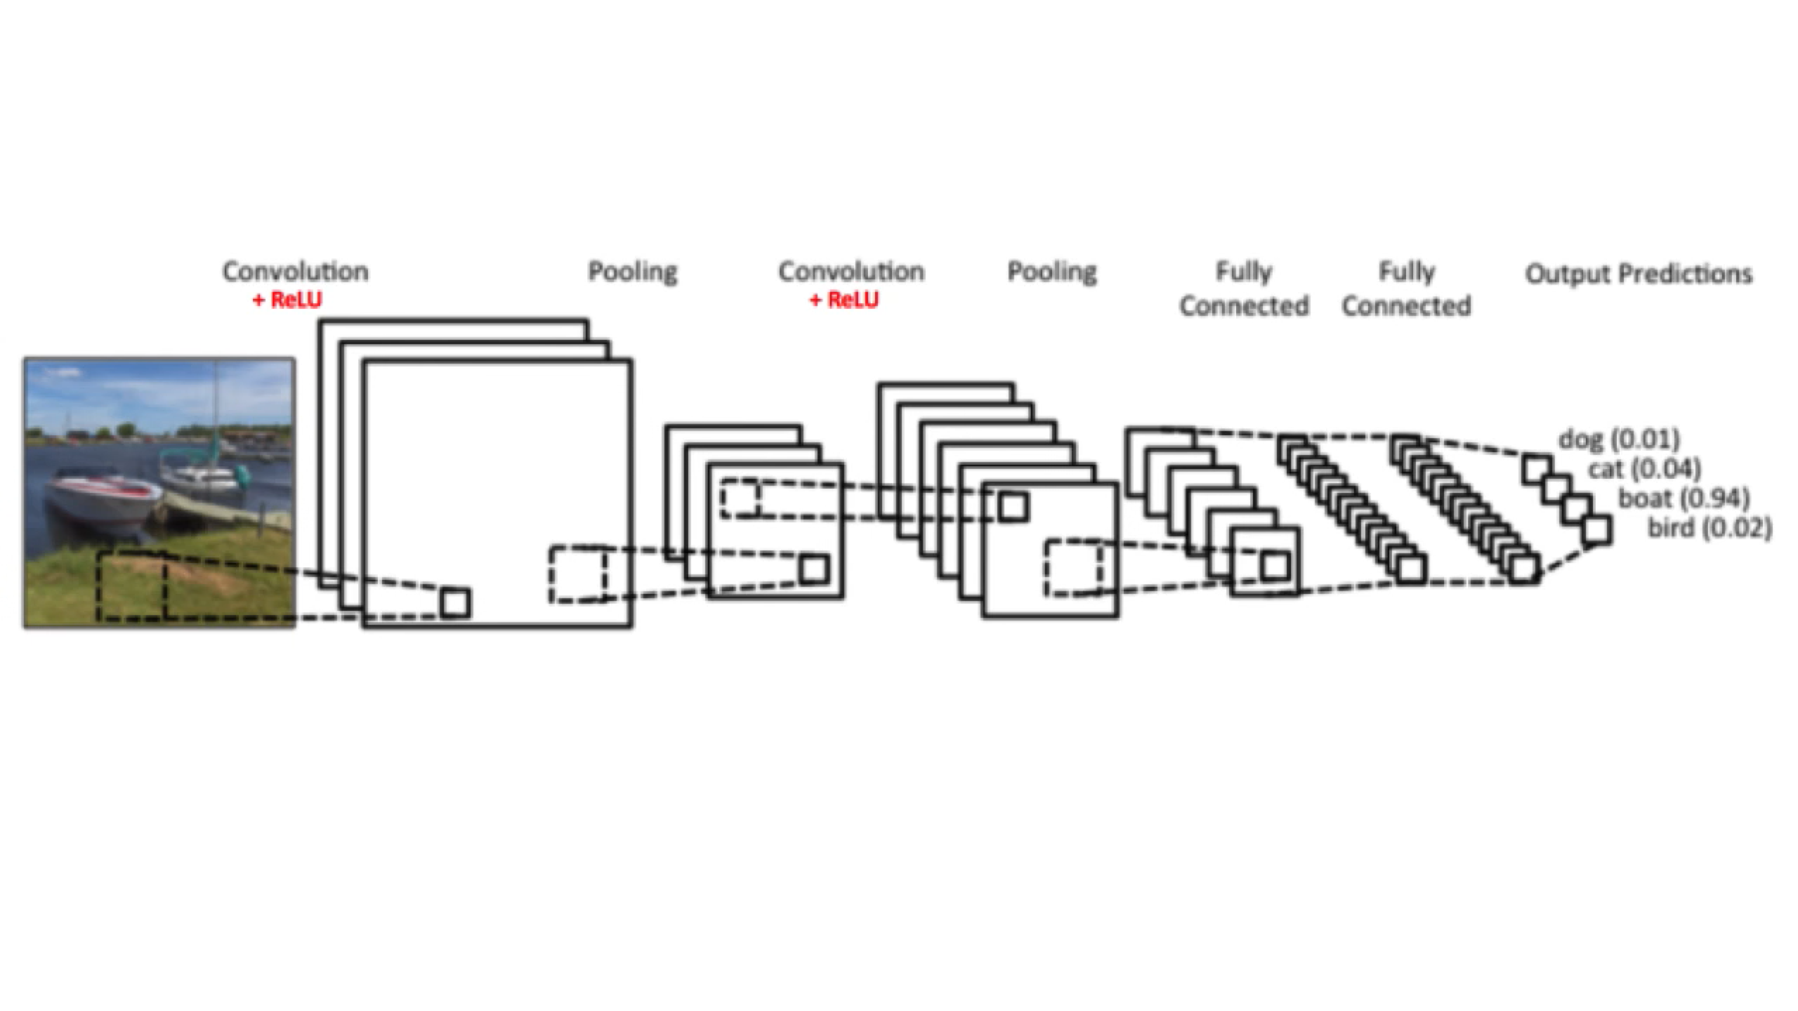
The real world
How this can be applied to the real world?
We do exactly the same. Start by sliding a square image over the image, the Convolution Layer step. The Pooling Layer will then decide what pieces it is getting.
We repeat these steps until the image is broken down to little pieces.
Last step is to apply one or serval Fully Connected Layers to figure out what filter matches our image.

Slide 10
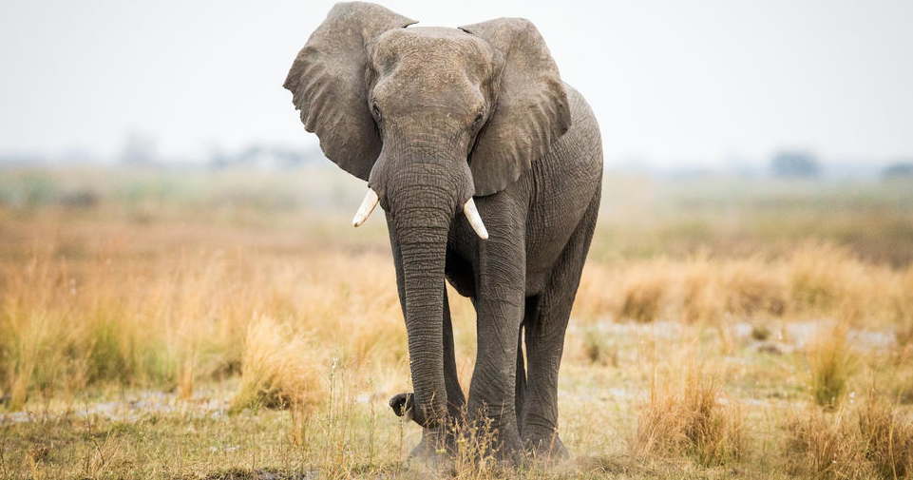
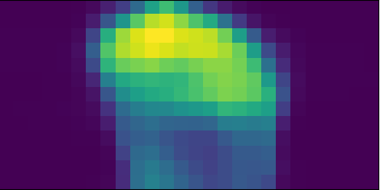
Heat-map
We could take this further and actually visualize our filters.
This can be used in many applications. For example we could use it to get a target coordinates and determine how far from the camera it is by taking a second picture.
For us, it could be used to verify our classifier, something which caused me pain last term when I was trying to come up with a regression model to describe the background noise. This time I made sure to have this taking care of from the start.

Slide 11
Demonstration
Let us pick a class and see how well we could classify it?
Let us go further and apply the heat-map to visualize the active layer.

Slide 12
References:
Convolutional Neural Networks: https://www.youtube.com/watch?v=2-Ol7ZB0MmU
Keras: https://keras.io/applications/
Heat-map: https://github.com/gabrieldemarmiesse/heatmaps

