Slide 1



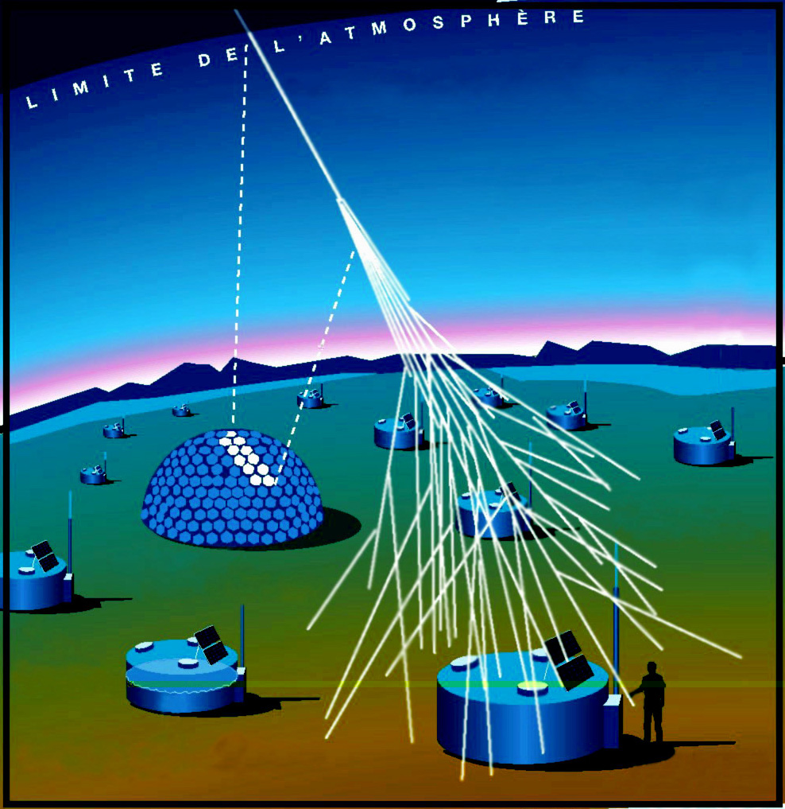
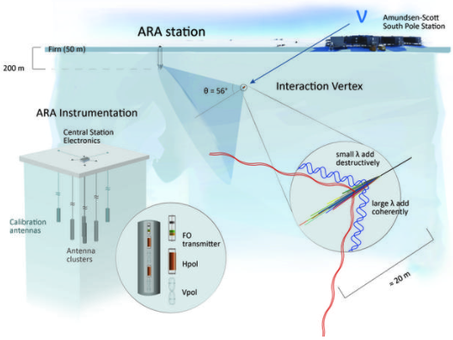
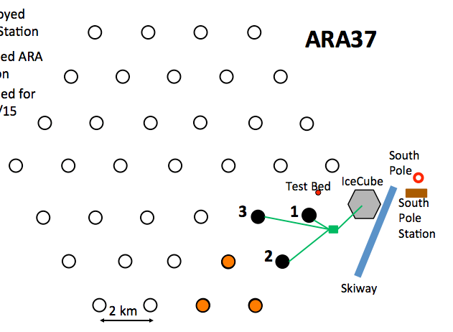
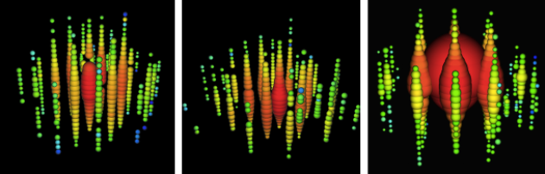
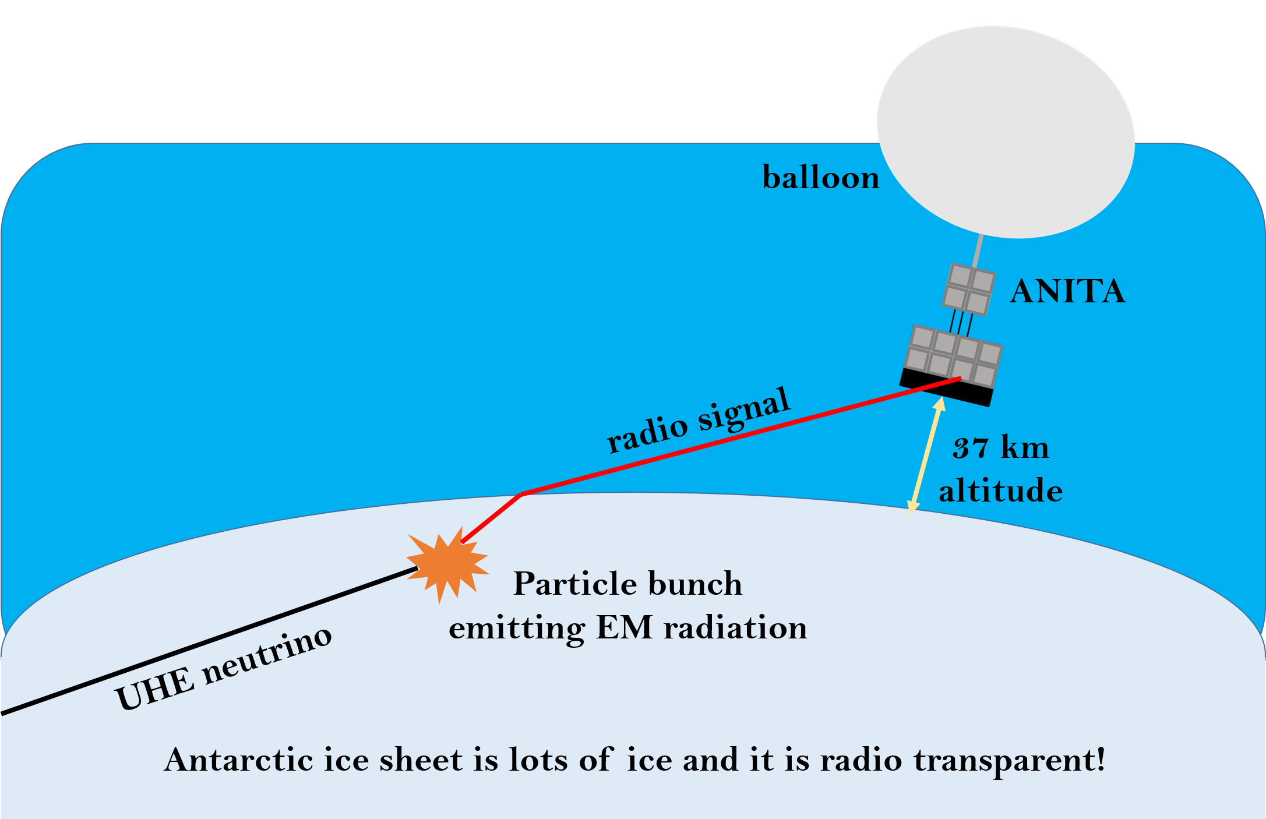
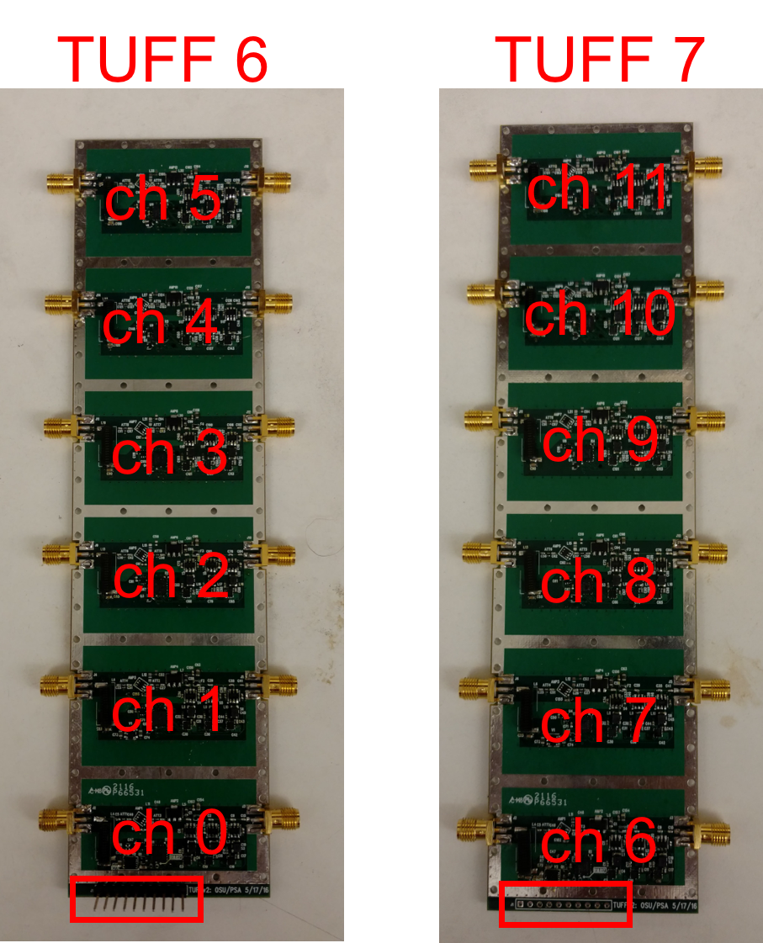
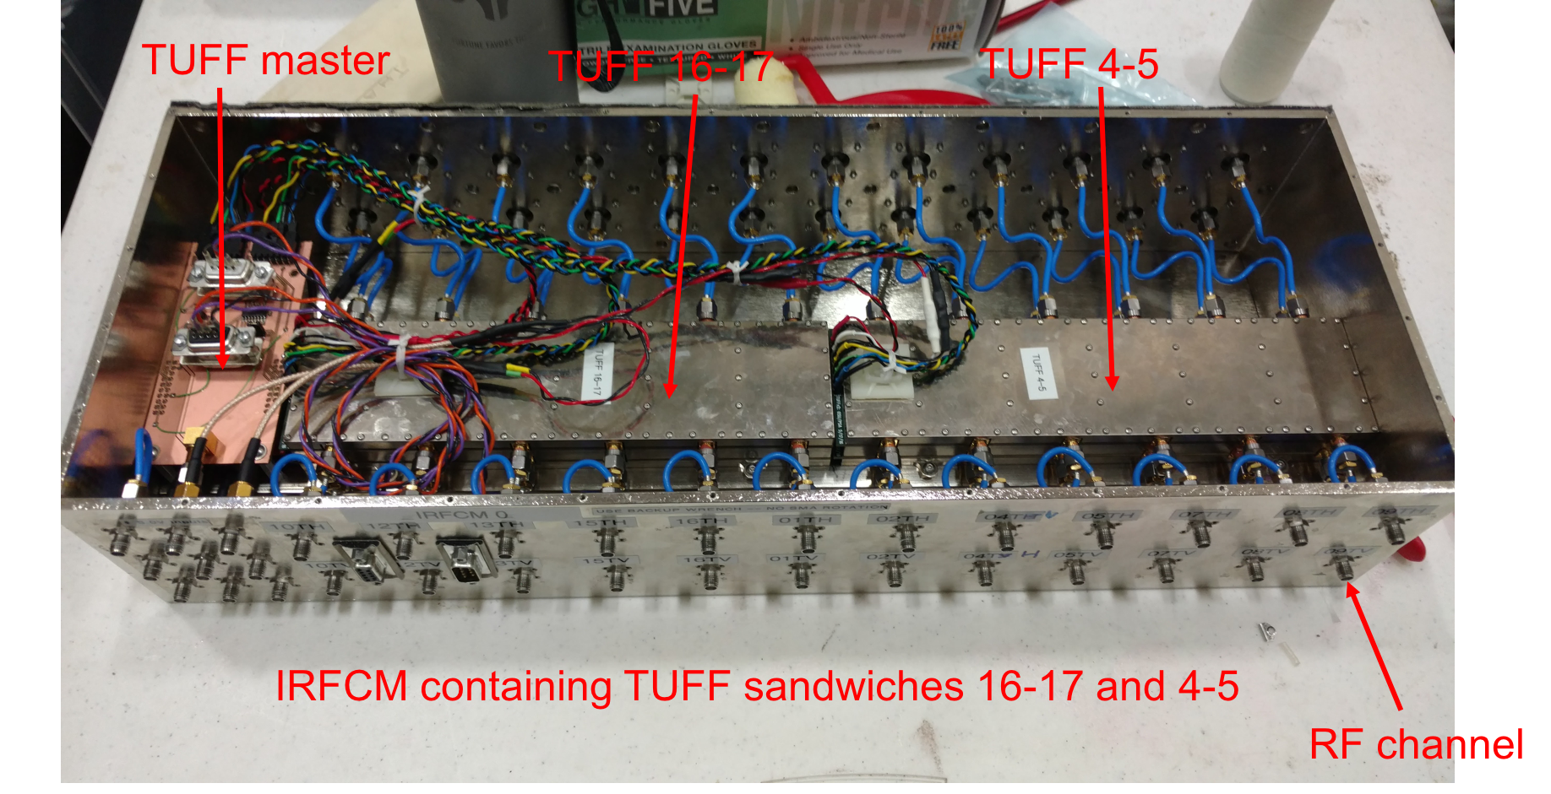
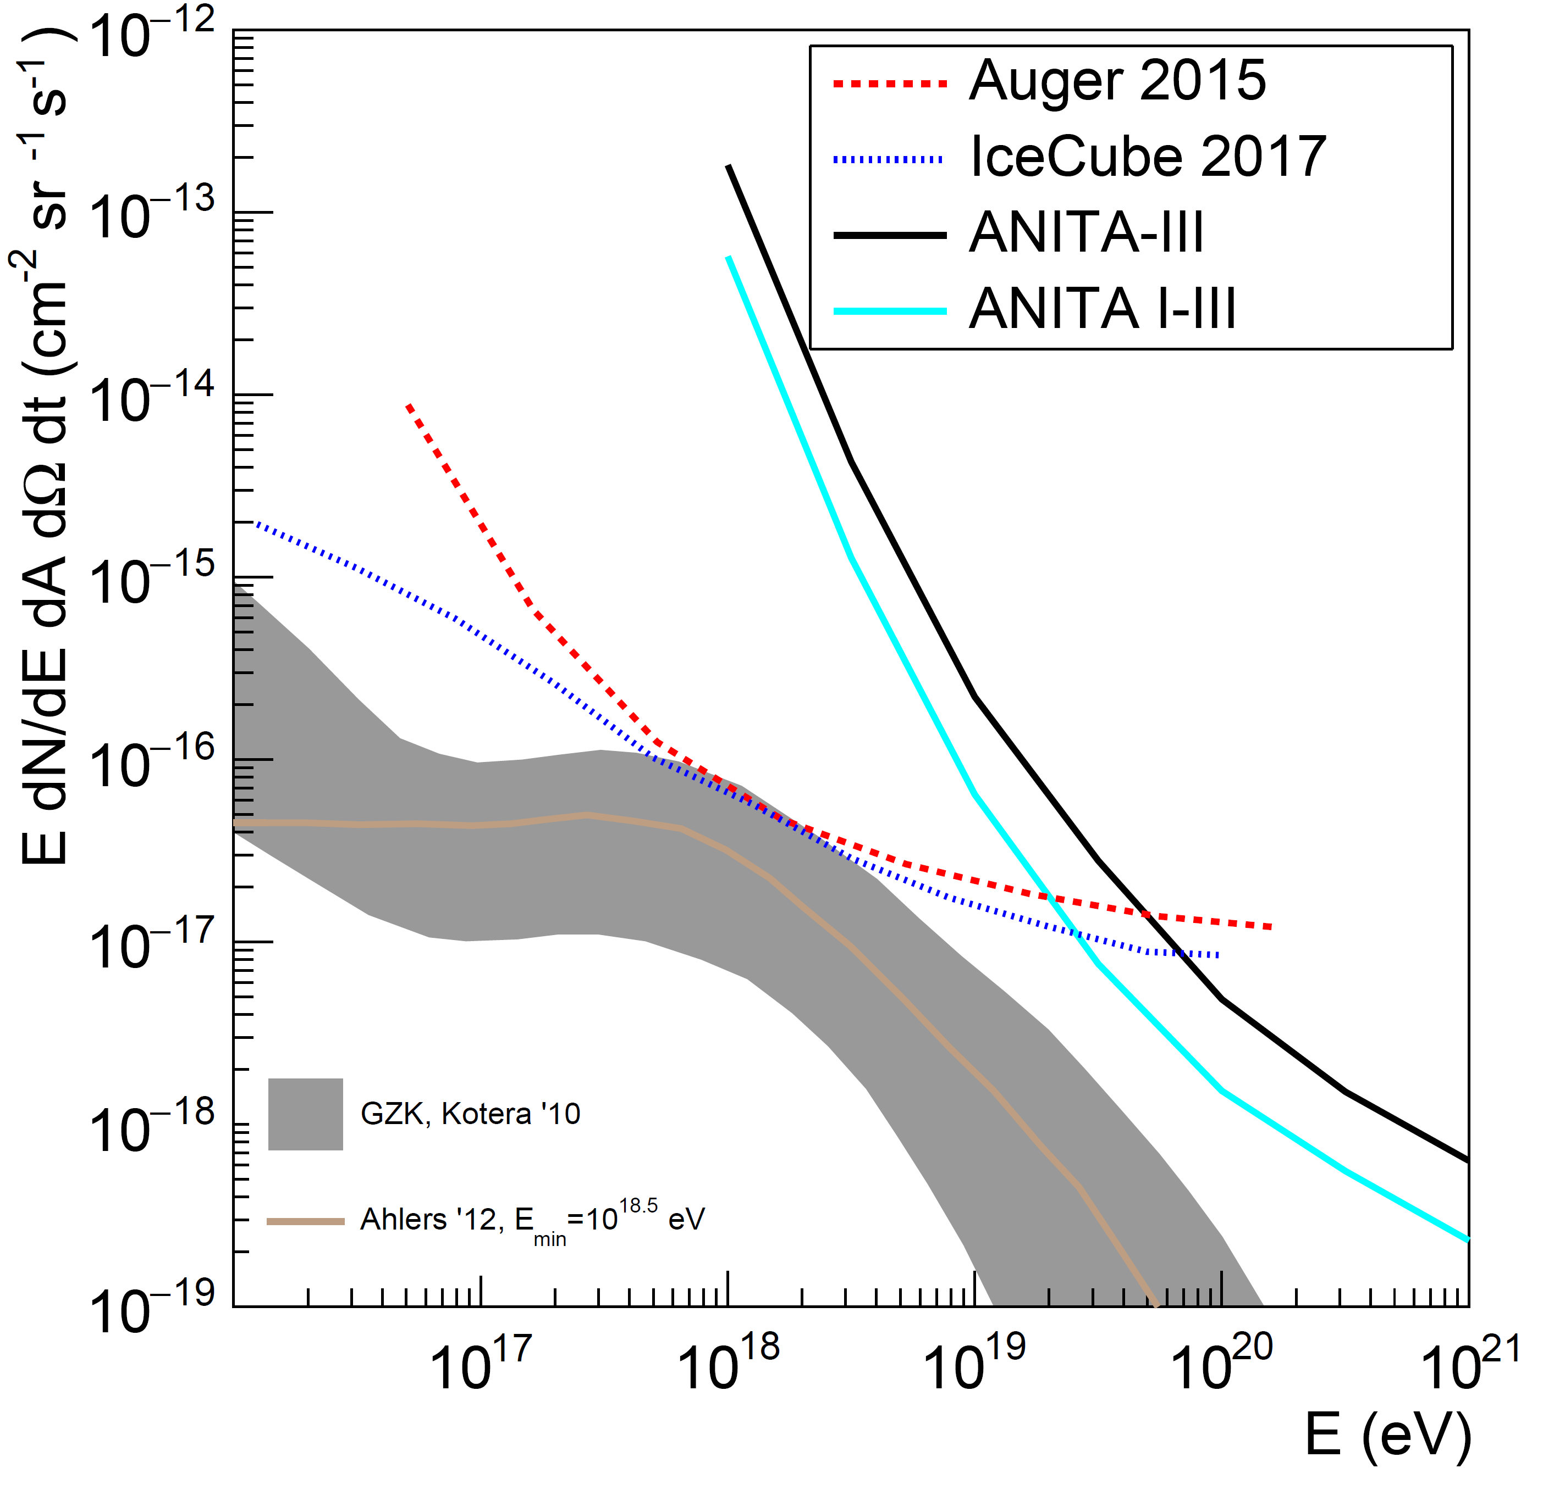
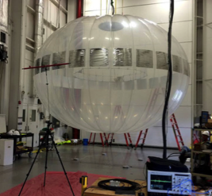
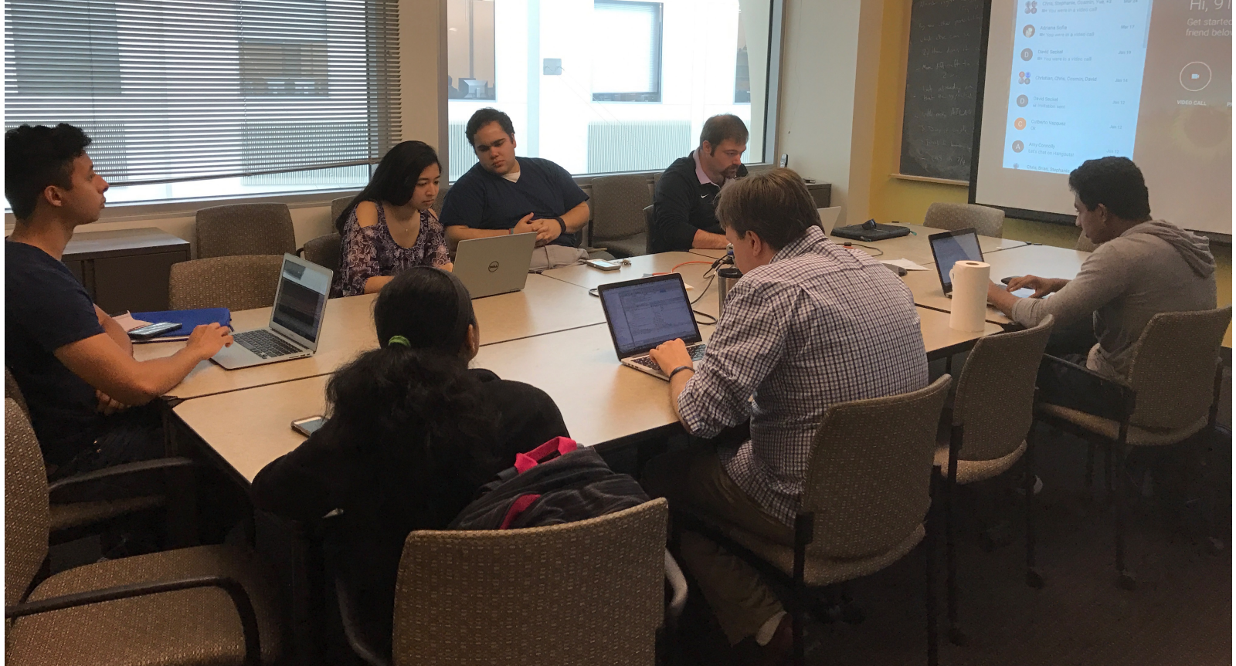
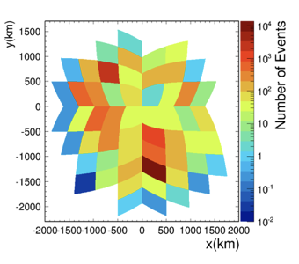
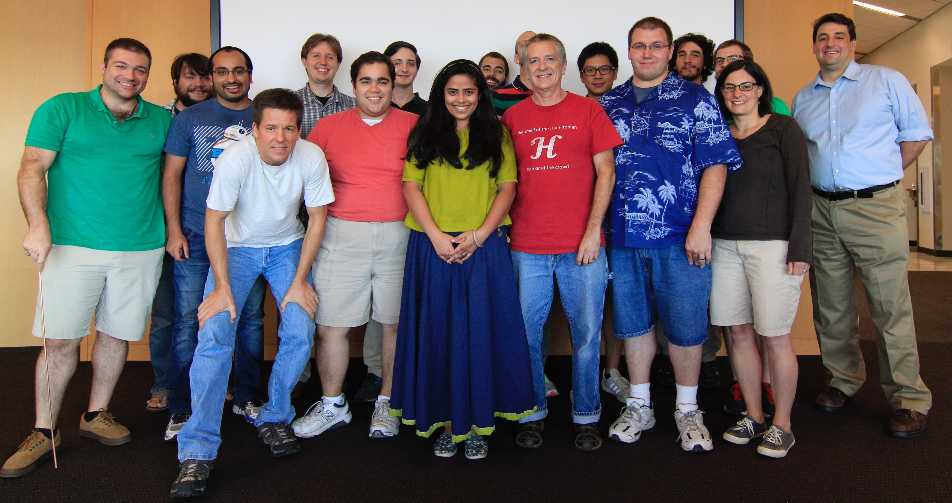
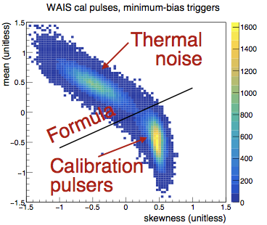
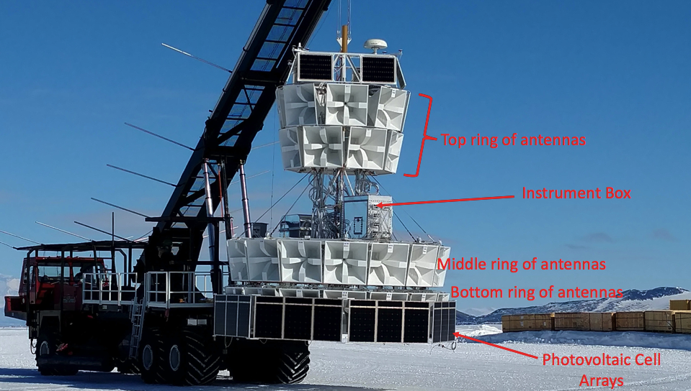
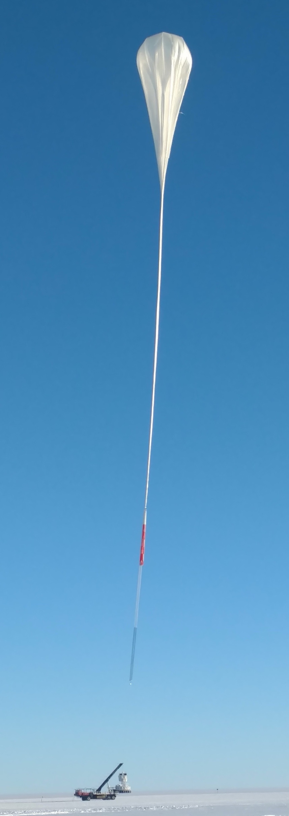

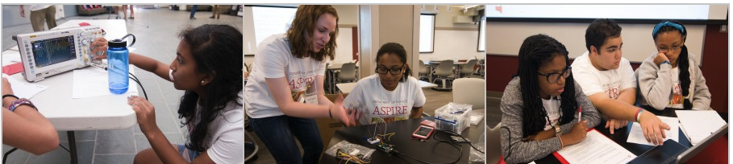
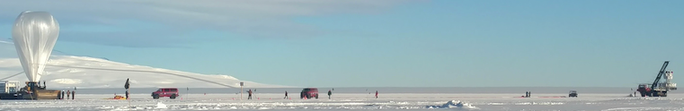
Astroparticle Experiments at OSU
Prof. Amy Connolly (connolly@physics.osu.edu) and Prof. Jim Beatty (beatty.85@osu.edu)
–
COLLEGE OF ARTS AND SCIENCES | CENTER OF COSMOLOGY AND ASTROPARTICLE PHYSICS | DEPARTMENT OF PHYSICS
Welcome! Interested in Multi-Messenger Astroparticle Physics? At OSU we work on several Astroparticle Experiment projects including IceCube, AUGER, ANITA, ARA! They all look for high-energy particles of astrophysical or cosmogenic origins. IceCube has observed the first astrophysical neutrinos! Others have observed cosmic-rays (CR). All of these projects are highly collaborative efforts. Here at OSU, we are involved in multiple aspects of each one, including hardware, electronics, simulation and analysis.
AUGER: Water Optical Cherenkov experiment in Argentina
Askaryan Radio Array (ARA)
IceCube, 1 km³ neutrino observatory at the South Pole, observes astrophysical neutrinos for the first time!
  will cover ~ 100 km² ice
Tunable TUFF Boards Filter RF Noise
From left to right, Bert, Ernie and Big Bird, with energies of 1.0, 1.1 and 2.2PeV.
p + γ → Δ* → π⁺ π⁰ →e⁺ νμ νe νμ γ γ
ARA observes Solar Flares!
ANITA dominates Neutrino Astronomy at energies > 10¹⁹ eV
We are well-equipped to build, test and deploy!
Above is a cartoon showing Askaryan radio detection of theorized ultra-high-energy (UHE) neutrinos
Plans for ExaVolt Antenna (EVA)
Why Antarctica?
Has lots of ice (dielectric target medium) for neutrinos to interact in and produce optical Cherenkov (IceCube) and radio Cherenkov (ANITA, ARA) light.
It is radio-quiet compared to rest of the world so less noisy for radio experiments.
Earth’s magnetic field points straight down giving cosmic-ray signals a distinctive polarization.
Summer polar vortex allows balloon-borne ANITA to fly in circles over the continent observing ~ 1 million km³ of Antarctic ice for UHE neutrinos.
Large thermal chamber for rapid thermal testing
Pick & Place Machine for rapid mass assembly
Radio (to be Anechoic) Chamber
Mill machine for Radio circuit boards
Genetic Programming
ANITA-2 Re-analysis
Exploring Machine Learning
ANtarctic Impulsive Transient Antenna (ANITA)
ANITA-4
ANITA-1: 06-07 | ANITA-2: 08-09
ANITA-3: 14-15 | ANITA-4: 2016!
ANITA-5: 2018?
CHEAPR 2016
Our science workshop for high school women funded by NSF | Hands on projects!
ANITA-4 before launch
http://u.osu.edu/aspire/
Oscilloscopes: perform radio interferometry
Arduino microcontroller: build and program radios
Mathematica: Learn ANITA analysis techniques
CURRENT GRAD STUDENTS
CONNOLLY GROUP: Oindree Banerjee, Brian Clark, Lauren Ennesser, Jorge Torres Espinosa, Julie Rolla
BEATTY GROUP: Keith McBride, Andres Medina
CURRENT POSTDOCS/STAFF
Patrick Allison, Carl Pfendner, Steven Prohira, Michael Sutherland,

