Slide 1



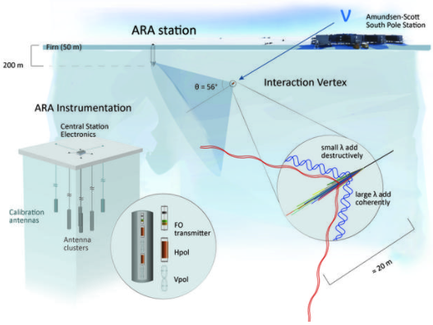
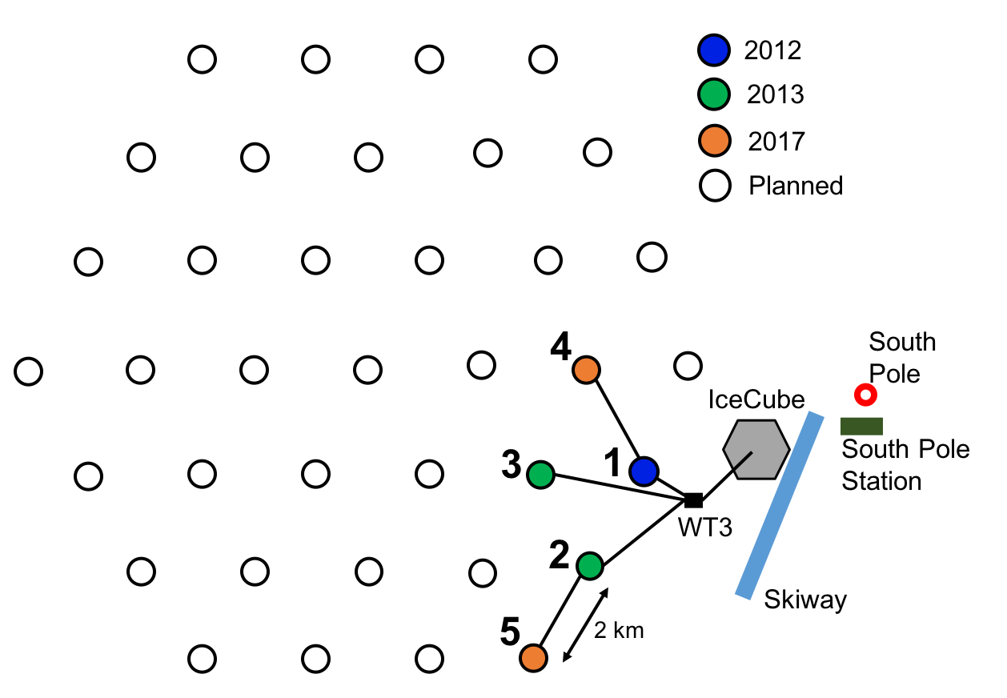
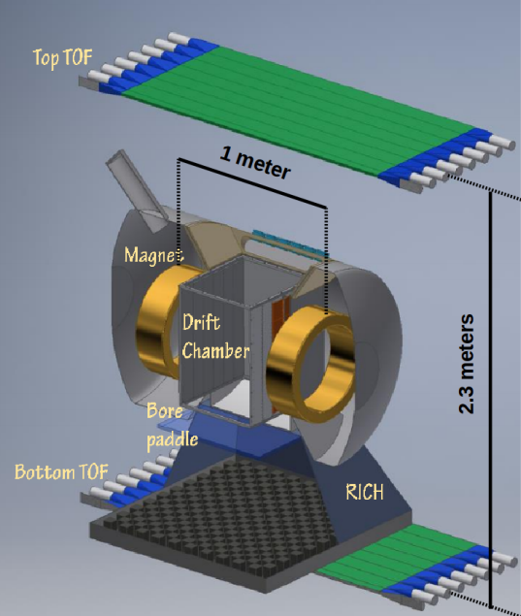
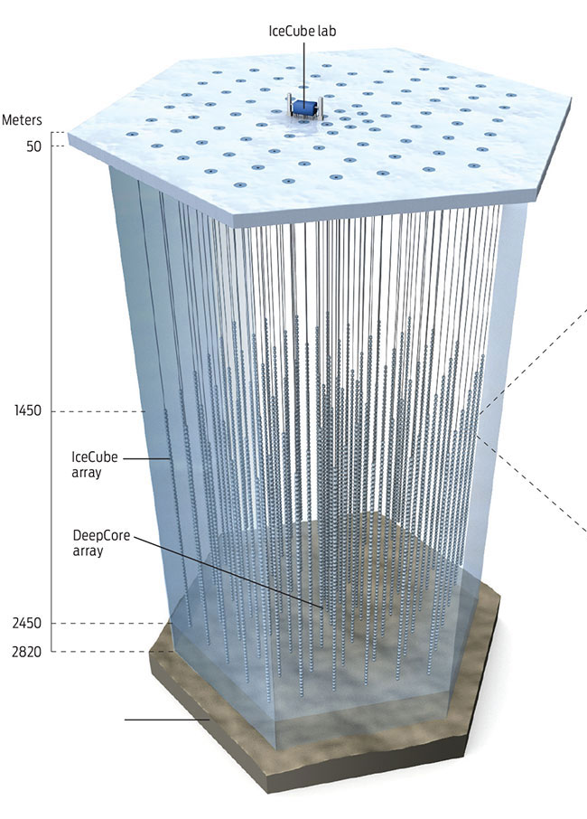
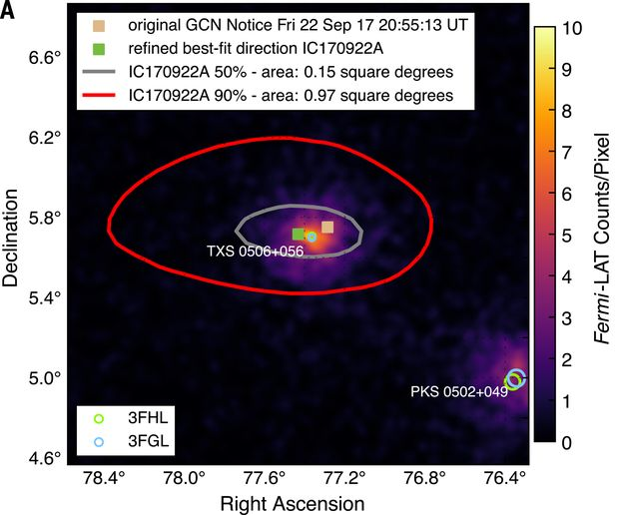
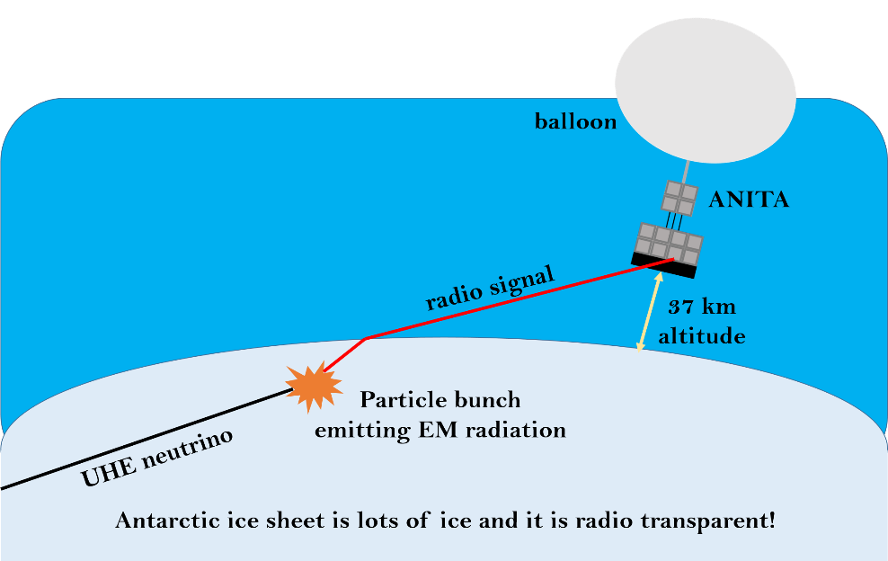
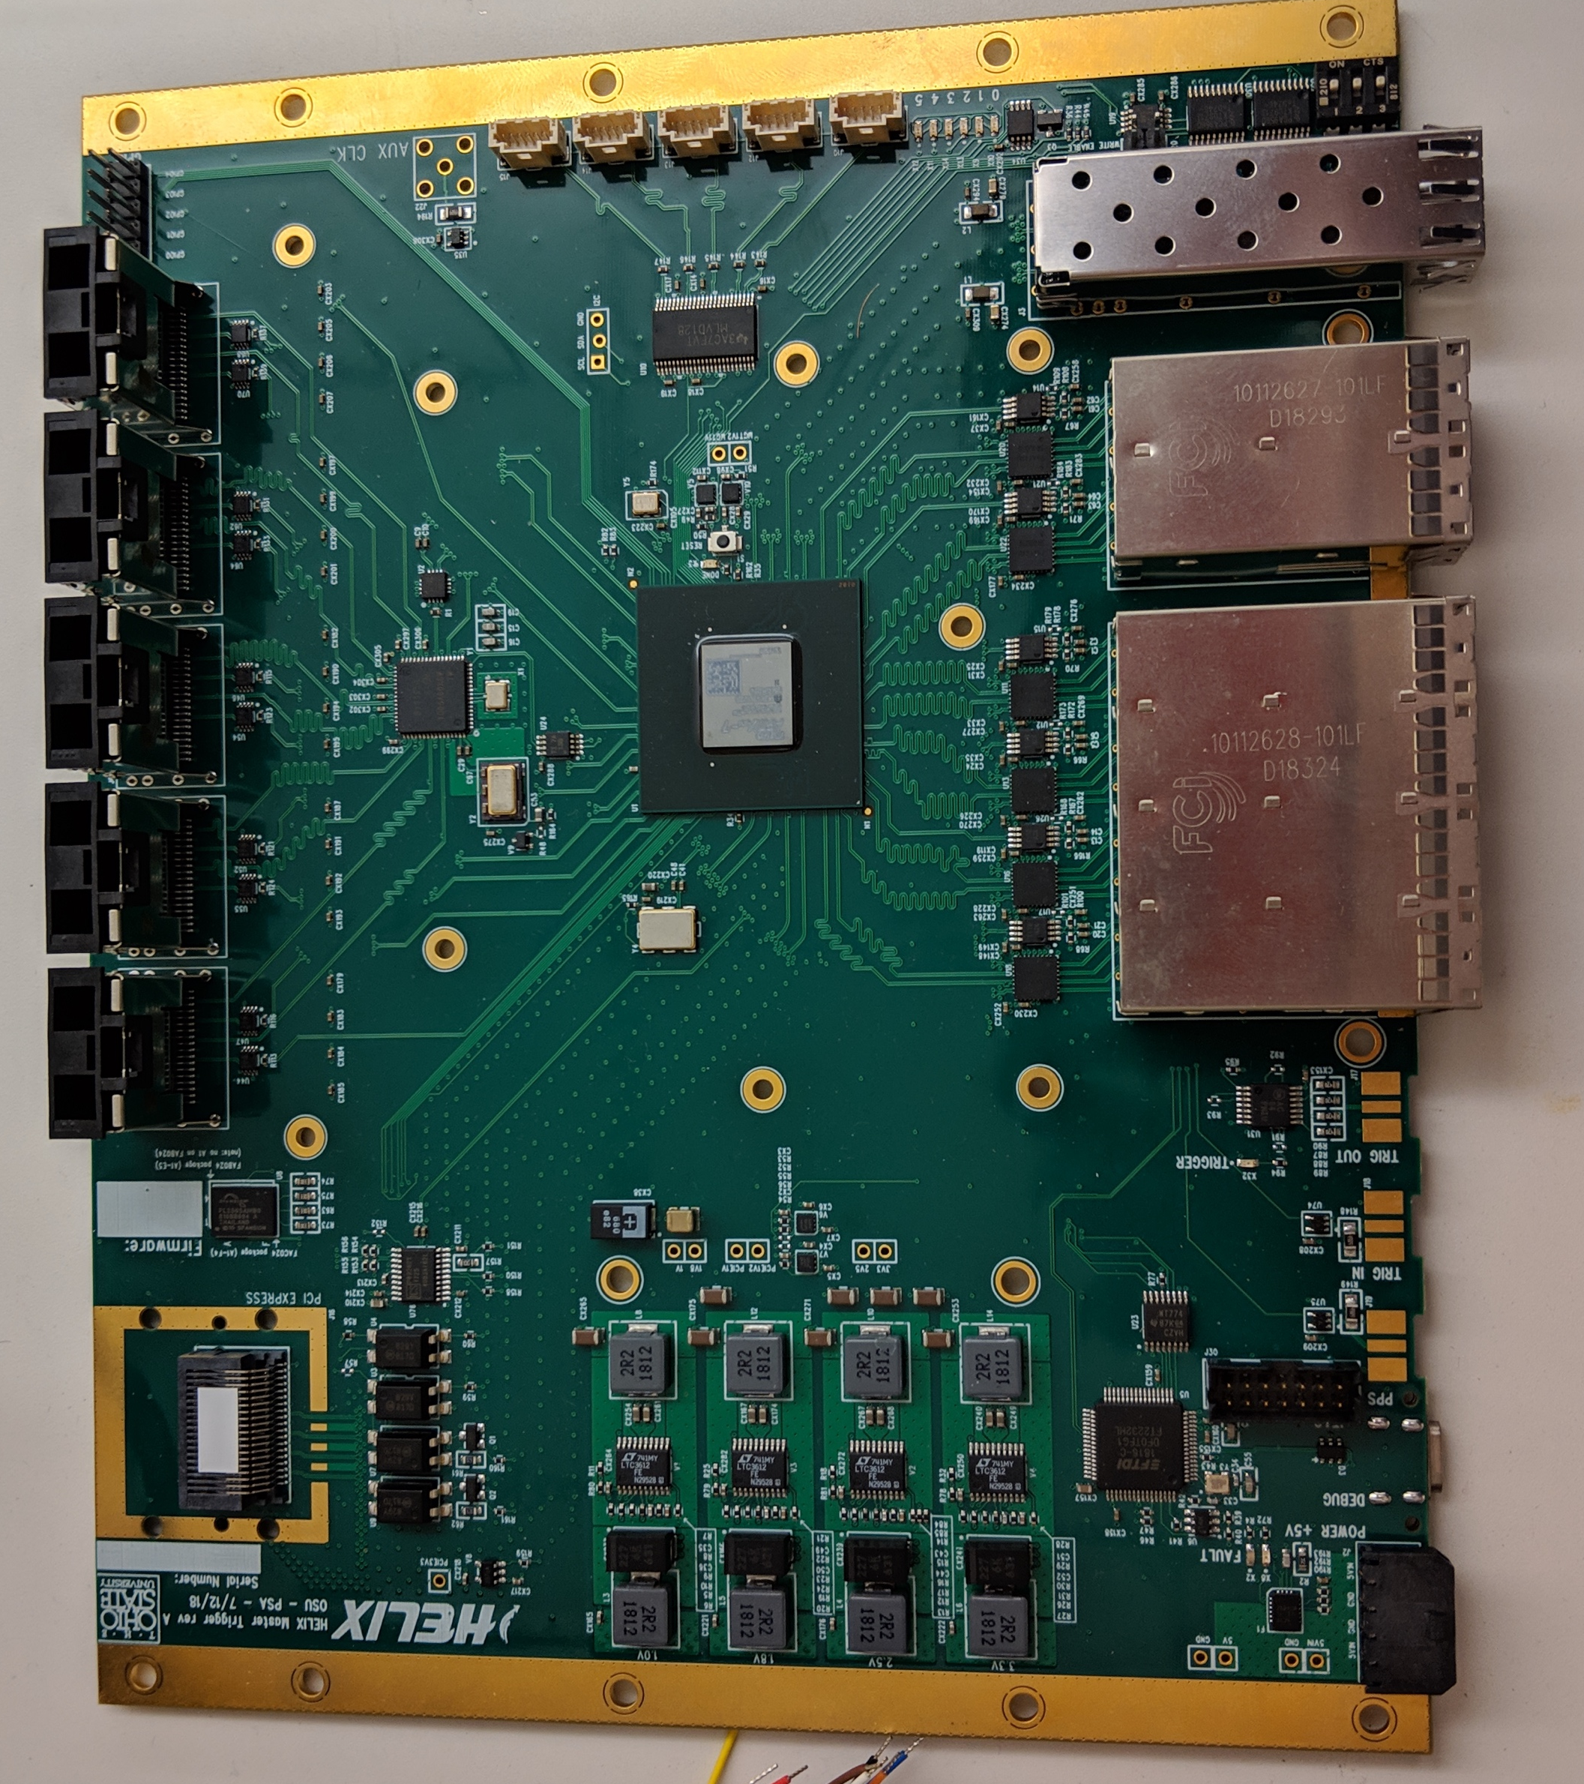
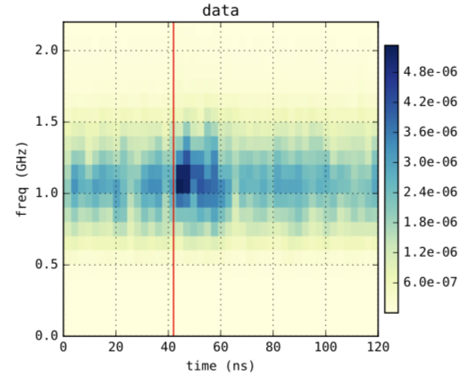

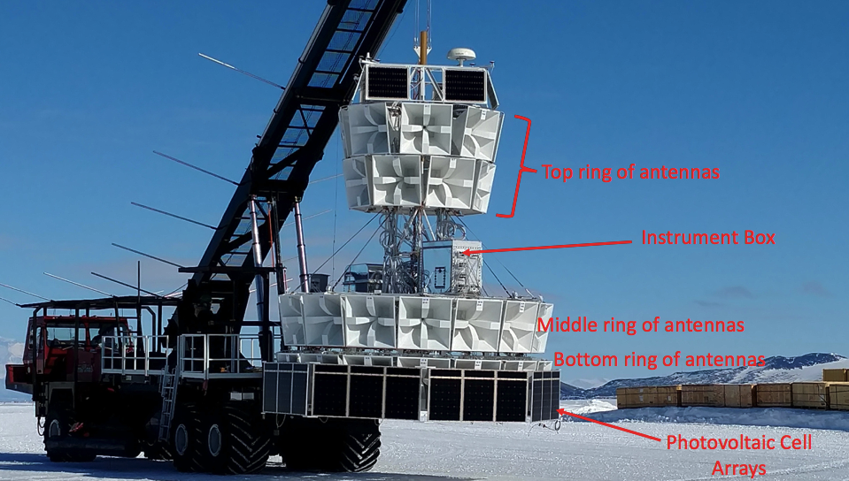
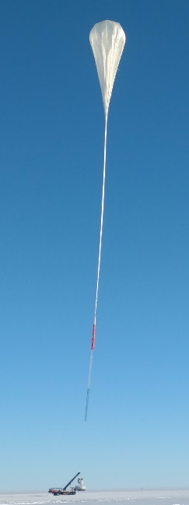
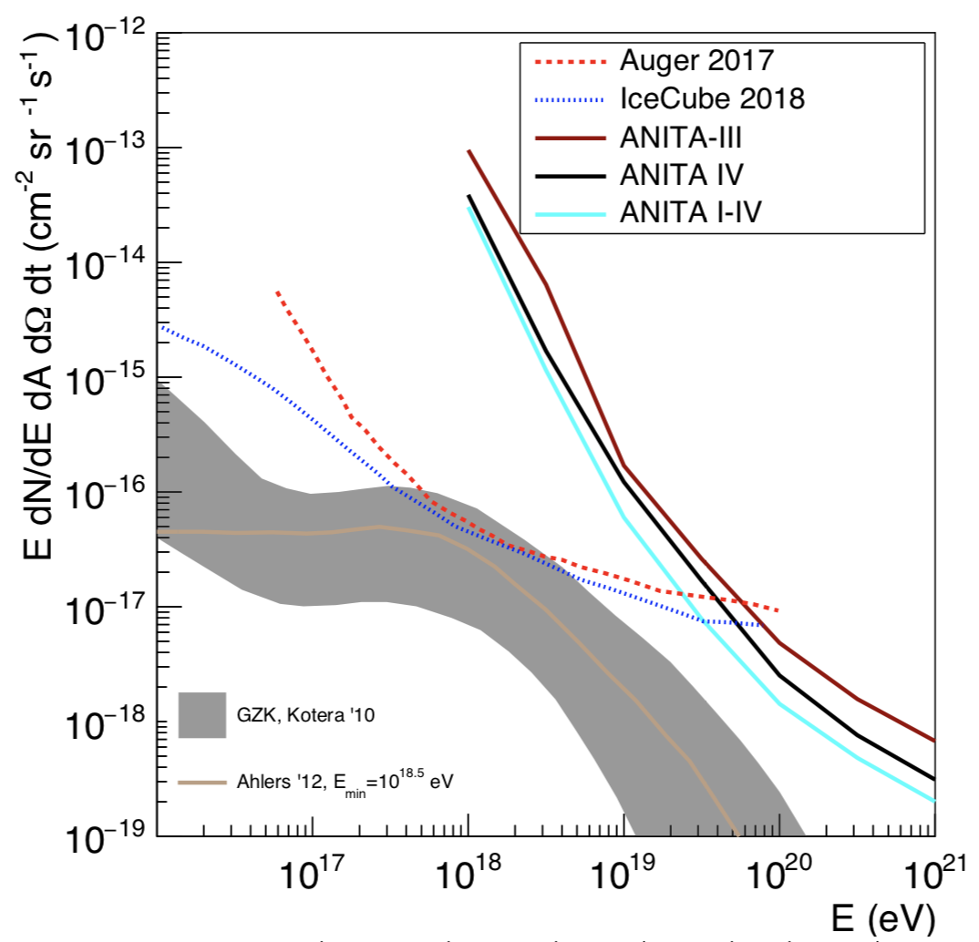
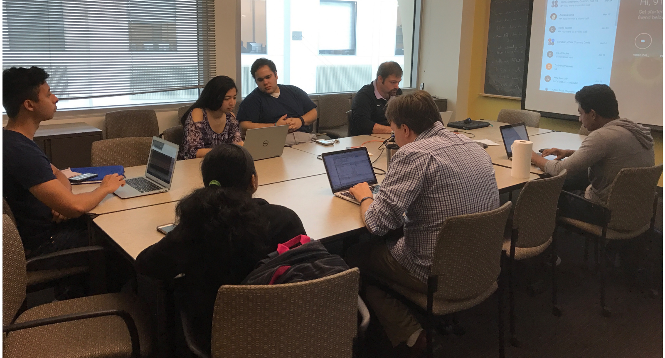
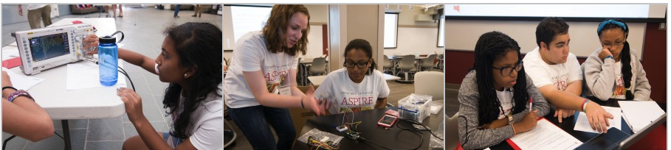
Astroparticle Experiments at OSU
Prof. Amy Connolly (connolly@physics.osu.edu) and Prof. Jim Beatty (beatty.85@osu.edu)
–
COLLEGE OF ARTS AND SCIENCES | CENTER FOR COSMOLOGY AND ASTROPARTICLE PHYSICS | DEPARTMENT OF PHYSICS
Welcome! At OSU we work on several Astroparticle Experiment projects including IceCube, ANITA, ARA, T576, and HELIX! They all look for high-energy particles of galactic, astrophysical or cosmogenic origins. All of these projects are highly collaborative efforts. Here at OSU, we are involved in all aspects of each experiment: hardware, simulation and analysis.
Askaryan Radio Array (ARA)
HELIX: High Energy Light Isotope eXperiment
IceCube, 1 km³ neutrino observatory at the South Pole, observes neutrino from flaring blazar
p + γ → Δ* → π⁺ π⁰ →e⁺ νμ νe νμ γ γ
ARA observes Solar Flares
ANITA-4
ANITA-1: 06-07 | ANITA-2: 08-09
ANITA-3: 14-15 | ANITA-4: 2016!
ANITA-5: 2018?
T576 experiment fires electrons at target at SLAC, looking for radar reflections off generated plasma
OSU builds the HELIX master trigger boards
Above is a cartoon showing Askaryan radio detection of theorized ultra-high-energy (UHE) neutrinos
ANITA dominates Neutrino Astronomy at energies > 10¹⁹ eV
Why Antarctica?
Has lots of ice for neutrinos to interact in and produce optical Cherenkov (IceCube) and radio Cherenkov (ANITA, ARA) light.
It is radio-quiet compared to rest of the world so less noisy for radio experiments.
Summer polar vortex allows balloon-borne ANITA and HELIX to fly in circles over the continent and stay at constant altitude. ANITA observes ~ 1 million km³ of Antarctic ice.
ANtarctic Impulsive Transient Antenna (ANITA)
Genetic Programming
CART: We are well-equipped to build, test and deploy!
Our science workshop for high school women funded by NSF -- Hands on projects!
Large thermal chamber for rapid thermal testing
Arduino: program radios
Pick & Place Machine for rapid mass assembly
Anechoic Chamber
Mill machine for Radio circuit boards
http://u.osu.edu/aspire/
Oscilloscopes: perform radio interferometry
Mathematica: do ANITA analysis
CURRENT GRAD STUDENTS
CONNOLLY GROUP: Brian Clark, Lauren Ennesser, Jorge Torres Espinosa and Julie Rolla
BEATTY GROUP: Keith McBride and Andres Medina
CURRENT POSTDOCS/STAFF
Patrick Allison and Steven Prohira

