Slide 1
Strategies and Prospects for High Energy Astrophysical Neutrino Detection
Alex Machtay

Slide 2

Table of Contents
Motivation
Optical Cherenkov technique
Overview of experiments
Radio techniques
Askaryan radiation
Geomagnetic radiation
Overview of experiments
Sensitivity
Astronomy
Physics
Cherenkov radiation
Setting constraints
Experiment comparisons

Slide 3
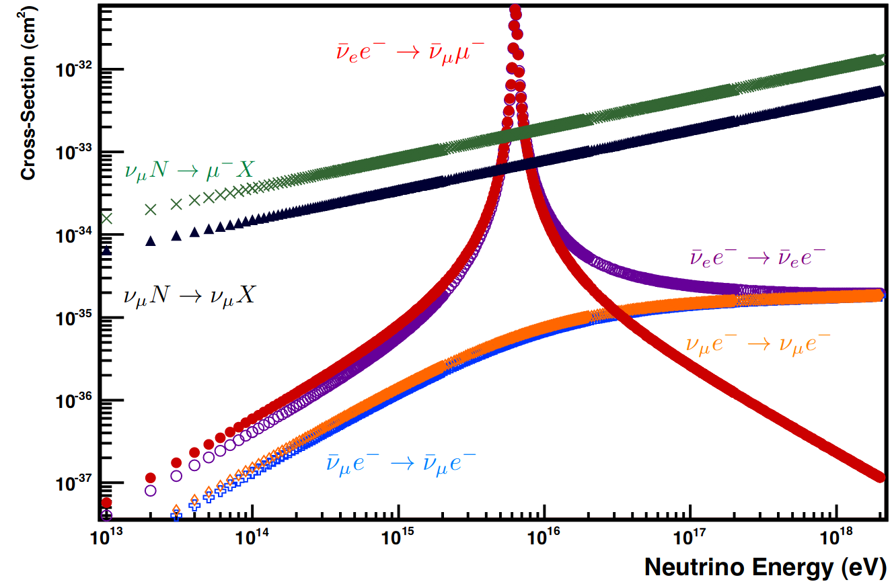
(Beyond) Standard Model Tests
HE & UHE neutrinos help study SM/BSM at highest energies
  LHC √s = 14 TeV for pp collisions
  100 PeV nu on nucleon is also √s about 14 TeV
Nu cross-section can indicate new physics
[1]

Slide 4
Cosmic Ray Spectrum
Explaining CR spectrum
  Energy flux similar b/n ν, γ, and CRs
    Implies same source
  Potential models are sensitive to neutrino data (ex: flavors, energy spectrum)
GZK effect predicts a sharp cutoff at E_{CR} ~ 10¹⁹ eV
  Caused by p + γ N + π
  We see a drop, though we have found CRs > cutoff
  Would be observable in neutrinos!

Slide 5
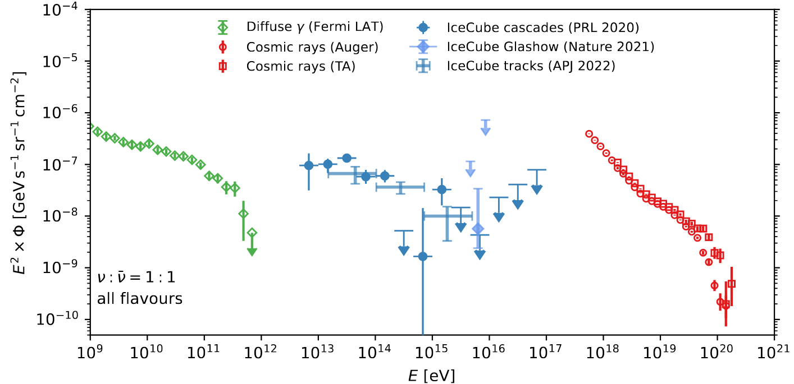
[2]

Slide 6
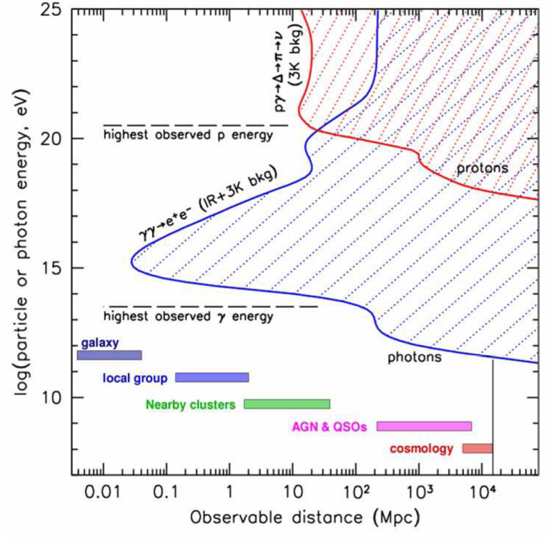
Multi-messenger Astronomy
Most of universe is opaque to HE photons and CRs
  Photons attenuate w/ CMB
  CRs attenuate and are deflected
Nus don't attenuate and are uncharged, so point back to distant sources
  Makes them useful messengers!
[3]

Slide 7
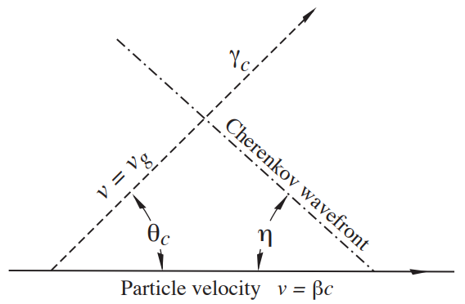
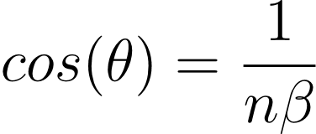
Optical Cherenkov Technique
Cherenkov radiation
  Occurs when charged particles in a medium move faster than the medium's phase velocity.
  Particles radiate due to interactions with atoms of the medium, forming a spherical wavefront.
  At v > c/n, wavefronts constructively interfere, forming Cherenkov cone
[4]

Slide 8


Cherenkov Radiation Technique
Two primary morphologies
  Tracks: long lines of activation from high energy lepton (muons, primarily)
  Cascades: roughly spherical deposits from particle showers
Neutrinos interact through two channels: CC and NC
  CC interactions produce leptons and hadronic showers
  NC interactions produce neutrino and hadronic showers
Digital Optical Modules (DOMs) are used to detect Cherenkov light from outcoming particles produced in the interaction
Strings of modules are put nearby each other to instrument a large volume and have good reconstruction of moving particles

Slide 9
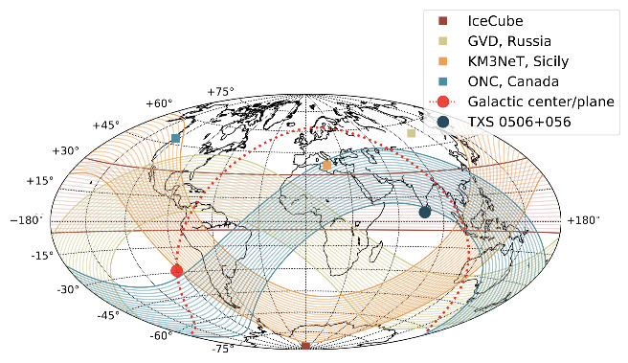
Optical Cherenkov Detectors
Use water/ice to search for optical signals from astrophysical neutrinos
Densely instrument ~1 km³ volumes with Digital Optical Modules (DOMs)
Backgrounds from atmospheric neutrinos and muons
Having multiple observatories helps cover full sky
  IceCube
  Cubic Kilometer Neutrino Telescope (KM3NeT)
  Baikal-GVD
  Pacific Oceanic Neutrino Experiment (P-ONE)

Slide 10
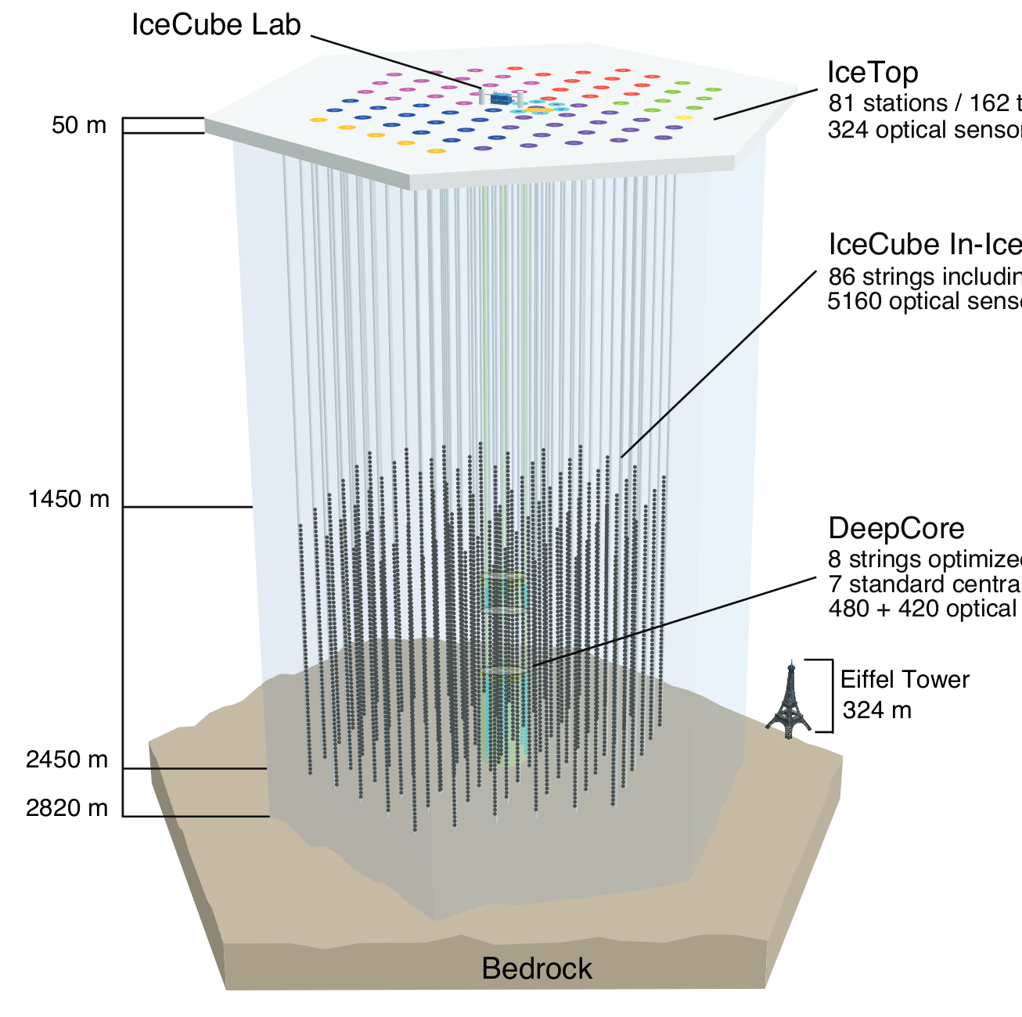
IceCube Observatory
86 strings with DOMs at 1450 - 2450 m below ice surface
  60 DOMs are spaced vertically on each string by 10 m, strings separated by 125 m
Detected handful of HE events below 10 PeV
Made observations of Glashow resonance at 2.3 sigma level

Slide 11
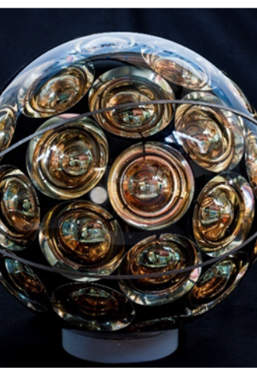
KM3NeT: ARCA
Similar to IceCube, except located in Mediterranean instead of ice
  Scattering/attenuation lengths in water longer than ice
  But more backgrounds! ⁴⁰K and bioluminescence
Since DOMs can move in water, positions are measured using LBL acoustic emitters detected by sensors on each DOM
KM3NeT coming online has maybe seen highest energy event yet!
  Would be "many 10s of PeV"
  Recently announced, needs to be robustly analyzed
[5]

Slide 12
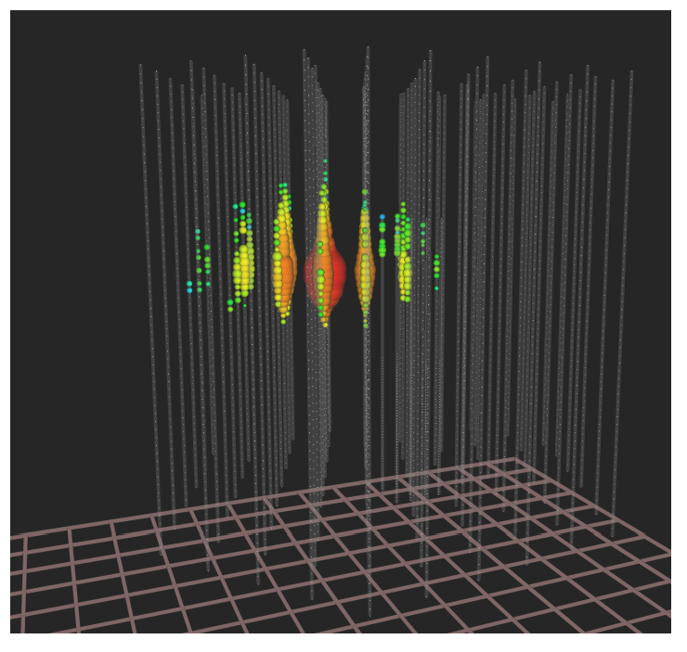
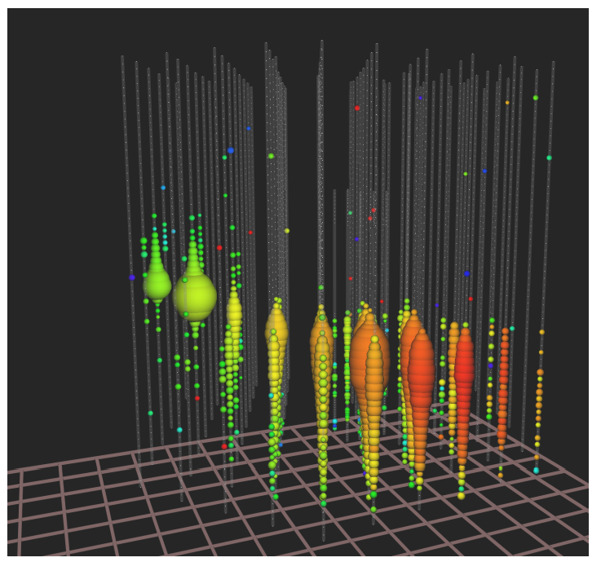
[6]

Slide 13
Optical Cherenkov from Space
Probe of Extreme Multi-Messenger Astrophysics (POEMMA) is a planned NASA mission to use two identical satellites to look for neutrinos on earth
Two operating modes
  Stereo: both observe same area pointing directly at Earth
    Used for CR fluorescence
  Limb: both point toward edge of Earth
    Used for air showers from CRs and tau neutrinos

Slide 14
Radio vs. Optical
Since flux drops down so quickly, it's important to instrument large volumes
However, it's prohibitively difficult to instrument large volumes densely (like IceCube)
  Need to be dense because of scattering and attenuation of optical light
Radio has much longer attenuation length than optical, so the same volume can be instrumented more sparsely

Slide 15
Radio Cherenkov: Askaryan Radiation
After neutrino interacts in the ice, we can get an EM shower
  Charged particles lose energy by emitting a photon
  Photon undergoes pair production
Shower has a characteristic size (~10 cm)
Positrons die off to annihilation
  Result is a net negative charge imbalance
Particles are moving roughly in the same direction, so the radiation they emit is coherent for wavelengths > shower size
  Above a threshold, signal is stronger than optical Cherenkov

Slide 16
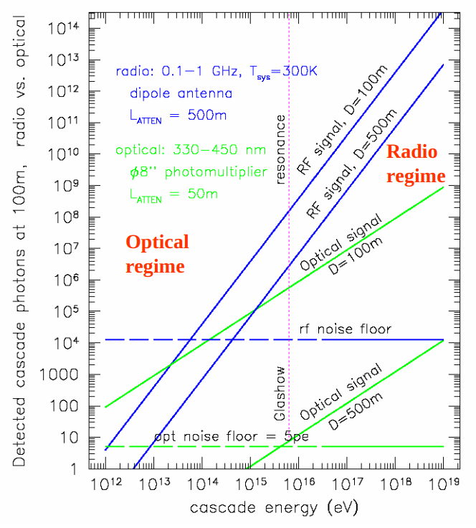
Radio Cherenkov: Askaryan Radiation
Optical Cherenkov is better at low energies, since signal is stronger at shorter wavelengths
However, above a threshold energy, Askaryan radiation dominates
This is the preferred method for in-situ detectors at HE
[7]

Slide 17
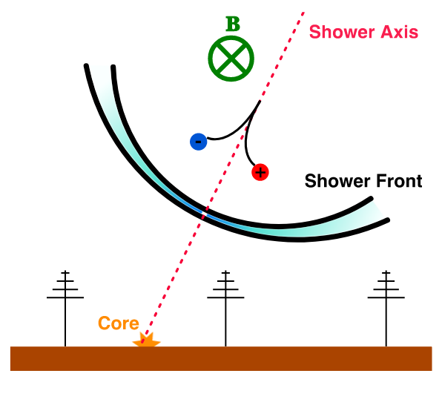
Geomagnetic Radio Emission
Electromagnetic Air Showers (EAS) can be produced in the atmosphere (often used to observe CRs)
Earth's magnetic field deflects particles of opposite charge in different directions, leading to a current
The current dies out due to energy losses from interactions with the air molecules
A changing current in time emits radio waves
  Signals are < 100 MHz
Can be caused by tau particles produced by "skimming" neutrinos
[8]

Slide 18
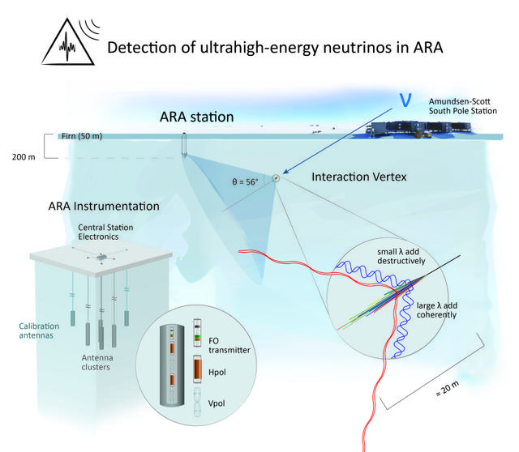
In-situ Askaryan Observatories
Multiple experiments designed to find Askaryan signals by instrumenting polar ice
  Askaryan Radio Array (ARA)
  Antarctic Ross Ice-Shelf Antenna Neutrino Array (ARIANNA)
  Radio Neutrino Observatory in Greenland (RNO-G)
Events most likely to come from above and interact below due to high cross-sections
  Expect a mostly linearly polarized signal
Background is largely thermal, anthropogenic, or continuous wave (CW)
  Askaryan Radio Array
[9]

Slide 19
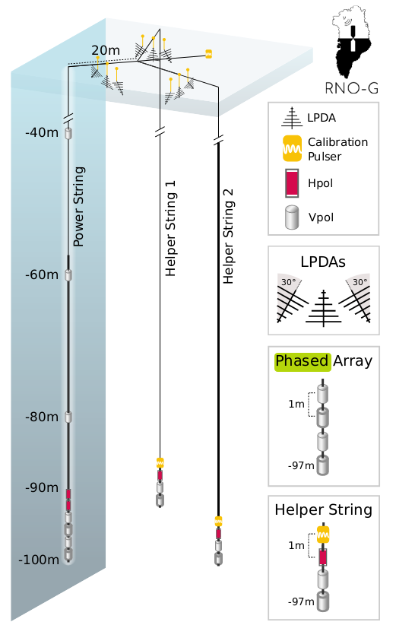
In-situ Askaryan Observatories
ARA and RNO-G have deep VPol and HPol antennas
  Good for observing Askaryan radiation in ice
  ARA: 150-850 MHz; RNO-G: 100-600 MHz
ARA station 5 and RNO-G also have a phased array
  Coherently sums received signals by each antenna to increase SNR
RNO-G and ARIANNA have shallow LPDAs
  Help with reconstruction and veto on CRs
[10]

Slide 20
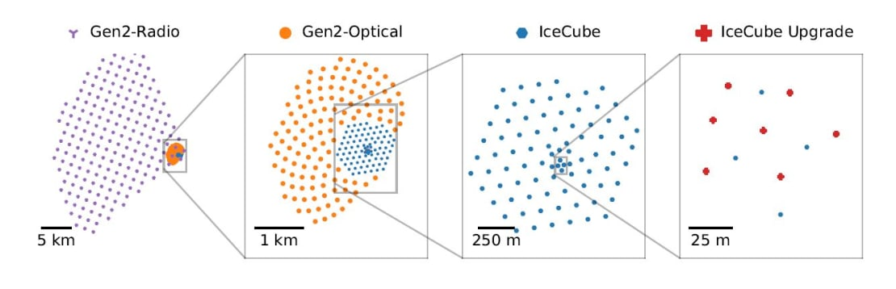
IceCube-Gen2
The planned expansion of IceCube will incorporate a radio component
  Like RNO-G, includes both deep VPol and HPol antennas and surface LPDAs
  VPols sensitive to Askaryan signals, LPDAs help veto cosmic rays
[11]

Slide 21
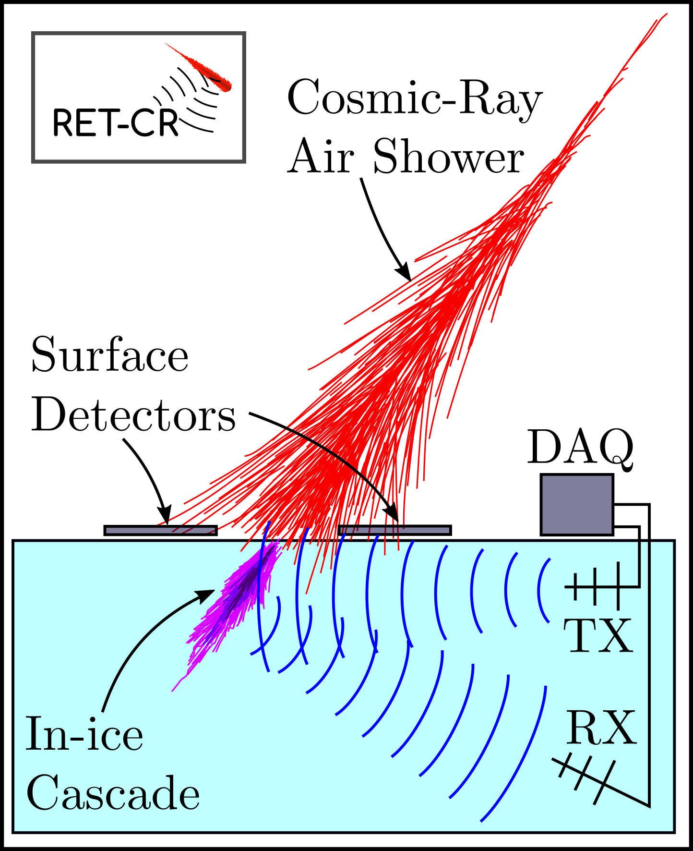
Radar Echo Telescope
Particle showers in a dense medium will ionize the medium, leading to free electrons
Instead of waiting to observe signals from particle showers, send signals to reflect off of the electron cloud
  This allows for very sparsely spaced stations
  Currently seeking to test concept by observing in-ice cascades produced by CR air showers
[12]

Slide 22
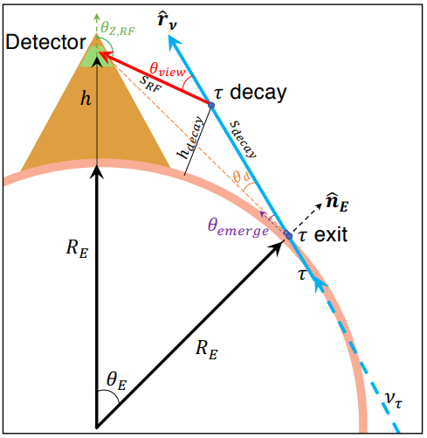
Elevated Observatories
Goal is to observe Earth skimming neutrinos
  Tau neutrinos interact shallowly in Earth and subsequent taus travel into atmosphere
  HE τ travel long distances before decaying
  Cherenkov angle is very small in air, so passes over experiments like ARA and IceCube
Solution: position observatories on mountains to see large volumes for potential tau decays
  Ex: Beam forming Elevated Array for COsmic Neutrinos (BEACON)
  Targets < 100 MHz signals with phased array
[13]

Slide 23
Balloon Observatories
Balloon experiments launched 40 km above Antarctica
Flying above continent gives view of much more ice
  However, polar vortex naturally brings flight to an end after ~30 days
Sensitive to Askaryan radiation in ice as well as air showers from CRs or earth skimming neutrinos
  Earth skimming neutrinos would be highest energy events, since cross-sections must make interacting in a small distance likely

Slide 24
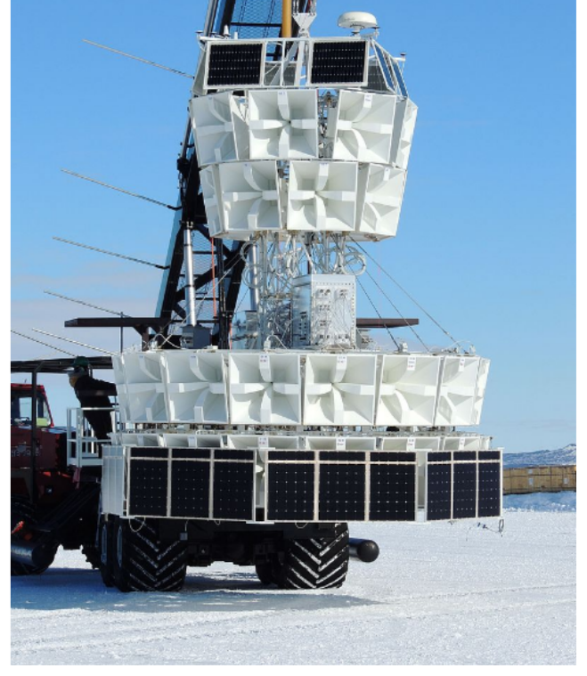
ANtarctic Impulsive Transient Antenna (ANITA)
Quad-ridge horn antennas are positioned azimuthally around payload
  Opposite ridges are electrically connected, giving VPol and HPol
  10 degree downward tilt to have a view of the ice
  Target 200-1200 MHz
Put strict constraints on HE and UHE flux
Payload for Ultrahigh Energy Observations (PUEO) will succeed ANITA
  Includes a low frequency instrument designed to target air showers and characterize noise (50 – 300 MHz)
[14]

Slide 25
Constraints on Neutrino Flux
Experiments seek to measure the flux of neutrinos at each energy
At HE, few events have been seen; none have been observed at UHE
To set constraints, we use the effective area based on the interaction length at each energy and the sensitive volume (effective volume found from simulations)
Since these are counting experiments, ask what Poisson distribution is consistent with number of events seen (usually zero)

Slide 26
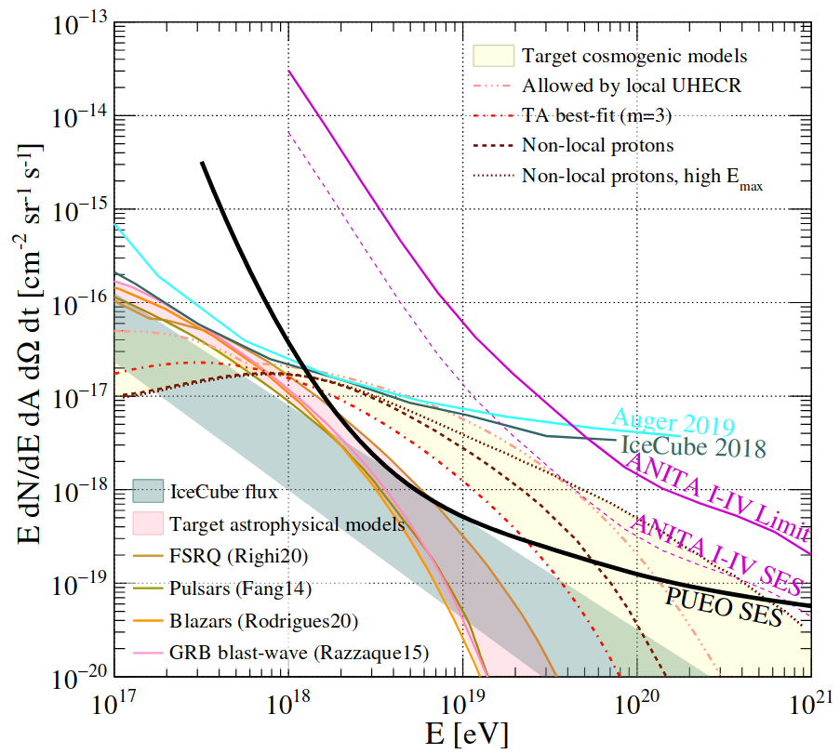
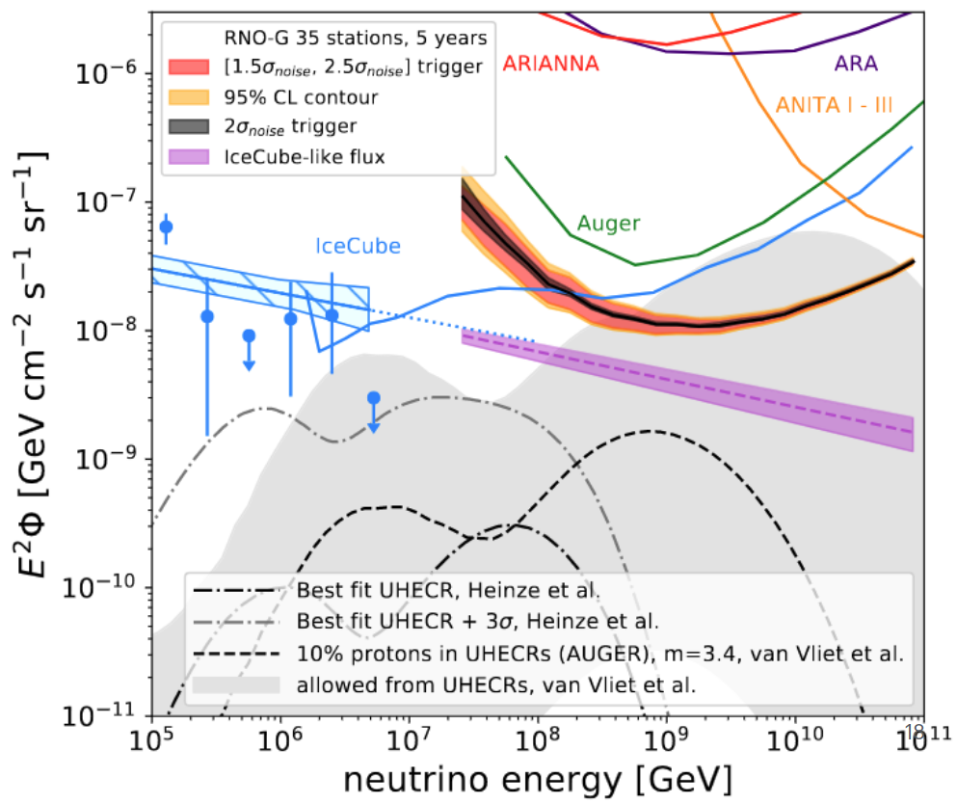
[15]
[16]

Slide 27
Bibliography
Formaggio & Zeller, https://journals.aps.org/rmp/pdf/10.1103/RevModPhys.84.1307
Ackermann et al, https://arxiv.org/pdf/2203.08096
Chen et al, https://arxiv.org/pdf/0902.3288
PDG 2022, https://pdg.lbl.gov/2022/reviews/rpp2022-rev-passage-particles-matter.pdf
Aiello et al, https://arxiv.org/pdf/2203.10048
Ahlers, https://arxiv.org/pdf/1805.11112
Gorham, https://www.slac.stanford.edu/econf/C040802/lec_notes/Gorham/Gorham_web.pdf
Huege, https://arxiv.org/pdf/1701.02995
ARA collaboration, https://ara.wipac.wisc.edu/home
Muzio, https://arxiv.org/pdf/2308.07224
IceCube Collaboration, https://icecube.wisc.edu/news/research/2020/08/icecube-gen2-will-open-new-window-on-universe/
Prohira, https://arxiv.org/pdf/2104.00459
Wissel, https://arxiv.org/pdf/2004.12718
Nam (credit Luke Bratton), https://pos.sissa.it/301/952/pdf
Luszczak, https://pos.sissa.it/444/1154/pdf
Hughes, https://indico.uchicago.edu/event/445/contributions/1204/attachments/268/394/RNO-G_ARENA_2024.pdf

